Slide 1
SMT Update To AMWG
June 2016

Slide 2
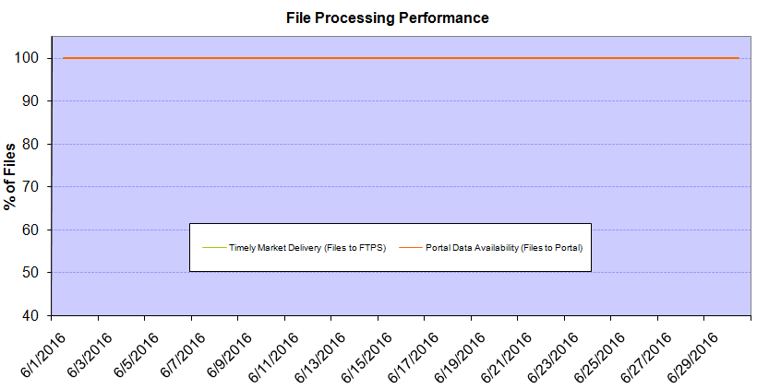
Monthly SMT Data Timelines AMWG CR 2014 002 End to End File Processing Completeness – JUNE 2016
% Timely Market Delivery - % of files posted to market (FTPS) by 11:00pm out of # of files received by SMT by 11:00pm.
% Portal Data Availability - % of files loaded to the database for data availability on portal by 6:00am next day for the files received by 11:00pm
* A LSE file includes usage data for up to 50,000 ESIIDs.
Observed Anomalies:
2

Slide 3
SMT API and FTPS Services Availability – JUNE 2016
The service availability is measured as a percentage of number of minutes the service was available out of the total number of minutes in a month, excluding planned outages.
Observed Anomalies:
Mar-Apr 2015: SMT outage and subsequent recovery/catch-up impacted API availability. FTPS was available for most of the part except on 03/21-03/22 for 36 hours.
26 Jul 2015: Services were unavailable for 12 hours due to Flash storage issue
25 Jan 2016: Services were unavailable for 19 hours due to storage configuration issue
07 Mar 2016: API Services were unavailable for 7hours due to Oracle archiver issue.
Notes:
3

Slide 4
SMT Number of Accounts by Type AMWG CR 2014 009 – JUNE 2016
Registered Users | ONC | CNP | AEPN | AEPC | TNMP | TOTAL
Active Residential Accounts | 37746 | 23565 | 1915 | 5274 | 2596 | 71096
Active Residential English Accounts | 37555 | 23402 | 1910 | 5161 | 2586 | 70614
Active Residential Spanish Accounts | 191 | 163 | 5 | 113 | 10 | 482
Non Active Residential Accounts | 18698 | 12804 | 1517 | 3246 | 688 | 36641
Total Residential Accounts | 56444 | 36369 | 3432 | 8520 | 3284 | 107737
TDSP User | 341 | 36 | 12 | 17 | 1 | 407
TDSP Admin | 4 | 4 | 4 | 4 | 3 | 19
Small Business User | 98 | 51 | 0 | 4 | 4 | 157
Small Business Admin | 2591 | 1394 | 77 | 276 | 107 | 4560
Total Agreements (Includes Active and Pending) | 1633 | 800 | 1 | 0 | 0 | 2434
Energy Data Agreements (Includes Active and Pending) | 1556 | 484 | 1 | 0 | 0 | 2041
Han Device Agreements (Includes Active and Pending) | 77 | 315 | 0 | 0 | 0 | 392
Han Service Agreements (Includes Active and Pending) | 0 | 1 | 0 | 0 | 0 | 1
IN SMT
ESI IDs | 3483032 | 2411126 | 197556 | 858021 | 229765 | 7179500
Meters | 3416376 | 2411094 | 198355 | 858246 | 229547 | 7113618
HAN Devices | 3852 | 5082 | 131 | 279 | 37 | 9381
Acknowledgement | 0 | 0 | 0 | 0 | 0
Pending | 0 | 3 | 0 | 0 | 0
Meter Ready | 18 | 5 | 41 | 114 | 25
Provisioned | 3834 | 5074 | 90 | 165 | 12
HAN Messages (MTD) | 0 | 0 | 0 | 0 | 0 | 0
HAN Messages (YTD) | 17 | 3 | 0 | 0 | 0 | 20
HAN Messages (Cumulative) | 339 | 7400 | 0 | 0 | 0 | 7739
Simple Text Messages | 103 | 2925 | 0 | 0 | 0
Load Control Messages | 100 | 2658 | 0 | 0 | 0
Pricing Messages | 92 | 53 | 0 | 0 | 0
Cancellation Messages | 44 | 1764 | 0 | 0 | 0
Supplemental – (Friends)
Total Agreements | 1668 | 1327 | 75 | 85 | 58 | 3213
Accepted Agreements | 732 | 513 | 33 | 29 | 19 | 1326
Pending Agreements | 5 | 2 | 0 | 1 | 0 | 7
Revoked Agreements | 244 | 256 | 10 | 7 | 6 | 523
Expired Agreements | 656 | 527 | 30 | 49 | 33 | 1295
Terminated Agreements | 31 | 29 | 2 | 0 | 0 | 62
 | TDSPs | REP | Small Business | Regulatory | Third Party
Registered Entities | 5 | 110 | 4433 | 2 | 97
Registered Users | 407 | 922 | 157 | 8 | 21
Registered Admins | 19 | 173 | 4445 | 4 | 104
HAN Messages Sent By | 332 | 7383

Slide 5
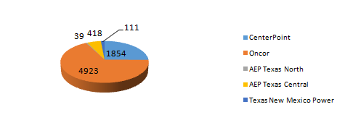
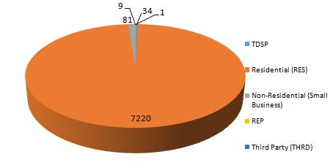
SMT ODR Details – JUNE 2016
Total ODR Requests TDSP wise statistics:
Total ODR Requests User type statistics:

