Slide 1
Project Update and Summary of
Project Priority List (PPL) Activity
July 14, 2016

Slide 2
Project Update Agenda
Project Portfolio Update p. 3-7
  Recent/Upcoming Project Highlights
  2016 Release Targets
  2016 Project Spending Forecast
  Revision Request Funding Placeholder Status
  Priority/Rank Options for Revision Requests with Impacts
Appendix
  Project Portfolio Gantt Chart p. 8-14
Location of Project Priority List (PPL): http://www.ercot.com/services/projects/index

Slide 3
Recent / Upcoming Project Highlights
EMS Upgrade – Go-live on 6/16/2016 Complete
2016 June Release – Week of 6/21/2016 Complete
  NPRR515 – Day-Ahead Market Self-Commitment of Generation Resources
  NPRR617 – Energy Offer Flexibility
  NPRR700 – Utilizing Actual Fuel Costs in Startup Offer Caps
  NPRR719 – Removal of Trigger and Req. to Reduce the DG Registration Threshold
  NPRR742 – CRR Balancing Account Invoice Data Cuts
  VCMRR008 – Alignment w/NPRR700, Utilizing Actual Fuel Cost in Startup Offer Caps
2016 July Retail Release – Weekend of 7/23/2016 In Flight
  RMGRR126 – Add’l ERCOT Validations for Customer Billing Contact Information File
  RMGRR137 – Timeline and Completion Process for Correcting CBCI Files
2016 August Release – Week of 8/30/2016 In Flight
  NPRR662 – Proxy Energy Offer Curves
  NPRR712 – Clarification of RUC Process
  NOGRR143 – Alignment with NERC Reliability Standard, BAL-001-TRE-1
Note: Projected Go-Live dates are subject to change.
Please watch for market notices as the effective dates approach.

Slide 4
2016 Release Targets – Board Approved NPRRs / SCRs / xGRRs
February 2/2 – 2/4 | April 4/12 – 4/14 | June 6/21 – 6/23 | August 8/30 – 9/1 | September 9/26 – 9/30 | December 12/6 – 12/8
NPRR588 NPRR615 NPRR686(b) | NPRR419 NPRR728 COPMGRR040 | NPRR515 NPRR617 NPRR700 NPRR719 NPRR742 VMCRR008 EMS Upgrade | NPRR662 NPRR712 NOGRR143 RMGRR126 RMGRR137 | NPRR219 SCR783 NOGRR050 NMMS Upgrade NPRR495 NPRR736 | NPRR272 NPRR573 NPRR714 NOGRR147 SCR787 SCR788 RMGRR127 SCR786
3 | 3 | 6 | 5 | 5 | 7
E
E
E
E
n/a
E
E
E
E
P
P
P
H
NS
I
I
NS
E
E
9/22
5/1
6/16
7/23 – 7/24
12/10 – 12/11
11/1 – 11/3
EMS Upgrade “Chill”
2016 TBD Items (and point at which they became “TBD”)
2014 | 2015 | February 2016 | April 2016 | June 2016
NOGRR084, NPRR664 | None | NPRR210, SCR781 H | None | NPRR754, NPRR758, SCR790
Go-live dates can differ from Protocol effective dates – Please refer to market notices for more details
APPENDIX
Red Text: New additions and target release changes
Strike-Through Text: Previous target release changes
(a), (b), etc. indicates multiple phases
In-Flight Items Planned for 2017 Delivery
CMM bundle (Planning): NPRR439, NPRR519, NPRR620, NPRR683, NPRR702, NPRR741, NPRR743
CRR Upgrade (Planning): SCR777
Release targets are subject to change
NPRR686(b) – Solar portion
Items Originally Targeted for 2016 Now Planned for 2017 Delivery
RRGRRs 003, 006, 007 (2017-R1 target)
NPRR272 (2017-R1 target)
Project Status Codes: NS = Not Started, I = Initiation, P = Planning, E = Execution, H = On Hold

Slide 5
2016 Project Spending Forecast
2016 PPL Budget = $22.5M
“Potential Demand” represents internal ERCOT projects that have not been fully approved

Slide 6
Revision Request Funding Placeholder Status
In 2016 and 2017, ERCOT forecasted $4.0M for Revision Request work
Yearly Revision Request Spending Forecast Summary
Project Status | 2016 | 2017
YTD Actuals | $1.10M | –
Approved – In-Flight / Complete | $2.64M | $1.15M
Approved – On Hold | $0.04M | $0.40M
Approved – Not Started | $0.26M | $1.15M
Remaining Funding | $1.06M | $1.30M
Total Allocation | $4.00M | $4.00M
As of 5/31/2016
Each year, an additional $400k is held in reserve in the event the $4M allocation is insufficient

Slide 7
Priority / Rank Options for Revision Requests with Impacts
Options for…
Revision Request | Description | Priority | Rank | Comments
NPRR755 | Data Agent-Only QSE Registration [ERCOT] | 2016 | 1558 | Consistent with items in the in-flight CMM project bundle – try to include in the CMM project since it is still in Planning
NPRR770 | Addition of Outaged Resource Capacity to Short-Term System Adequacy Report [Morgan Stanley] | 2016 | 872 | If ERCOT comments are approved, recommend ranking with NPRR495 and NPRR736 for inclusion in in-flight project
NPRR778 | Modifications to Date Change and Cancellation Evaluation Window [Texas SET Working Group] | 2017 | 1830 | Current in-flight Retail projects make this a 2017 project candidate
RMGRR134 | Allow AMS Data Submittal Process for TDSP-Read Non-Modeled Generators [ERCOT] | 2017 | 1810 | Multiple projects impacting resources needed for this RMGRR make it a 2017 project candidate
RRGRR009 | Adding Voltage Limit Sets, Relay Loadability, MLSE, and GMD Data [ERCOT] | 2016 | 1505 | Ranked right after RRGRR007 – allows for bundling with RRGRRs 003, 006 and 007

Slide 8
Appendix
  6/30/2016 Project Gantt
    In-flight items sorted by Project End Date
    “On Hold” projects listed separately
    “Not Started” items sorted by Project Start Date

Slide 9
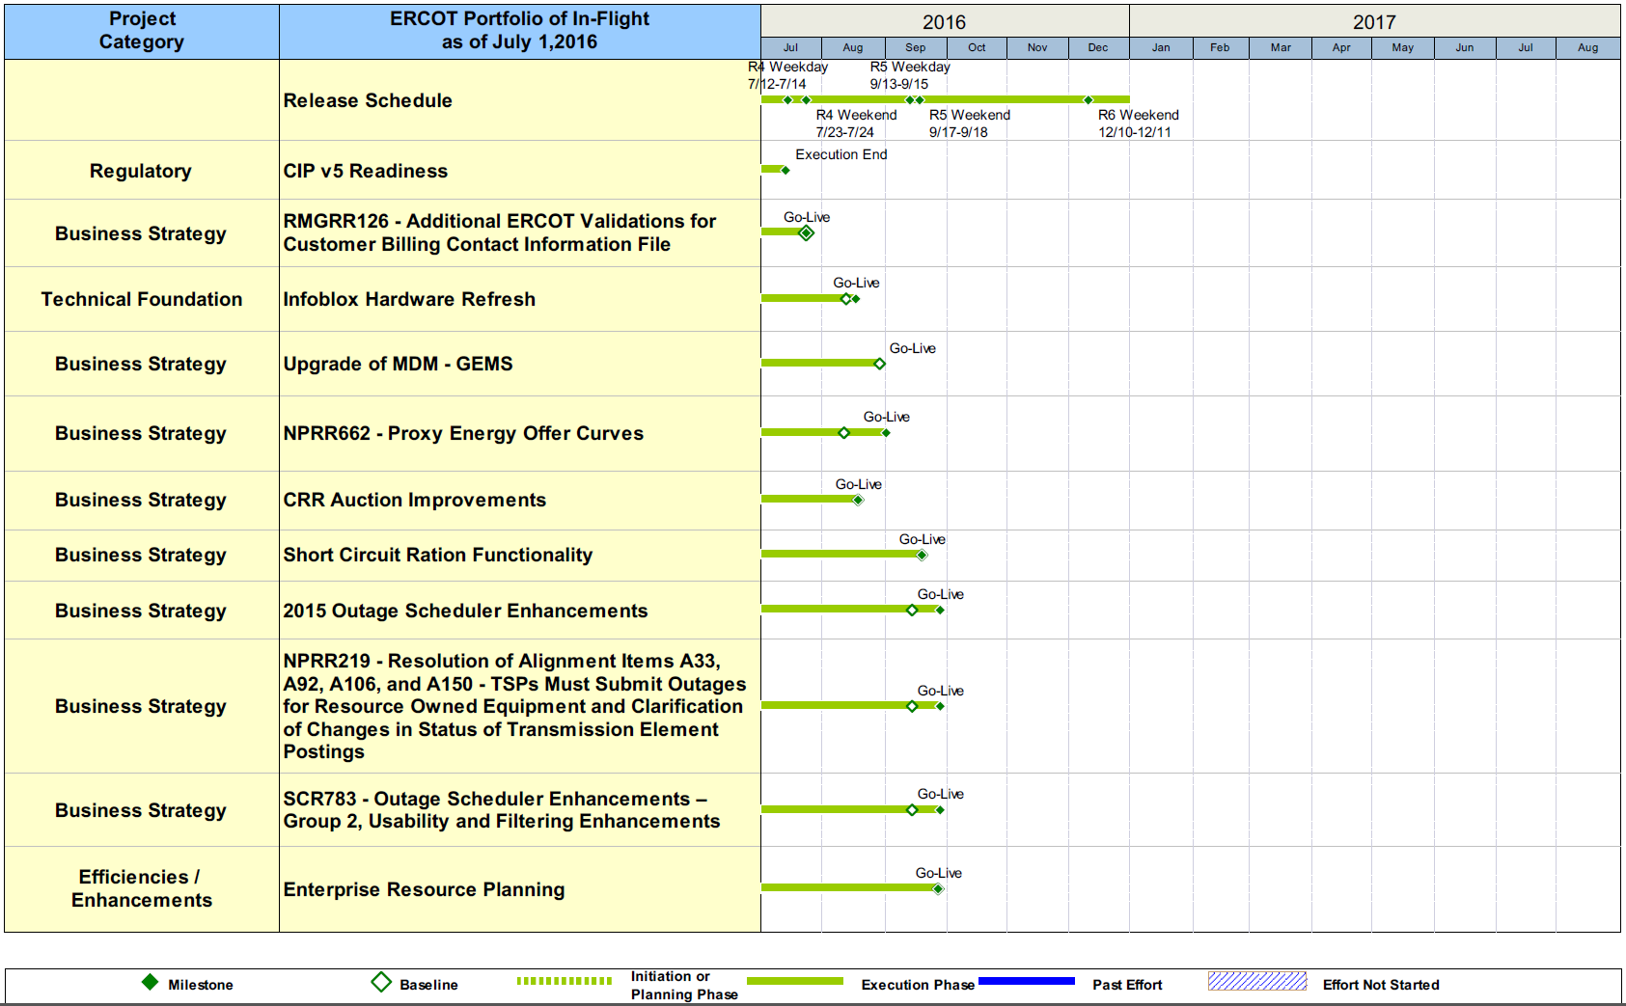
Project Portfolio Status – as of 6/30/2016

Slide 10
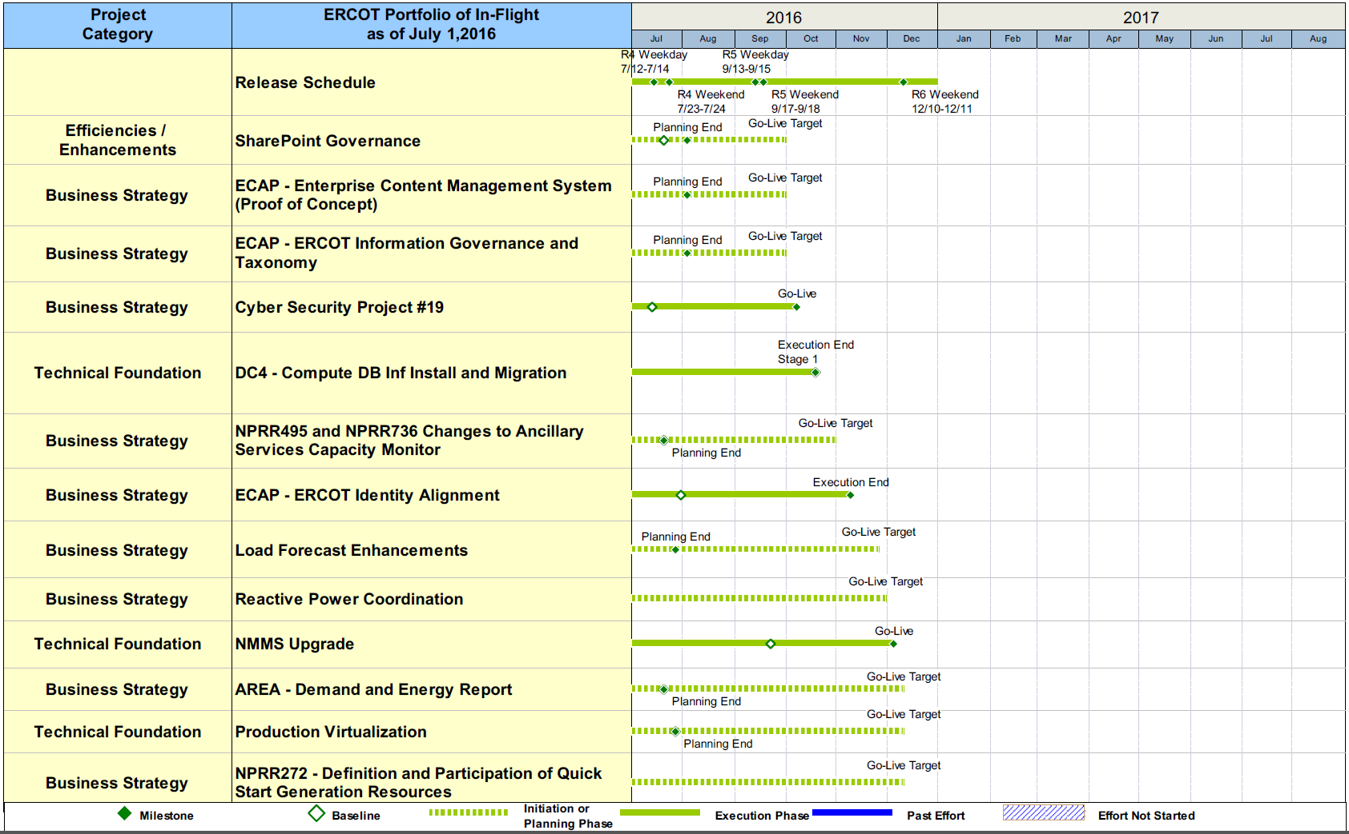
Project Portfolio Status – as of 6/30/2016

Slide 11
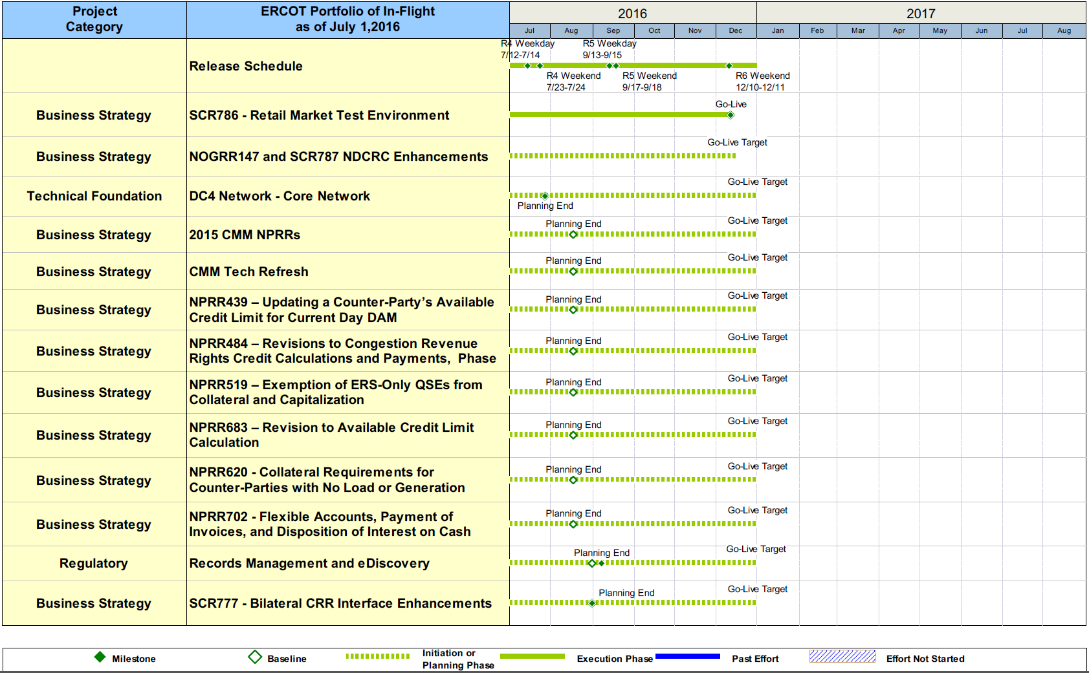
Project Portfolio Status – as of 6/30/2016

Slide 12
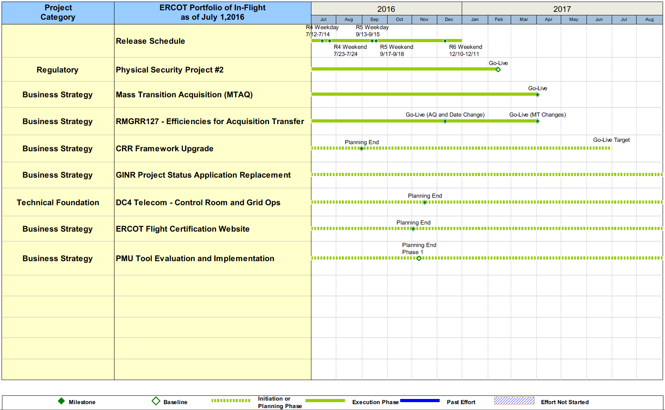
Project Portfolio Status – as of 6/30/2016

Slide 13
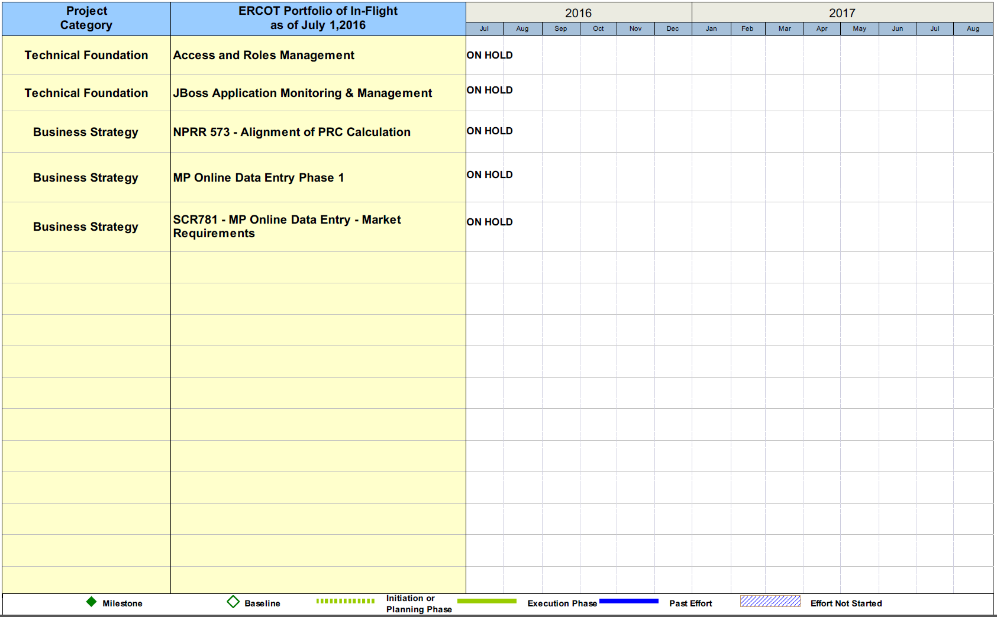
Project Portfolio Status – as of 6/30/2016

Slide 14
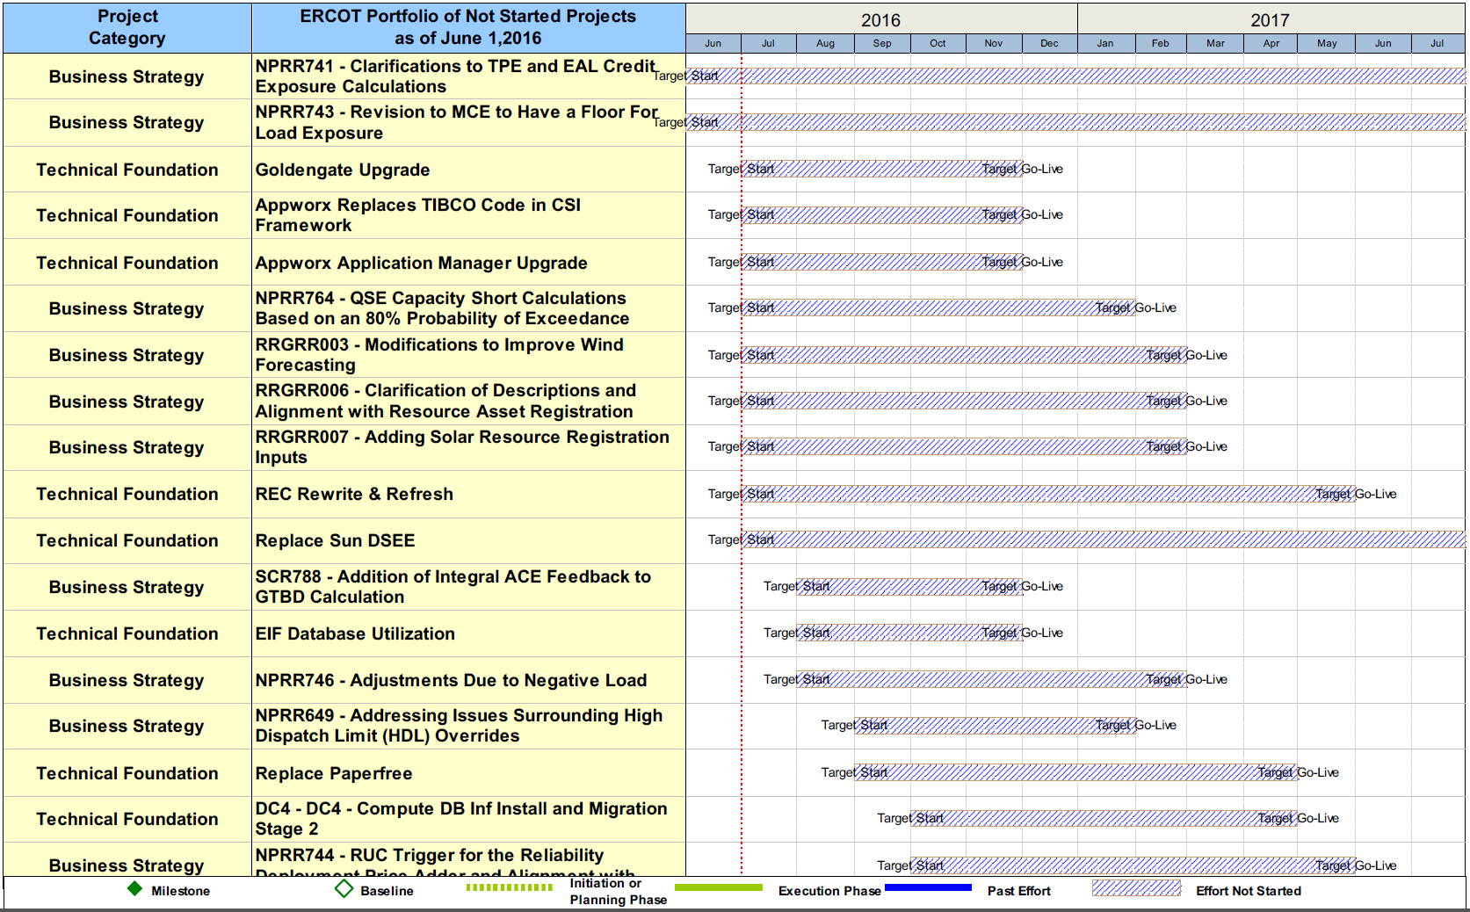
Project Portfolio Status – as of 6/30/2016

Slide 15
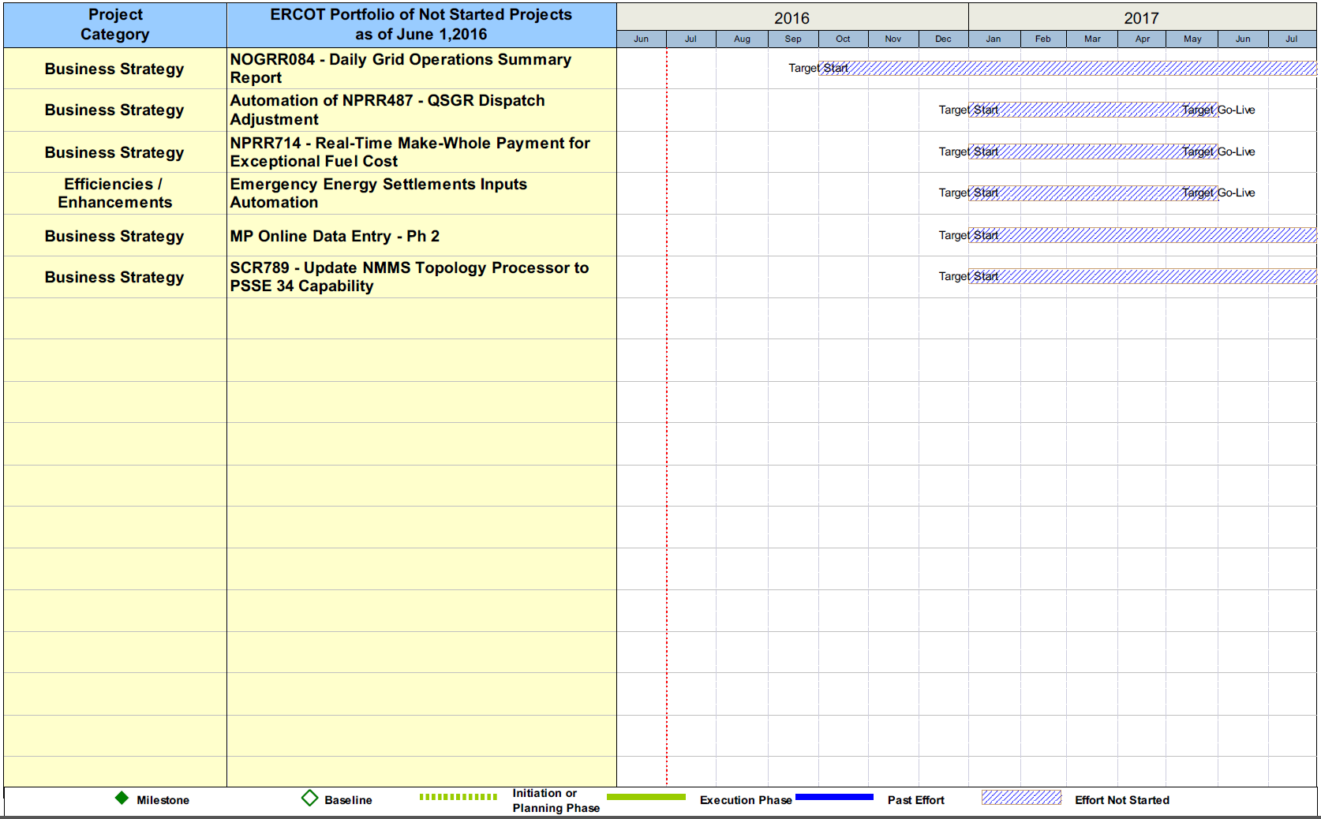
Project Portfolio Status – as of 6/30/2016

