Slide 1
Electromagnetic Pulse (EMP) EPRI Project Update
Rob Manning
rmanning@epri.com
Vice President, Transmission
EPRI
Grid Resilience Working Group
July 11, 2016

Slide 2
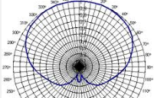

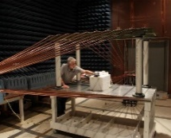
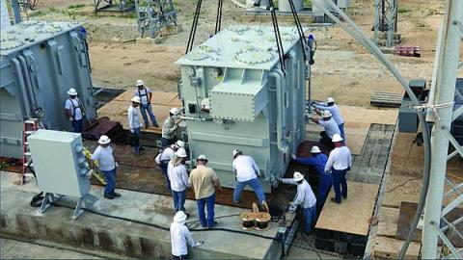
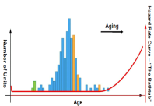
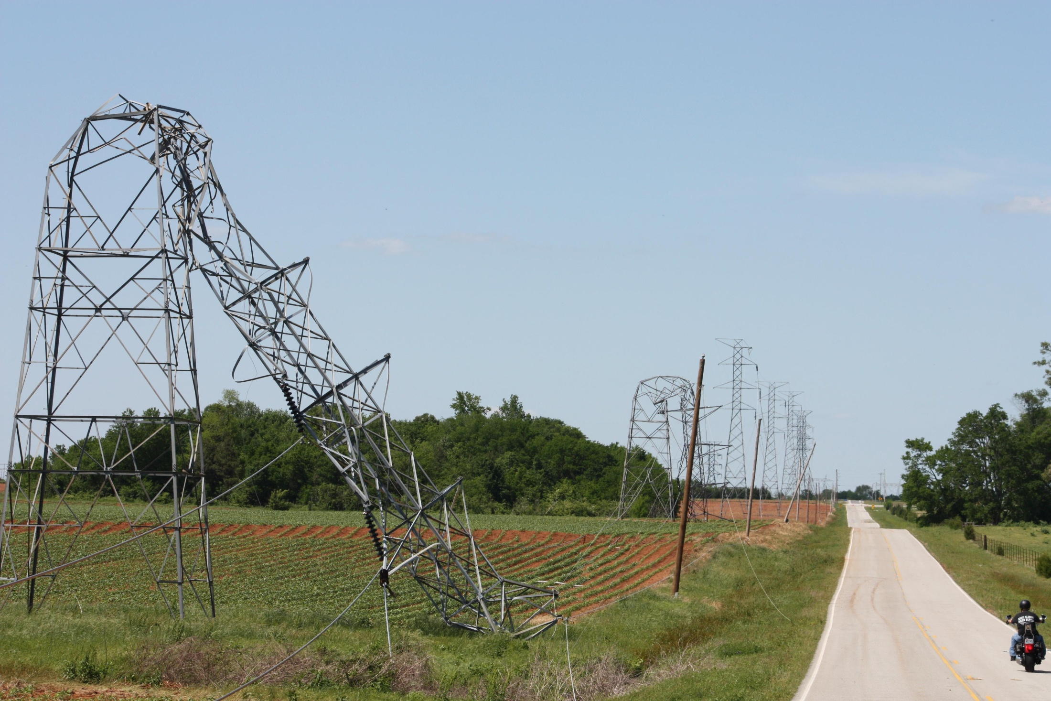
EMP Project Plan – Initial Focus on Transmission
Threat Characterization
Benefits and Stakeholder Communication
Three year Research Plan
beginning February, 2016
EMP Vulnerability
Trial Implementation
Decision Support
Impacts and Risks
Mitigation, Hardening & Recovery
Severity 1
Severity 2
Impact
Severity 3
Severity 4
Likelihood

Slide 3
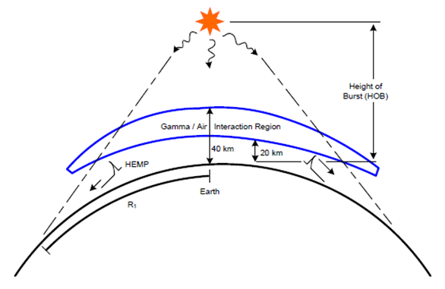
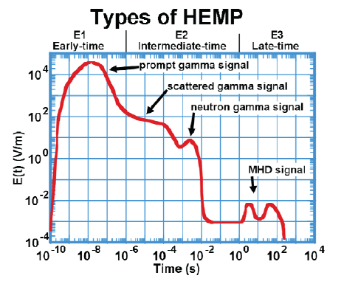
Categorizing Electromagnetic Pulse (EMP)
Intentional, man-made attack
  E1 – Very fast rise time, may result in damage to electronic components either directly, or by coupling into the attached wires.
  E2 – Similar to lightning, can result in damage to electronics and potential flashover of distribution class insulation.
  E3 – Long duration and low frequency, similar to GMD, but EMP (E3) has two potential impacts; increased reactive power consumption and potential protection system misoperation as a result of harmonics.
EMP can occur with little or no warning, most operational strategies are inapplicable.

Slide 4
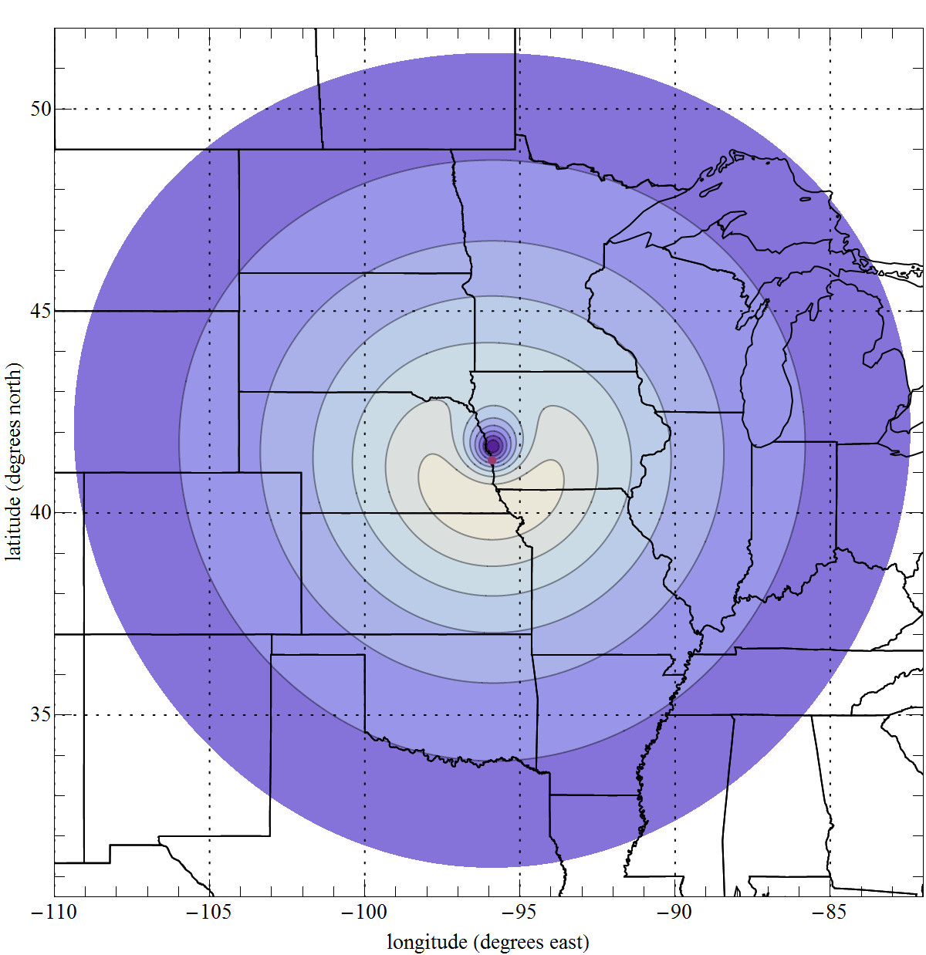
High Altitude Burst Generated EMP (HEMP)
The HEMP signal extends to the visual horizon as seen from the burst point
A large device detonated at 400–500 km over central USA would affect all of the continental USA
Effects depend on: altitude of the detonation, energy yield, gamma ray output, interactions with the earth’s magnetic field, and electromagnetic shielding of targets
16
14
12
10
8 kV/m
6

Slide 5
Understanding Probability and Consequence
Rare
Unlikely
Possible
Likely
Frequent
Extreme
Is EMP Truly a High Impact Low Frequency Event?
Major
Impact
Moderate
Do we understand the potential impact?
What can be done to limit the impact?
Minor
Incidental
Likelihood

Slide 6
Grid Resilience Working Group EMP Goals
Develop an understanding of potential impacts of a high altitude electromagnetic pulse event on the power system,
Investigate the measures that are already or could be implemented to prevent or mitigate these impacts,
Assess the feasibility, benefits and costs of implementing such measures in the ERCOT region.
Meaningful progress required by start of Texas Legislature reconvening in early 2017.

Slide 7

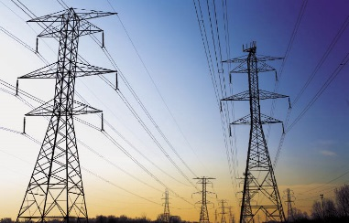

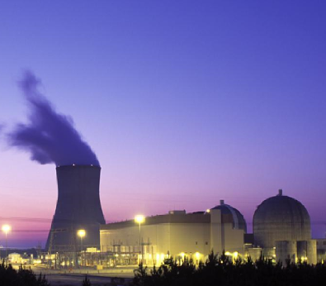
EPRI Project Scope (Page 1 of 2)
Characterization of EMP threats
Determine Stresses to Transmission Assets
Impact of E3 on transformer thermal and magnetics
Electronic component EMP (E1 and E2) vulnerability test protocol, testing, and analysis
Vulnerability of internal insulation to E1 and E2
Vulnerability of external insulation to E1 and E2

Slide 8
EPRI Project Scope (Page 2 of 2)
Impact of EMP failure of distribution and generation systems on the Transmission System
EMP’s impact on systems that support transmission
Test protocol development and testing for evaluation of EMP hardening approaches
Development and documentation of recovery strategies
Decision support framework
EMP leading industry practices / trial implementation evaluation
Annual conference and workshop

Slide 9
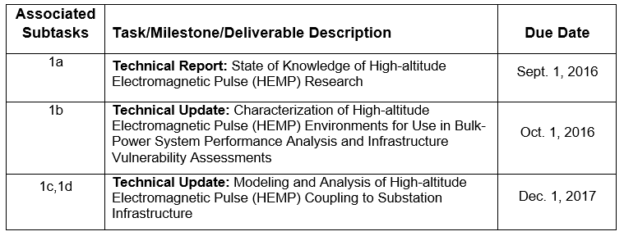
Task 1: Threat Characterization (E1, E2, and E3)
This task is:
  Identifying the state of knowledge of unclassified HEMP research.
  Identifying conservative (bounding) HEMP waveforms (magnitude, spatial and time dependent characteristics, etc.) that can be used to assess the potential impacts on bulk-power system components.
  Investigating the physics of HEMP propagation and coupling to power system infrastructure.

Slide 10
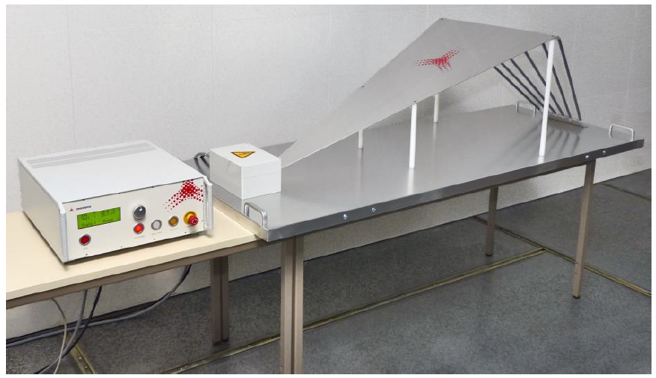
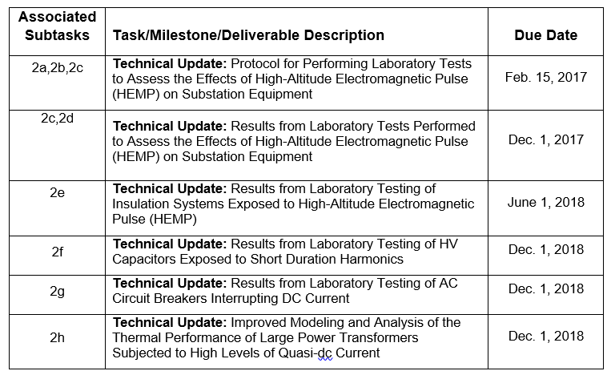
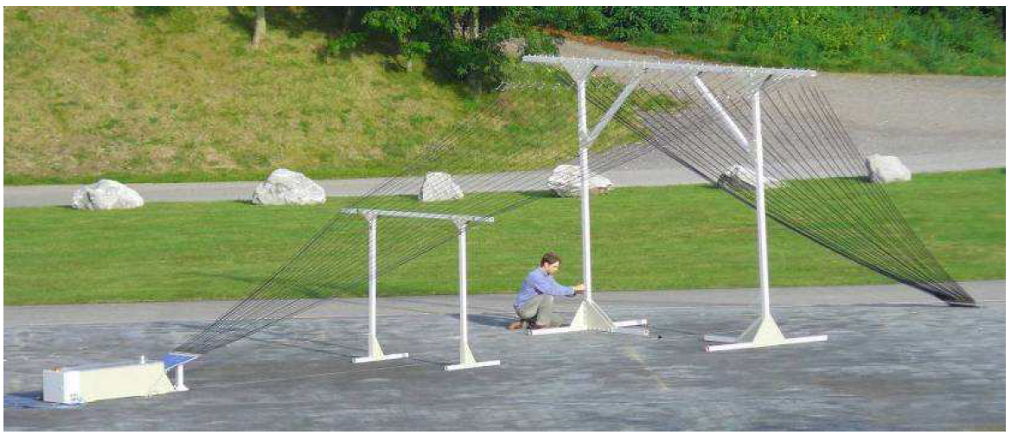
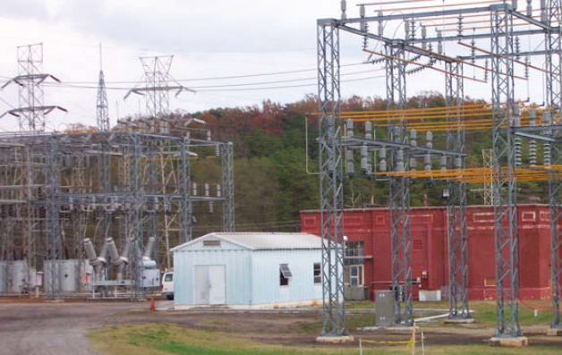
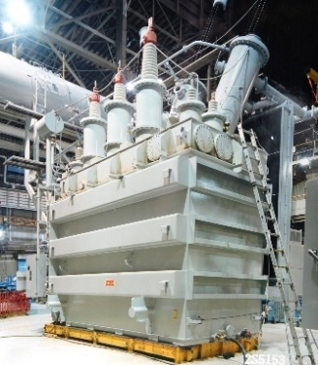
Task 2: EMP Vulnerability
This task is identifying the vulnerability of transmission system and support assets (P&C, communications, SCADA, cables, transformers, insulators, etc.) exposed to the HEMP threat defined in Task 1 - Threat Characterization.
Both radiated and conducted transients are
included.

Slide 11
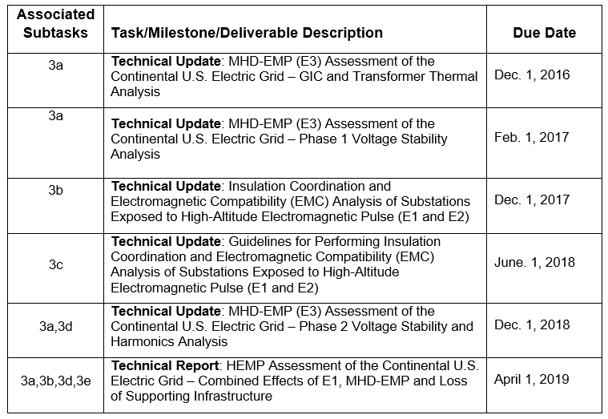
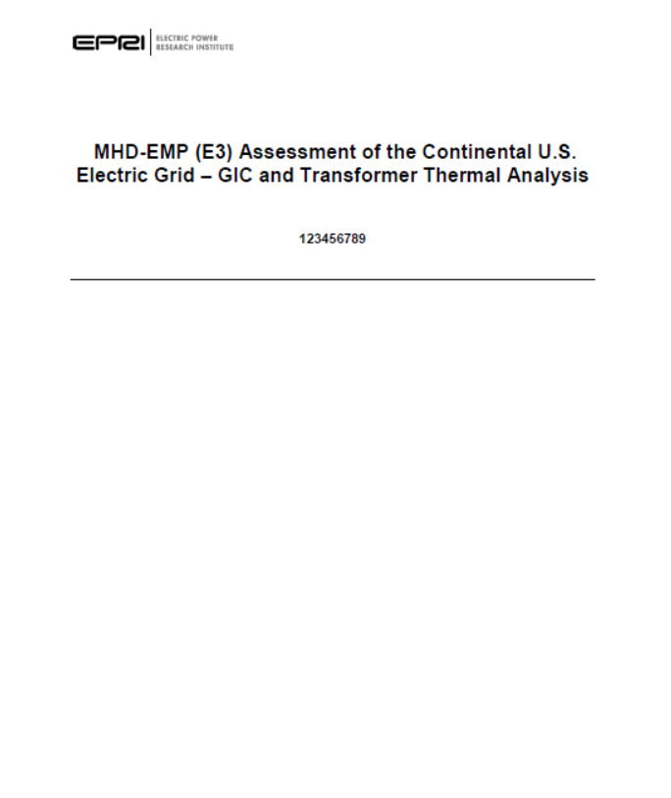
Task 3: Impacts
This task is assessing the potential impacts of a HEMP attack on the bulk-power system.
Assessment techniques, models and tools for assessing the impacts of a HEMP attack are also being developed.
CONFIDENTIAL
?

Slide 12
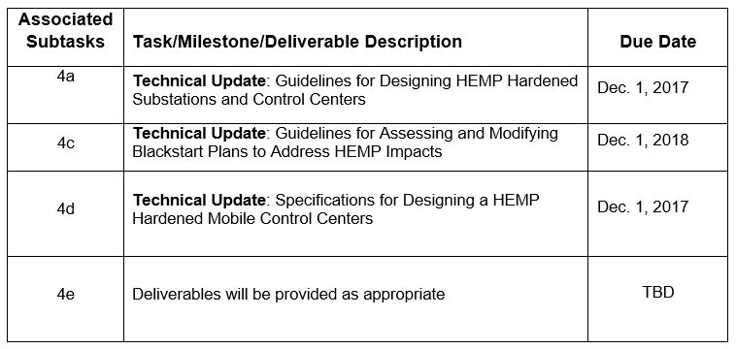
Task 4: Mitigation, Hardening and Recovery
This task is assessing various mitigation and hardening approaches that can be employed to reduce the impacts of HEMP on bulk-power system reliability.
Potential unintended consequences (impacts) of various mitigation and hardening strategies are being evaluated.
Enhanced recovery procedures/plans are being developed.
CONFIDENTIAL
?

Slide 13
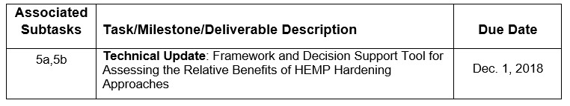
Task 5: Decision Support
This task is developing methodologies and tools to support risk-informed decisions regarding the implementation of HEMP hardening and mitigation measures.
A framework for assessing the relative benefits of various hardening and mitigation approaches is being developed.
Support tools designed to aid in decision making are being developed.

Slide 14
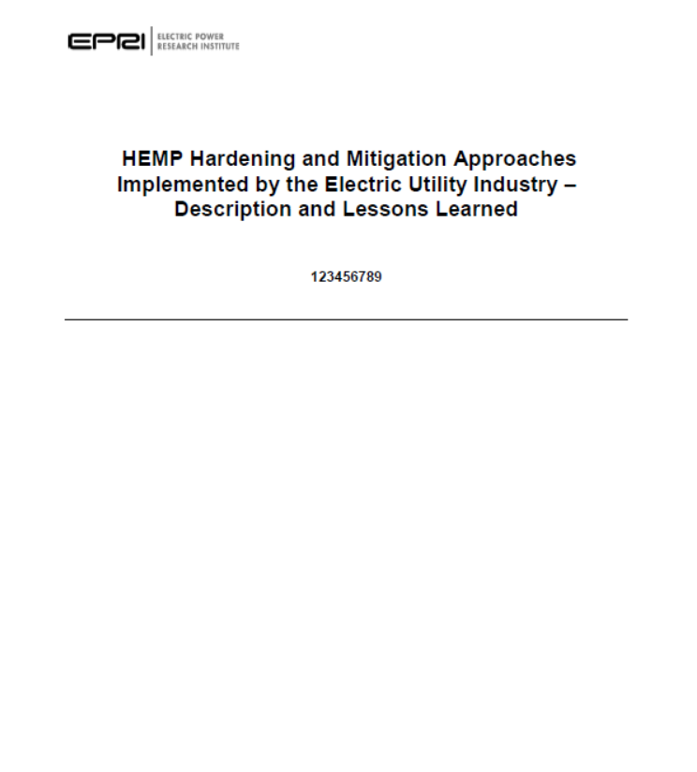
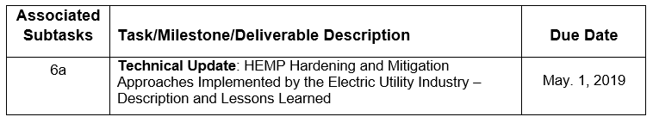
Task 6: Trial Implementation
This task is developing a collection of leading industry practices with regards to HEMP mitigation and hardening.
Applications of various assessment techniques and mitigation options will be catalogued, and the effectiveness and lessons learned will be communicated.
CONFIDENTIAL
?

Slide 15
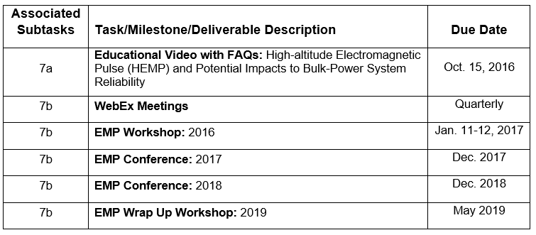
Task 7: Trial Implementation
This task is developing communications for member utilities and stakeholders in order to inform them of the background and potential impacts of HEMP, and share new learnings in a timely manner.
Please note
date change!

Slide 16
Rob Manning
rmanning@epri.com
Vice President, Transmission

