Slide 1
PDCWG Report to ROS
Chair: Percy Galliguez, Brazos Electric Power Cooperative, Inc.
Vice Chair: Stewart Rake, Luminant
ROS
July 7th, 2016

Slide 2
Report Overview & Notes
Report Overview
  Meeting Minutes
  BAL-001-TRE-1 FMEs & IMFR
    4 FMEs in the month of May
    BAL-001-TRE-1 Unit Performance Report now includes Solar resources.
  Frequency Control Report

Slide 3
Meeting Minutes
PDCWG Meeting 6/15/16
  Regulation & Frequency Control Reports
  GREDP Performance Analysis
  MOD-026-1 & MOD-027-1 Discussion
  NDCRC Reactive Testing Form Discussion
  Retirement of Sydney Niemeyer (as of 6/30/16)
  Reviewed 5 FME’s
    05/05/2016 12:31:01
      Loss of 627 MW
      674 MW/0.1HZ Response
    05/12/2016 14:31:29
      Loss of 588 MW
      763 MW/0.1HZ Response
    05/21/2016 8:18:49
      Loss of 559 MW
      1,019 MW/0.1HZ Response

Slide 4
Frequency Measurable Events Performance
June 2016

Slide 5
Frequency Measurable Events
There were 2 FMEs in June.
  6/6/2016 16:21:42
    Loss of 517 MW
    Interconnection Frequency Response: 820 MW/0.1 Hz
    3 of 40 Generation Resources had less than 75% of their expected Initial Primary Frequency Response.
    3 of 40 Generation Resources had less than 75% of their expected Sustained Primary Frequency Response.
  6/19/2016 18:14:33
    Loss of 669 MW
    Interconnection Frequency Response: 857 MW/0.1 Hz
    5 of 42 Generation Resources had less than 75% of their expected Initial Primary Frequency Response.
    6 of 42 Generation Resources had less than 75% of their expected Sustained Primary Frequency Response.

Slide 6
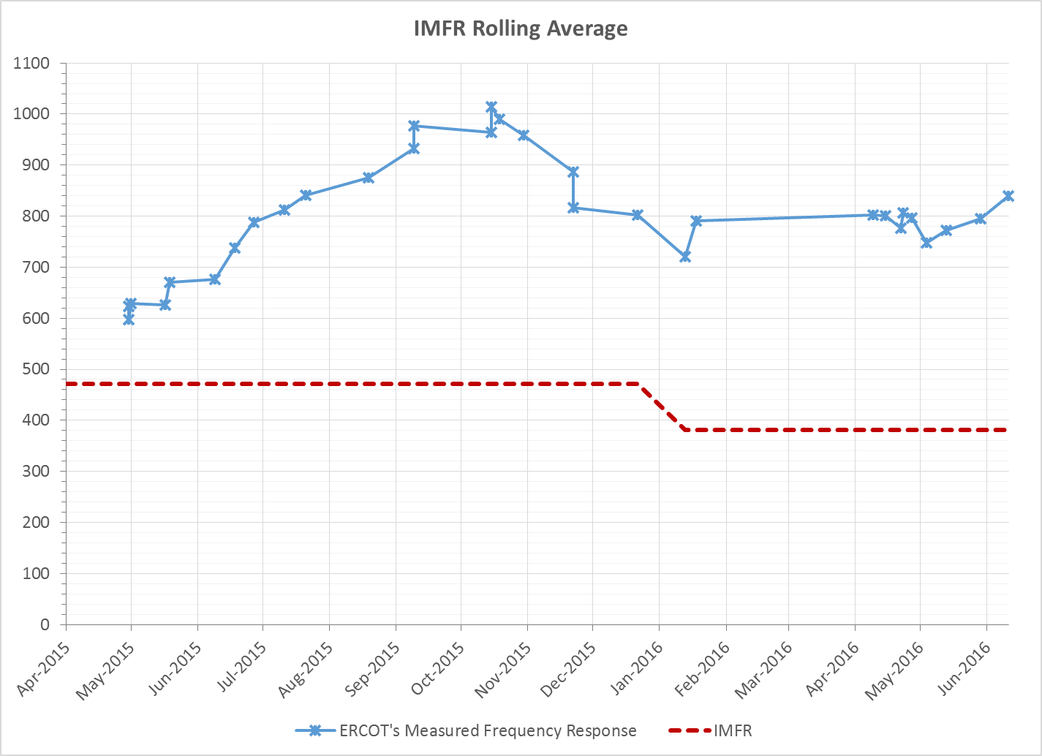
Interconnection Minimum Frequency Response (IMFR) Performance
IMFR Performance currently 840.08 MW/0.1Hz

Slide 7
Frequency Control Report
January 2016

Slide 8
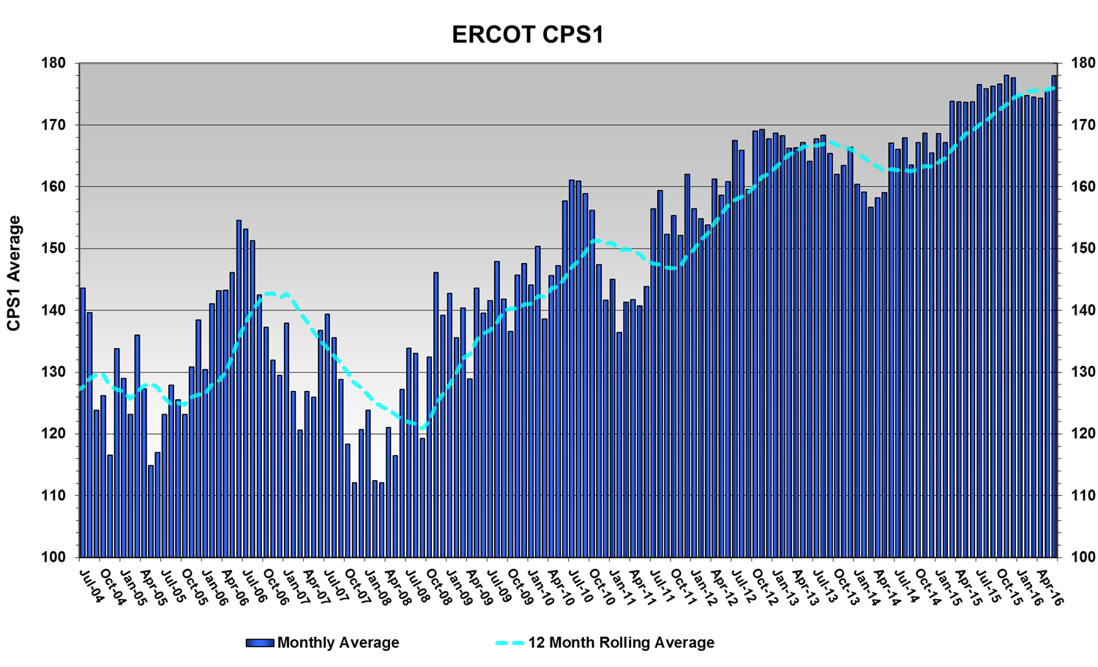
CPS1 Performance
CPS1 12 Month Rolling Average = 176.09%

Slide 9
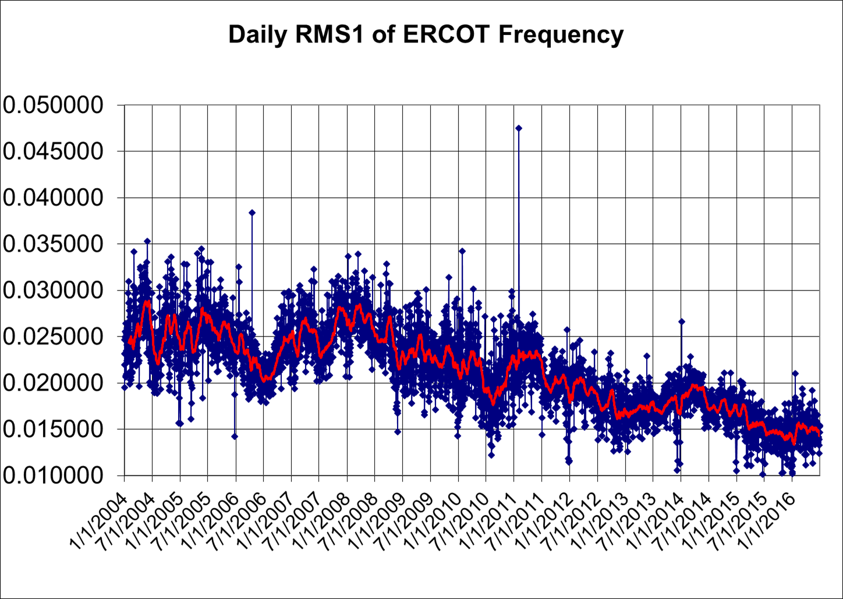
RMS1 Performance of ERCOT Frequency

Slide 10
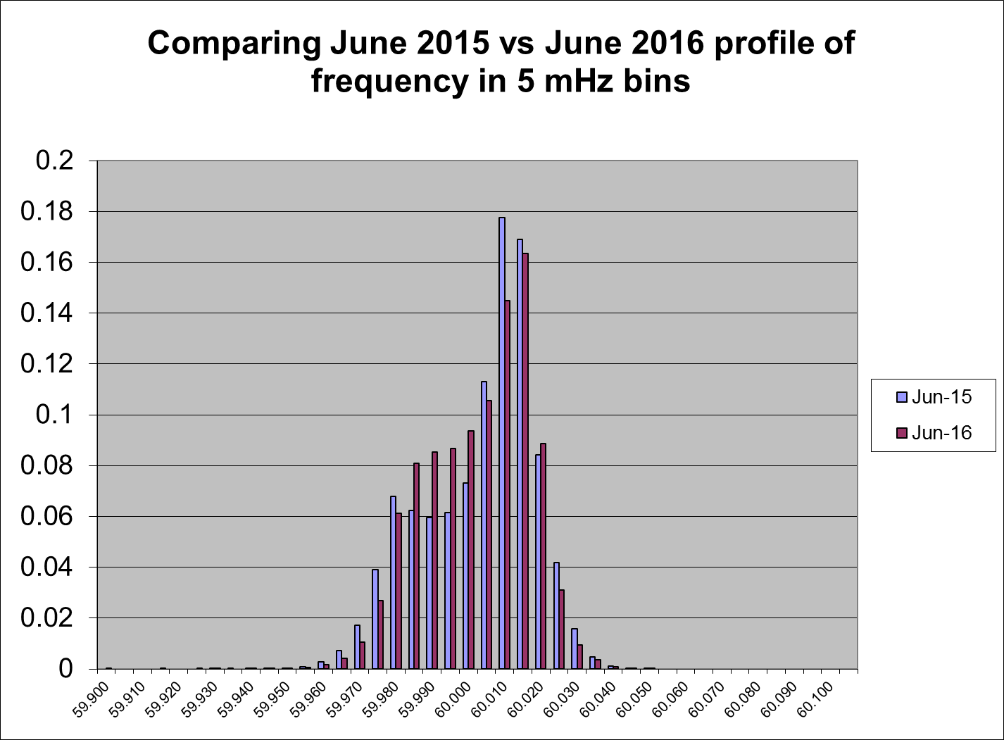
Frequency Profile Analysis
Year | Low Side (<60Hz) | High Side (>60Hz)
2015 | 170.48 | 175.97
2016 | 174.69 | 181.12
Year | Mean | Standard Deviation
2015 | 60.000658 | 0.016701
2016 | 59.999967 | 0.015599

Slide 11
Time Error Corrections
There were 9 Time Error Corrections (TEC) in June.

Slide 12
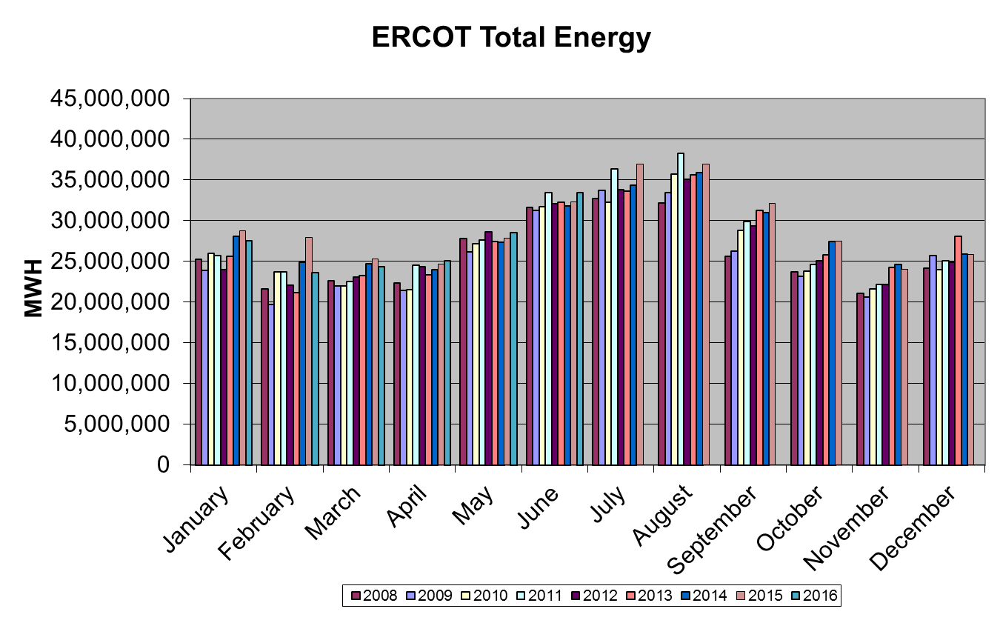
Wind Generation Performance

Slide 13
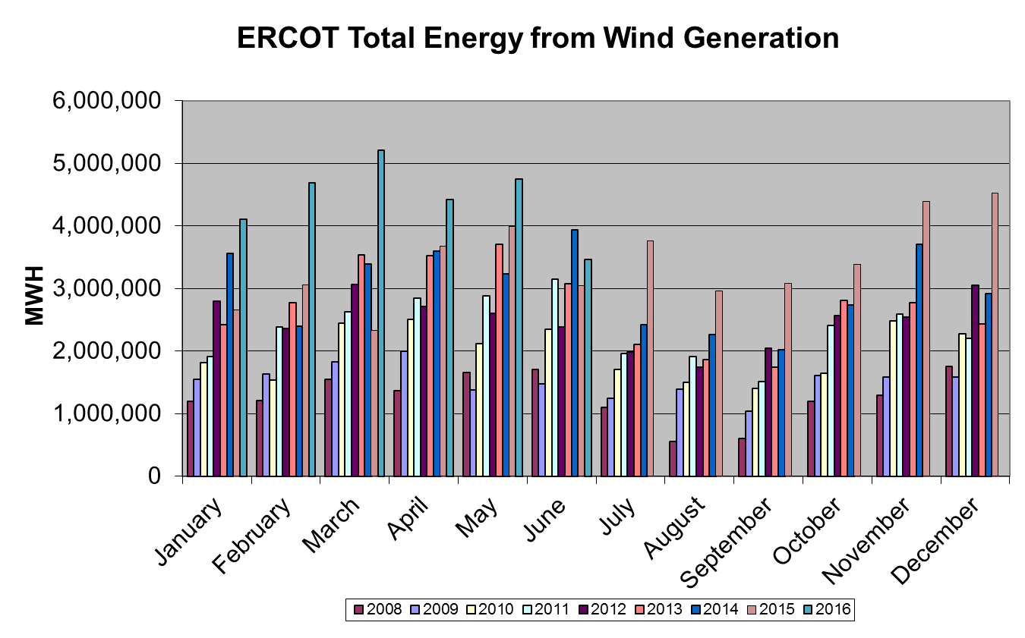
Wind Generation Performance

Slide 14
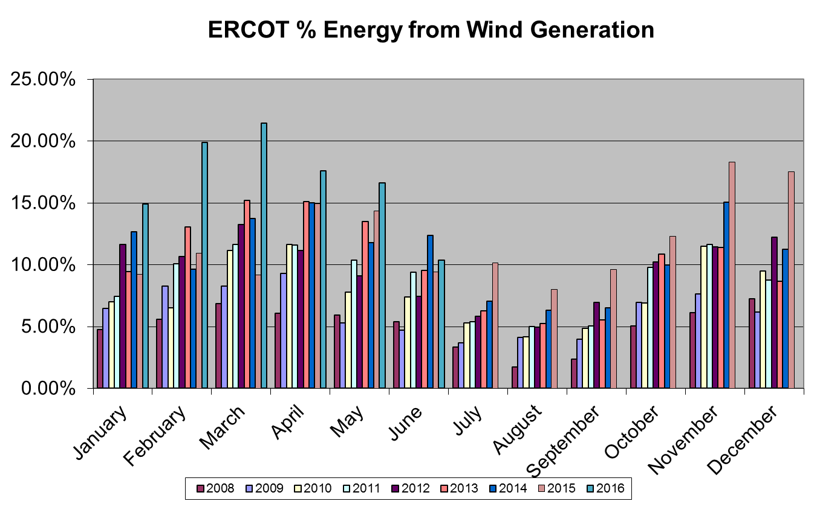
Wind Generation Performance

Slide 15
Questions?

