Slide 1
SAWG Update to WMS
July 6th, 2016
Brandon Whittle

Slide 2
Report Releases
Draft LTRA Data
Housekeeping
None

Slide 3
MIRTM – Update
None!
ERCOT needs more time to work through their software created to do the analysis.

Slide 4
CDR
NPRR759 Segmentation of the Total New Capacity Estimate in the ERCOT CDR – Still evaluating, could work into an approach outlined below.
Add a tab with variants of two major data points
Load Forecast: Mild, Normal (used on main tab), Extreme Weather
Planned Resources: All IA, IA with Air & Water (used on main tab), and PG 6.9 (IA, Air, Water, Security).
Calculate Reserve Margins using the above (9 per year)
Refer to this second tab from the main tab

Slide 5
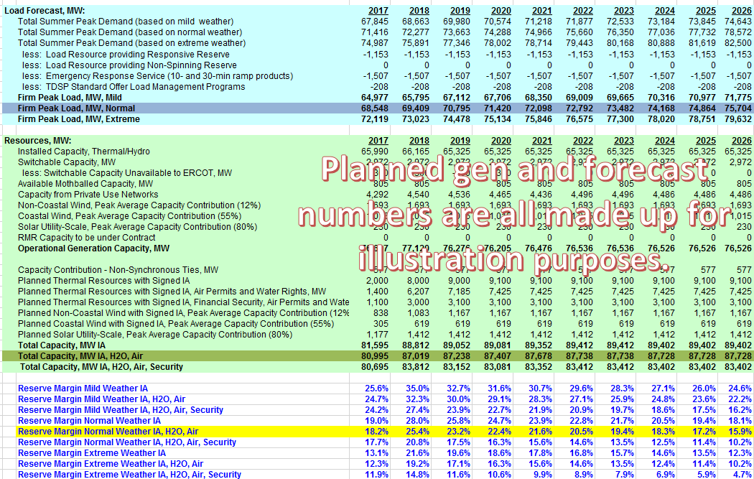
CDR Second Tab
Example only
May just include the alternate forecasts and the resultant margins
Still under discussion

Slide 6
CDR Horizon
SAWG recommends reducing the time horizon for the CDR, currently considering 3 to 5 years.
Factors influencing this decision are:
Historical planned generation notifications
Timing of financial security posting
ERCOT’s Load Forecast confidence.

Slide 7
Next Meeting – August 15th, 2016
Expected Agenda Items
MIRTM Update – with Data!
CDR
NERC LTRA – Update
NOTE: POSSIBLE July webcast to go over MIRTM, will notice appropriately.

