Slide 1
Demand Side Working Group Update to the Wholesale Market Subcommittee
7/6/2016

Slide 2
DSWG Update to WMS
WMS assigned the DSWG to investigate DR deployment impacts on SCED when NPRR 626 was implemented
May 1st UF event occurred at 20:20 and lasted 4 minutes
  Frequency dropped near 59.7Hz that caused 927MW of LR to trip
UF events were specifically excluded from the NPRR language
  In accordance with expectations, no reliability adder was calculated for this event

Slide 3
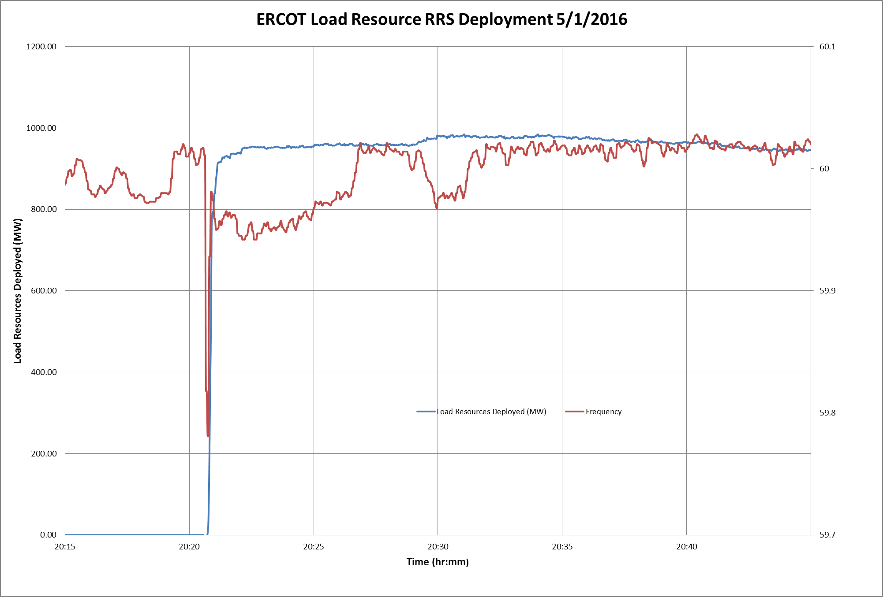
DSWG Update to WMS

