Slide 1
Switchable Generation Resources
WMS
7/6/2016

Slide 2
Agenda
Review of Switchable Generation Resources (SWGRs) in ERCOT
ERCOT SWGR whitepaper
Project next steps

Slide 3
SWGRs in ERCOT
A Switchable Generation Resource (SWGR) is defined in the ERCOT Protocols as “A Generation Resource that can be connected to either the ERCOT Transmission Grid or a non-ERCOT Control Area.”

Slide 4
SWGR sites
Tenaska Kiamichi is a natural gas-fired combined-cycle generation facility located in Pittsburg County, Oklahoma
Tenaska Gateway is a natural gas-fired combined-cycle generation facility located in Rusk County, Texas
The Tenaska Frontier facility is a natural gas-fired combined-cycle generation facility located in Grimes County, Texas
The Frontera Generation facility is a natural gas-fired combined-cycle generation facility located in Hidalgo County, Texas
Antelope Station is a natural gas-fired reciprocating engine driven generation facility located in Hale County, Texas
Elk Station is a natural gas-fired simple-cycle combustion turbine driven generation facility located in Hale County, Texas

Slide 5
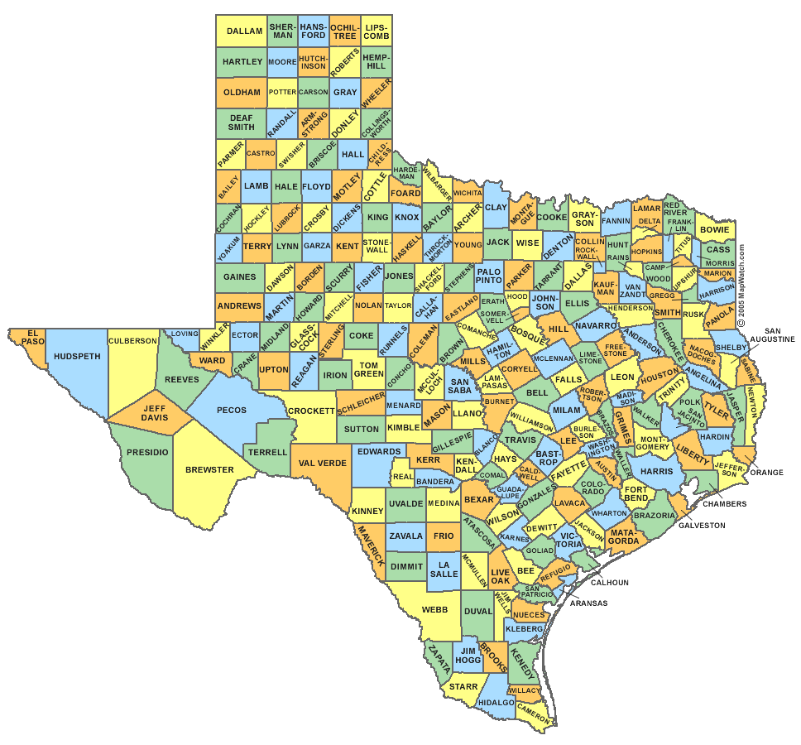

SWGR sites
Antelope and Elk
Tenaska Kiamichi
Tenaska Gateway
Tenaska Frontier
Frontera

Slide 6
ERCOT SWGR whitepaper
Purpose
Describe the current ERCOT rules and procedures (ERCOT Protocols, Operating Guides, Other Binding Documents, etc.) under which Switchable Generation Resources operate within the ERCOT Region.
Describe challenges to the ERCOT market and grid operations areas.
Identify areas needing clarification and/or changes to ERCOT rules, protocols, guides or processes with the goals of
  - Providing ERCOT the ability to manage grid reliability and markets effectively
  - Providing Generation Resource operators with maximum flexibility and efficient use of their Switchable Generation Resources via clear and unambiguous ERCOT rules
  - Providing market participants transparency in disclosure reports as to SWGR operations

Slide 7
ERCOT SWGR whitepaper
Contents:
Modeling, Definitions and the Interconnection Process
Operations
  COP submittal
  Switching under normal and emergency conditions
  Outage submittal
Market Operations
  CRR
Market Settlements
  Emergency conditions
Planning
Coordination

Slide 8
Project next steps
Project timeline:
July 6th – WMS meeting
July 7th - ROS meeting
Working groups under ROS and WMS to be assigned various topics
Receive comments
Workshop will be scheduled if requested
ERCOT NPRRs after comments received
Submit comments to David Thompson
  David.Thompson@ERCOT.com

Slide 9
Questions

