Slide 1

Current CDR Energy Efficiency Capacity Forecast Methodology and Top-Down ERCOT Modeling Approach
GATF Meeting
6/10/2013

Slide 2
Current CDR Energy Efficiency Capacity Forecast Methodology

Slide 3
Forecast Development Assumptions
Base year is 2013
Incremental energy efficiency program impact is 0.4% of total load for residential and commercial sectors (including NOIEs)
  Proportion of total load forecast that is commercial and residential load is 90%
Demand response capacity from TDSPs available in 2013 is 270 MW; annual growth rate assumed to be zero

Slide 4
Forecast Development Assumptions
Average measure life is seven years, and all programs assumed to start and end at the same time
  net effect is seven-year accumulation of annual program capacity additions followed by seven-year moving sum (e.g., in year 2020, program capacity for 2013 drops off as year 2020 capacity is added)
Incremental program additions derated by 50% to account for capacity savings embedded in the long-term load forecast and unrealized potential savings

Slide 5
Detailed Data

Slide 6
Top Down
Energy Efficiency Modeling Approach
Divider Slide
Divider Slide (optional)

Slide 7
Outline
Forecasting Models Overview
Top-Down Energy Efficiency Approach
Summary
Questions

Slide 8
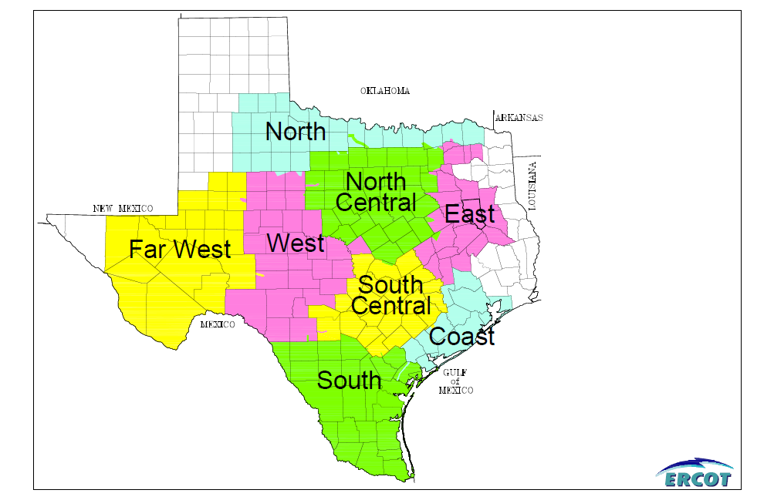
Weather Zones

Slide 9
Long-Term Load Forecast Model Description
Independent models are created for each of ERCOT’s eight weather zones
Two sets of models are used to create the long-term load forecast
  Daily energy models
  Hourly energy models

Slide 10
Long-Term Load Forecast Model Description
Daily energy models
  Creates a total energy forecast for each weather zone, for each day in the forecast time period
  Long-term growth in energy consumption is correlated with non-farm employment forecast
  The same weather is used for each forecast year
Hourly energy model
  Allocates energy from the daily energy forecast to each hour within the month for each weather zone

Slide 11
Daily Energy Model Description – Input Variables
Season
  Summer (May though through September)
  Winter (December, January, and February)
  Spring (March and April)
  Fall (October and November)
Day type
  Weekdays excluding holidays
  Saturday
  Sunday or holidays

Slide 12
Daily Energy Model Description – Input Variables
Weather variables
  Unique to each weather zone
  Two different cooling degree thresholds for the summer
  Two different heating degree thresholds for the winter
  One cooling degree threshold and one heating degree threshold for the spring and fall
  Each cooling and heating threshold was determined in a manner that maximizes the historical model fit based on the R-square statistic
Daylight minutes

Slide 13
Daily Energy Model Description
Each weather zone model forecasts daily MWh per one thousand non-farm jobs
Selected this modeling approach due to concerns of heteroscedasticity

Slide 14
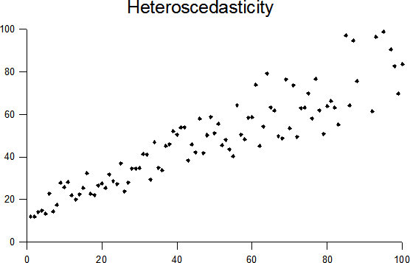
Heteroscedasticity Example

Slide 15
Daily Energy Model Example
(Daily Energy _{NCENT} ) / Non-Farm Employment _{NCENT} =
79.48 + 1.92 CDD₆₇ + 1.05 CDD₈₀ per day
  this model uses Cooling Degree Days with bases of 67 and 80
  this model is for the summer season
For simplicity the above is for weekdays
Weekends and holidays would have a different intercept value

Slide 16
Hourly Energy Model Description
A neural network model was developed for each weather zone, for each month, day type, and hour that forecasts the hourly fraction of energy for each hour within a day
The neural network models are based on the following variables:
  Current day’s temperatures at 7 a.m., noon, and 7 p.m.
  Hourly fraction of the prior hour
  Forecasted daily MWh per 1000 jobs

Slide 17
Top Down Energy Efficiency Approach
Start with daily model from the summer
  (Daily Energy _{NCENT} ) / Non-Farm Employment _{NCENT} =
  79.48 + 1.92 CDD₆₇ + 1.05 CDD₈₀ per day
Restated in general terms
  Daily Mwh = Base Load + Cooling Load

Slide 18
Top Down Energy Efficiency Approach
Y = c + aX₁ + bX₂ or Y = aX₁ + bX₂ + c
  Y = Daily Mwh per thousand jobs
  c = Base Load
  a = Cooling coefficient
  b = Cooling coefficient
Multiplying equation by non-farm employment gives
  Y = aX₁ + bX₂ + c
  Y = Daily Mwh
  c = Base Load
  a = Cooling coefficient
  b = Cooling coefficient

Slide 19
Top Down Energy Efficiency Approach
To project impacts of future energy efficiency improvements the coefficients (a, b, and c) change on an annual basis
Coefficients are adjusted based on the annual growth rates calculated from the EIA Annual Energy Outlook

Slide 20
Top Down Energy Efficiency Example
Calculating Commercial Space Cooling Electric Intensity Compound Annual Growth Rate (CAGR)
  2010 Space Cooling = 0.56 quads
  2010 Commercial Floor Space = 81.1 billion square feet
  2010 Space Cooling Intensity =
  0.56 quads / 81.1 billion square feet = 6,905 Btus per square foot
  2035 Space Cooling = 0.54 quads
  2035 Commercial Floor Space = 103 billion square feet
  2010 Space Cooling Intensity =
  0.54 quads / 103 billion square feet = 5,243 Btus per square foot
Yields a 0.99 compound annual rate of decline for 2010 - 2035

Slide 21
Top Down Energy Efficiency Example
  Apply the 0.99 compound rate of decline to the cooling coefficients in the equation Y = aX₁ + bX₂ + c
For the first forecast year:
  Y = (0.99)(a)(X₁)+ (0.99)(b)(X₂)+ c
For the second forecast year:
  Y = (0.992)(a)(X1)+ (0.992)(b)( X2)+ c
For the nth forecast year:
  Y = (0.99n)(a)(X1) + (0.99n)(b)(X2)+ c

Slide 22
Top Down Energy Efficiency Approach
Seeing that weather zone models are used (as opposed to customer classification models) requires that a relative proportion of residential load to non-residential load be determined based on the most recent historical year
Need to apply a factor to the previous equations which represents the historical percentage of the impacted load in the weather zone
For the nth forecast year:
  Y = (0.99^{n})(a)(f)(X₁) + (0.99^{n})(b)(f)(X₂)+ (c)(f)
  Where f represents the fraction of load impacted by the energy efficiency program(s)

Slide 23
Top Down Energy Efficiency Example
Similar approach would be used on energy efficiency programs that impact base load
  Impact would be applied to the c coefficient in the equation
  Y = aX₁ + bX₂ + c

Slide 24
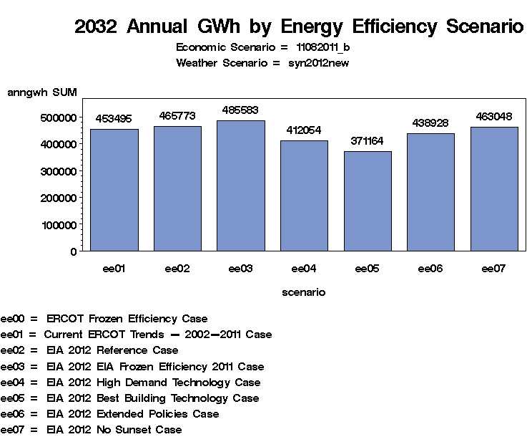
EIA Scenarios - Energy Efficiency Impacts

Slide 25
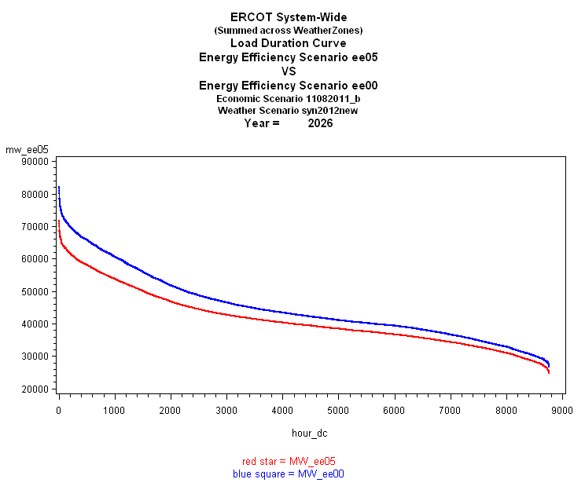
EIA Best Building Technology - Energy Efficiency Impact

Slide 26
Summary
Not feasible to build bottom up models given staff / time constraints
Possible that a top-down approach will yield results that are as good as the bottom-up approach
This is a new process which is still in the very early stages of evaluation
Likely to have more benefit when class level models are developed

Slide 27
Questions
ON
OFF

