Slide 1
June – September SCT Procurement
ERCOT Update to DSWG
Mark Patterson
June 17, 2016

Slide 2
Time Period 1 Procurement - JunSep16
Clearing Price: $2.12
MW Procured: 837.135
MW Not Procured: 27.6
Resources Procured: 375
Resources Not Procured: 10
Expenditure Limit | $478,718.29
Amount Spent | $457,879.36
Unspent | $20,838.93
 | NWS ERS -10 | NWS ERS-30
MW Procured | 312.034 | 525.101
ERS Generators (Resources) Procured | 9 | 13
Number of Resources Procured | 150 | 225

Slide 3
Time Period 2 Procurement - JunSep16
Clearing Price: $1.98
MW Procured: 904.254
MW Not Procured: 30.55
Resources Procured: 445
Resources Not Procured: 11
Expenditure Limit | $797,863.82
Amount Spent | $769,881.86
Unspent | $27,981.96
 | NWS ERS -10 | NWS ERS-30
MW Procured | 319.429 | 584.825
ERS Generators (Resources) Procured | 9 | 13
Number of Resources Procured | 160 | 285

Slide 4
Time Period 3 Procurement - JunSep16
Clearing Price: $21.21
MW Procured: 858.504
MW Not Procured: 0.6
Resources Procured: 363
Resources Not Procured: 3
Expenditure Limit | $4,787,182.92
Amount Spent | $4,697,888.42
Unspent | $89,294.50
 | NWS ERS -10 | NWS ERS-30 | WS ERS-30
MW Procured | 284.399 | 551.572 | 22.533
ERS Generators (Resources) Procured | 9 | 13 | 0
Number of Resources Procured | 123 | 236 | 4

Slide 5
Time Period 4 Procurement - JunSep16
Clearing Price: $22.32
MW Procured: 823.479
MW Not Procured: 0.5
Resources Procured: 330
Resources Not Procured: 3
Expenditure Limit | $4,787,182.92
Amount Spent | $4,742,053.23
Unspent | $45,129.69
 | NWS ERS -10 | NWS ERS-30 | WS ERS-30
MW Procured | 276.074 | 524.872 | 22.533
ERS Generators (Resources) Procured | 9 | 13 | 0
Number of Resources Procured | 117 | 209 | 4

Slide 6
Time Period 5 Procurement - JunSep16
Clearing Price: $2.08
MW Procured: 851.441
MW Not Procured: 29.135
Resources Procured: 361
Resources Not Procured: 13
Expenditure Limit | $478,718.29
Amount Spent | $456,917.30
Unspent | $21,800.99
 | NWS ERS -10 | NWS ERS-30
MW Procured | 310.019 | 541.422
ERS Generators (Resources) Procured | 8 | 13
Number of Resources Procured | 143 | 218

Slide 7
Time Period 6 Procurement - JunSep16
Clearing Price: $2.36
MW Procured: 770.393
MW Not Procured: 14.10
Resources Procured: 324
Resources Not Procured: 9
Expenditure Limit | $2,720,158.98
Amount Spent | $2,665,374.89
Unspent | $54,784.09
 | NWS ERS -10 | NWS ERS-30
MW Procured | 296.224 | 443.774
ERS Generators (Resources) Procured | 9 | 13
Number of Resources Procured | 137 | 187

Slide 8
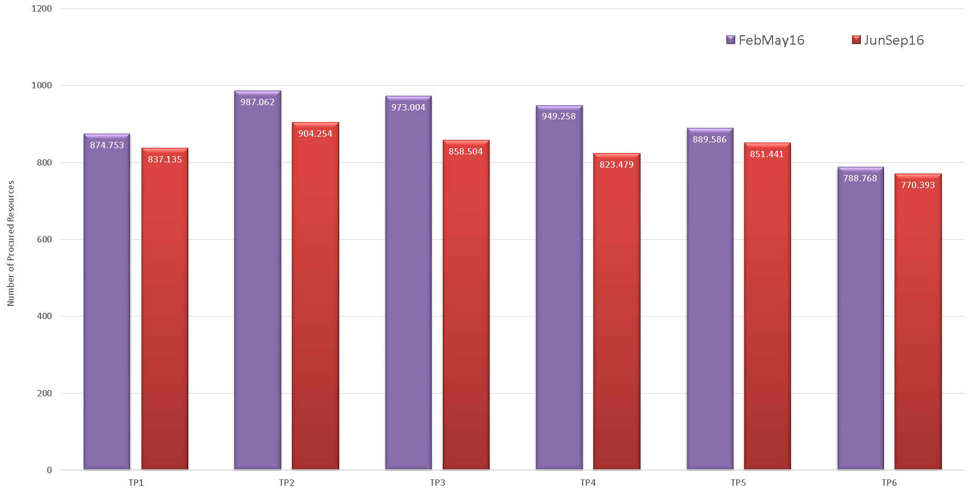
ERS MW Procurement

Slide 9
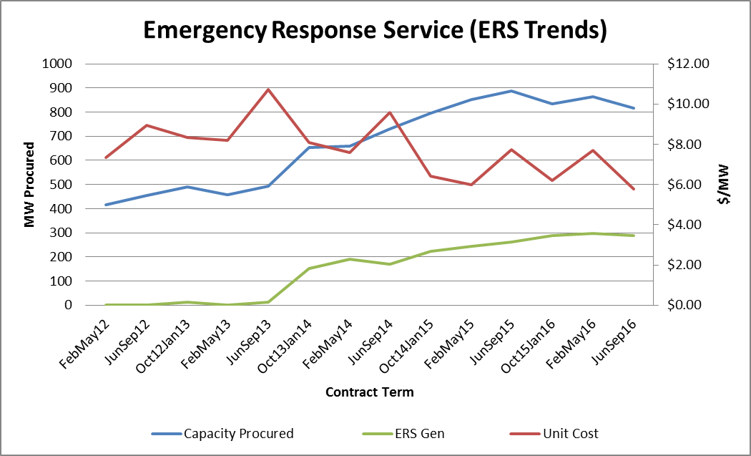
Emergency Response Service (ERS) Trends

Slide 10
Procurement Expenditure Limit Allocation Table

