Slide 1
SMT Update To AMWG
May 2016

Slide 2
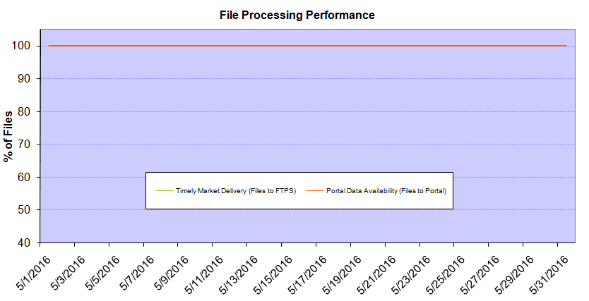
Monthly SMT Data Timelines AMWG CR 2014 002 End to End File Processing Completeness – MAY 2016
% Timely Market Delivery - % of files posted to market (FTPS) by 11:00pm out of # of files received by SMT by 11:00pm.
% Portal Data Availability - % of files loaded to the database for data availability on portal by 6:00am next day for the files received by 11:00pm
* A LSE file includes usage data for up to 50,000 ESIIDs.
Observed Anomalies:
2

Slide 3
SMT API and FTPS Services Availability – MAY 2016
The service availability is measured as a percentage of number of minutes the service was available out of the total number of minutes in a month, excluding planned outages.
Observed Anomalies:
Mar-Apr 2015: SMT outage and subsequent recovery/catch-up impacted API availability. FTPS was available for most of the part except on 03/21-03/22 for 36 hours.
26 Jul 2015: Services were unavailable for 12 hours due to Flash storage issue
25 Jan 2016: Services were unavailable for 19 hours due to storage configuration issue
07 Mar 2016: API Services were unavailable for 7hours due to Oracle archiver issue.
Notes:
3

Slide 4
SMT Number of Accounts by Type AMWG CR 2014 009 – MAY 2016
Registered Users | ONC | CNP | AEPN | AEPC | TNMP | TOTAL
Active Residential Accounts | 37030 | 23029 | 1971 | 5223 | 2531 | 69784
Active Residential English Accounts | 36839 | 22873 | 1966 | 5111 | 2521 | 69310
Active Residential Spanish Accounts | 191 | 156 | 5 | 112 | 10 | 474
Non Active Residential Accounts | 18139 | 12472 | 1439 | 3159 | 653 | 35559
Total Residential Accounts | 55169 | 35501 | 3410 | 8382 | 3184 | 105343
TDSP User | 309 | 40 | 12 | 17 | 1 | 379
TDSP Admin | 4 | 4 | 4 | 4 | 3 | 19
Small Business User | 94 | 46 | 0 | 4 | 4 | 148
Small Business Admin | 2561 | 1377 | 75 | 274 | 102 | 4499
Total Agreements (Includes Active and Pending) | 1567 | 708 | 1 | 0 | 0 | 2276
Energy Data Agreements (Includes Active and Pending) | 1514 | 409 | 1 | 0 | 0 | 1924
Han Device Agreements (Includes Active and Pending) | 53 | 298 | 0 | 0 | 0 | 351
Han Service Agreements (Includes Active and Pending) | 0 | 1 | 0 | 0 | 0 | 1
IN SMT
ESI IDs | 3475748 | 2406391 | 197502 | 857711 | 226815 | 7164167
Meters | 3408405 | 2406358 | 198290 | 857938 | 226619 | 7097610
HAN Devices | 3890 | 5176 | 134 | 282 | 38 | 9520
Acknowledgement | 0 | 0 | 0 | 0 | 0
Pending | 0 | 2 | 0 | 0 | 0
Meter Ready | 30 | 10 | 42 | 115 | 25
Provisioned | 3860 | 5164 | 92 | 167 | 13
HAN Messages (MTD) | 0 | 0 | 0 | 0 | 0 | 0
HAN Messages (YTD) | 17 | 3 | 0 | 0 | 0 | 20
HAN Messages (Cumulative) | 339 | 7400 | 0 | 0 | 0 | 7739
Simple Text Messages | 103 | 2925 | 0 | 0 | 0
Load Control Messages | 100 | 2658 | 0 | 0 | 0
Pricing Messages | 92 | 53 | 0 | 0 | 0
Cancellation Messages | 44 | 1764 | 0 | 0 | 0
Supplemental – (Friends)
Total Agreements | 1627 | 1305 | 75 | 85 | 57 | 3149
Accepted Agreements | 718 | 505 | 33 | 29 | 18 | 1303
Pending Agreements | 5 | 0 | 0 | 1 | 0 | 6
Revoked Agreements | 238 | 254 | 10 | 7 | 6 | 515
Expired Agreements | 640 | 518 | 30 | 48 | 33 | 1269
Terminated Agreements | 26 | 28 | 2 | 0 | 0 | 56
 | TDSPs | REP | Small Business | Regulatory | Third Party
Registered Entities | 5 | 110 | 4377 | 2 | 88
Registered Users | 379 | 898 | 148 | 8 | 21
Registered Admins | 19 | 173 | 4389 | 4 | 94
HAN Messages Sent By | 332 | 7383

Slide 5
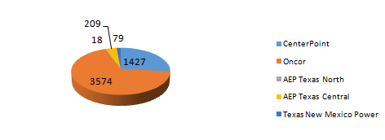
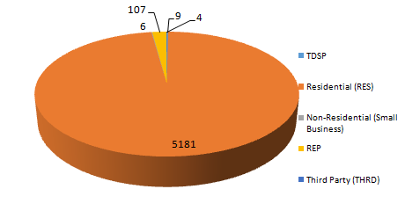
SMT ODR Details – MAY 2016
Total ODR Requests TDSP wise statistics:
Total ODR Requests User type statistics:

