Slide 1
NPRR 759 & CDR Scenarios
for Discussion Purposes
SAWG
June 20, 2016

Slide 2
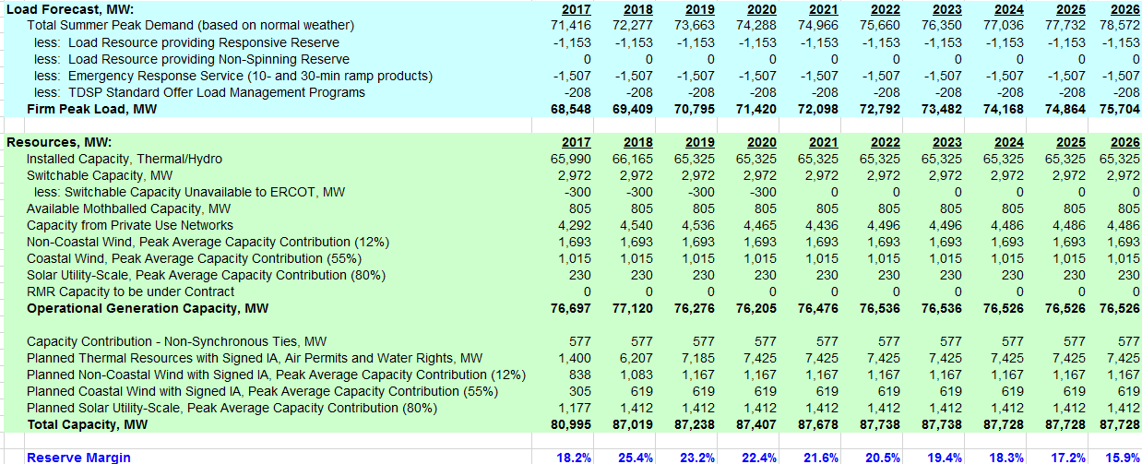
2016, Actual

Slide 3
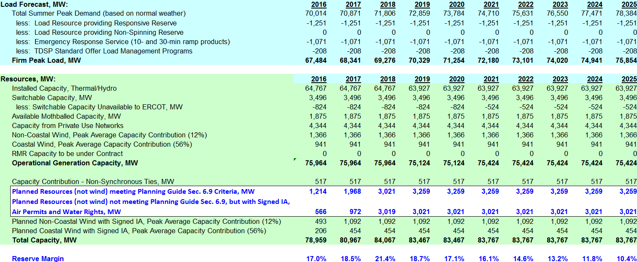
NPRR 759
Additional data added for Planned Resources based on PG 6.9
Reserve Margin line stays the same

Slide 4
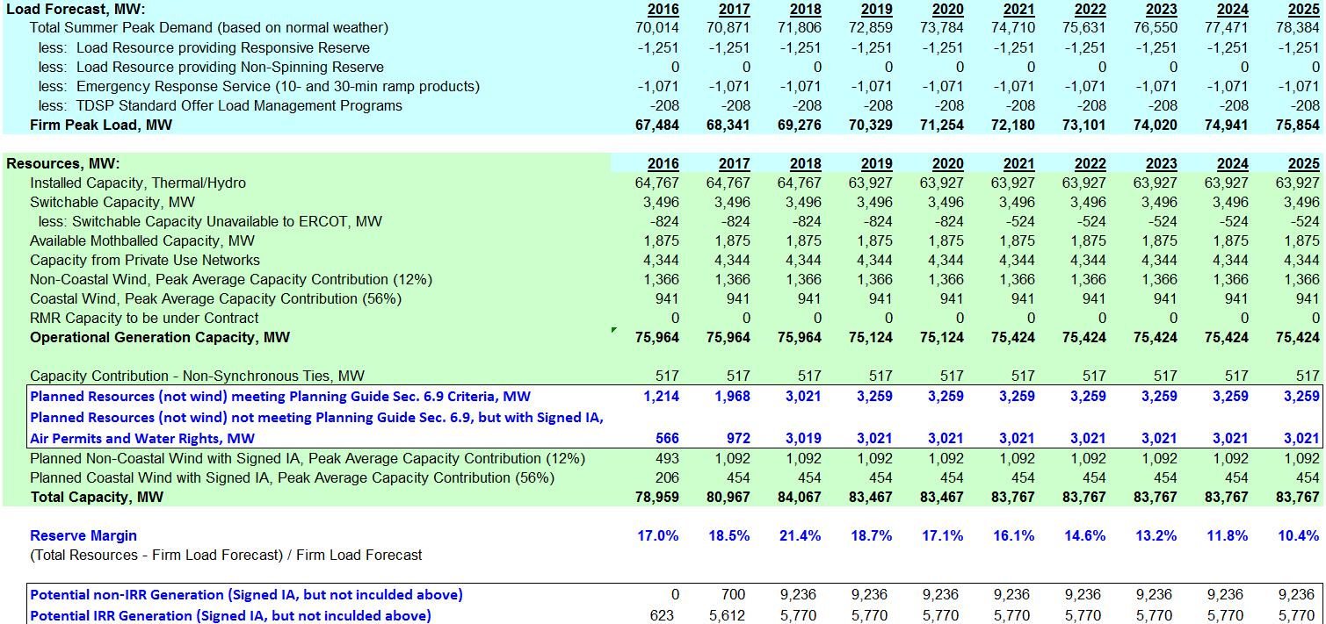
NPRR 759 – Industrial
Additional data added for Planned Resources
Reserve Margin line stays the same

Slide 5
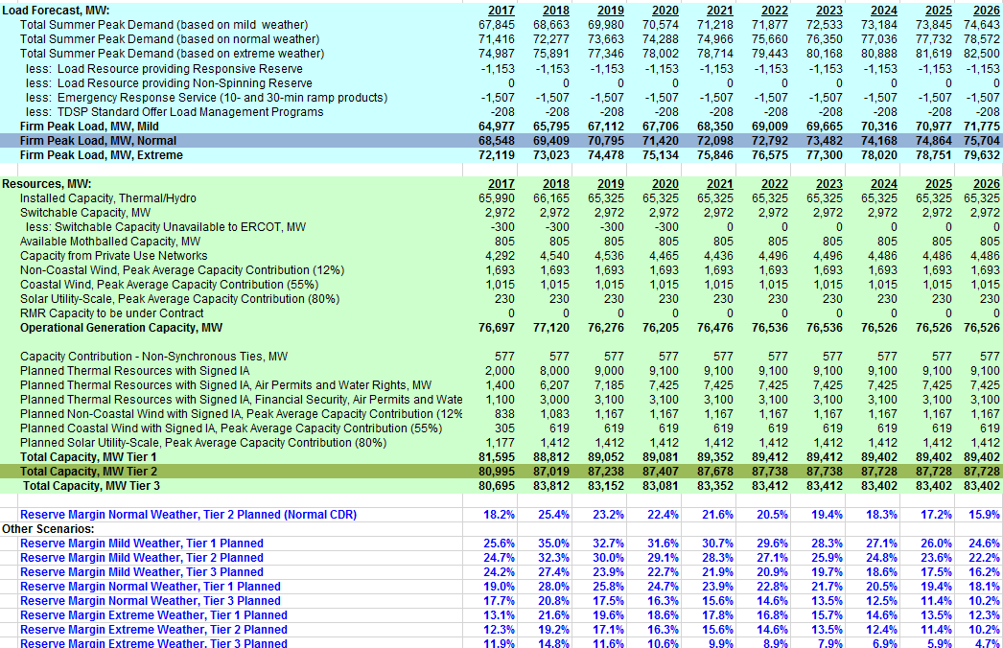
NPRR 759 3x3
3 Forecasts
3 Tiers of Planned Resources
Calculates 9 Margins

Slide 6
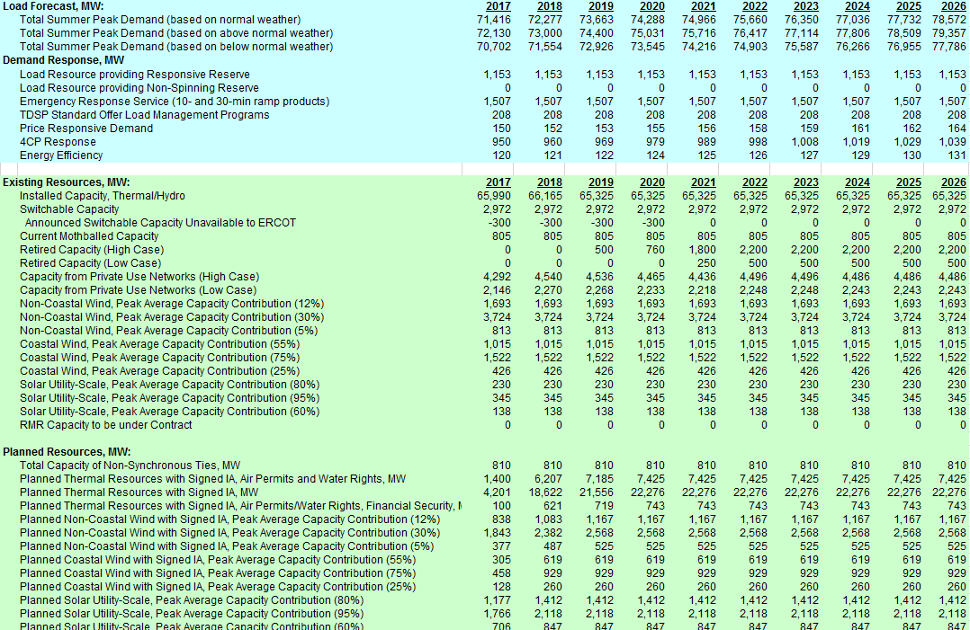
DIY
3 Forecasts
Retirements
Pun Options
3 Wind
3 Solar
3 Tiers Thermal Planned
9 IRR Planned
NO Margins Calculated

Slide 7
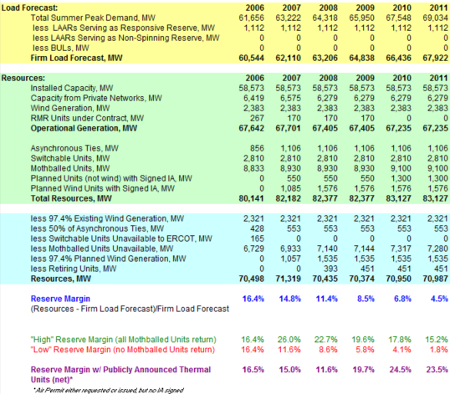
2006, Actual
Planned Resources
3 Mothball Options
4 Margins Calculated

Slide 8
SAWG Recommendation?
The question is not, “Should we have Scenarios?”
The question is, IF we had Scenarios how would we do it?
Let the voters decide.
Consensus view on what to do with 759?

