Slide 1
2016 LTSA Update
Doug Murray
6/21/2016

Slide 2
Agenda
Introduction
Scenario Retirement Process
Scenario Summary Results
Appendix

Slide 3
Introduction
The Long-Term System Assessment (LTSA) uses a scenario-based modeling approach to identify long-term transmission system needs
Eight scenarios were developed by Regional Planning Group stakeholders based on a review of trends and forecasts of a variety of drivers influencing the future of the ERCOT grid
  Scenario descriptions are provided in previous LTSA presentations (link: http://www.ercot.com/content/wcm/key_documents_lists/75283/2016_LTSA_Scenario_Assumptions.pptx)
  All scenarios, including the Current Trends scenario, assume full implementation of the Regional Haze rule (which is currently finalized but subject to ongoing litigation).
Project Status:
  ERCOT has completed the generation expansion analysis for all scenarios, identifying generation additions and retirements for each
  Based on these results, ERCOT will select 2 or 3 of the scenarios for detailed transmission analysis to identify long-term transmission projects to address system economic and reliability needs
  Final report will be completed in December 2016

Slide 4
Scenario Retirement Process
Resource expansion analyses indicate that most of the coal units affected by the Regional Haze rule, if implemented as designed, are likely to retire across the scenarios studied. These retiring units include:
  Coal units required to retrofit with new scrubbers under the Regional Haze rule (retire by Feb. 2021)
    Big Brown 1 and 2, Monticello 1 and 2, Coleto Creek (3,018 MW)
  Coal units required to upgrade existing scrubbers under the Regional Haze rule and located in a county proposed for nonattainment with the 2010 SO₂ standard (retire by Feb. 2019)
    Monticello 3, Martin Lake 1, 2, and 3 (3,260 MW)
  Modeling analysis indicates retirement of these units consistent with the 2019 – 2021 Regional Haze regulatory deadlines although earlier retirements would be possible depending on unit-specific capital investment requirements.
Additional unit retirements have been assessed by scenario using unit-specific economic analysis

Slide 5
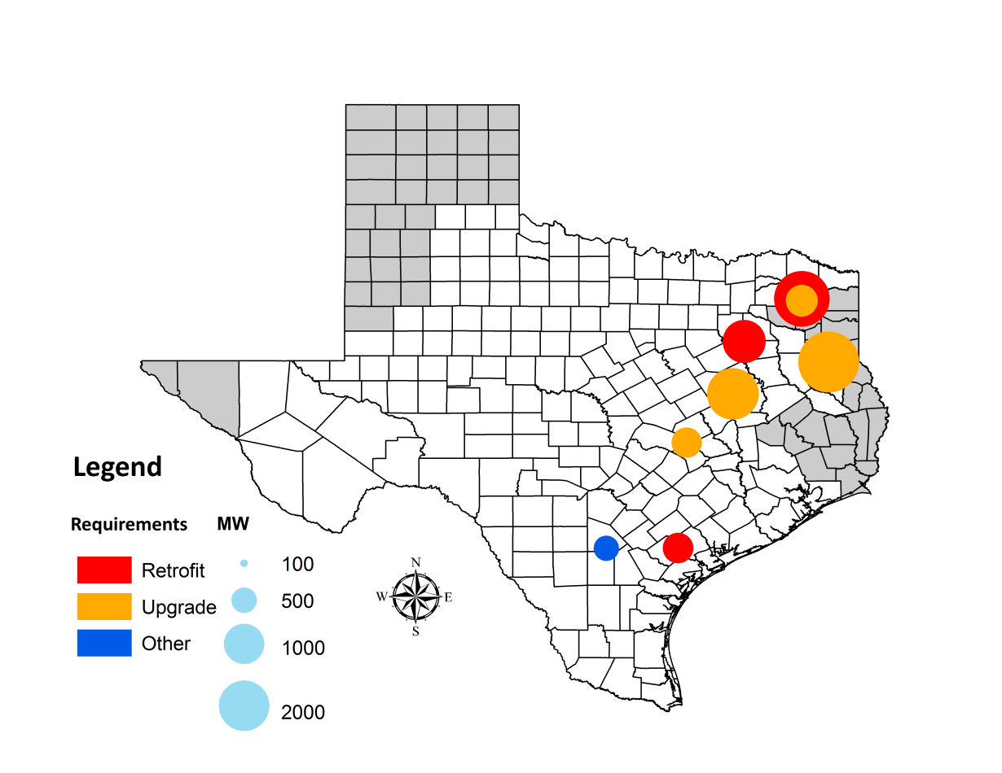
Regional Haze Affected Units in ERCOT
Monticello 3
Monticello 1, 2
Big Brown 1, 2
Martin Lake 1, 2, 3
Sandow 4
Limestone 1, 2
San Miguel
Coleto Creek
5

Slide 6
Scenario Summary Results
Main drivers of scenario results are natural gas price and solar capital costs
Large amounts of solar built in all scenarios
Unserved energy occurs in all scenarios and occurs mainly in the early evening hours following solar down ramp (slide 11)
Storage units in the High Storage/Electric Vehicle Adoption scenario operate mainly during times of high solar ramping
  Sensitivity with higher amounts of storage should be analyzed
Impact of large amounts of electric vehicles appears minimal if charging is controlled

Slide 7
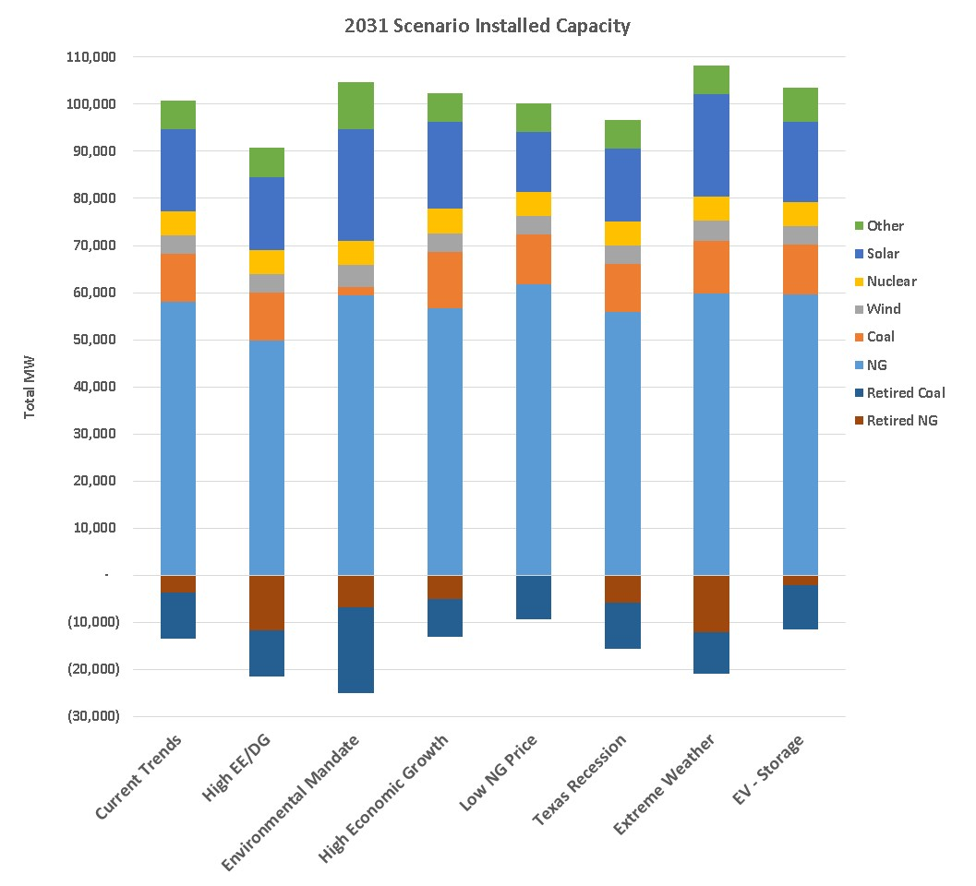
2031 Capacity by Scenario
Chart includes added and retired capacity
Wind and solar capacity shown based on CDR capacity contributions

Slide 8
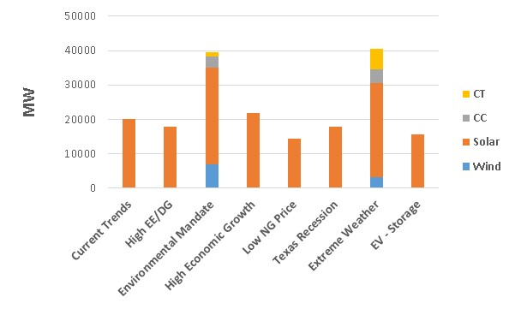
Scenario Additions by 2031
Capacity additions vary by scenario from a low of 14,500 MW in the Low NG Price scenario to a high of 40,532 MW in the Extreme Weather Scenario
Most capacity additions are solar and vary from a low of 14,500 MW to a high of 28,100 MW

Slide 9
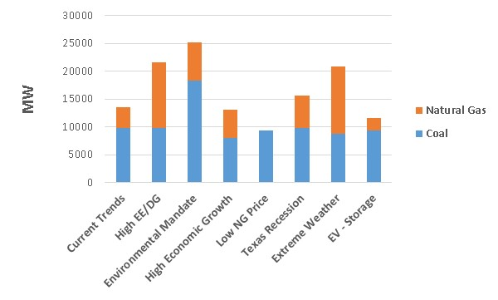
Scenario Retirements by 2031
Retirements vary by scenario from a low of 9,417 MW in the Low NG Price scenario to a high of 25,112 MW in the Environmental Mandate Scenario
Most of the natural gas units retired are old steam units; most of the coal unit retirements are due to the Regional Haze rule and the added carbon price in the Environmental Mandate scenario

Slide 10
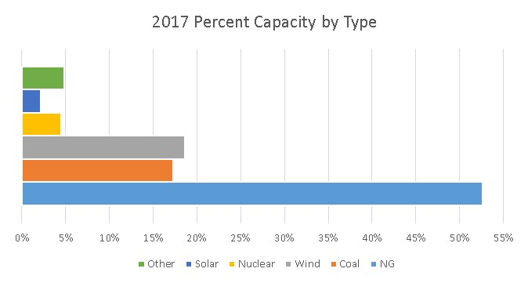
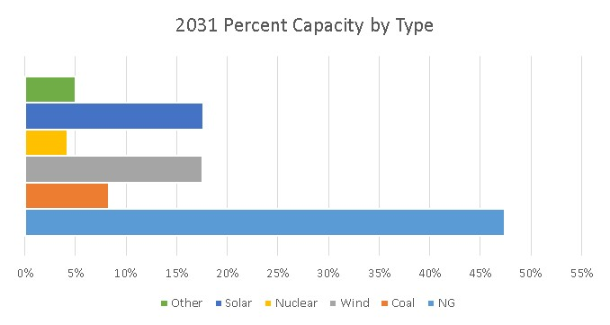
Current Trends Capacity by Type 2017 vs 2031
All scenarios show roughly the same transition from 2017 to 2031
A substantial reduction in coal capacity and a large increase in solar

Slide 11
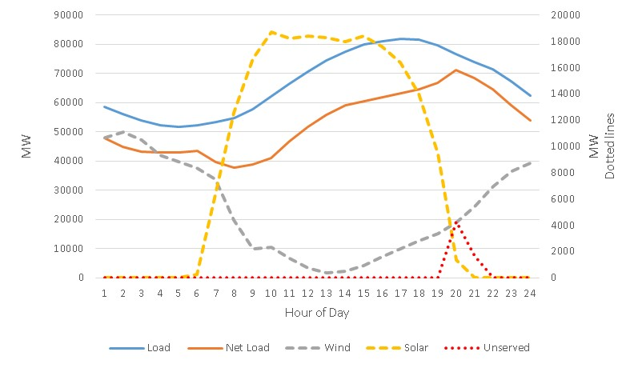
2031 Evening Solar Issue
All scenarios show roughly the same shortage of capacity in the evening hours because of the large amounts of installed solar

Slide 12
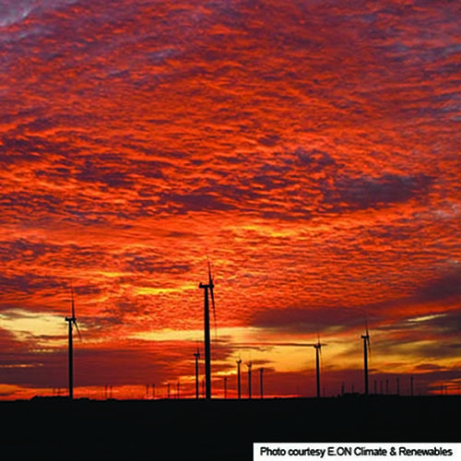
Questions
Contact info:
Doug Murray Julie Jin
douglas.murray@ercot.com julie.jin@ercot.com
512.248.6908 512.248.3982
Sandeep Borkar
sandeep.borkar@ercot.com
512.248.6642

Slide 13
Appendix

Slide 14
Current Trends Results
Unserved energy in 2026 and 2031
Reserve margin in final year – 10.4%
Built 20,200 MW solar
Retirements total 13,505 MW in 2031
9,808 MW of coal retirements

Slide 15
High Economic Growth Results
Small amount of unserved energy in 2026 with larger amount in 2031
Reserve margin in final year – 13.8%
Built 21,700 MW solar, 221 MW Wind
Retirements total 13,071 MW
7,959 MW of coal retirements

Slide 16
Environmental Mandate Results
Unserved energy in 2022, 2026 and 2031
Reserve margin in final year – 12.9%
Built 28,100 MW solar
Retirements total 25,112 MW
18,288 MW of coal retirements

Slide 17
Texas Recession Results
Small amount of unserved energy in 2031
Reserve margin in final year – 10.4%
Built 17,800 MW solar
Retirements total 15,675 MW
9,808 MW of coal retirements

Slide 18
Low Natural Gas Results
Small amount of unserved energy in 2026 and 2031
Reserve margin in final year – 8.7%
Built 14,500 MW solar
Retirements total 9,417 MW
9,417 MW of coal retirements

Slide 19
High EE and DG Results
Small amount of unserved energy in 2026 and 2031
Reserve margin in final year – 11.6%
Built 17,900 MW solar
Retirements total 21,654 MW
9,808 MW of coal retirements

Slide 20
Extreme Weather Scenario
Included a drought similar to the 1950’s between the years 2022 and 2027
New combined cycle capital costs increased to account for dry cooling
Assumed generator de-rates/outages due to water supply impacts
  De-rates/outages ranged from a total impact of 200 MW in 2022 to 13,000 MW by 2027
  De-rates/outages due to water supply availability, temperature limits in water permits, and impacts to the operation of hydro units

Slide 21
Extreme Weather Results
Small amount of unserved energy in 2022, 2026 and 2031
Reserve margin in final year – 16.8%
Built 27,200 MW solar, 3,344 MW of wind and roughly 10,000 MW of NG
Retirements total 20,873 MW
8,826 MW of coal retirements

Slide 22
High EV and Storage Adoption Scenario
Assumes penetration of 1.6 million electric vehicles by 2031
Added 500 MW of CAES units and 500 MW of batteries
Load forecast was adjusted to account for 1,000 MW of residential/commercial batteries

Slide 23
High EV and Storage Results
Small amount of unserved energy in 2026 and 2031
Reserve margin in final year – 9.4%
Built 15,600 MW solar,
Retirements total 10,721MW
9,417 MW of coal retirements

