Slide 1
Credit Exposure Back casting for NPRR760
Suresh Pabbisetty, FRM, ERP, CQF, CSQA.
Lead Technical Analyst, Credit
June 22, 2016

Slide 2
Agenda
Suggested Methodology
Assumptions & Limitations
Back casting of TPE calculations
Impacts to TPE market wide
Impacts to TPE market wide and by CP category

Slide 3
Credit Exposure Back casting for NPRR760
Suggested Methodology

Slide 4
Credit Exposure Back casting for NPRR760
Suggested Methodology:
Operating Days with no activity, substitute 0 for average calculations
Changes applied to RTLE, URTA and DALE related averages

Slide 5
Credit Exposure Back casting for NPRR760
Assumptions & Limitations

Slide 6
Credit Exposure Back casting for NPRR760
Assumptions & Limitations:
M1:
CP specific M1 values were implemented effective from September 1st, 2014. The average CP specific M1 based on prior analysis was 14.
The M1 value was 20 prior to September 1st, 2014 for all CPs, it takes approximately 52 days for the new CP specific M1 to be fully effective.
M1 is used as multiplier for RTLE and DALE.
As NPRR760 changes related to RTLE, URTA and DALE, this back casting analysis duration is limited to November 1st, 2014 through April 30th, 2016 due to significant change in M1 values as result of CP specific M1 implementation.
Most recent M1 values as reset by September 1st, 2015, are used for this analysis.
CPs and their QSE relationship snapshot taken as of 31st May, 2016.

Slide 7
Credit Exposure Back casting for NPRR760
Data Inputs & Transformations

Slide 8
Credit Exposure Back casting for NPRR760
Data Inputs & Transformations:
QSE level RTM and DAM statements were aggregated to the CP level by Operating Day.
RTLE, URTA and DALE are recalculated as;
Per protocols – CP specific M1 and averages without 0 substitution for missing activity
Per NPRR760 – CP specific M1 and averages with 0 substitution for missing activity
Counter-Parties’ participation and their representation of QSEs and or CRR Account Holders could change from time to time
A snapshot Counter-Parties’ information is taken as of May 31st , 2016 and used for the overall analysis
other exposure components used were as calculated/adjusted with respect to corresponding historical business date
Applicable SAF was used in both NPRR760 and current protocols scenarios.

Slide 9
Credit Exposure Back casting for NPRR760
Results
Market-wide Exposure Summary

Slide 10
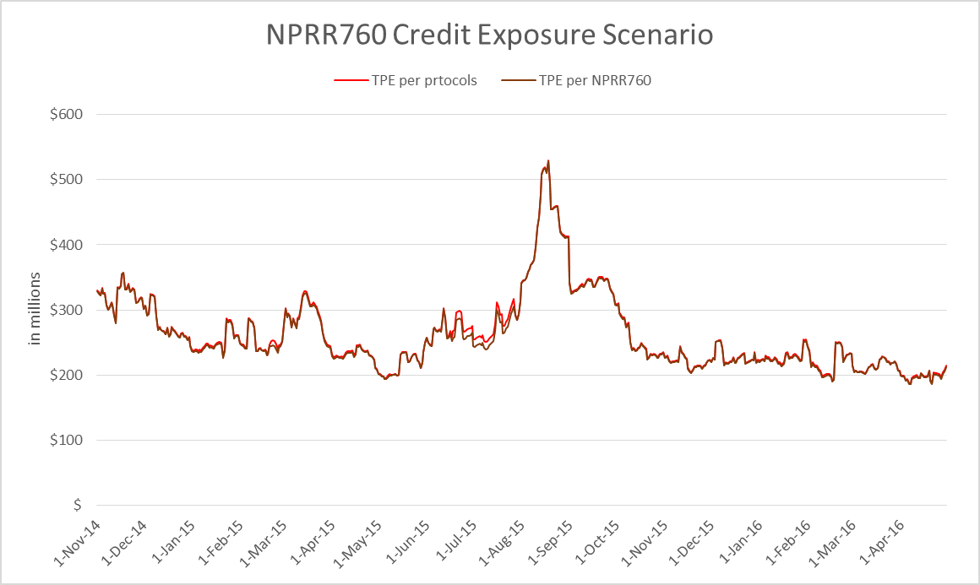
Credit Exposure Back casting for NPRR760
Results – Exposure Summary:

Slide 11
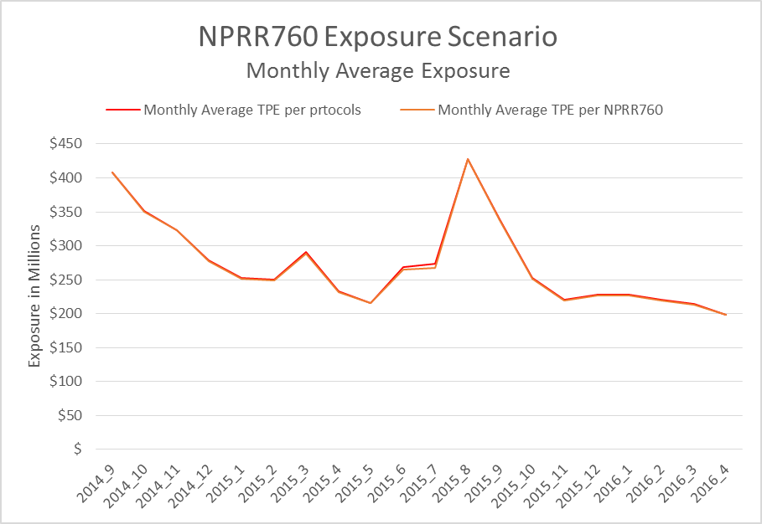
Credit Exposure Back casting for NPRR760
Credit Exposure Back casting for NPRR760 :

Slide 12
Credit Exposure Back casting for NPRR760
Results – Market-wide Exposure options descriptive statistics:
Average exposure reduction under NPRR760 is about $2 million lower
There is extremely high correlation between exposure under NPRR760 to exposure under current protocols
Under NPRR760, maximum reduction in exposure is about $11 million and maximum increase in exposure is about $0.6 million

Slide 13
Credit Exposure Back casting for NPRR760
Results – Market-wide Exposure options descriptive statistics by CP Category:
There is no significant change of exposure observed for Load-Only, Generation-Only and Load & Generation categories.
For Traders-Only category under NPRR760, there is an average reduction in exposure of about $2 million.

Slide 14
Credit Exposure Back casting for NPRR760
Results
Generation-Only Exposure Summary

Slide 15
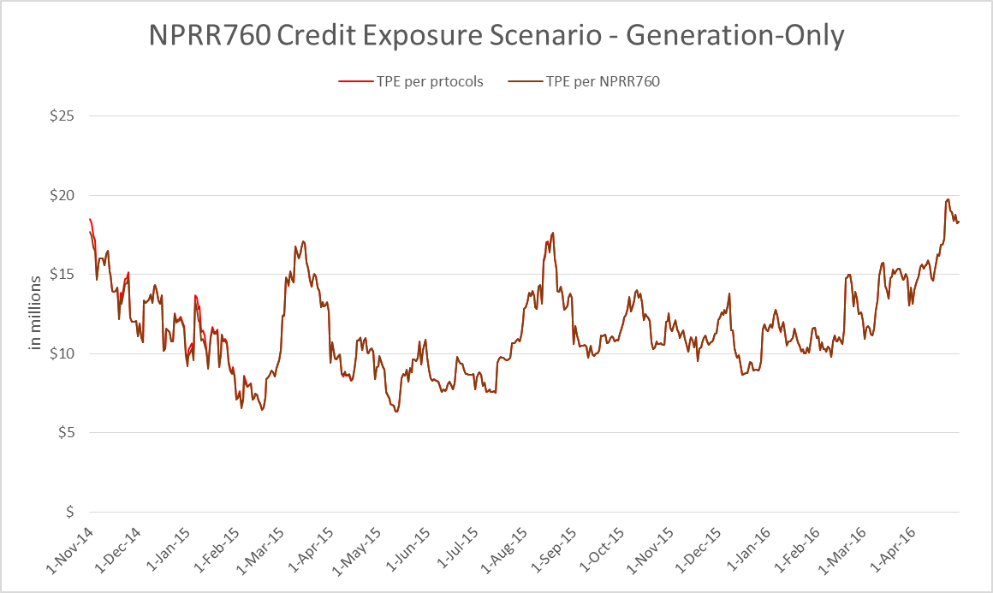
Credit Exposure Back casting for NPRR760
Results: Generation-Only Exposure Summary

Slide 16
Credit Exposure Back casting for NPRR760
Results: Generation-Only Exposure options descriptive statistics:
Average exposure under NPRR760 is almost same as exposure under current protocols

Slide 17
Credit Exposure Back casting for NPRR760
Results
Load-Only Exposure Summary

Slide 18
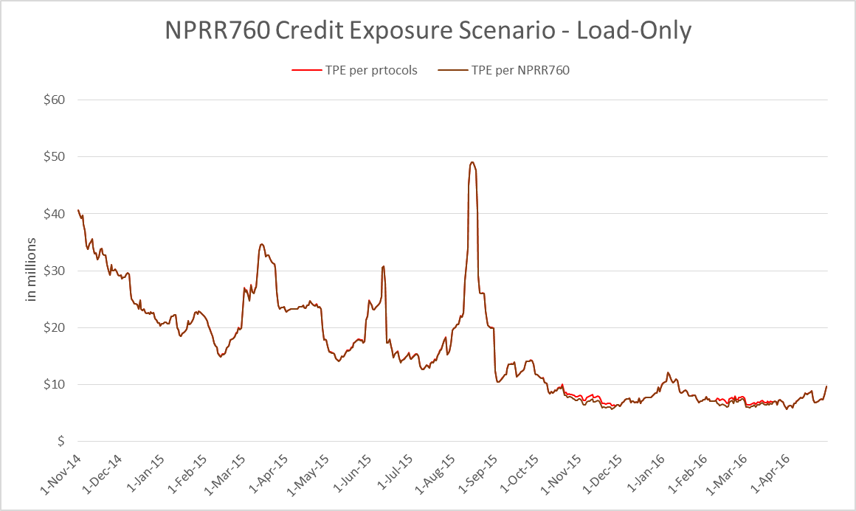
Credit Exposure Back casting for NPRR760
Results: Load-Only Exposure Summary

Slide 19
Credit Exposure Back casting for NPRR760
Results: Load-Only Exposure options descriptive statistics:
Average exposure under NPRR760 is almost same as exposure under current protocols

Slide 20
Credit Exposure Back casting for NPRR760
Results
Load & Generation Exposure Summary

Slide 21
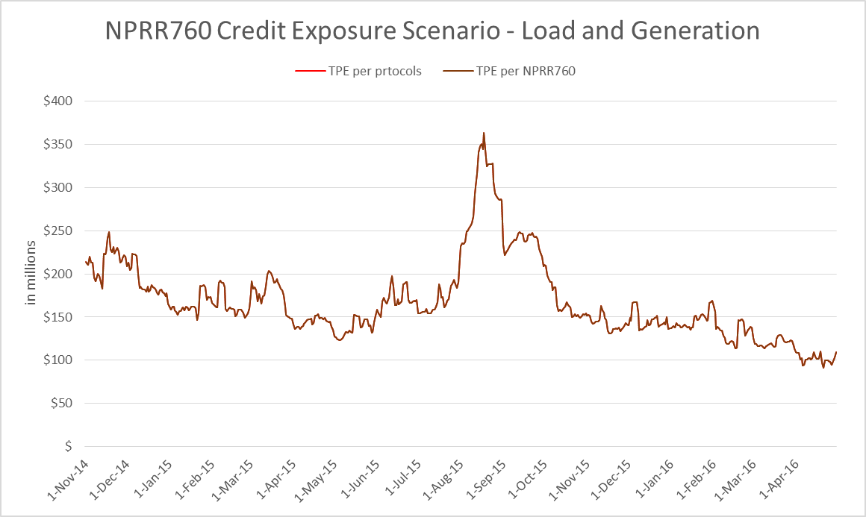
Credit Exposure Back casting for NPRR760
Results: Load & Generation Exposure Summary

Slide 22
Credit Exposure Back casting for NPRR760
Results: Load & Generation Exposure options descriptive statistics:
Average exposure under NPRR760 is almost same as exposure under current protocols

Slide 23
Credit Exposure Back casting for NPRR760
Results
Trader-Only Exposure Summary

Slide 24
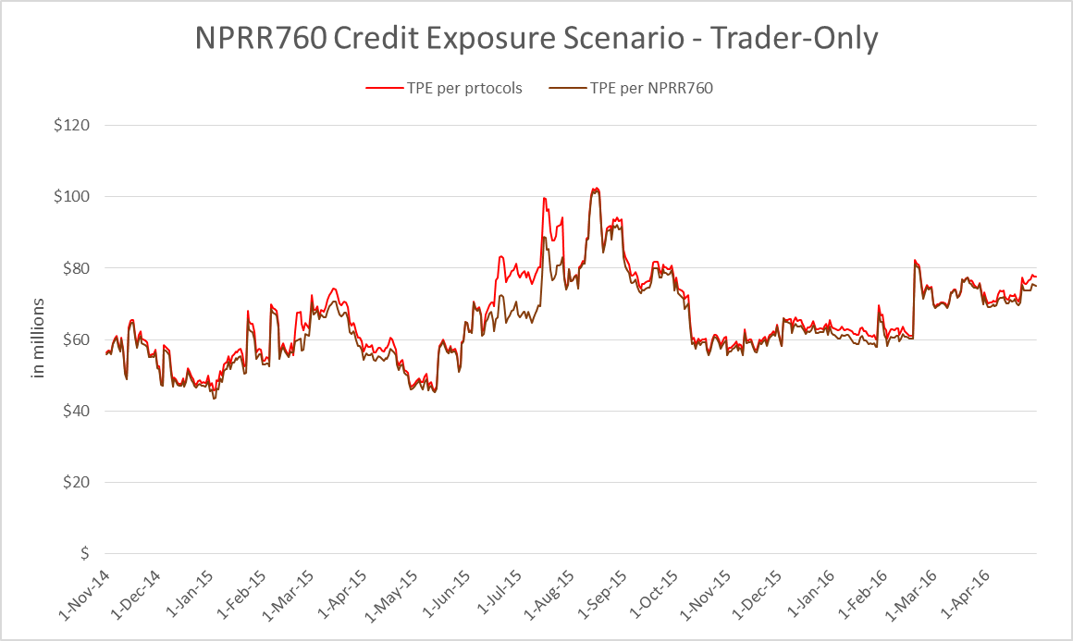
Credit Exposure Back casting for NPRR760
Results: Trader-Only Exposure Summary

Slide 25
Credit Exposure Back casting for NPRR760
Results: Trader-Only Exposure options descriptive statistics:
Average exposure under NPRR760 is about $2 million lower than exposure under current protocols

Slide 26
Credit Exposure Back casting for NPRR760
Questions

