Slide 1
PDCWG Report to ROS
Chair: Percy Galliguez, Brazos Electric Power Cooperative, Inc.
Vice Chair: Stewart Rake, Luminant
ROS
June 9th, 2016

Slide 2
Report Overview & Notes
Report Overview
  Meeting Minutes
  BAL-001-TRE-1 FMEs & IMFR
    4 FMEs in the month of May
    BAL-001-TRE-1 Unit Performance Report now includes Solar resources.
  Frequency Control Report

Slide 3
Meeting Minutes
PDCWG Meeting 5/11/16
  Regulation & Frequency Control Reports
  GREDP Performance Analysis
  MOD-026-1 & MOD-027-1 Discussion
  FRRS Discussion
  Reviewed 5 FME and 1 non-FME ERCOT Frequency Disturbances
    04/17/2016 23:30:44
      Loss of 663 MW
      872 MW/0.1HZ Response
    04/23/2016 1:54:22
      Loss of 402 MW
      687 MW/0.1HZ Response
    04/30/2016 1:16:20
      Loss of 432 MW
      584 MW/0.1HZ Response
    05/01/2016 12:32:30
      Loss of 562 MW
      906 MW/0.1HZ Response
    05/01/2016 20:20
      Loss of 1,311 MW
      893 MW/0.1HZ Response
    5/5/2016 12:31:01
      Loss of 627 MW
      674 MW/0.1HZ Response

Slide 4
Frequency Measurable Events Performance
May 2016

Slide 5
Frequency Measurable Events
There were 4 FMEs in May.
  5/1/2016 12:32:30
    Loss of 562 MW
    Interconnection Frequency Response: 906 MW/0.1 Hz
    5 of 48 Generation Resources had less than 75% of their expected Initial Primary Frequency Response.
    4 of 48 Generation Resources had less than 75% of their expected Sustained Primary Frequency Response.
  5/5/2016 12:31:01
    Loss of 627 MW
    Interconnection Frequency Response: 674 MW/0.1 Hz
    2 of 31 Generation Resources had less than 75% of their expected Initial Primary Frequency Response.
    4 of 31 Generation Resources had less than 75% of their expected Sustained Primary Frequency Response.

Slide 6
Frequency Measurable Events
  5/12/2016 14:31:29
    Loss of 588 MW
    Interconnection Frequency Response: 763 MW/0.1 Hz
    11 of 33 Generation Resources had less than 75% of their expected Initial Primary Frequency Response.
    9 of 33 Generation Resources had less than 75% of their expected Sustained Primary Frequency Response.
  5/21/2016 8:18:49
    Loss of 559 MW
    Interconnection Frequency Response: 1,019 MW/0.1 Hz
    11 of 57 Generation Resources had less than 75% of their expected Initial Primary Frequency Response.
    8 of 57 Generation Resources had less than 75% of their expected Sustained Primary Frequency Response.

Slide 7
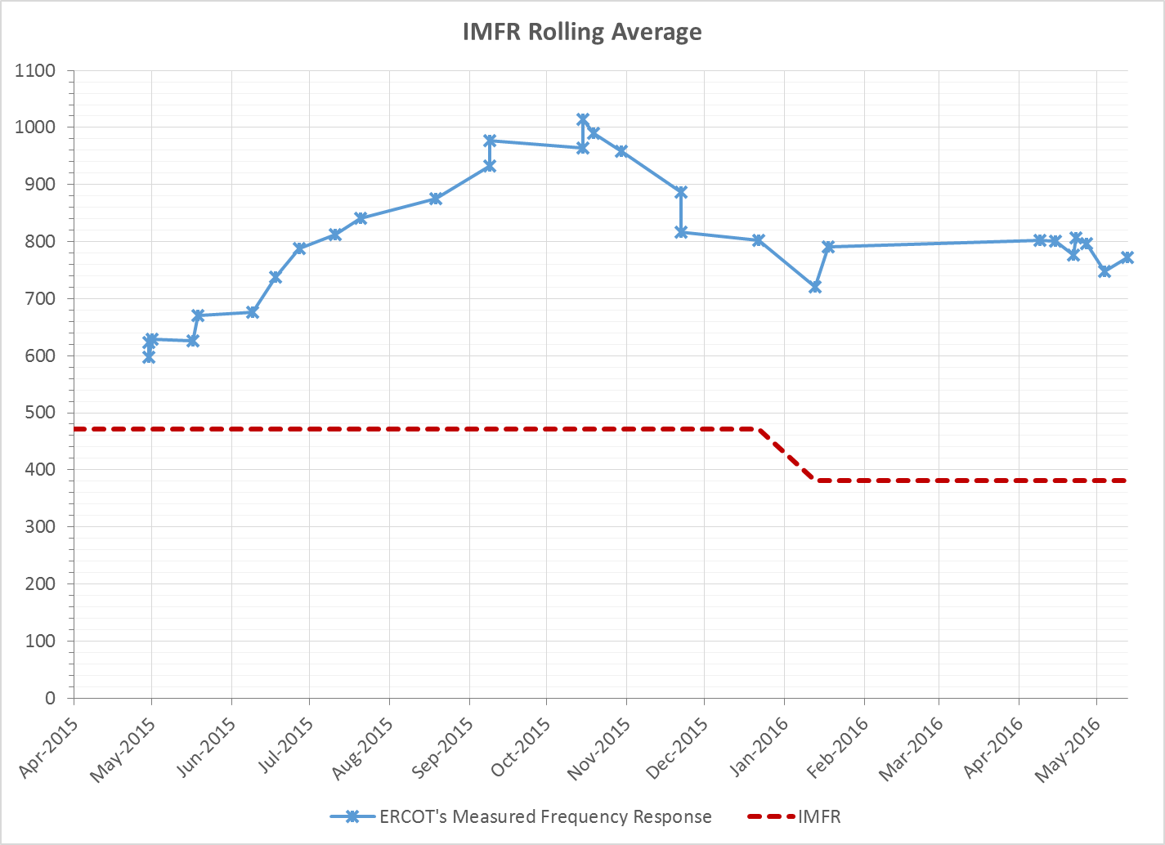
Interconnection Minimum Frequency Response (IMFR) Performance
IMFR Performance currently 772.32 MW/0.1Hz

Slide 8
Frequency Control Report
January 2016

Slide 9
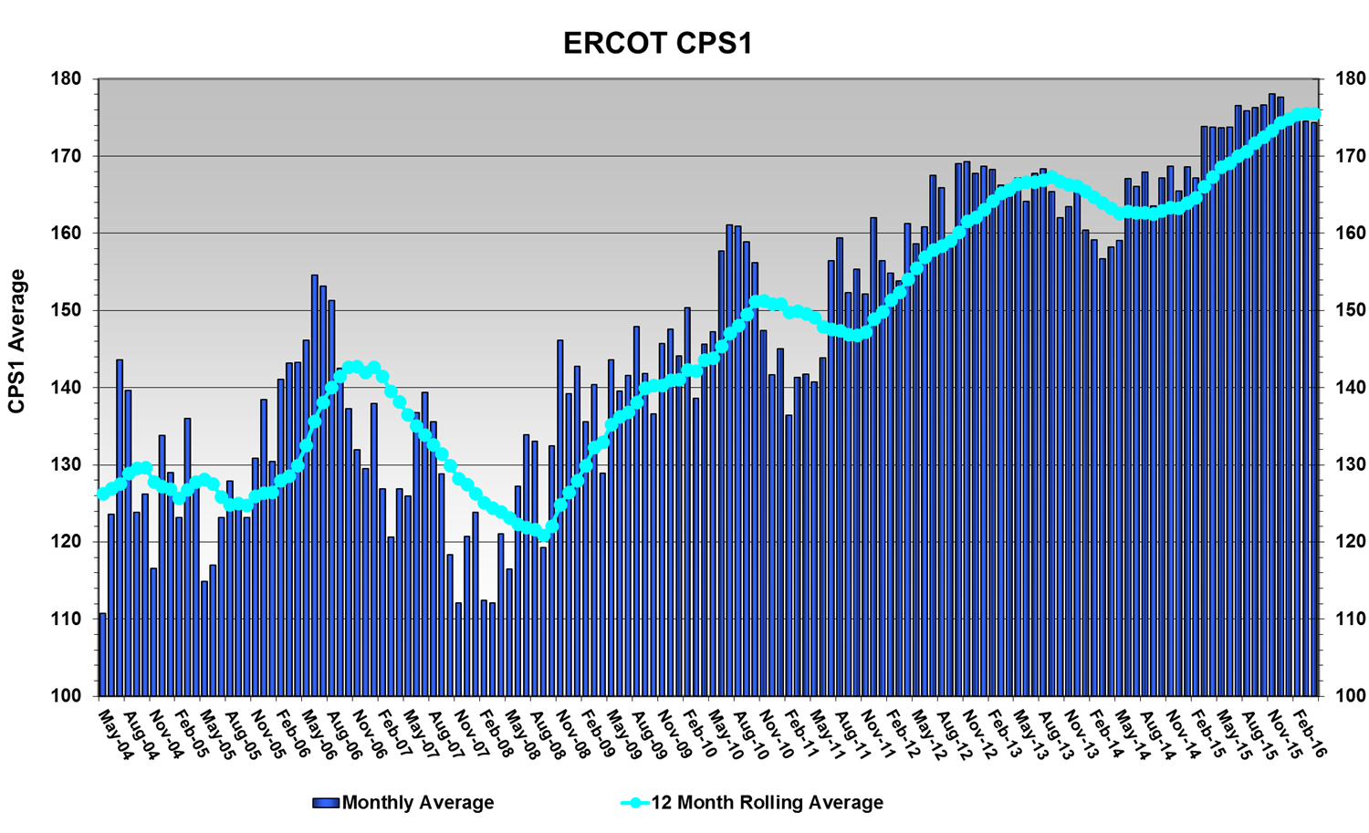
CPS1 Performance
CPS1 12 Month Rolling Average = 175.72%

Slide 10
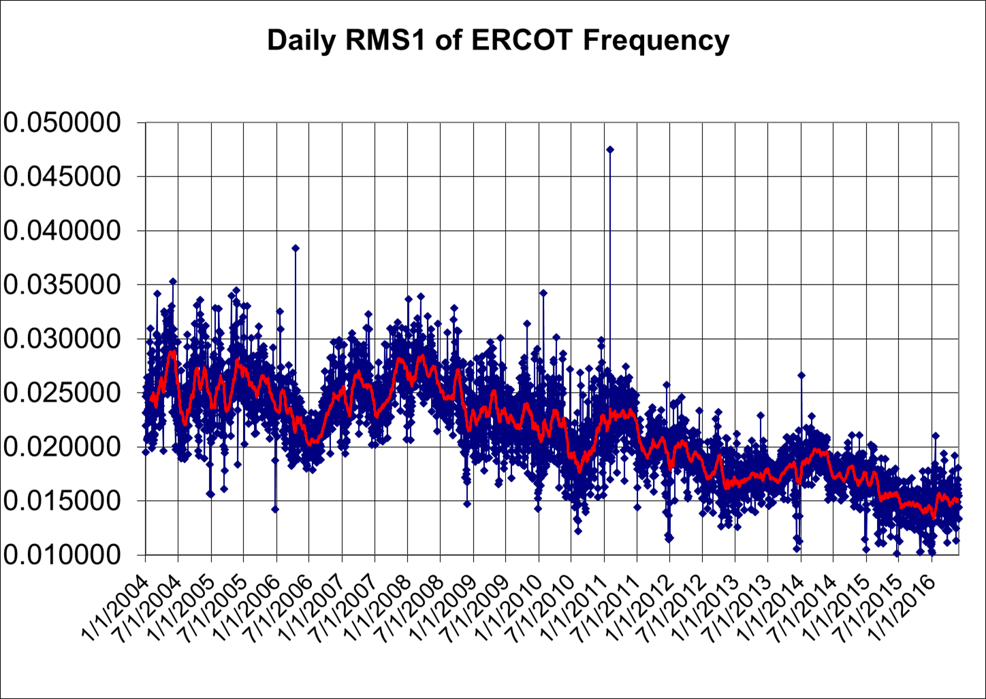
RMS1 Performance of ERCOT Frequency

Slide 11
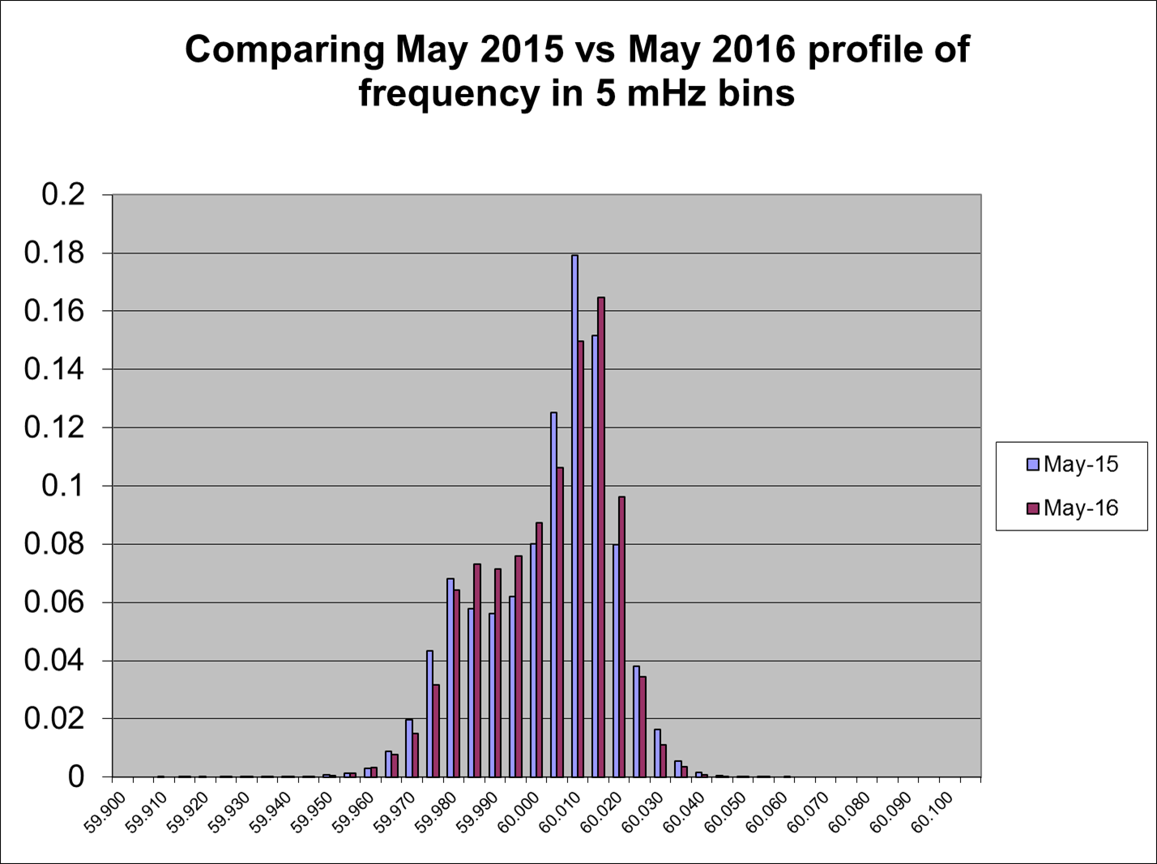
Frequency Profile Analysis

Slide 12
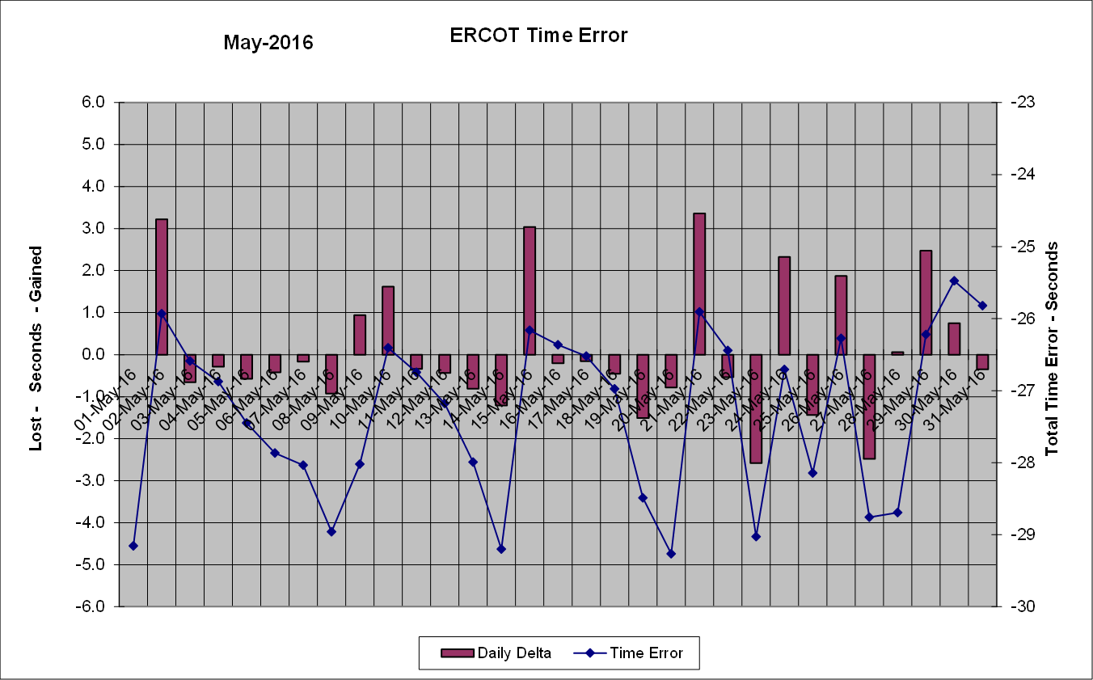
Time Error Corrections
There was 8 Time Error Corrections (TEC) in May.

Slide 13
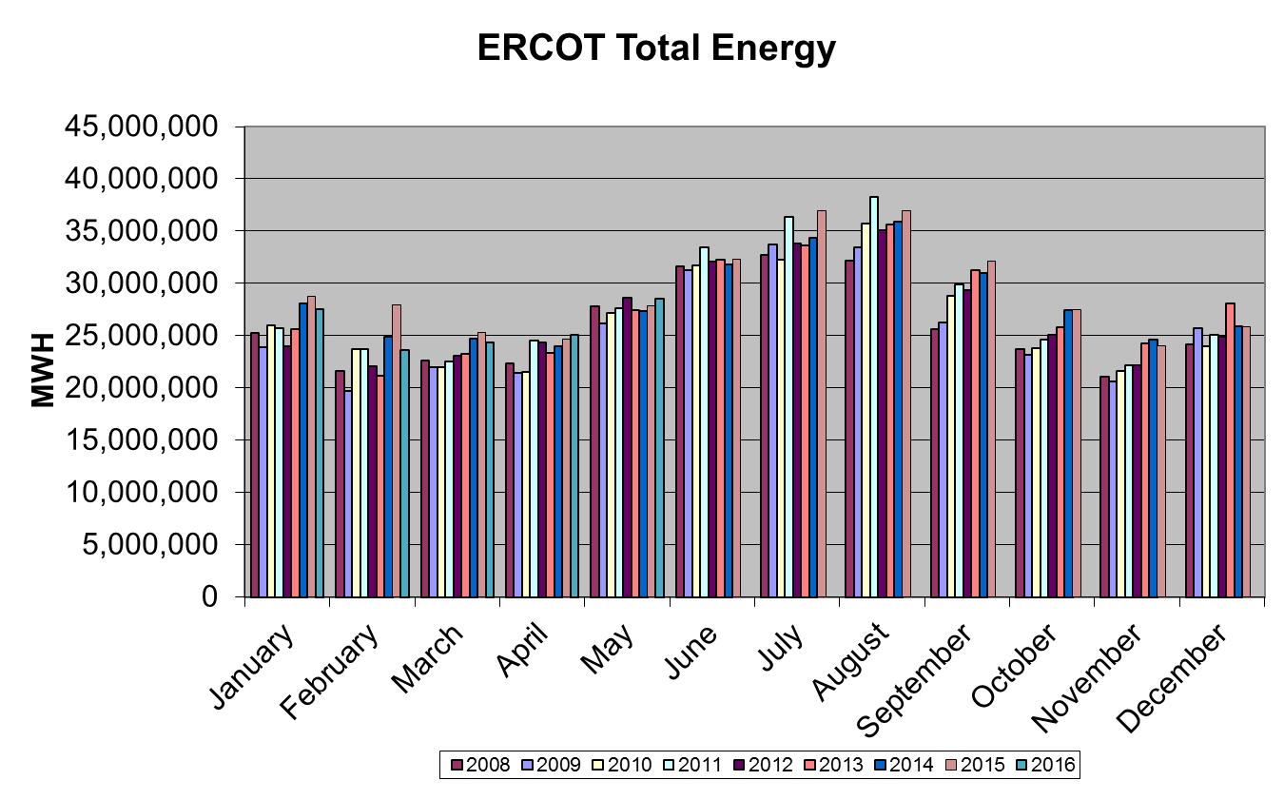
Wind Generation Performance

Slide 14
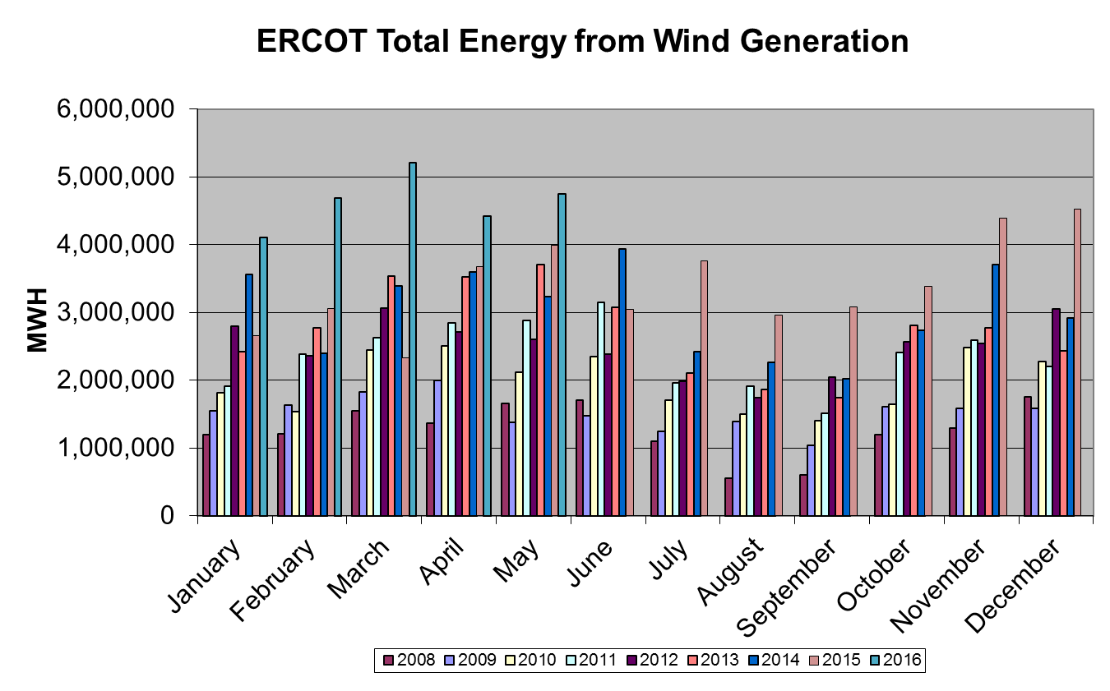
Wind Generation Performance

Slide 15
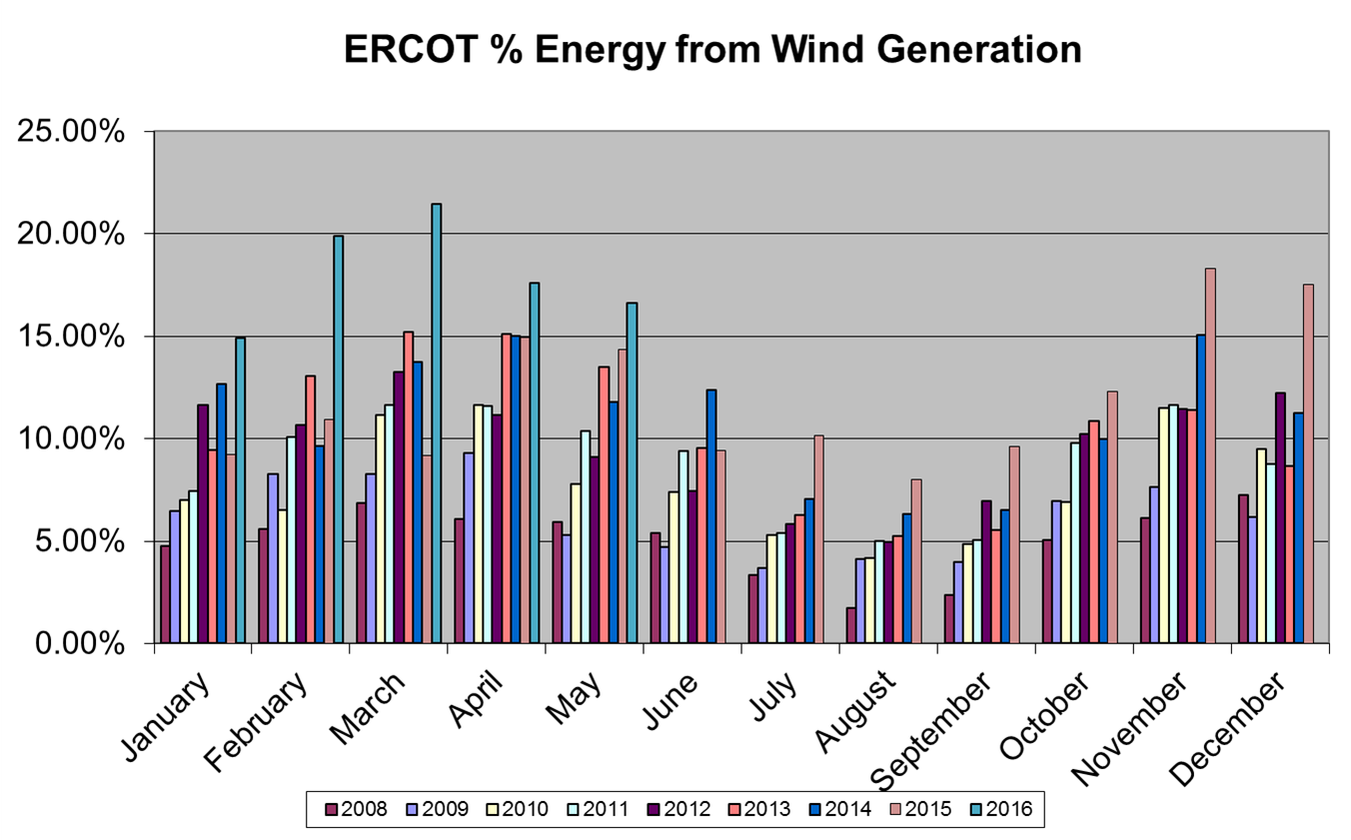
Wind Generation Performance

Slide 16
Questions?

