Slide 1
Market Credit Working Group update to the Wholesale Market Subcommittee
6/08/2016

Slide 2
MCWG update to WMS
Joint meeting of MCWG and CWG on Wednesday, May 18th
4 NPRRs reviewed for credit impacts
  4 NPRRs had no credit impact
Referrals
  NPRR760 Calculation of Exposure for Days with No Activity
    ERCOT will bring back analysis on exposure impact
  NPRR773 Broadening Scope of Acceptable Letter of Credit Issuers
    Expand beyond a “bank” to allow Co-op financial institutions

Slide 3
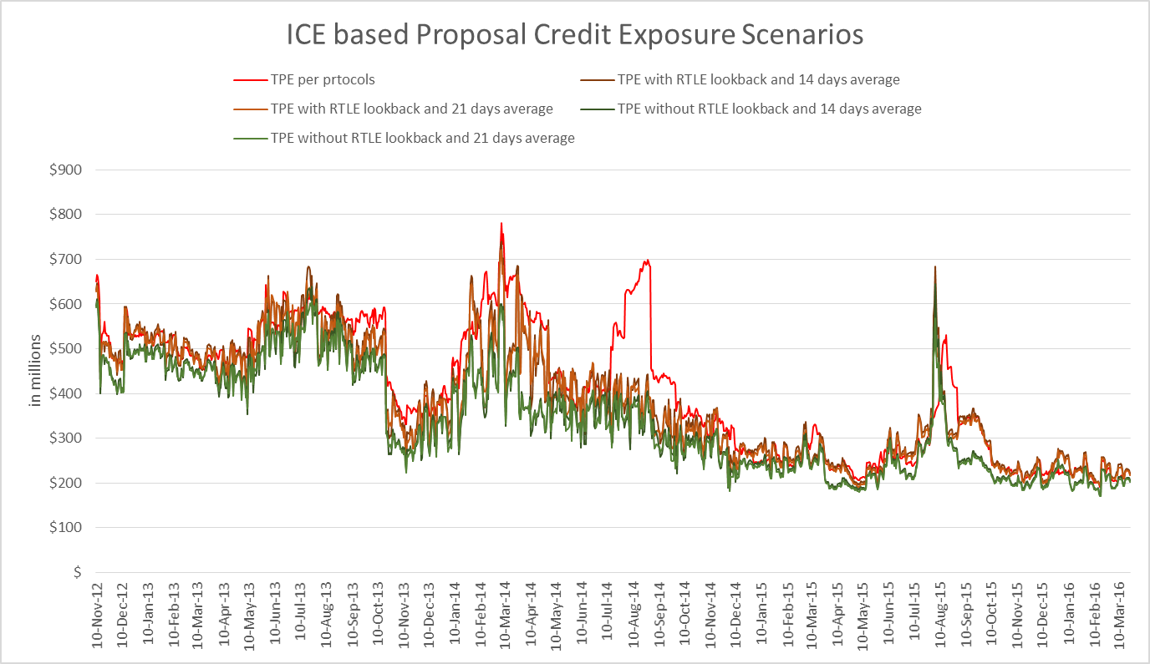
MCWG update to WMS

Slide 4
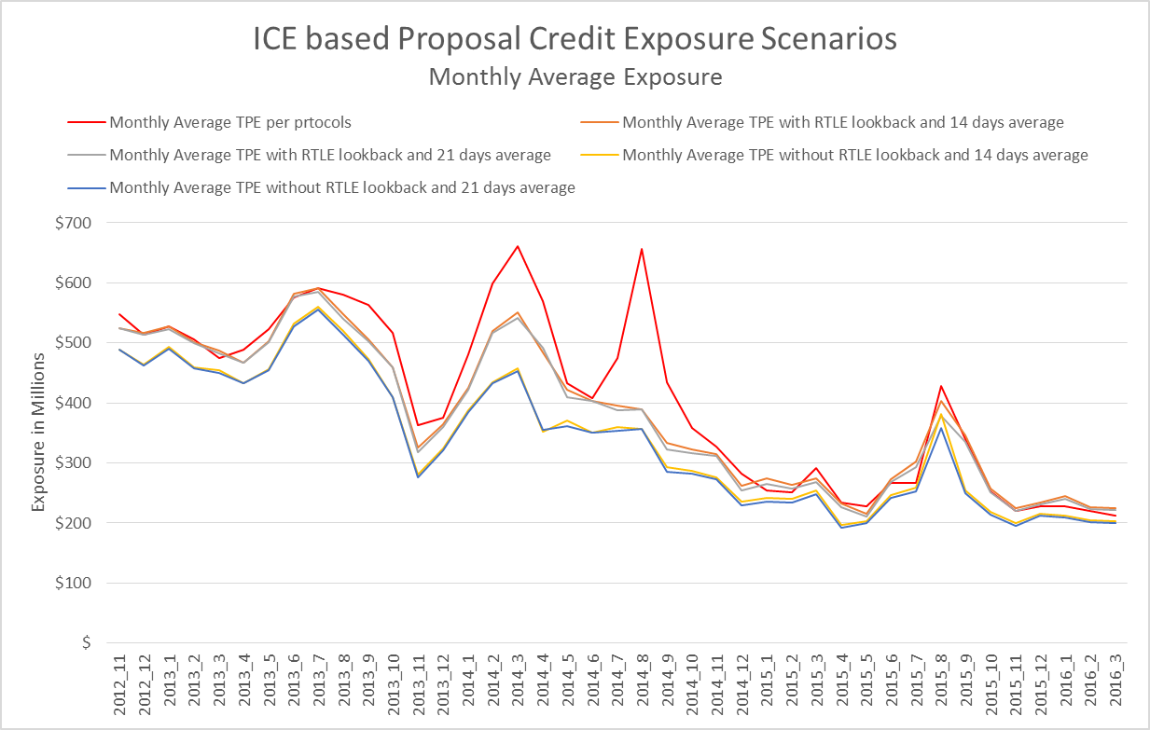
MCWG update to WMS

Slide 5
MCWG update to WMS
Homework for Stakeholders: Review draft NPRR posted on 5/18/16 CWG/MCWG meeting page and provide feedback/comments
  Excellent summary prepared by ERCOT
Design features to pay attention to: Weighting Factors to apply to ICE forward prices, duration of averages, 40-day lookback, MAF language

