Slide 1
NERC: Essential Reliability Services
Julia Matevosyan
Lead Electrical Engineer
Resource Adequacy
ERCOT

Slide 2
Goals of Essential Reliability Services Task Force
Inform, educate, and build awareness on the implications of the changing resource mix
Consider technical aspects of ERS when making decisions related to interconnecting new resources or market and tariff oversight
Have direct influence on policy decisions with regards to changes in the resource mix

Slide 3
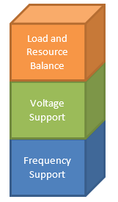
ERS Fundamentals
“Building blocks” of physical capabilities
Accentuated by resource changes
Not all MWs are equal
Some partly covered through ancillary services
Accommodate local/regional needs
Resource Adequacy
Reliability
Essential Reliability Services
Source: NERC

Slide 4
ERSTF Recommended Measures
Measure 1 – Synchronous Inertial Trend (Interconnection)
Measure 2 – Initial Frequency Deviation following largest contingency
Measure 3 – Synchronous Inertial Trend (Balancing Area)
Measure 4 – Frequency Response
Measure 6 – Net Load Ramping Variability
Measure 7 – System Reactive Capability

Slide 5
Frequency Support Measures
  Frequency support is essential to system reliability
  Frequency support capability of the generation fleet is changing due to increasing use of non-synchronous generation, other changes in generation resource mix (e.g. coal retirement, increased use of natural gas fired generation).
  It is important to monitor these changes and their impact on frequency support to address any issues in timely and effective manner (by e.g. incentivizing frequency support from new generation and load resources)

Slide 6
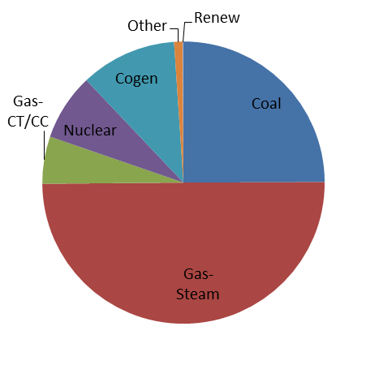
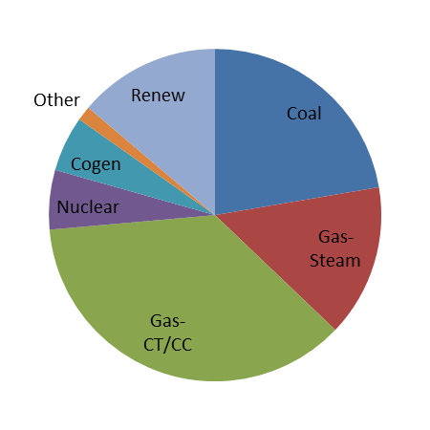
Changing Resource Mix in ERCOT
Late 1990s
2015

Slide 7
Proposed Frequency Support Measures
  Minimum synchronous inertial response (SIR) historically and projected for the future (Measure 1 for interconnection and Measure 3 for BA).
  Frequency deviation within the first 0.5 seconds following the largest contingency of the interconnection at minimum synchronous inertia conditions (Measure 2 for interconnection).
  Comprehensive set of frequency response measures following observed contingency events (Measure 4).

Slide 8
  Frequency Support Measures: Measure 1 and 3, Synchronous Inertial Response at Interconnection and BA level
  Synchronous Inertial Response is stored kinetic energy that is extracted from the rotating mass of online synchronous machines following a disturbance in a power system;
  SIR determines initial rate of change of frequency following a contingency;
  At any instance SIR is calculated as machine’s inertial constant H times it’s MVA rating. Total system SIR is calculated as a sum of SIR from all online synchronous machines.
  The proposed measure would track minimum synchronous inertia, historically and projected for 3 years in the future based on generation interconnection agreements.
  ERSTF Outcome: Inertia data collection in real time for each interconnect at highest available resolution (responsibility of NERC Resource Subcommittee)

Slide 9
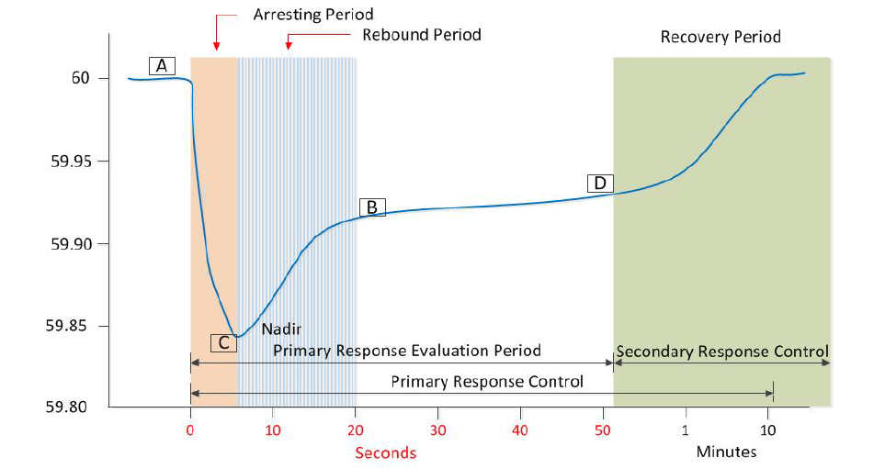
Frequency Excursion and Recovery
Inertia Response

Slide 10
Measure 1&3: Monitor Trends in Inertia
Synchronous inertia is declining……
ERCOT Historic Kinetic Energy Boxplots (2010–2017), red dots are projected lowest inertia based on the planned wind projects with SGIAs & FC as of May 2016 GIS report.
Notes:
Measure 1 and 3, Synchronous Inertial Response at Interconnection and BA level
Synchronous Inertial Response is stored kinetic energy that is extracted from the rotating mass of online synchronous machines following a disturbance in a power system;
SIR determines initial rate of change of frequency following a contingency;
At any instance SIR is calculated as machine’s inertial constant H times it’s MVA rating. Total system SIR is calculated as a sum of SIR from all online synchronous machines.
The proposed measure would track minimum synchronous inertia, historically and projected for 3 years in the future based on generation interconnection agreements.
According to April 2016 GIS report (5/1/2016) , 19,932 MW of wind generation with SGIA and FC by the end of 2016; 23,136 MW with SGIA and FC by the end of 2017

Slide 11
  Frequency Support Measures: Measure 2, Frequency Deviation Following the Largest Contingency
  At minimum SIR conditions historic and projected (Measure 1) , determine frequency deviation within the first 0.5 second following the largest contingency (as defined by Resource Contingency Criteria (RCC) in BAL-003-1 for each interconnection).
  This measure is only at the interconnection level.
  This measure would capture changes in frequency rate of change due to changing SIR on a system.
  Analytical expression can be used to calculate frequency deviation based on SIR and size of contingency (no need for dynamic study)
  ERSTF Outcome: Proposed to calculate at NERC using collected inertia data

Slide 12
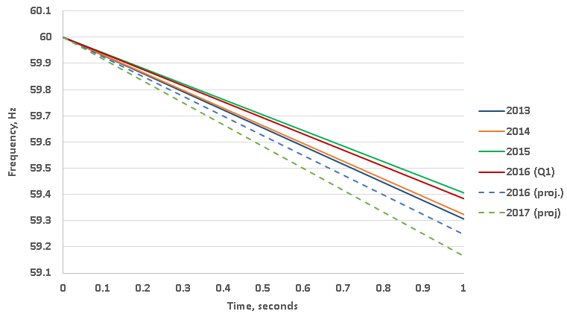
Measure 2: Frequency Deviation
Decline in inertia → Increase in Frequency Deviation
Calculated ERCOT System Frequency after 2750 MW Generation Trip
(2013-2017)

Slide 13
  Frequency Support Measures: Measure 4, Frequency Response at Interconnection Level
  Frequency response is the traditional metric used to describe interconnection’s performance in arresting and stabilizing frequency after the loss of resources or load (NERC ALR1-12 metric).
  Frequency response performance evaluation has been limited to BA level with, traditionally, only 2 – 6 seconds scan-rate frequency data;
  Conventional definition of frequency response is based on stabilizing frequency (Value B);
  Advancements in high resolution synchronized measurement technology allow examining frequency response at higher scan-rates;
  The proposed Measure 4 is based on sub-second resolution frequency measurements (10-60 samples/s) from PMUs and FDRs.
  The measure is split into several sub-measures covering the full spectrum of frequency response.
  ERSTF Outcome: Implemented as a part of frequency performance analysis by NERC.

Slide 14
Measure 4, Frequency Response at Interconnection Level

Slide 15
Measure 6, Ramping Variability Measure
High penetration of VERs may require increased system ramping capability
In CAISO with significant amounts of VERs and non-dispatchable resources, ramping is already a challenge:
Need to mitigate steep intra-hour net demand ramps and multi-hour ramps
Need for more flexible resources with faster ramping capability
Need for resources with capability to start and stop fast and multiple times per day

Slide 16
Measure 6, Ramping Variability Measure
Measure 6 provides both historical (3 years) and future (one year four years out in the future)
Calculate one hour up/down and three hour up/down ramping requirements
The data requirements include one minute net load data (or the smallest sample rate available and a projected build out of generation & load over the next three years
ERSTF Outcome: Ramping Variability Measure will be included in NERC’s Long Term System Assessment.

Slide 17
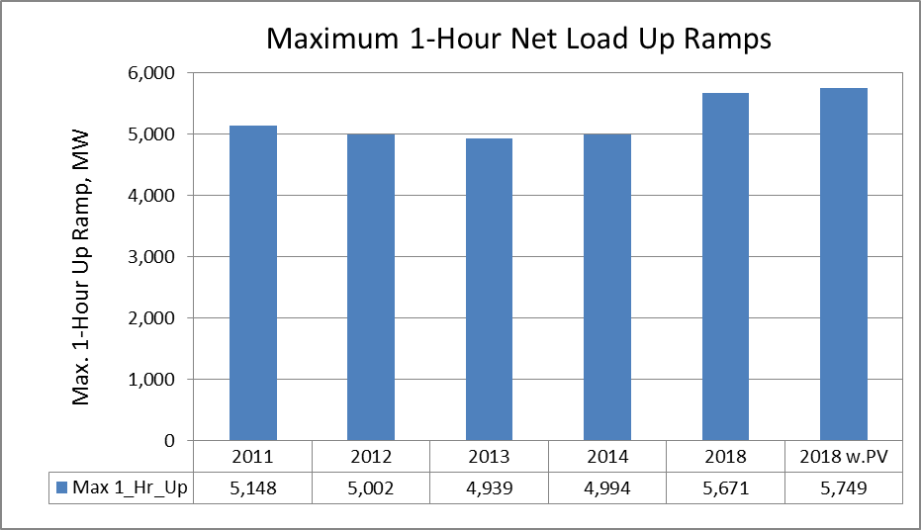
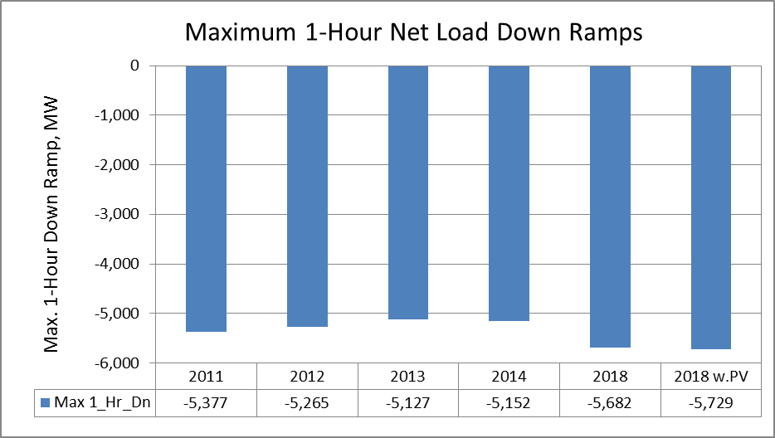
Measure 6, ERCOT Yearly One-Hour Ramp

Slide 18
Measure 6: CAISO, Need More Flexibility for Ramping
How do we address the need for flexibility?
CAISO Yearly One-Hour Ramp Distribution
Red shaded area represents 2 σ from the mean
Source: NERC

Slide 19
Measure 7: Reactive Capability of the System
Voltage management is essential to system reliability
Must encompass both baseline operations as well as contingency conditions
Is best done at a sub-area/cluster level due to inability to move reactive support long distances on the transmission system
Can effectively be done through a combination of static and dynamic reactive power sources

Slide 20
Measure 7: Reactive Capability of the System
The proposed measure will track system static and dynamic resources
These quantities will be tracked by BA on either the entire BA footprint or appropriate sub-area/cluster level within the BA footprint
The quantities will be gathered at peak, shoulder and light load levels
ERSTF Outcome: NERC Performance Analysis Subcommittee (PAS) collect the data and the NERC System Analysis and Modeling Subcommittee will review data and develop industry trends.

Slide 21
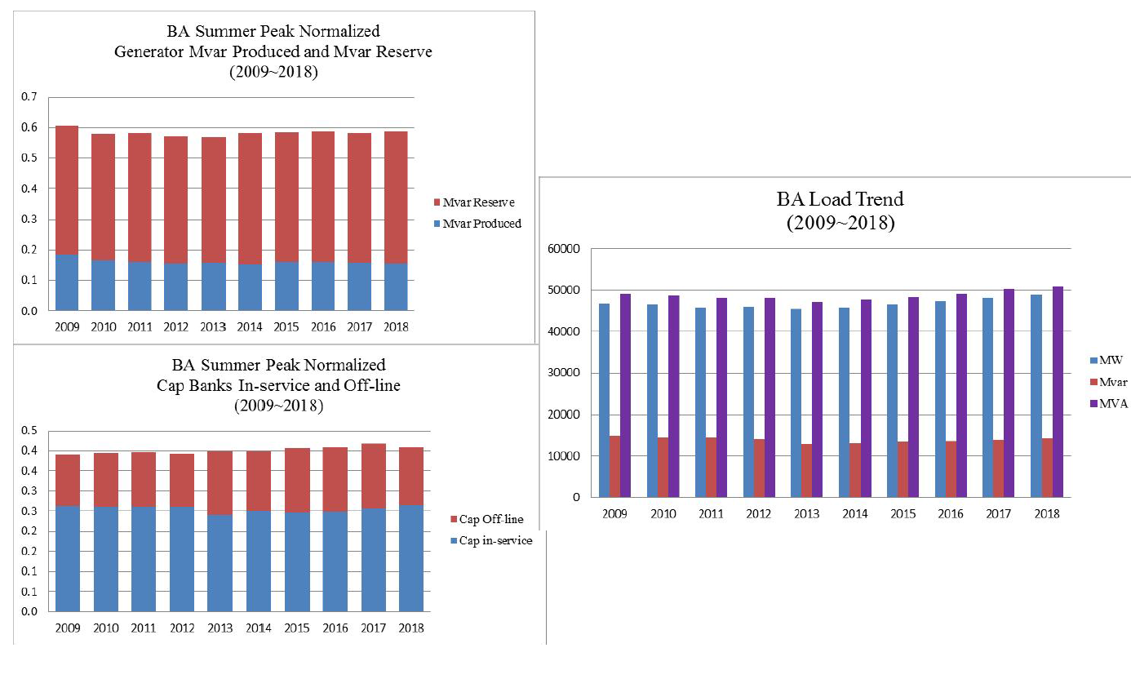
Measure 7: Reactive Capability example

Slide 22
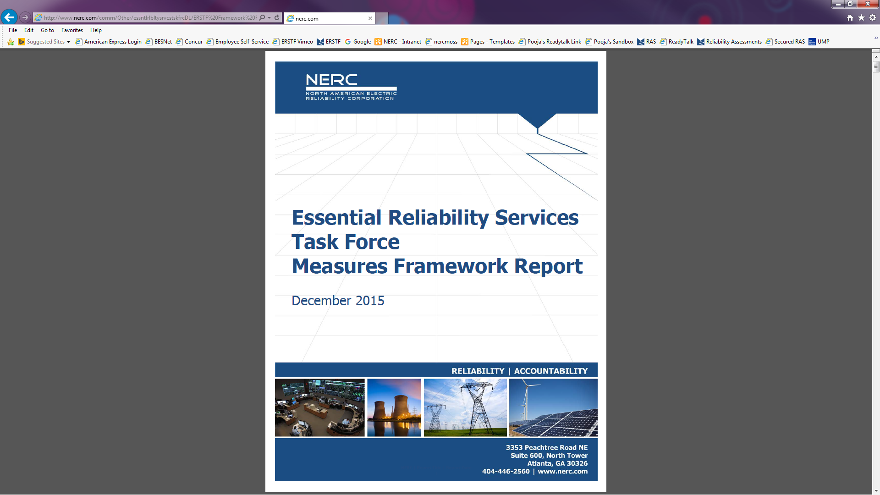
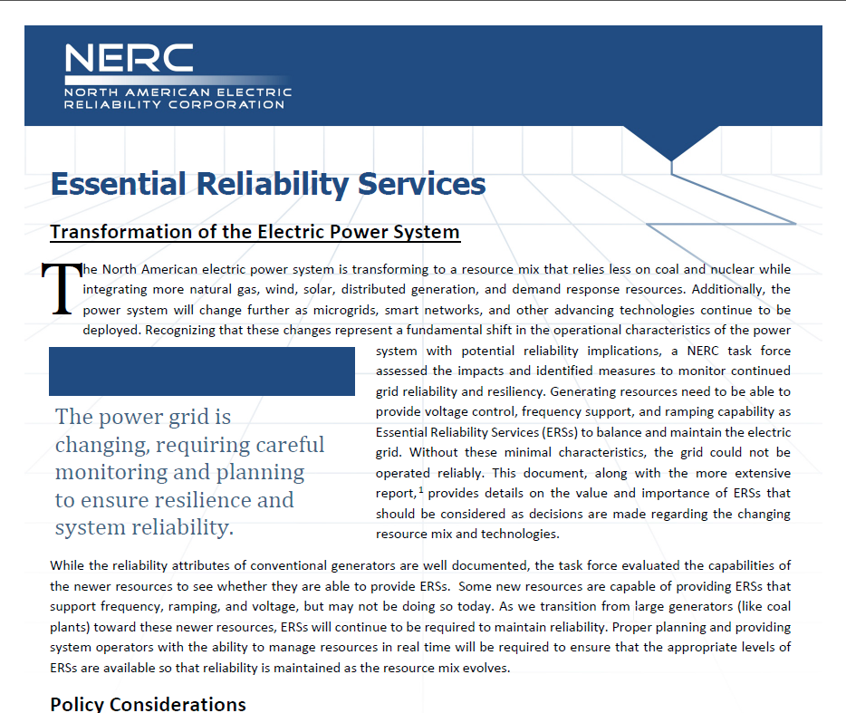
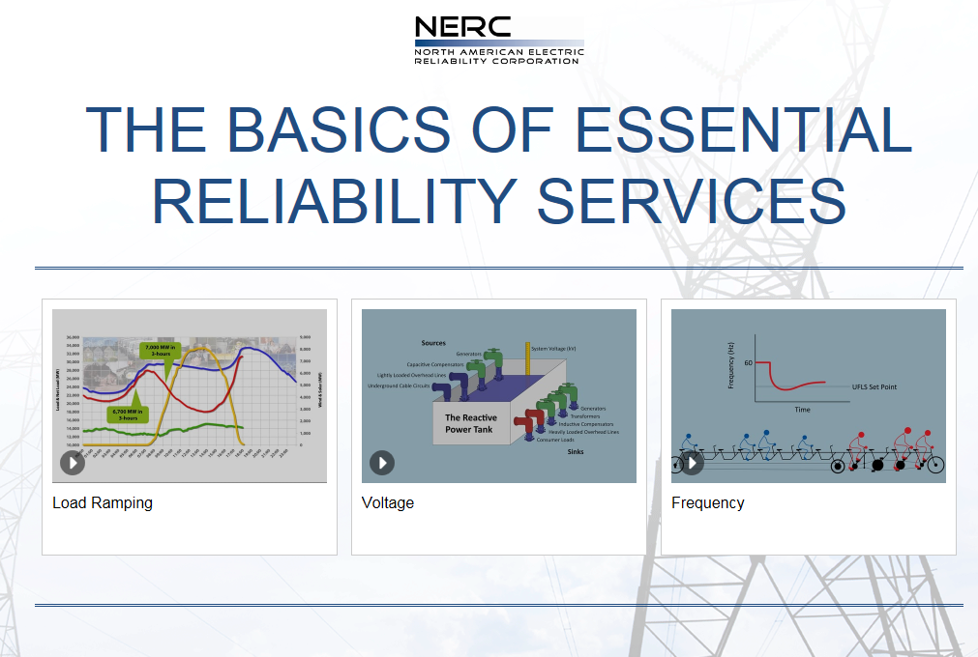
In 2015 NERC Board Approved
Goals of Essential Reliability Services Task Force
        Framework Report Abstract Document ERS Videos
Source: NERC

Slide 23
Future of ERSTF
NERC Board requested continuation of ERS efforts:
  ERSTF → ERSWG
  Define and develop ‘Sufficiency Guidelines’ for each measure
  Focus on Distributed Energy Resources, hence DERTF formed as an additional subgroup

Slide 24
Inertia Sufficiency Guideline
Develop a step by step guideline for critical inertia calculation for each system based on current frequency control practices
Analyze if this level of inertia is attainable
Trend system inertia relative to the critical inertia level using Measure 1&3
Propose planning time-frame analysis and operation planning tools for tracking.

Slide 25

Questions and Answers
Julia Matevosyan
jmatevosjana@ercot.com

Slide 26
Additional Material
2015 Long-Term Reliability Assessment
http://www.nerc.com/pa/RAPA/ra/Reliability%20Assessments%20DL/2015LTRA%20-%20Final%20Report.pdf
Essential Reliability Services Task Force Measures Framework Report
http://www.nerc.com/comm/Other/essntlrlbltysrvcstskfrcDL/ERSTF%20Framework%20Report%20-%20Final.pdf
Essential Reliability Services – Abstract (2-pager)
http://www.nerc.com/comm/Other/essntlrlbltysrvcstskfrcDL/ERS%20Abstract%20Report%20Final.pdf
The Basics of Essential Reliability Services (Multimedia Presentation)
https://vimeopro.com/nerclearning/erstf-1
Essential Reliability Services Task Force Website
http://www.nerc.com/comm/Other/Pages/Essential-Reliability-Services-Task-Force-(ERSTF).aspx

