Slide 1




Service-aware Security for
Threat & Incident Management
Dario Lobozzo

Slide 2

Remote utility sites are the weakest link
SCADA networks were designed for security by obscurity
  Industrial automation devices utilize basic authentication methods
  SCADA protocols do not support any role-base authorizations
Physical access to a remote site can be easily gained
  Remote sub-stations are unmanned
  Authorized site visitors gain access to the local network
Inter-site sessions are not considered trusted
  An insider in 1 site can gain unsupervised access to other sites
  Man-in-Middle attacks can hack into the private network
“smart grid cyber-security guidelines did not address an important element… risk of attacks that use both cyber and physical means”
Electricity Grid Modernization; Report to Congressional requesters, US GAO, January 2011

Slide 3






Attack Vectors on the OT network
Control center
Excess Access Rights
PLC
PLC
OT network
Malware in SCADA Computers
Man in the middle attack
Compromised Field Device

Slide 4
Securing the Distributed SCADA operations
Defense Method | Attack Vector
SCADA Deep-Packet-Inspection to block unauthorized traffic from the SCADA server | Malware in the SCADA Computers
Encrypted VPN tunnels over the untrusted links | Man in the Middle
Restricted access to the critical assets using user-based and task-based policies | Excess Access Rights in Remote site
IPS/IDS (Intrusion Prevention/Detection) for behavioral analysis of distributed automation | Compromised Field Device

Slide 5


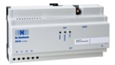

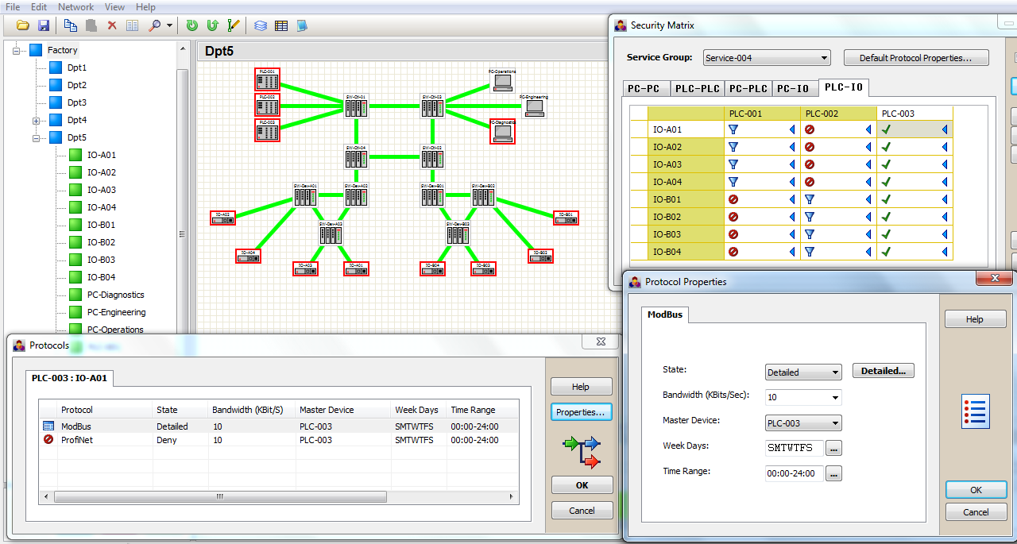
Distributed IPS for ICS networks
Patent Pending
Per-user role-based validation of SCADA sessions
  Applied to both IP & Serial devices
Distributed Deployment @ each end-point
  Inline IPS or Virtual IDS
End-to-End support logic
  Intuitive provisioning based on auto-learning
  Event log with SOC tools integration

Slide 6
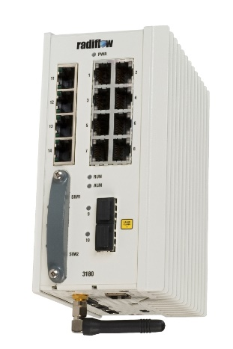
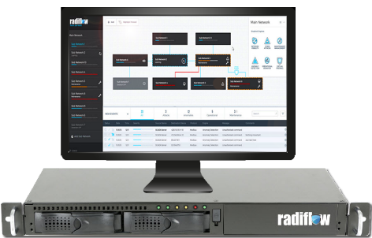


Cyber Security solutions for Critical Distributed Automation networks
Distributed
Secure
Gateway
SCADA IDS Server
Isolation
Self Learning
Anomaly Detection
Controlling Exceptions

Slide 7
ISOC – Integrating IT/OT/PACS Security
An efficient security solution should integrate:
  IT security
  OT security
  Physical Access Control
All information should be correlated in a central ISOC
“In twenty years as the Chief Director of Incident Response with the FBI I have seen 2 systems which were truly air-gapped”

Slide 8

Requirements and Guidelines
Focus on addressing the concerns as laid out by:
NIST Cybersecurity Framework
DOE ES-C2M2
NERC's CIPv5

Slide 9
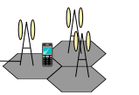







VPN over Cellular Network
Connecting private sub-networks over a public or private network
Remote site connection using Hub & Spoke GRE tunnels
IP Sec used to encrypt the GRE tunnels
Certificates used to authenticate remote parties
L2 or L3 VPN modes available
Primary
SIM
IPSec tunnel
ACTIVE
Cell site
ISP #1
INTERNET
IPSec tunnel
OFF
NAT
router
Secondary
SIM
Cell site
ISP #2

Slide 10
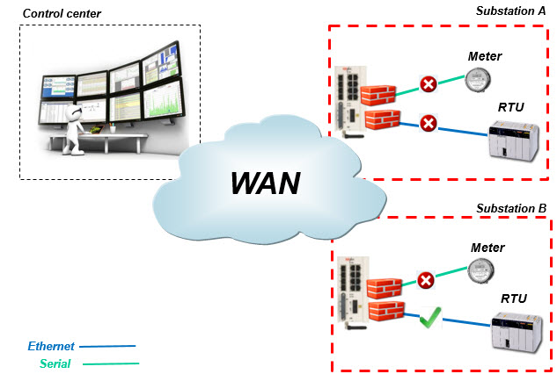
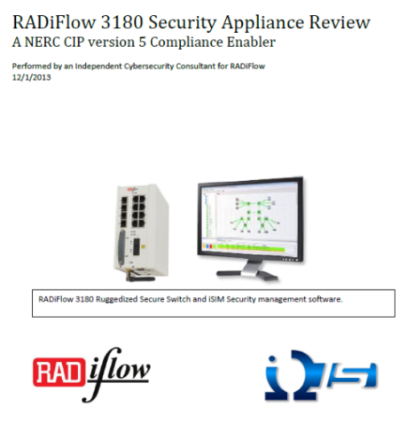
Secure Access for Substation Automation
Identity management for detailed per user authorizations
Validation of SCADA behavior per user
Automatic learning of SCADA behavior
Detailed log of user activities
IPsec VPN for inter-site connectivity
Support Ethernet and Serial devices

Slide 11
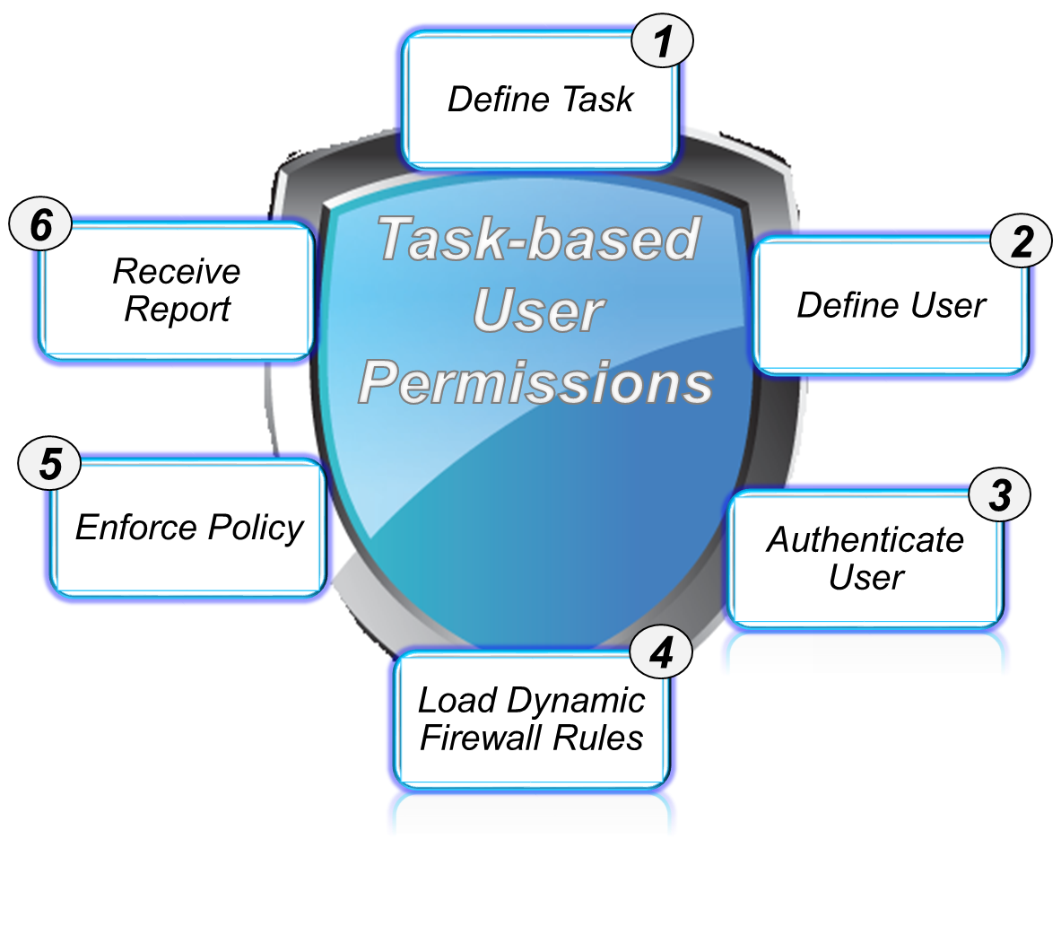

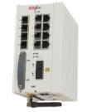

Controlling Exceptions: Authentication Proxy
The Goal: Controlling the openness of the network for maintenance operations.
The Method: Setting policy per maintenance task, per user.
Restricted access to site devices
Applied both to IP and Serial
Full Audit Log of user activities
IPsec VPN for inter-site connectivity
Identity Management

Slide 12




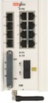


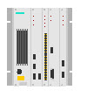
Authentication Proxy Use Case
Profile based Remote user authentication at site gateway
Restricted access to site devices
Technician allowed transparent access
On-the Fly Firewall Provisioning
Utilization of Telnet, SSH, and in future releases TACACS+ and RADIUS Auth.
SCADA2
SCADA1
central
Remote site
Ethernet
IED
rs232
RTU
Technician
Authentication.
Profiles.
Logs.
Ethernet
PLC

Slide 13




Event Logger for Scalable deployment
Receive various types of events
  Serial & IP
  Multiple formats
Re-format events
  Unified Structure
  Additional info
Log raw data & formatted data
Send formatted events to SIEM
  After filtering
  with flow-control
Optional
  Redundant uplinks
  Encrypt Data
Syslog Server
central
<new severity> <info> <message>
<severity> <message>
RTU
Syslog client
Syslog server
Syslog client
<severity> <message>
PLC
Syslog client
Site 1
Notes:
----- Meeting Notes (11/5/15 10:39) -----
CGR
809
829
GPS

Slide 14
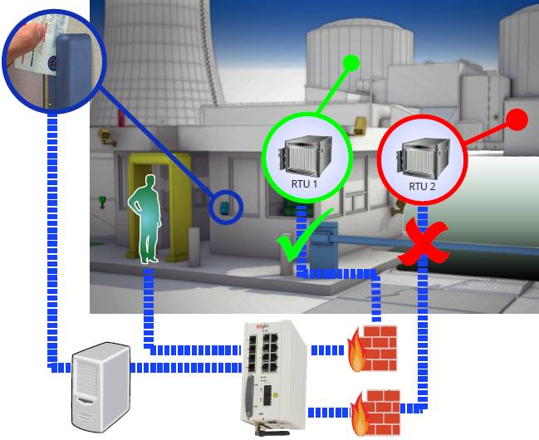
Integrated Physical & Cyber security
Distributed SCADA IPS in each site
Correlation with physical security systems for dynamic user authentication
Validate per-user SCADA operations
Integration with central SIEM tool
Restricted user operations in the Cyber corridors of Distributed automation networks

Slide 15
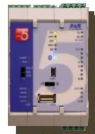
Integrated Physical & Cyber security
Mercury Panel System Arch
Unified policy enforcement
Cyber Policies enacted due to Physical Policies
Access Control Head End
Remote site – Sub Station
SCADA
central
Ethernet
IED
rs232
RTU
Access Control Panel
Mercury
Event Logger
Tied to all points
Technician
Ethernet
PLC

Slide 16

Cyber Physical Access Control List
Physical & Cyber
Integration
Allows for checking what is happening in both physical and cyber world against pre-defined rules in order to enforce minimum access required to perform an assigned task.
Identity | Assigned Task | Physical access | Logical (cyber) access
GE engineer A | Firmware Update | GE rack area only | Admin command on GE RTU only
Schneider engineer B | System expansion | Schneider rack area only Placement of new physical object in room | Setup test command to new Schneider RTU only
Historian engineer C | Data backup | Control room only access | Historian server read only access

Slide 17
Radiflow Solutions offering
Security feature | Radiflow 3180 | Security feature | Radiflow 3180
IP Sec VPN | Yes | User-to-IED activity logs | Yes
VPN over cellular | Yes | Password management for IEDs | Yes
X.509 certificates | Yes | Syslog messages | Yes
White list firewall | Yes | IP Router | Yes
DPI firewall for SCADA protocols | Yes | Serial to IP gateway for SCADA protocols | Yes
Per IED firewall policy | Yes | Integration with Physical security | Yes
Authentication proxy - ETH | Yes | Integration with IDS server | Yes
Authentication proxy - Serial | Yes | -Network & Application learning | Yes
IED password sync from central DB | Yes | -SCADA Anomaly detection | Yes
Layer 2 Switch | Yes | -Dashboard & Map GUI | Yes

Slide 18

Summary
Intra-network security is mandatory
RADiFlow Service-aware Industrial Networking solution
  Unique distributed service-aware firewall by the network
  Integrated defense-in-depth tool-set
  Optimize CapEx and OpEx
For more details:
  info@radiflow.com
  www.radiflow.com

