Slide 1
EFL Renewable Content Calculator
RMS – June 7, 2016

Slide 2
Background
Several productive discussions with ERCOT already to reach agreement on certain minor changes to EFL calculator for next year to enhance usability
Adding benchmark value, de-emphasizing emissions data that is no longer required, incorporating out-of-state renewable contracts
Need stakeholder guidance on other contemplated changes regarding EFL calculator mechanics

Slide 3
Motivation
Eliminate Confusion About EFL Renewable Content Calculation
Promote Consistency Across the Market

Slide 4
Key Concept: Default Scorecard
What is the “default scorecard”? See 25.476(e)(4)
Statewide (including non-ERCOT) fuel mix, less REC retirements (in ERCOT)
It is not the Renewable Portfolio Standard (RPS) required % (2015’s RPS was ~5.6%)
In 2015:
Statewide 2015 MWh | 380,604,455.23
2015 REC Retirements (Any Vintage) | 30,241,759
 | Coal/Lignite | Nat Gas | Nuclear | Renew | Other | Total
Statewide Avg % | 28.3% | 49.1% | 10.3% | 12.1% | 0.2% | 100.0%
MWh | 107,744,753.80 | 186,866,367.60 | 39,384,317.35 | 45,918,997.73 | 690,018.76 | 380,604,455.23
MWh (less RECs) | 107,744,753.80 | 186,866,367.60 | 39,384,317.35 | 15,677,238.73 | 690,018.76 | 350,362,696.23
Default Scorecard % | 30.8% | 53.3% | 11.2% | 4.5% | 0.2% | 100.0%
Notes:
2015 Statewide REC Requirement: 14,919,894
2015 Total Sales Subject to RPS: 264,868,692
Source: www.texasrenewables.com (ERCOT)

Slide 5
Key Concept: Benchmark %
Established by 16 TAC 25.476(f)(5)(B)(ii)
Effectively requires all EFLs to have at least the Renewable Portfolio Standard (RPS) required %
Defined as SRR ÷ TS
SRR = Statewide REC Requirement
TS = Total Sales
Not the default scorecard required by 25.476(e)
In 2015: 14,919,894 ÷ 264,868,692 = 5.6%
Benchmark
5.0%
5.0%
5.9%
5.6%
Notes:
Source: www.texasrenewables.com (ERCOT)

Slide 6
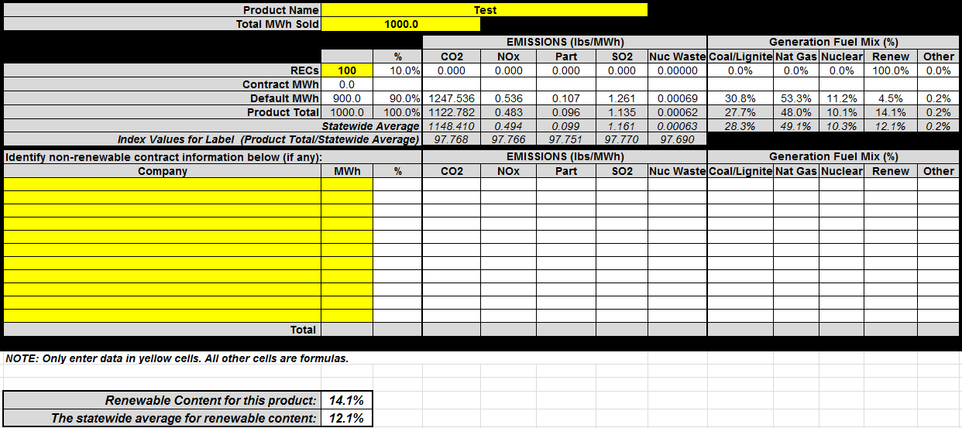
Key Concept: Calculator Mechanics
Uses weighted averages – renewable content is determined by weighted average of RECs (100% renewable), purchased power contracts (generator-specific %), and default scorecard % (changes yearly)
Originally designed to support emissions reporting on EFLs (no longer required by PUC Rules)
Ex:
(10% x 100%) + (90% x 4.5%) = 10% + 4.05% = 14.1%
6

Slide 7
Default Scorecard EFL Calculator Dynamics
Weighted averaging with the default % yields counterintuitive results
a standard product (only retiring 5.6% RPS mandate) will show 9.9%
(56/1000) x 100% + (944/1000) x 4.5% = 9.9%
retiring no RECs yields 4.5% (default %)
(0/1000) x 100% + (1000/1000) x 4.5% = 4.5%
a 50% product need only retire 47.6% RECs
(476/1000) x 100% + (524/1000) x 4.5% = 49.96%
but a 100% product must retire 100% RECs
(1000/1000) x 100% + (0/1000) x 4.5% = 100%
EFL % and RECs as % of MWh converge towards 100%
Retiring 56 RECs (RPS Mandate)
results in an EFL disclosure
% of 9.9%
EFL Calculator reports 50% before RECs/Sales = 50%
RPS % = 5.6%
Default % = 4.5%

Slide 8
Hypothesis: REPs Interpret EFL Calculator Differently
Using as intended (or using statewide average?)
Using old versions of the EFL Calculator
Not entering RECs retired (assuming Default=RPS)
Not using the EFL calculator at all
Who knows what else
2014 RPS+Default = 11%
2014 Statewide Avg=11%
2012 RPS+Default = 9%
2014 Default = 5%
2011 Default = 3%
Impossible Calculator Output
Actual 2014 RPS %
Maybe 2014 RPS+2013 Default?
2010 RPS+Default = 10%

Slide 9
One Rule, Two (Separate) Compliance Obligations
ERCOT Compliance – 25.476(e)
REP Compliance – 25.476(f)-(h)
The registration agent (ERCOT) shall maintain a database of TX generator scorecards reflecting fuel mix and environmental data
By April 1 each year, ERCOT shall calculate and publish a statewide average fuel mix, statewide average emission rates, and a default scorecard to account for generation not authenticated by retiring RECs
REPs must update EFLs for prior year’s renewable content by July 1 and report to ERCOT
For EFL disclosures, renewable content may be determined using RECs, REC offsets, qualified out-of-state supply contracts, and the Texas State Average Fuel Mix [but not the default scorecard mix]
Each EFL must meet a minimum benchmark renewable % (statewide RPS)
PUC Rules do not require publication or use of a calculator, but do require ERCOT to publish certain information and dictate how REPs may validate renewable marketing claims

Slide 10
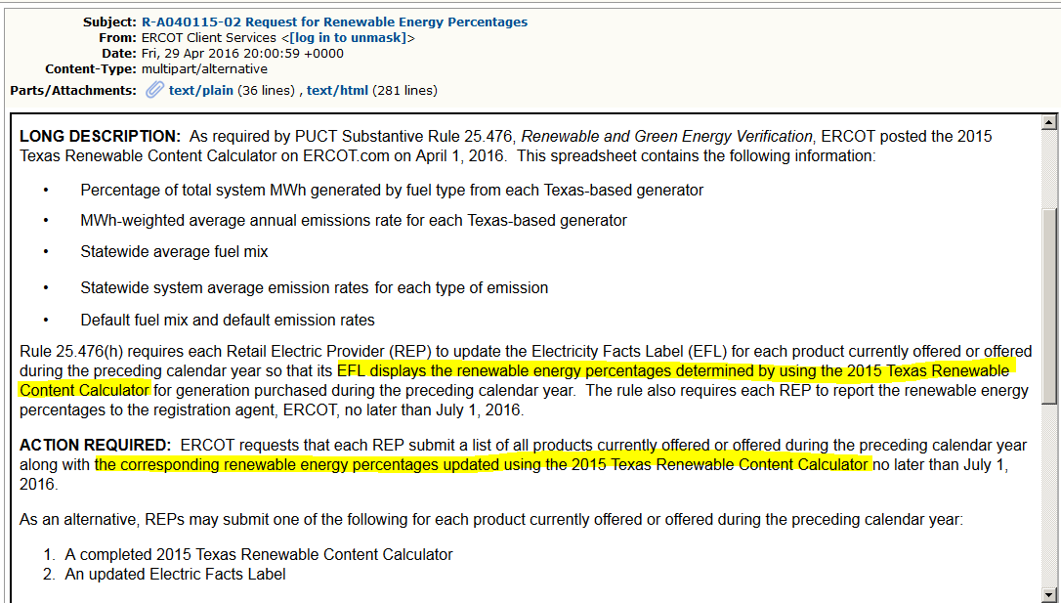
Impression Of Required Use
ERCOT notice implies REPs must use EFL Renewable Content Calculator

Slide 11
Question: Should The Default Scorecard Count In The EFL Calculator?
Not explicitly allowed for use by REPs in PUC Rules
Contributes to confusion over proper EFL calculator usage
Reflects non-ERCOT renewable content in competitive area (ERCOT-only) disclosures
Eliminating default % allows for more straightforward EFL content calculation
ERCOT can still publish (as required by 25.476(e)), but does not have to be in the EFL calculator

Slide 12
Next Steps?
Present alternative calculator structure proposal at future meeting (posted to this meeting’s materials, however, use password ‘calculator’ to unlock spreadsheet)
Voting item?
Questions?

