Slide 1
Appeal of PRS Rejection of NPRR 667
Dan Woodfin
Director, System Operations
TAC
May 26, 2016

Slide 2
Resource mix has changed
Resource mix in ERCOT Market has changed significantly since current AS framework was developed
This has changed both the need for AS and the capability of resources to provide the AS
Other
0.9%
Renewables
0.008%
Cogen
11%
Coal
22.4%
Coal
25%
Gas-Steam
14.8%
Nuclear
8%
Gas-CT/CC
5%
Late 1990s
2015
Renewables
13.8%
Gas-CT/CC
36.5%
Cogen
5.3%
Gas-Steam
50%
Nuclear
5.7%
Other
1.4%

Slide 3
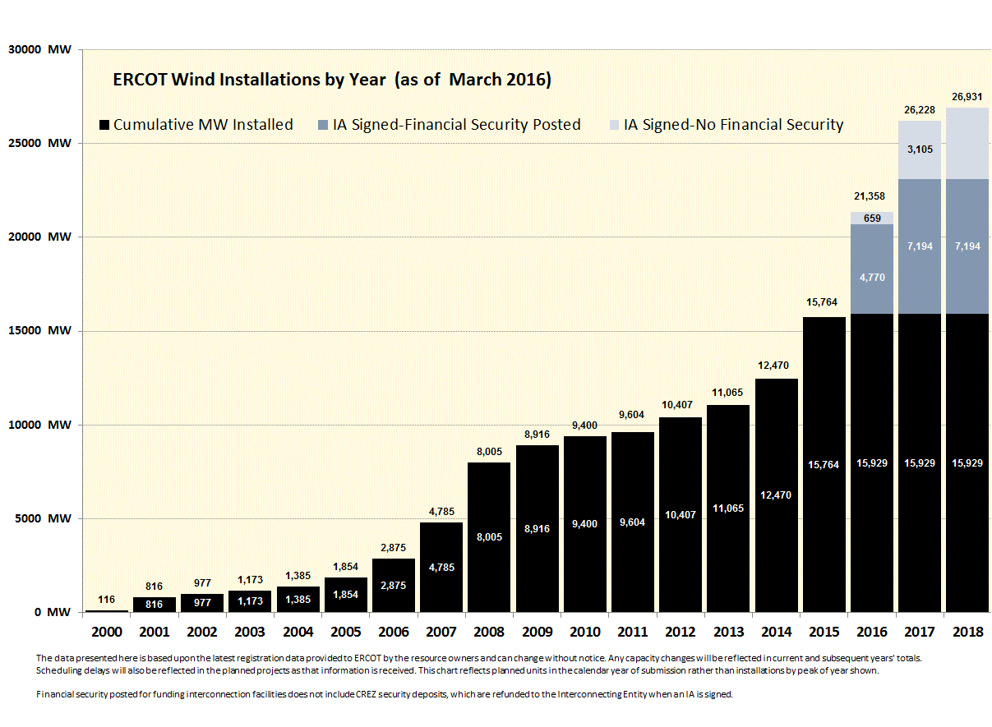
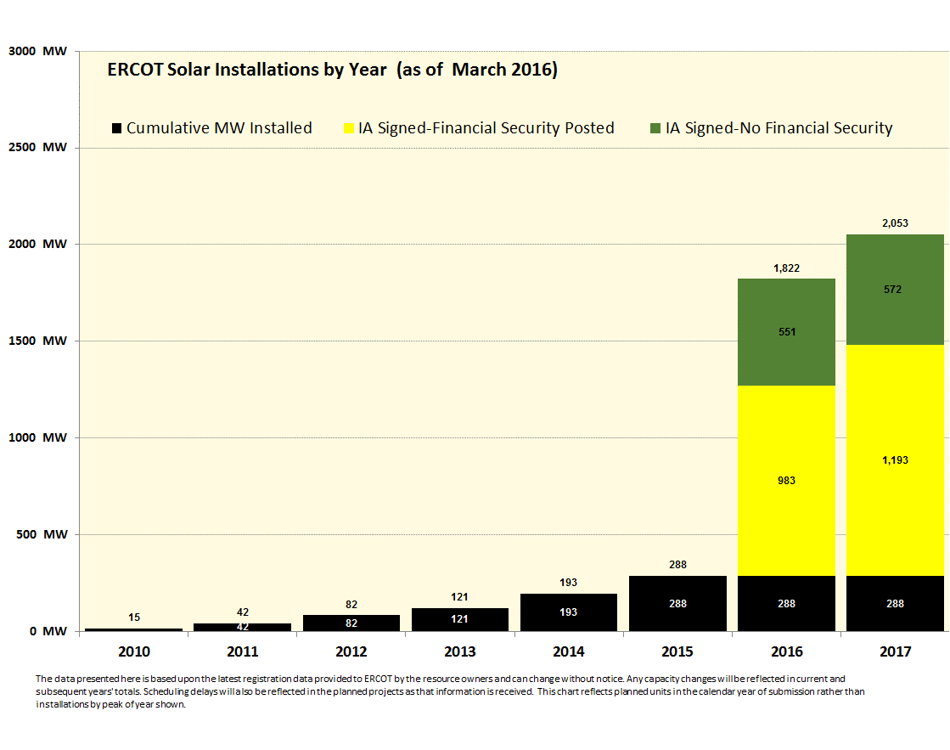
Continued change in resource mix expected
Significant additional changes to the resource mix are likely over the next 3 years
With a 3-year implementation plan for NPRR 667, the drivers for restructuring the AS framework need to be addressed now

Slide 4
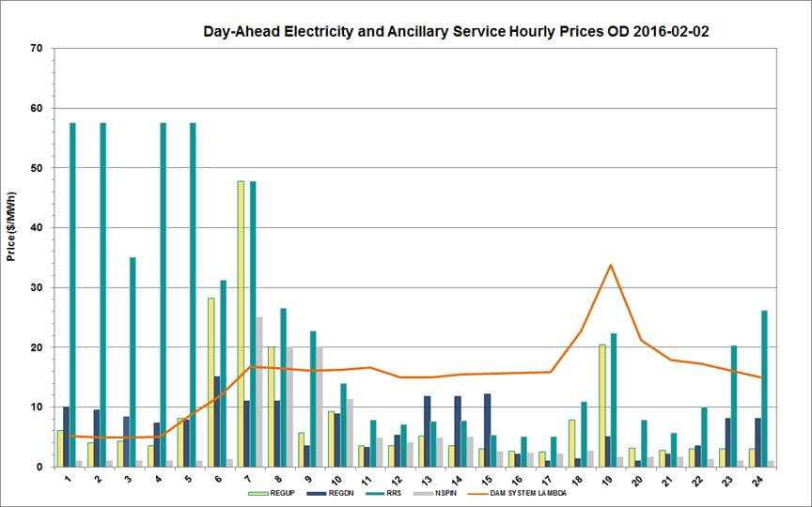
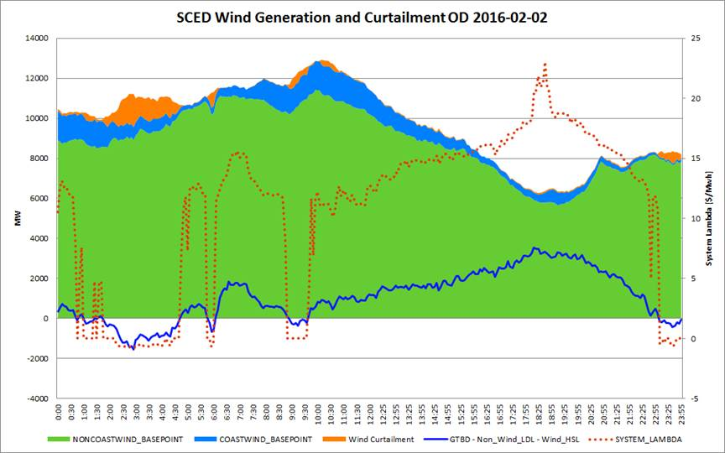
Current AS framework needs improvement
During high wind/low load periods, the current bundled AS framework will:
Keep higher cost generation online to provide AS
Extend and deepen negative price periods
Curtail lower cost resources
Result in increased AS prices and produce overall higher costs
The frequency of high wind/low load periods is increasing

Slide 5
Existing “Bundled” Ancillary Services
Current
AS Requirements designed around inherent capabilities of steam boiler units
These requirements serve as barriers to entry for new resources that otherwise could meet underlying technical needs of the system
Regulation Up
Fast-Responding Regulation Up
Regulation Down
Fast-Responding Regulation Down
Responsive
59.7 Hz,
Must be able to sustain deployment
Non-Spin
Up to 30 minutes to deploy
Must be dispatched by SCED

Slide 6
Proposed Future Ancillary Services
Current
Proposed
Regulation Up
Fast-Responding Regulation Up
Regulation Up
Fast-Responding Regulation Up
Mostly unchanged
Regulation Down
Fast-Responding Regulation Down
Regulation Down
Fast-Responding Regulation Down
Fast Frequency Response 1
59.8 Hz, Limited duration
Fast Frequency Response 2
59.7 Hz, Longer duration
Responsive
Primary Frequency Response
Contingency Reserves 1
SCED-dispatched
Contingency Reserves 2
Manually dispatched
Non-Spin
Supplemental Reserves 1
SCED-dispatched
Supplemental Reserves 2
Manually dispatched
Synchronous Inertial Response
Ongoing development

Slide 7
Nearly 3 Years of Stakeholder Input
3 Years
Spring
2016
Spring
2019
9/2013
11/2014
ERCOT Posts Future
Ancillary Services
White Paper
Implementation
PRS/TAC/Board Approval
Additional stakeholder workshops
and Cost/Benefit Study; revisions to
NPRR based on Stakeholder input
~25 Stakeholder work sessions
to gather input and improve proposal
ERCOT Files NPRR 667,
with significant modifications to original
proposal based on stakeholder input

Slide 8
Stakeholder input shaped the current proposal
ERCOT’s original proposal modified significantly through stakeholder input
Fundamental Services were changed
Details of NPRR modified
Current
Original ERCOT Proposal
Revised 667
Regulation Up
Fast-Responding Regulation Up
Regulation Up
Fast-Responding Regulation Up
Regulation Up
Fast-Responding Regulation Up
Regulation Down
Fast-Responding Regulation Down
Regulation Down
Fast-Responding Regulation Down
Regulation Down
Fast-Responding Regulation Down
Fast Frequency Response
Fast Frequency Response 1
Fast Frequency Response 2
Responsive
Primary Frequency Response
Primary Frequency Response
Contingency Reserves
Contingency Reserves 1
Contingency Reserves 2
Non-Spin
Supplemental Reserves 1
Supplemental Reserves 2

Slide 9
Substitutability => liquidity
Current
Proposed
Regulation Up
Fast-Responding Regulation Up
Regulation Up
Fast-Responding Regulation Up
Mostly unchanged
Regulation Down
Fast-Responding Regulation Down
Regulation Down
Fast-Responding Regulation Down
Fast Frequency Response 1
59.8 Hz, Limited duration
Fast Frequency Response 2
59.7 Hz, Longer duration
Responsive
Primary Frequency Response
Contingency Reserves 1
SCED-dispatched
Contingency Reserves 2
Manually dispatched
Non-Spin
Supplemental Reserves 1
SCED-dispatched
Supplemental Reserves 2
Manually dispatched

Slide 10
NPRR 667 supports TAC Goals for 2016
5. Develop and implement needed market design corrections and improvements which are cost effective.
Brattle study found the NPRR had benefits much greater than costs (even after adjustment to lower gas prices) and was good market design.
6. Pursue the appropriate implementation of load participation
NPRR provides several opportunities for increased load participation.
7. Pursue the appropriate implementation of emerging technologies.
NPRR667 allows increased flexibility and efficiency in integrating new resources and facilitates their participation in the AS markets.
11. Collaborate with ERCOT Staff on the review of Ancillary Service needs and implement changes as necessary.
ERCOT and stakeholders have worked together to refine NPRR667.
12. Maintain market rules that support open access to the ERCOT markets and transmission network.
NPRR667 removes significant barriers to entry for diverse types of resources needed to reliably support the continually changing resource mix.

Slide 11
Appeal
ERCOT requests that TAC recommend approval of NPRR667, in order to:
Provide a holistic and efficient set of AS to meet the changing reliability challenges of the ERCOT System;
Remove barriers to entry for new Resources that can meet the technical needs of the system; and
Allow a coordinated transition to address future AS needs rather than addressing these needs through a piecemeal approach.

