Slide 1
WEST TEXAS SENSITIVITY STUDY
May 17, 2016
Prepared For:
ERCOT Regional Planning Meeting
Austin, TX

Slide 2
OUTLINE
Objectives
Background
  Historical Perspective
  Permian Basin
Planning Process
  Observations
  Suggestions and Recommendations
Appendix

Slide 3
OBJECTIVES
Study’s Objectives Changed Over Time
  Initial 2015 Objective: Reasonableness
    A one-off assessment as to the reasonableness of prior load submittals.
    Global oil industry dynamics changed.
    Confidentiality barrier.
  Current 2016 Objective: Planning Process
    Evaluate planning process.
    Outline its strengths and weaknesses.
    Identify how and where improvements can be made.
EVA’s Objectives
  Remain independent
  Work with all the stakeholders
    TDSPs.
    Producers.
    ERCOT.

Slide 4
OUTLINE
Objectives
Background
  Historical Perspective
  Permian Basin
Planning Process
  Observations
  Suggestions and Recommendations
Appendix

Slide 5
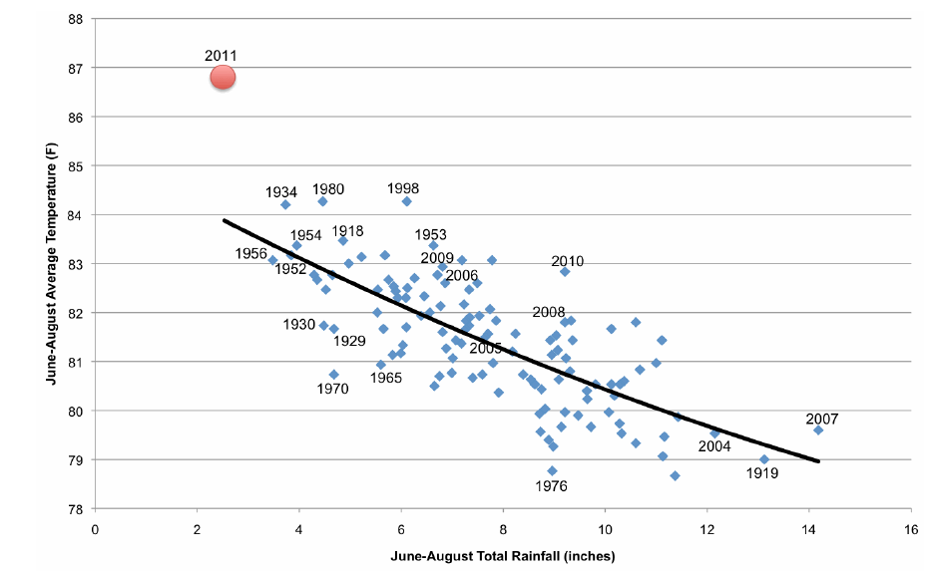
HISTORICAL PERSPECTIVE
Sequence of Events
  Prior to 2011
    Permian Basin⁽¹⁾ drilling activity was at modest levels and production was declining.
  2011
    ERCOT and TDSPs were focused on other events and did not fully appreciate the sharp increase in drilling activity.
      In 2011 the combination of record heat and drought resulted in record load.
        Primary focus was avoiding rolling blackouts.
(1) Focus is West Texas.

Slide 6
HISTORICAL PERSPECTIVE: SEQUENCE OF EVENTS
  2012 to 2014
    West Texas power loads surged.
      2014 West Texas rig count was 4.5 times the 2009 average.
    Any excess distribution and transmission capacity was exhausted.
    Significant congestion occurred.⁽¹⁾
      In 2012 eight of the top 15 constraint points within ERCOT were in West Texas (i.e., congestion rent equaled $270 million).
      Projections for 2013 were that the top five constraint points within ERCOT would be in West Texas.
(1) See exhibits in Appendix.

Slide 7
HISTORICAL PERSPECTIVE: SEQUENCE OF EVENTS
  2015/2016
    Significant decline in drilling activity.
    However, power loads continue to grow because of additional artificial lift for existing wells.
    Beginning a lull period, which represents a unique time window to improve the overall planning process.
      Declining well completions.
      Flat to declining production.
MONTHLY WEST TEXAS WELL COMPLETION

Slide 8
HISTORICAL PERSPECTIVE: SEQUENCE OF EVENTS
Assessment
  TDSPs/ERCOT
    Initially caught off guard.
      Missed the initial ramp up in drilling activity and did not appreciate fully that this was the beginning of a multi-year trend.
      Did not fully appreciate the significant increase in energy intensity that is associated with unconventional drilling vs. historical conventional drilling.
    Once behind the curve it was very difficult to catch up.
    Nevertheless, the TDSPs have strengthened and expanded their systems significantly.
      In 2015 only one of the top 15 ERCOT constraint points was in West Texas.⁽¹⁾
      In 2016 committed to Far West Texas Project, which includes a greenfield 345 kV line.⁽²⁾
See exhibit in Appendix.
See “Far West Texas Project”, Presentation to ERCOT Regional Planning Group, April 21, 2016.

Slide 9
HISTORICAL PERSPECTIVE: SEQUENCE OF EVENTS
  All stakeholders
    Communications throughout the planning process were not close to optimum.
    Tensions between the stakeholders, while improving, have been very high.
      Numerous examples of impairment to operations because of lack of timely service.
  Going forward
    TDSPs/ERCOT.
      Have much greater appreciation of the unique attributes of the Permian Basin and its likely role in world oil markets.
      Foresee a significant recovery in West Texas drilling activity and production.
      Want to be prepared for the next surge.
        Do not want a repeat of the 2012 to 2014 period.
      Focus is solving the problem in the aggregate.
    Producers.
      For the most part, want to improve the following:
        Communications.
        The overall planning process and are willing to work with TDSPs and ERCOT.
        The overall coverage of the industry’s power requirements.

Slide 10
PERSPECTIVE FOR THE PERMIAN BASIN
Global Oil Industry
  Global excess supply likely will not be eroded fully until YE2017
  Erosion of the very large global storage overhang unlikely to start before 2018
  Net result is that a sustained period of low oil prices is likely
    Drilling activity in West Texas will be suppressed during this period.

Slide 11
PERSPECTIVE FOR THE PERMIAN BASIN
Permian Basin
  Combination of size and economics make it the most significant oil basin in the U.S.
    While other U.S. oil basins have very attractive characteristics, the Permian Basin stands out.
  The Permian Basin represents a world class field⁽¹⁾
    Once recovery starts production could increase one MMBD.
(1) The combination of Sprayberry, Wolfcamp and Bone Springs by themselves represents a world class field.

Slide 12
PERSPECTIVE FOR THE PERMIAN BASIN
  The Permian Basin likely will be at the forefront when oil prices recover
    Forefront for U.S.
    Forefront for Non-OPEC (i.e., marginal barrel on the upside).⁽¹⁾
      Particularly with the cancellation and/or deferral of many major projects (e.g., offshore). ⁽²⁾
Long term the marginal barrel for Non-OPEC on the downside includes the expensive deepwater megaprojects, some Canadian tar sand projects and some production in several countries that have very high cash costs. Fletcher, Laurence and Kantchev, Georgi, “In Oil, A Trader Stands Out by Swing,” Wall Street Journal, April 5, 2016.
A year ago 210 deepwater projects were expected to come online between 2016 and 2021. Current estimates are that only 118 of these projects will come online, with the remainder either cancelled or experiencing extended delays. “Can Deepwater Compete With Low-Cost Shale?”, Petroleum Intelligence Weekly, April 4, 2016, p. 1-2.

Slide 13
OUTLINE
Objectives
Background
  Historical Perspective
  Permian Basin
Planning Process
  Observations
  Suggestions and Recommendations
Appendix

Slide 14
PLANNING PROCESS: GENERAL OBSERVATIONS
Will Review A Series Of Observations Concerning The Planning Process
  Derived from a series of meetings and conference calls with each of the stakeholders
    TDSPs.
    Producers.
    ERCOT.
Assessment
  Improvements have been made in the overall planning process
  There is a good baseline to build upon
  However, further improvements are required in order to be prepared for the next surge

Slide 15
PLANNING PROCESS: GENERal OBSERVATIONS
Inverse Relationship
  For the typical well there is an inverse relationship between the production level of a well and the power requirements for that well
    Alternatively, there is a direct correlation between the life of a well and the well’s power requirements.
  A key consequence of this relationship is:
    Increasing power requirements for West Texas will last for a very long time.
      Sequence of events:
        West Texas drilling activity recovers.
        Production surges – potentially one MMBD increase.
        Power requirements continue to grow for an extended period of time.

Slide 16
PLANNING PROCESS: GENERAL OBSERVATIONS
Limitations
  Unlikely that the optimum planning process will ever be achieved, because of some of the inherent characteristics of the stakeholders
  More specifically, the following represent obstacles to achieving the optimum planning process
    Entrenchment: Each of the stakeholders represents large entities that are fairly entrenched in their business guidelines and policies.
      Historically these guidelines, procedures and policies have served each stakeholder well.
      Each stakeholder, to a degree, expects third parties to adapt to their procedures.
    Competition: With the exception of ERCOT there has been significant competition among the various members of each stakeholder group, which can and has inhibited the exchange of information.
    Confidentiality: Obtaining and executing useful confidentiality agreements remains a barrier.
    Heterogeneous: The producer community in particular is not a monolith.
      There are considerable differences among the various producers in size, business approaches, policies, etc.
      The above requires the TDSPs and ERCOT to have flexible and adaptive planning processes (i.e., one size does not fit all).
  Going Forward
    With effort the net impact of these limitations can be reduced even if they cannot be eliminated.
    While the overall planning process cannot be perfected, it can be improved.

Slide 17
PLANNING PROCESS: KEY CHARACTERISTICS
Power Requirements: Simplified Assessment of Key Components
  New wells (producers)
    Surface facilities for water, recycling, and disposal.⁽¹⁾
    New production results in added infrastructure requirements (NGL plants and pipeline capacity).
  Existing wells (producers)
    Initial artificial lift.
    Secondary and tertiary enhanced oil recovery (EOR).
      Water flood and CO₂ injection.
      Very large power requirements.⁽²⁾
  New infrastructure (midstream companies)
Technology
  The selection among various technologies can impact significantly the power requirements for each of the above components
    Surface Facilities: Pumping vs. trucking.
    Artificial lift: Gas lift vs. electric submersible pumps (ESPs).⁽³⁾
    NGL plants: Gas-driven vs. electric-driven.⁽⁴⁾
  The choice of what is the appropriate technology varies by firm.
A typical 8-well tank battery with compression requires approximately 0.7 MW. A complex water transfer system (i.e., pipelines and several pumps) requires approximately ___ MW.
One scheduled CO₂ flood expansion will require approximately 4 MW.
A set of eight wells using gas-lift requires approximately 0.03 MW, including some compression. A set of eight wells using ESPs requires approximately 0.7 to 1.6 MW.
A large gas-driven NGL plant requires approximately 5 to 8 MW. A large electric-driven NGL plant requires approximately 40 MW.

Slide 18
PLANNING PROCESS: KEY CHARACTERISTICS
Infrastructure
  Power requirements for NGL plants remains a unique challenge
    Power requirements are large and lumpy.
    Power requirements are impacted significantly by choice of technology.⁽¹⁾
    Difficult to obtain long-term outlook of power requirements.
      Midstream firms dependent upon producer production forecasts (i.e., by location).
  Likely will require a unique planning process and/or outreach
    Thinking outside the box.
Differences
  There are significant variations in power requirements among producers, with size being a critical factor
(1) 5 to 8 MW for large gas-driven plant; approximately 40 MW for large electric-driven plant..

Slide 19
SIMPLIFIED OVERVIEW OF POWER REQUIREMENTS (LARGE PRODUCERS)
⁽¹⁾
⁽¹⁾
1) Only a few West Texas firms are actively involved in either water flood or CO₂ injection.

Slide 20
SIMPLIFIED OVERVIEW FOR POWER REQUIREMENTS (SMALL PRODUCERS)

Slide 21
PLANNING PROCESS: KEY CHARACTERISTICS
    Small producers are a significant part of the aggregate assessment of West Texas power requirements.
      Represent approximately 70% of the firms currently operating rigs.
      Represent approximately one-third of the current oil-directed rig count.
      Represent approximately 54% of wells completed in 2016 YTD.⁽¹⁾
CURRENT RIG COUNT FOR WEST TEXAS
Load Submittals
Total = 57 Firms
Total = 154 Rigs
2016 YTD Wells = 184
2015 percentage for load submittals was less than 39%, however there have been a number of consolidations and bankruptcies over the last year with large firms increasing their acreage holdings..

Slide 22
PLANNING PROCESS: EVALUATIONS
Coverage
  In order to achieve a more accurate aggregate assessment of future West Texas power requirements the coverage of producers in the region needs to be increased
    Particularly true since extrapolation technologies can be treacherous – for example:
      Power requirements for small firms cannot be extrapolated from large firms and vice-a-versa.
      Choices in technology vary by firm.
  Firms previously submitting load submittals accounted for:
    55 to 60% of production coming from the key formations.
    35 to 40% of the current count.

Slide 23
PLANNING PROCESS: evaluations
  Coverage is improving but further outreach is required
    Currently working with PBPA to increase coverage of PBPA members.
      Several large firms either have not made load submittals or have made rather limited load.
    Currently working to increase coverage of non-PBPA members.
    This will take time.
Core Competencies
  Power planning as a core competence
    While many producers have power planning as a core competence, other do not.
      The latter significantly reduces the ability to obtain long-term plans and inhibits communications.
    Two ways to obtain power planning as a core competence:
      Develop it internally within firm – primary alternative for large firms.
      Use third-parties with expertise in power planning – primary alternative of smaller firms.
  Tracking the oil and gas industry as a core competence
    While both TDSPs and ERCOT are improving, they need to improve their capabilities to track the oil and gas industry and their expertise about the various facets of the industry.

Slide 24
PLANNING PROCESS: evaluations
Common Oil Price Forecast
  Load submittals based upon different long-term oil price forecasts are not additive
    Power requirements of one producer based upon $75/BBL oil prices are not additive to the power requirements of another oil producer that assumes $45/BBL.
  5-year load submittals should be based upon a common oil price forecast
    Common forecast undoubtedly will change from year-to-year.
    Nevertheless, overall the aggregate assessment will be robust.
    Common forecast for submittals is not in any way intended to replace internal forecasts by individual producers.
Environmental Issues
  There are several environmental issues on the horizon that could have the following impacts:
    Increase overall West Texas power requirements behind aggregate load forecast.
      Further reductions by the EPA for field level NOx emissions could reduce significantly the use of diesel generator sets.⁽¹⁾
      This, in turn, could increase both the need for on-the-grid power and urgency for the receipt of on-the-grid power.
EPA’s recent revision to the National Ambient Air Quality Standards, which cover ground-level ozone, reduced ozone limits from 75 ppb to 65-70 ppb. During its review process the EPA considered a 60 ppb standard, which would result in areas containing 94% of the population being in non-attainment. A 60 ppb standard also would make the continued use of diesel-generator sets in the field highly impractical and, as a result, increase the requirement for grid power. The EPA will reevaluate ozone levels in approximately five years. Snow, Nick, “Senate panel divided on bills to modify EPA’s proposed ozone rules”, Oil & Gas Journal, June 29, 2015, p. 20-21 and “EPA air proposals should recognize progress, API officials says”, Oil & Gas Journal, December 8, 2014, p. 26-27.

Slide 25
PLANNING PROCESS: evaluations
    Increased scrutiny for any infrastructure projects, such as major transmission line projects.
      Current examples include:
        In the Pacific Northwest ‘the thin green line’.⁽¹⁾
        In Texas the Supreme Court case for the Denbury Green Pipeline.⁽²⁾
  Net result is that in the future all stakeholders likely will have to work together more closely to support major transmission projects, because of increased scrutiny.
Pipeline Model vs. Electric Model
  Producer community very familiar with pipeline model
    Enter into long-term contracts for firm pipeline capacity.
    Firm pipeline capacity available whenever it is required.
    Pipeline transport gas and liquids over very long distances.
  Some in the producer community tend to equate pipeline model to how the transmission and distribution of electricity should work.
In the Northwest a series of loosely connected environmental groups consisting primarily of local residents have been able to delay or cause the cancellation of approximately 30 energy related projects, including oil pipelines, port expansions, railroad expansions and energy specific projects. Altman, Alex, “Inside the Fossil Fuel Right in the Pacific Northwest: The thin green line in Oregon’, Time, February 4, 2016.
The Denbury Green Pipeline will be reviewed by the Texas Supreme Court for a second time. While this particular case is not applicable directly to transmission lines and at its core focuses on adequate compensation for right-away secured under eminent domain, it represents potentially a key first step that infrastructure projects in the future will be subject to greater scrutiny. Matewitz, Jim, “Texas Supreme Court to rehear “bizarre” pipeline case”, Texas Tribune, April 6, 2016.

Slide 26
PLANNING PROCESS: evaluations
  However, electric model is very different⁽¹⁾
    There are not any long-term contracts for capacity.
    There is not any firm reservation of capacity.
    Transmission/distribution occurs over relatively shorter distances.
    Electric model more closely aligns with highway model.
      Namely first come first served and that can vary over time periods.
  Outreach efforts need to continually emphasize this difference that often remains in the background for some producers
See Appendix for examples..

Slide 27
PLANNING PROCESS: evaluations
Overall Power Planning Process
  Simplified view
    Producer provided PME requests and load expectations to TDSPs for a 5-year forecast.
    ERCOT receives load forecasts from transmission utilities by substation for a 6-year forecast.
    ERCOT compiles load data, planned generation, and planned transmission upgrades and additions to build transmission planning models for use by ERCOT and TDSPs.
    ERCOT and TDSPs use the models to identify transmission needs and develop solutions.
    ERCOT develops 6-year Regional Plan, which focuses on an aggregate assessment and contingency planning.
      Required by state law.
    TDSPs propose specific projects to resolve identified needs on the transmission system.
  Context for West Texas
    Primary focus is on TDSP load submittals to ERCOT.
    However, load submittals to ERCOT are only one segment of the overall power planning process.
    Critical interface and primary point of contact occurs between TDSPs and producers.
      This is where trust and key exchange of information occurs.
      ERCOT is heavily dependent upon this component of the power planning process to be successful.
    ERCOT cannot operate as an island.
    Net result is that it is necessary to evaluate the entire West Texas power planning process.

Slide 28
OUTLINE
Objectives
Background
  Historical Perspective
  Permian Basin
Planning Process
  Observations
  Suggestions and Recommendations
Appendix

Slide 29
PLANNING PROCESS: SUGGESTIONS AND RECOMMENDATIONS
Long Time Horizon
  Be prepared for a very long period of growth for West Texas power requirements
    Sustained oil price recovery key to the starting point for next surge.
    Rate of growth an unknown.
    Environmental issues could accelerate growth rates.
OXY’S PERMIAN BASIN ACREAGE PROFILE

Slide 30
PLANNING PROCESS: SUGGESTIONS AND RECOMMENDATIONS
Limitations
  Each of the stakeholders needs to become more adaptive and flexible
    A conscious effort needs to be made to overcome, to a greater degree, both the entrenchment and confidentiality issues.
  PUCT should consider an ongoing process of periodic meetings among stakeholders
    PUCT’s adoption of a facilitator role for thorny issues would represent a significant improvement of the overall power planning process.
    West Texas is in the process of becoming that important.
Outreach
  Continuation of all types of outreach programs – specific examples include:
    Routine meetings between TDSPs and individual producers.
      For specific instances extend outreach from regional to corporate level.
    PBPA Oil and Gas Seminar.⁽¹⁾
    Presentations and coordination by ERCOT and TDSPs with the PBPA.
    Presentations and educational efforts to various industry organizations.
      April 2016 presentation to Gas Producers Association (GPA).
        Presentation to Technical Committee was so well received that it is being presented to the GPA BOP.
      Development of special power planning course for small producers under the auspices of the Society of Petroleum Engineers.
      Assessments in industry publications, such as recent ‘Midstream Monitor’ article.⁽²⁾
    Objective is to increase both quantity and quality of participation in the power planning process
PBPA Coal and Gas Seminar “An Education on Permian Basin O&G Production Operations and Midstream Processing”, November 10, 2015.
Hart, Paul, “Permian Basin’s Growth Threatens Power Overload”, Midstream Monitor, April 22, 2016, p. 2-4.

Slide 31
PLANNING PROCESS: SUGGESTIONS AND RECOMMENDATIONS
Aggregate
  Focus on an aggregate long-term assessment
    This requires continued outreach by TDSPs and ERCOT to get more producers to submit in load submittals.
      Outreach to non-participating PBPA members.
        Work with PBPA leadership.
      Outreach to non-PBPA members.
    Importantly, seek greater coverage of smaller producers.
      Work with third-party firms that coordinate power planning.
      Create unique and more flexible power planning approaches.
Five-Year Planning
  Objective is at least a 5-year load submittal
  Large producers, in general, are capable of meeting the 5-year threshold
  However, process needs to be more adaptive and creative for smaller producers
    Allow smaller producers to submit qualitative assessments for later years of planning horizon.
    One mechanism to achieve above is the use of a West Texas map that divides counties into subsegments.^{(1), (2)}
      Coded map can be used to indicate where future drilling activity for each small producer is likely to be concentrated.
      Proposed map can be improved over time.
      Example map for single county note below.⁽²⁾
Initial draft of map has been reviewed and supported by some producers and TDSPs, as well as ERCOT.
While there are numerous exceptions, focal point for subsegments within each county was the ‘blocks’ indicated on the standard West Texas land map.

Slide 32
PLANNING PROCESS: PROPOSED MAP FOR midland

Slide 33
PLANNING PROCESS: PROPOSED MAP FOR LYNN COUNTY

Slide 34
PLANNING PROCESS: SUGGESTIONS AND RECOMMENDATIONS
Core Competencies
  Producers need to continue to build power planning as a core competency within their organizations
    Use of third-parties may be the best alternative for smaller producers.
  TDSPs and ERCOT need to continue to improve their capabilities to track the oil and gas industry and their expertise about the various facets of the industry
    Insights:
      Sustained $45 to $50/BBL: Some producers will start to increase drilling activity.
      Sustained $60 to $65/BBL: West Texas production will enter growth phase – potentially rapid growth.
      Current West Texas rig count by county readily available on a weekly basis (i.e., a relatively simple process).
      West Texas well completions by county more difficult to attain, but can be done.
        TRR Commission data not user friendly.
        Third-party services are available at cost.

Slide 35
PLANNING PROCESS: SUGGESTIONS AND RECOMMENDATIONS
Common Oil Price
  In order to increase the validity and usefulness of aggregate annual load submittals use a common oil price forecast
  A suggested initial price forecast has been submitted to PBPA
    For subsequent years a select group of PBPA members can develop common forecast.
    Institutionalize process.

Slide 36
PLANNING PROCESS: SUGGESTIONS AND RECOMMENDATIONS
Infrastructure
  Infrastructure power planning has been problematic⁽¹⁾
    Only a limited number of infrastructure firms.
    Requires a unique and more adaptive approach.
      Refocus outreach programs.
      Routine meetings with individual firms.
      Identify ‘hotspots’.⁽²⁾
  Build upon recent improvements in power planning by some infrastructure firms
    Nevertheless, other infrastructure firms remain problematic.⁽³⁾
Large and lumpy loads.
For counties with significant production growth there are a limited number of logical locations for new NGL plants (e.g., expansion of existing facilities, intersection of pipelines and power lines, etc.).
Fortunately, problematic firms use gas-driven technology.

Slide 37
EXAMPLE OF WEST TEXAS INFRASTRUCTURE LOAD FORECAST⁽¹⁾
Similar load forecasts available for interim years.

Slide 38
PLANNING PROCESS: SUGGESTIONS AND RECOMMENDATIONS
Load Submittals
  Current ERCOT load submittal requests power requirements by location
  Recommend addendum to current load submittal forms
    Request producers to identify future estimates of additional NGL and pipeline capacity requirements.
      Based upon individual firm’s production forecast
    For limited group of producers request qualitative assessment of likelihood of new water flood and CO₂ injection projects.⁽¹⁾
  Traditional econometric based load forecasting will not work for West Texas
  Suggest that TDSPs, as well as ERCOT, invest some resources to develop separate long-term load forecasting model/module for the unique features of West Texas:
    Model would be supplemental to producer load submittals.
    Model likely would extend for 10 years.
    Model could be improved over time.
    Model would help improve ERCOT and TDSP expertise and insights for oil industry.⁾
Group of producers in this category for West Texas appears to be Occidental, Exxon/XTO, Apache and Energen.

Slide 39
PLANNING PROCESS: SUGGESTIONS AND RECOMMENDATIONS
  Exogenous inputs⁽¹⁾
    Infrastructure power requirements.
      Based upon production algorithm.
    Water flood power requirements.
    CO₂ injection requirements.
  Develop algorithms by county
Based upon discussion with producers.

Slide 40
OUTLINE
Objectives
Background
  Historical Perspective
  Permian Basin
Planning Process
  Observations
  Suggestions and Recommendations
Appendix

Slide 41
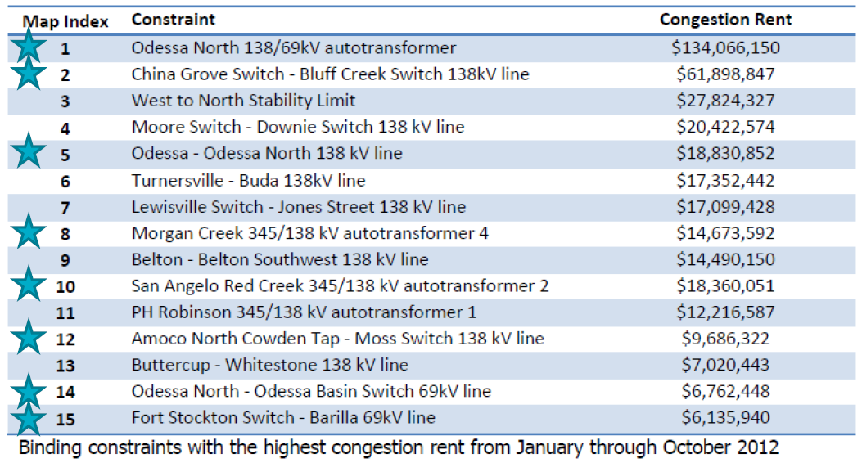
2012 top 15 constraints on the ercot system
Source: ERCOT, Report on Existing and Potential Electric System Constraints and Needs, December 2012.

Slide 42
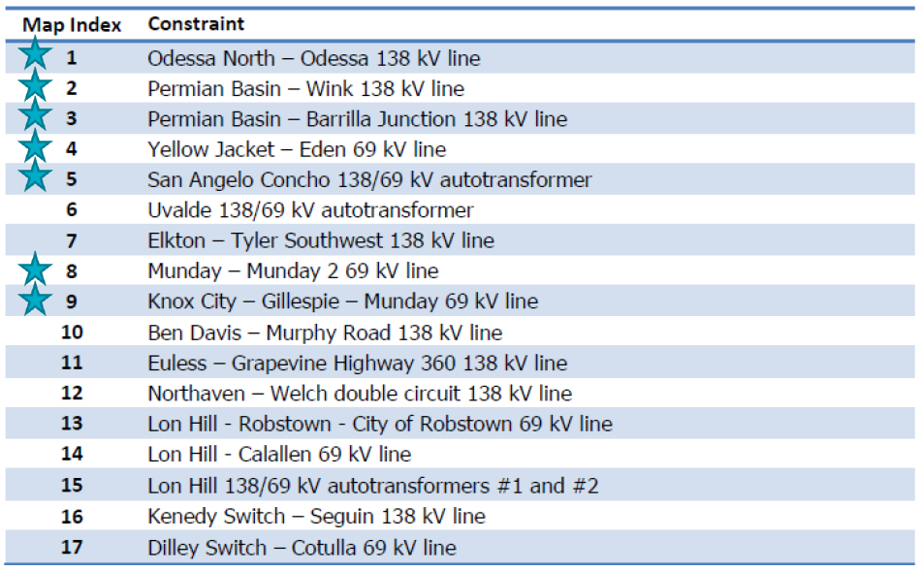
2012 five-year transmission plan – projected 2013 reliability constraints
Source: ERCOT, Report on Existing and Potential Electric System Constraints and Needs, December 2012.

Slide 43
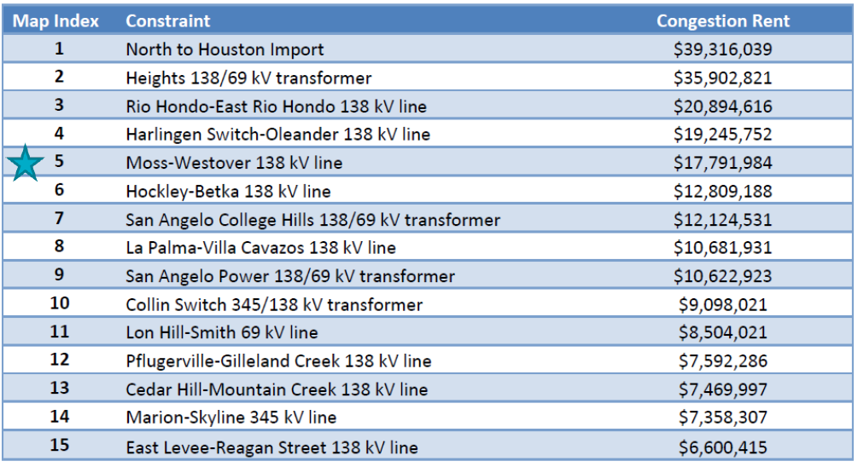
2015 top 15 constraints on the ercot system
Source: ERCOT, Report on Existing and Potential Electric System Constraints and Needs, December 2015.

Slide 44
RECENT WEST TEXAS OIL RIG COUNTY BY OPERATOR

Slide 45
WEST TEXAS
West Texas Drilling Activity
  Drilling activity remains strong in four counties – significant declines in other counties
    Midland Basin: Midland and Martin counties.
    Delaware Basin: Reeves and Loving counties.
PBPA Coal and Gas Seminar “An Education on Permian Basin O&G Production Operations and Midstream Processing”, November 10, 2015.
Hart, Paul, “Permian Basin’s Growth Threatens Power Overload”, Midstream Monitor, April 22, 2016, p. 2-4.

Slide 46
WEST TEXAS

Slide 47
TDSP SYSTEM IMPROVEMENTS

Slide 48
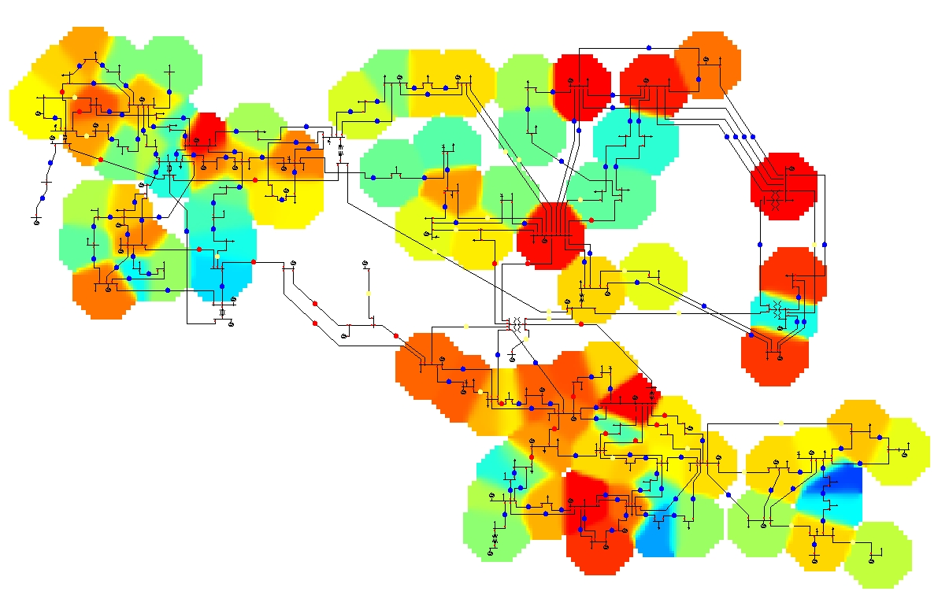
EXAMPLE LOAD HEAT MAP – EXHIBIT I

Slide 49
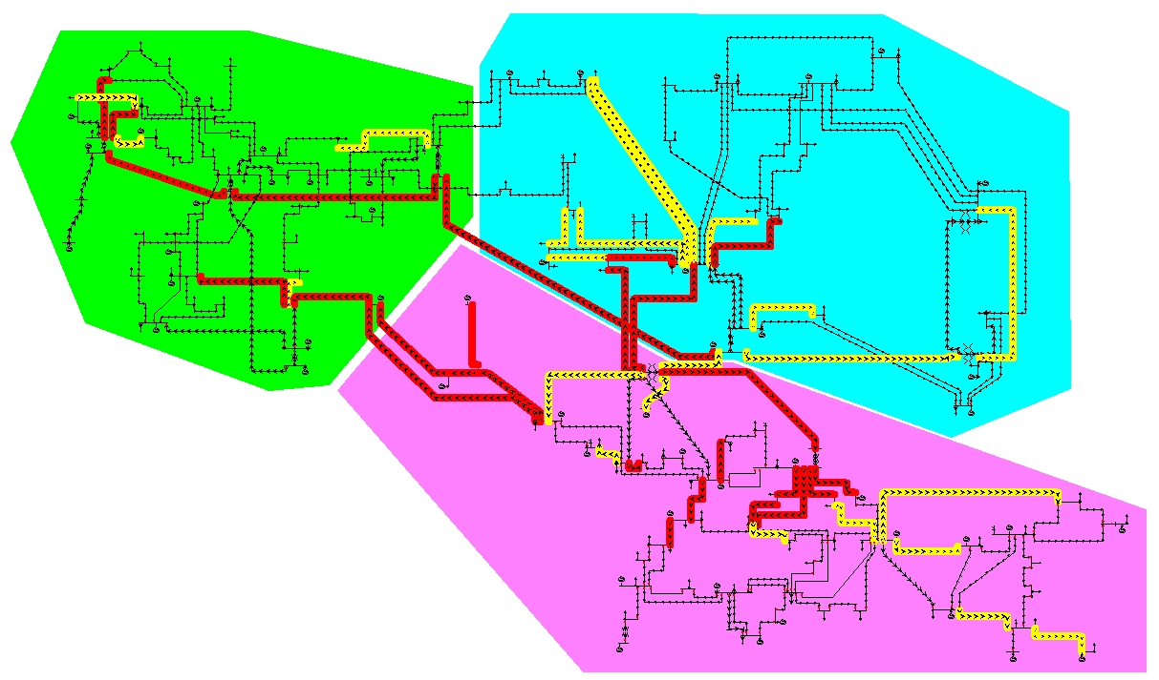
EXAMPLE LINE OVERLOADS MAP – EXHIBIT Ii

Slide 50
presentation by
Stephen L. Thumb

