Slide 1
SMT Update To AMWG
April 2016

Slide 2
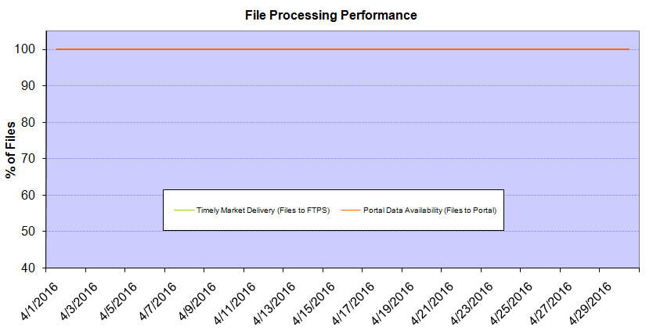
Monthly SMT Data Timelines AMWG CR 2014 002 End to End File Processing Completeness – APR 2016
% Timely Market Delivery - % of files posted to market (FTPS) by 11:00pm out of # of files received by SMT by 11:00pm.
% Portal Data Availability - % of files loaded to the database for data availability on portal by 6:00am next day for the files received by 11:00pm
* A LSE file includes usage data for up to 50,000 ESIIDs.
Observed Anomalies:
2

Slide 3
SMT API and FTPS Services Availability – APR 2016
The service availability is measured as a percentage of number of minutes the service was available out of the total number of minutes in a month, excluding planned outages.
Observed Anomalies:
Mar-Apr 2015: SMT outage and subsequent recovery/catch-up impacted API availability. FTPS was available for most of the part except on 03/21-03/22 for 36 hours.
26 Jul 2015: Services were unavailable for 12 hours due to Flash storage issue
25 Jan 2016: Services were unavailable for 19 hours due to storage configuration issue
07 Mar 2016: API Services were unavailable for 7hours due to Oracle archiver issue.
Notes:
3

Slide 4
SMT Number of Accounts by Type AMWG CR 2014 009 – APR 2016
Registered Users | ONC | CNP | AEPN | AEPC | TNMP | TOTAL
Active Residential Accounts | 36619 | 22673 | 2001 | 5289 | 2504 | 69086
Active Residential English Accounts | 36427 | 22525 | 1996 | 5177 | 2494 | 68619
Active Residential Spanish Accounts | 192 | 148 | 5 | 112 | 10 | 467
Non Active Residential Accounts | 17808 | 12346 | 1389 | 3042 | 635 | 34926
Total Residential Accounts | 54427 | 35019 | 3390 | 8331 | 3139 | 104012
TDSP User | 306 | 40 | 12 | 17 | 2 | 377
TDSP Admin | 4 | 4 | 4 | 4 | 3 | 19
Small Business User | 92 | 44 | 0 | 4 | 4 | 144
Small Business Admin | 2530 | 1365 | 75 | 268 | 100 | 4447
Total Agreements (Includes Active and Pending) | 1584 | 716 | 1 | 0 | 0 | 2301
Energy Data Agreements (Includes Active and Pending) | 1531 | 417 | 1 | 0 | 0 | 1949
Han Device Agreements (Includes Active and Pending) | 53 | 298 | 0 | 0 | 0 | 351
Han Service Agreements (Includes Active and Pending) | 0 | 1 | 0 | 0 | 0 | 1
IN SMT
ESI IDs | 3475929 | 2402337 | 197482 | 857323 | 224672 | 7157743
Meters | 3408075 | 2402304 | 198274 | 857543 | 224477 | 7090673
HAN Devices | 3898 | 5218 | 135 | 285 | 38 | 9574
Acknowledgement | 0 | 0 | 0 | 0 | 0
Pending | 0 | 6 | 0 | 0 | 0
Meter Ready | 15 | 5 | 43 | 117 | 25
Provisioned | 3883 | 5207 | 92 | 168 | 13
HAN Messages (MTD) | 0 | 0 | 0 | 0 | 0 | 0
HAN Messages (YTD) | 12 | 3 | 0 | 0 | 0 | 15
HAN Messages (Cumulative) | 334 | 7400 | 0 | 0 | 0 | 7734
Simple Text Messages | 98 | 2925 | 0 | 0 | 0
Load Control Messages | 100 | 2658 | 0 | 0 | 0
Pricing Messages | 92 | 53 | 0 | 0 | 0
Cancellation Messages | 44 | 1764 | 0 | 0 | 0
Supplemental – (Friends)
Total Agreements | 1608 | 1292 | 73 | 84 | 57 | 3114
Accepted Agreements | 709 | 503 | 32 | 29 | 18 | 1291
Pending Agreements | 7 | 0 | 0 | 0 | 0 | 7
Revoked Agreements | 235 | 248 | 9 | 7 | 6 | 505
Expired Agreements | 631 | 514 | 30 | 48 | 33 | 1256
Terminated Agreements | 26 | 27 | 2 | 0 | 0 | 55
 | TDSPs | REP | Small Business | Regulatory | Third Party
Registered Entities | 5 | 109 | 4326 | 2 | 88
Registered Users | 377 | 854 | 144 | 7 | 20
Registered Admins | 19 | 171 | 4338 | 3 | 92
HAN Messages Sent By | 327 | 7383

Slide 5
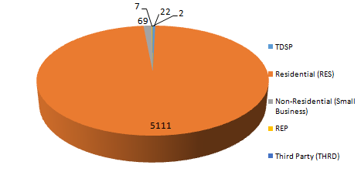
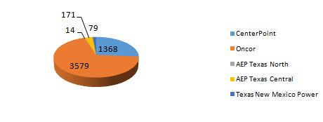
SMT ODR Details – APR 2016
Total ODR Requests TDSP wise statistics:
Total ODR Requests User type statistics:

