Slide 1
Multi-Interval Real-Time Market (MIRTM)
Demand and Wind Estimation Updates
SAWG
Sean Chang
Market Analysis
May 16, 2016

Slide 2
Table of Contents
Introduction
Improving Demand Estimation
Improving Wind HSL Estimation
Examining Net Load Estimation Error Distribution
Observations & Next Steps
Appendix

Slide 3
Introduction
Improving Demand Estimation
Short-Term Load Forecast (STLF)
Generation-To-Be-Dispatched (GTBD) Calculation Methodology
2. Improving Wind HSL Estimation
Indicative Pricing Tool currently uses a heuristically determined linear equation to estimate wind HSL
Currently, plan is for MIRTM to use Persistence to estimate wind HSL
Improvements using ARIMA at the system-wide level were devised to show potential improvement in short-term wind HSL estimation
If time permits, ERCOT will devise plant or region specific ARIMA coefficients for wind HSL estimation

Slide 4
Introduction
3. Examining Net Load Error Distribution
Combines the impact of demand and wind estimation
  Note that this is not a direct input into MIRTM
Examine error distribution to see performance at outer percentiles
Net Load for this presentation is defined as:
  Estimated Demand – Estimated Wind HSL
  and
  Actual Demand – Actual Wind HSL

Slide 5
Improving Demand Estimation

Slide 6
Introduction
Both STLFs use weather and calendar variables as basic inputs.
Current STLF (Legacy system in the EMMS)
  Based on regression similar day model using lagged load values as well as lagged load from 24 hours ago of a similar day
New STLF (Blended Model)
  First 15 minutes is based on a regression model using lagged load values (forecast of total MW for a weather zone)
  Next 45+ minutes is based on a regression model of ramp rates (forecast of total MW change from last actual value)
See May 2015 SAWG meeting page for previous presentation: http://www.ercot.com/calendar/2015/5/27/55033-SAWG

Slide 7
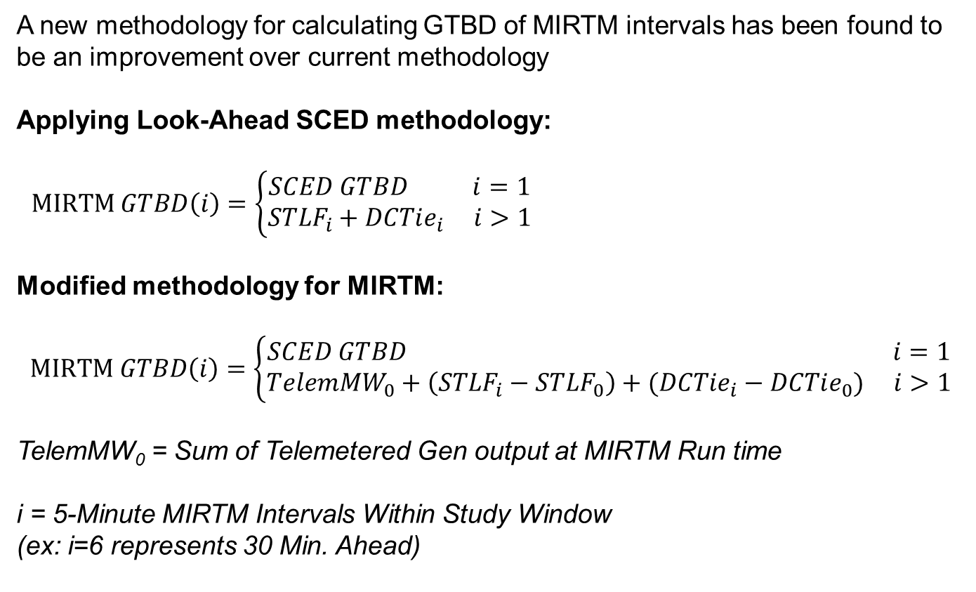
Introduction
A new methodology for calculating GTBD of MIRTM intervals has been found to be an improvement over current methodology
Applying Look-Ahead SCED methodology:
$MIRTM GTBD\left(i\right)=\left\{\begin{aligned}SCED GTBD i=1 \\ {STLF}_{i}+DCTie_{i} i>1\end{aligned}\right.$
Modified methodology for MIRTM:
$$MIRTM GTBD\left(i\right)=\left\{\begin{aligned}SCED GTBD i=1 \\ TelemMW_{0}+\left(STLF_{i}−STLF_{0}\right)+(DCTie_{i}−DCTie_{0}) i>1\end{aligned}\right.$$
TelemMW₀ = Sum of Telemetered Gen output at MIRTM Run time
i = 5-Minute MIRTM Intervals Within Study Window
(ex: i=6 represents 30 Min. Ahead)

Slide 8
Introduction
Both the current STLF and new STLF are used in the analysis along with the modified methodology for four combinations:
  MIRTM GTBD with current STLF
  MIRTM GTBD with new STLF
  MIRTM GTBD Modified with current STLF
  MIRTM GTBD Modified with new STLF
The calculated MIRTM GTBD errors are benchmarked using Estimated – Reference where Reference is:
  First interval (i=1): Actual SCED GTBD
  Intervals 2 – 6 (i=2…6): Sum of generator output at end of SCED interval

Slide 9
Statistics of MIRTM GTBD Modified with New STLF vs. Reference

Slide 10
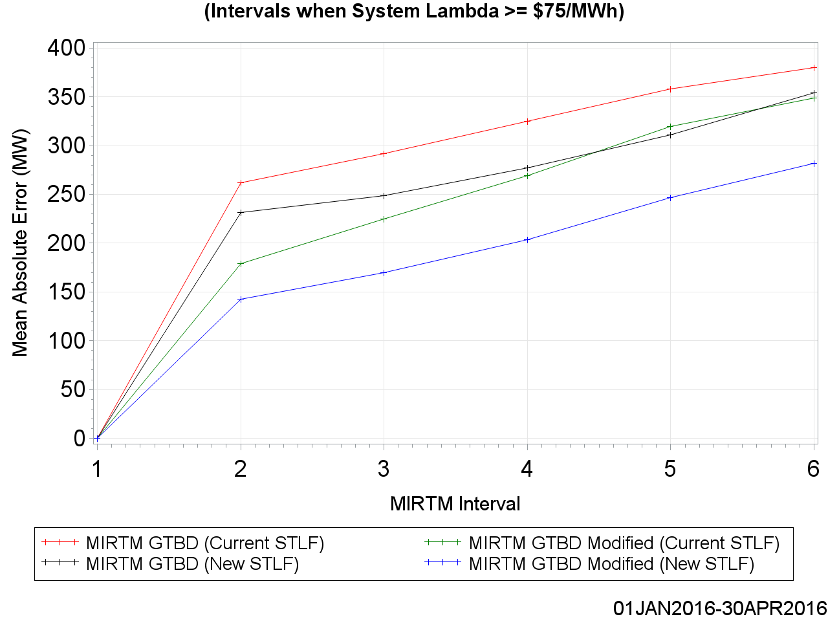
Statistics of MIRTM GTBD Modified with New STLF vs. Reference

Slide 11
Improving Wind HSL Estimation

Slide 12
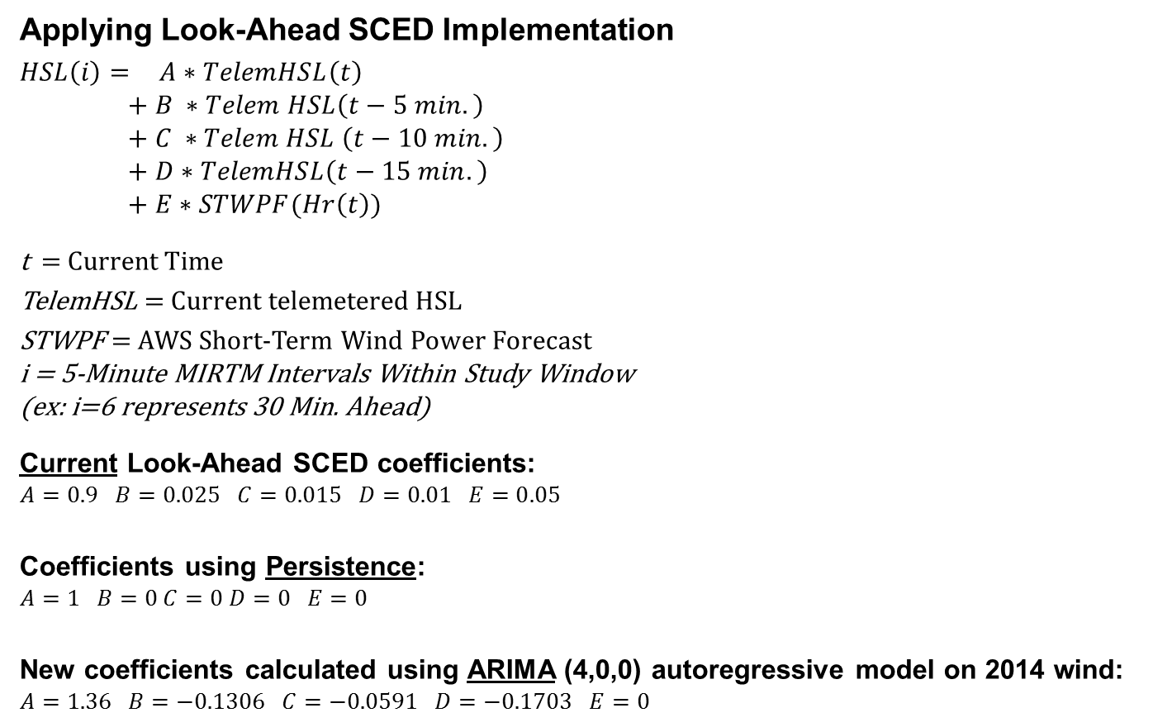
Improving Wind HSL Estimation in MIRTM
Applying Look-Ahead SCED Implementation
$HSL\left(i\right)=$ $A∗TelemHSL\left(t\right)$
$$+ B ∗Telem HSL\left(t−5 min.\right)$$
$$+ C ∗Telem HSL \left(t−10 min.\right)$$
$$+ D∗TelemHSL\left(t−15 min.\right)$$
$$+ E∗STWPF(Hr\left(t\right))$$
t = Current Time
TelemHSL = Current telemetered HSL
STWPF = AWS Short-Term Wind Power Forecast
i = 5-Minute MIRTM Intervals Within Study Window
(ex: i=6 represents 30 Min. Ahead)
Current Look-Ahead SCED coefficients:
$$A=0.9 B=0.025 C=0.015 D=0.01 E=0.05$$
Coefficients using Persistence:
$$A=1 B=0 C=0 D=0 E=0$$
New coefficients calculated using ARIMA (4,0,0) autoregressive model on 2014 wind:
$$A=1.36 B=−0.1306 C=−0.0591 D=−0.1703 E=0$$
Notes:
Performance is calculated using system-wide wind. Actual implementation would require each unit to be treated separate. Further work is being done.

Slide 13
Statistics of Estimated Wind HSL vs. Actual Wind HSL

Slide 14
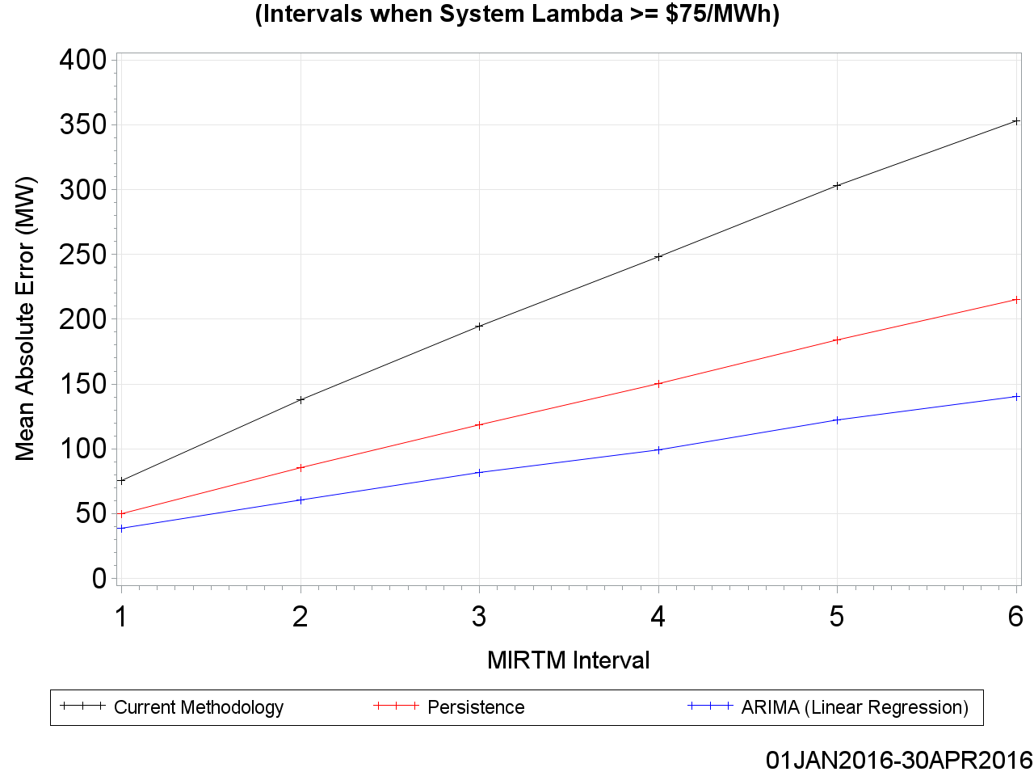
Statistics of Estimated Wind HSL vs. Actual Wind HSL

Slide 15
Examining Net Load Error Distribution

Slide 16
Examining Net Load Error Distribution
Both the STLF and Wind HSL Estimation are combined into a singular value to examine its distribution. The following three combinations are chosen:
  MIRTM GTBD Modified with Current STLF minus Persisted Wind HSL
  MIRTM GTBD Modified with New STLF minus Persisted Wind HSL
  MIRTM GTBD Modified with New STLF minus ARIMA Wind HSL
The calculated net load errors are benchmarked using:
(Actual Demand – Actual Wind HSL) – (Estimated Demand – Estimated Wind HSL).

Slide 17
Net Load Estimation Error Analysis
July 1, 2015 – April 30, 2016
All Intervals

Slide 18
MAE of Load, Wind, and Net Load Forecasts

Slide 19
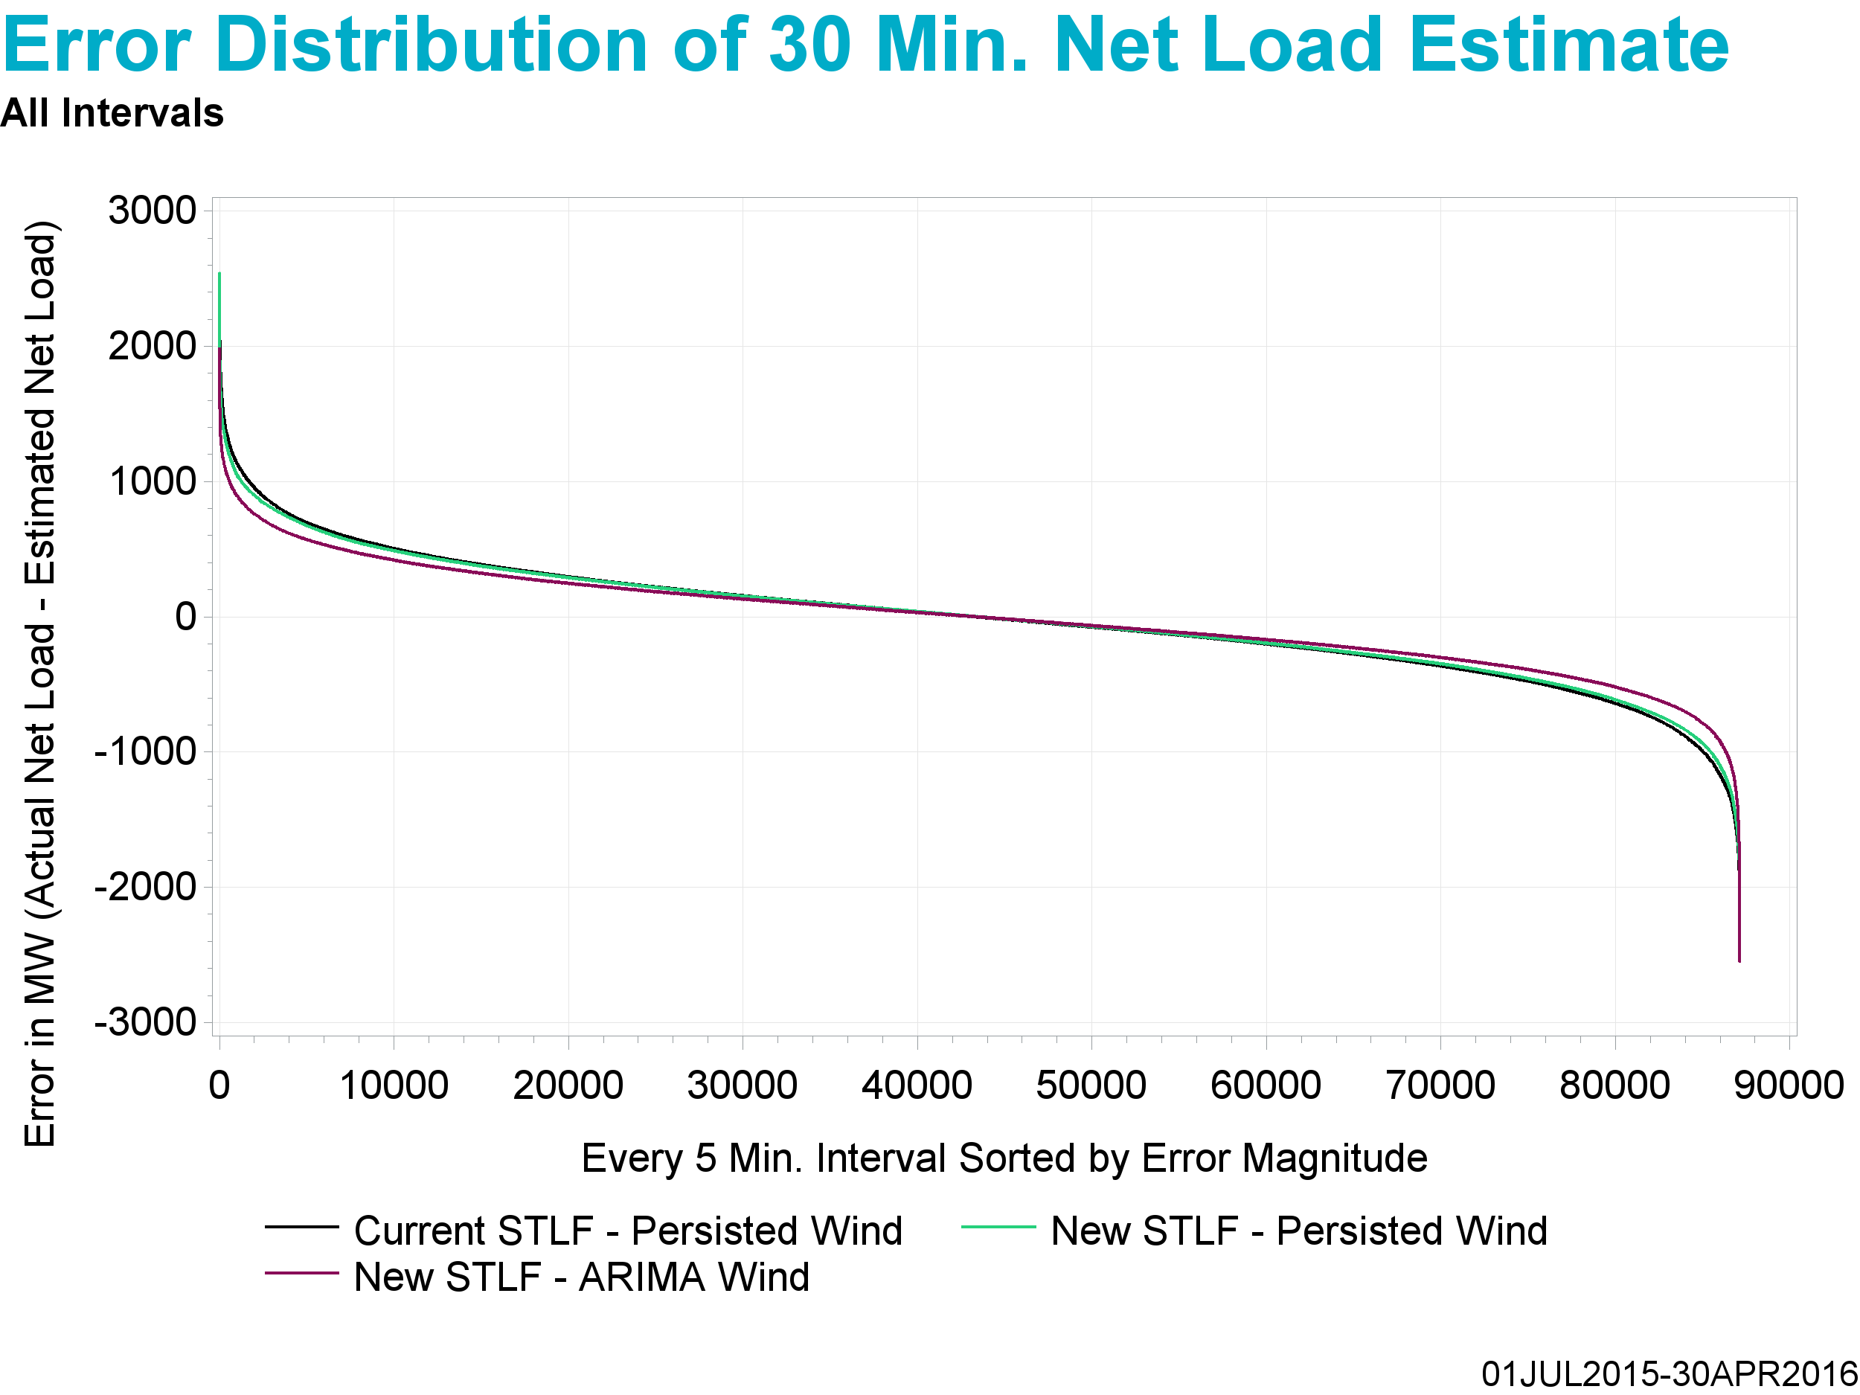
Underestimate
Overestimate

Slide 20
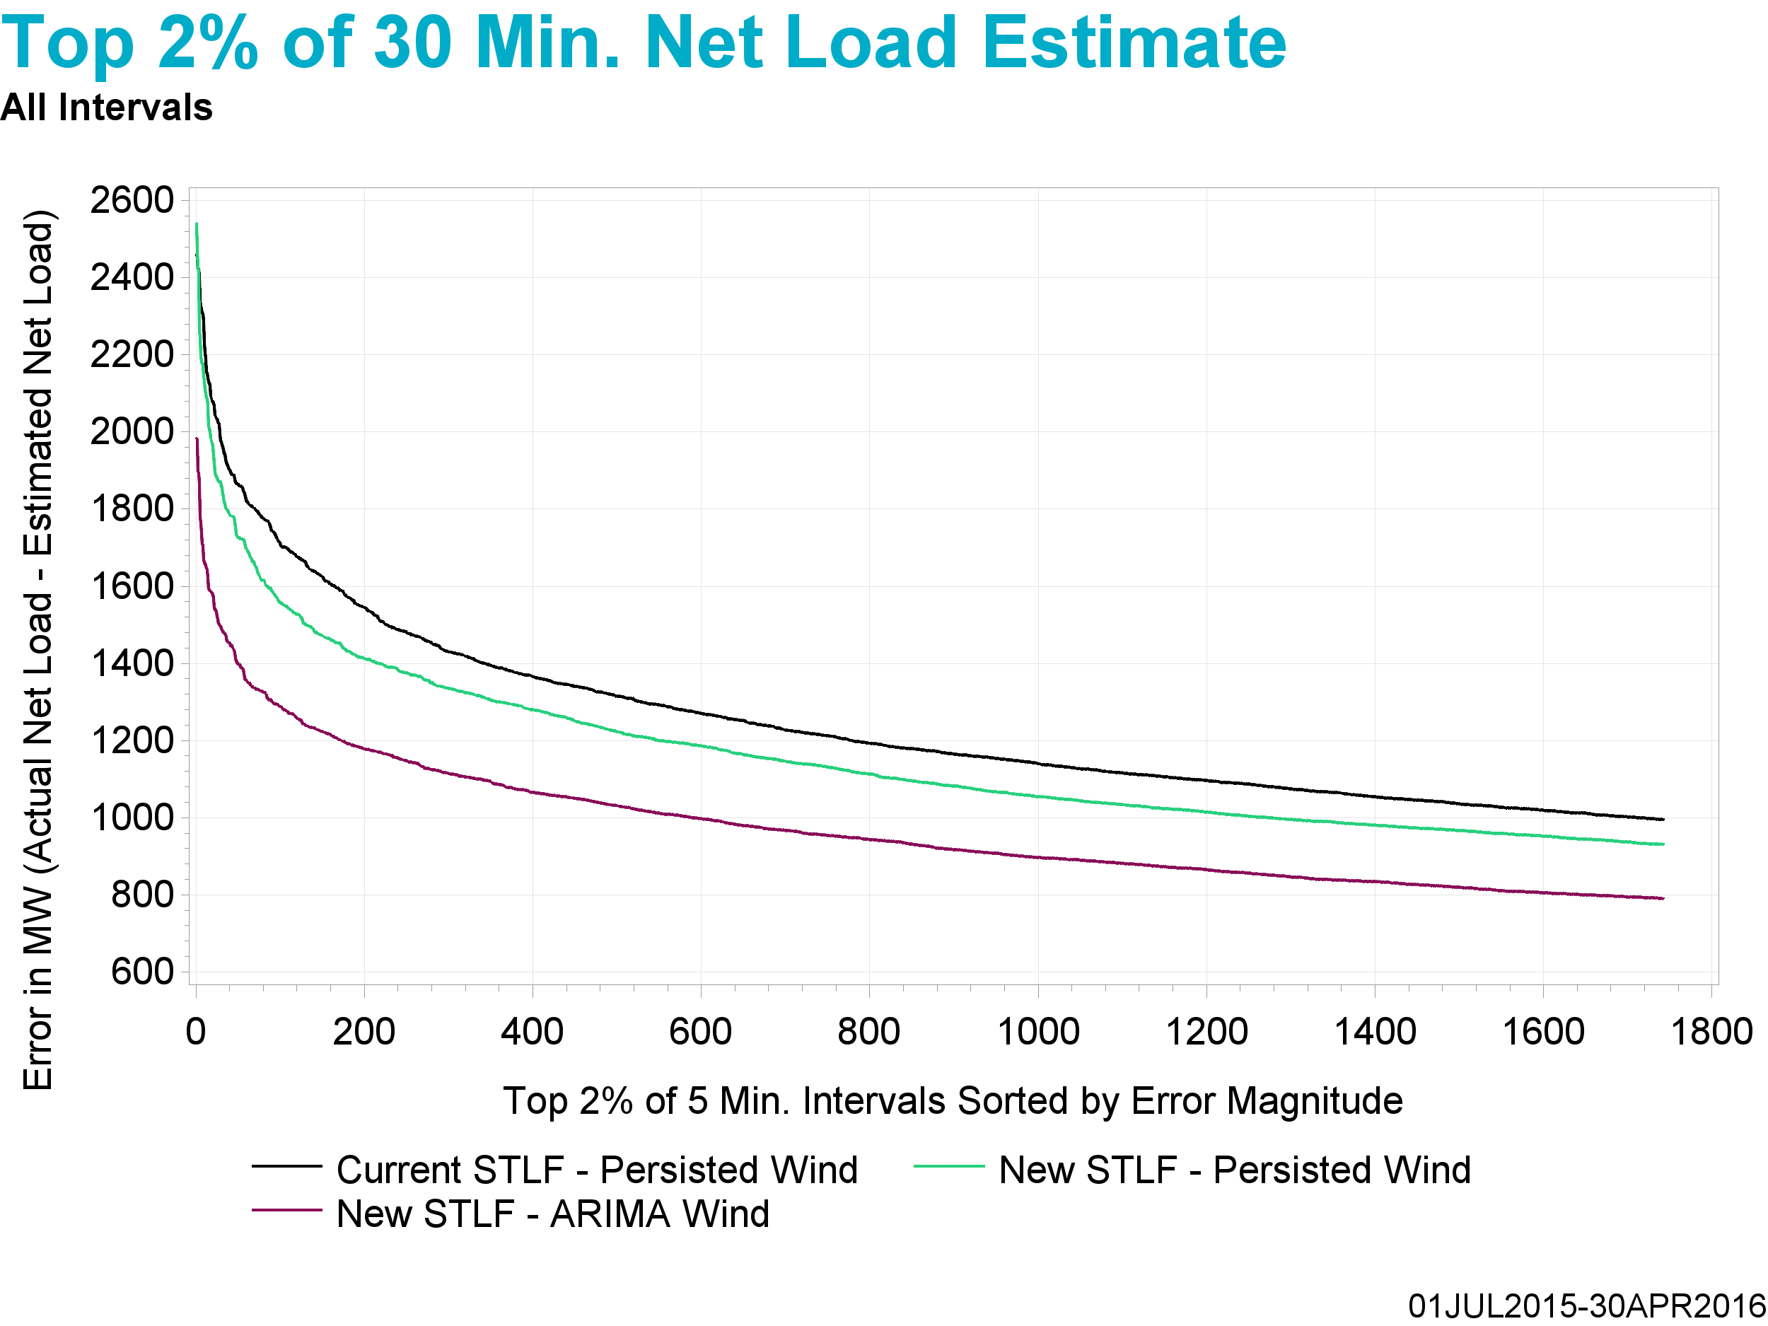
Underestimate

Slide 21
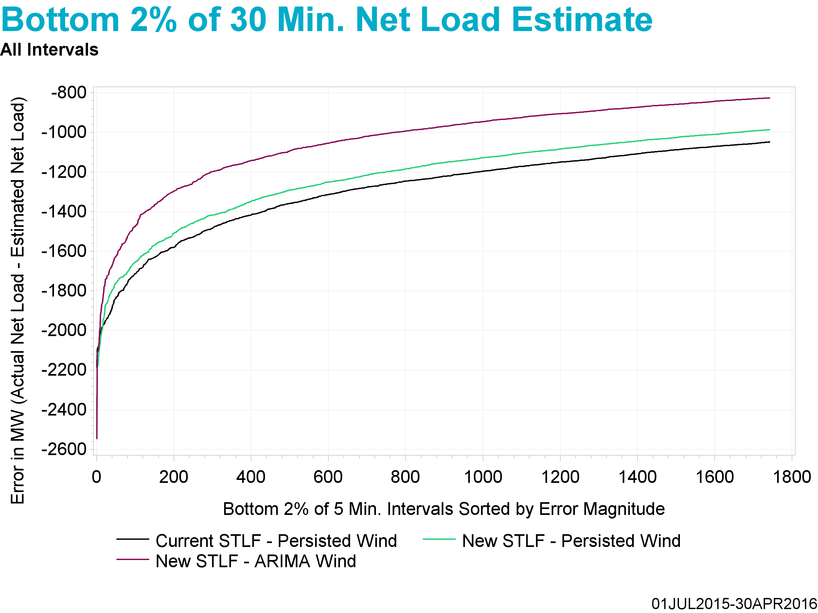
Overestimate

Slide 22
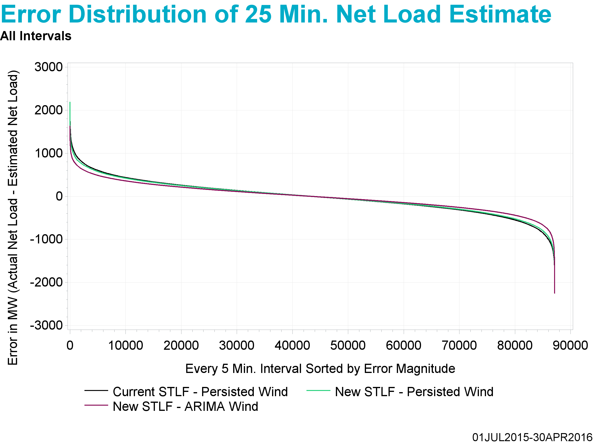
Underestimate
Overestimate

Slide 23
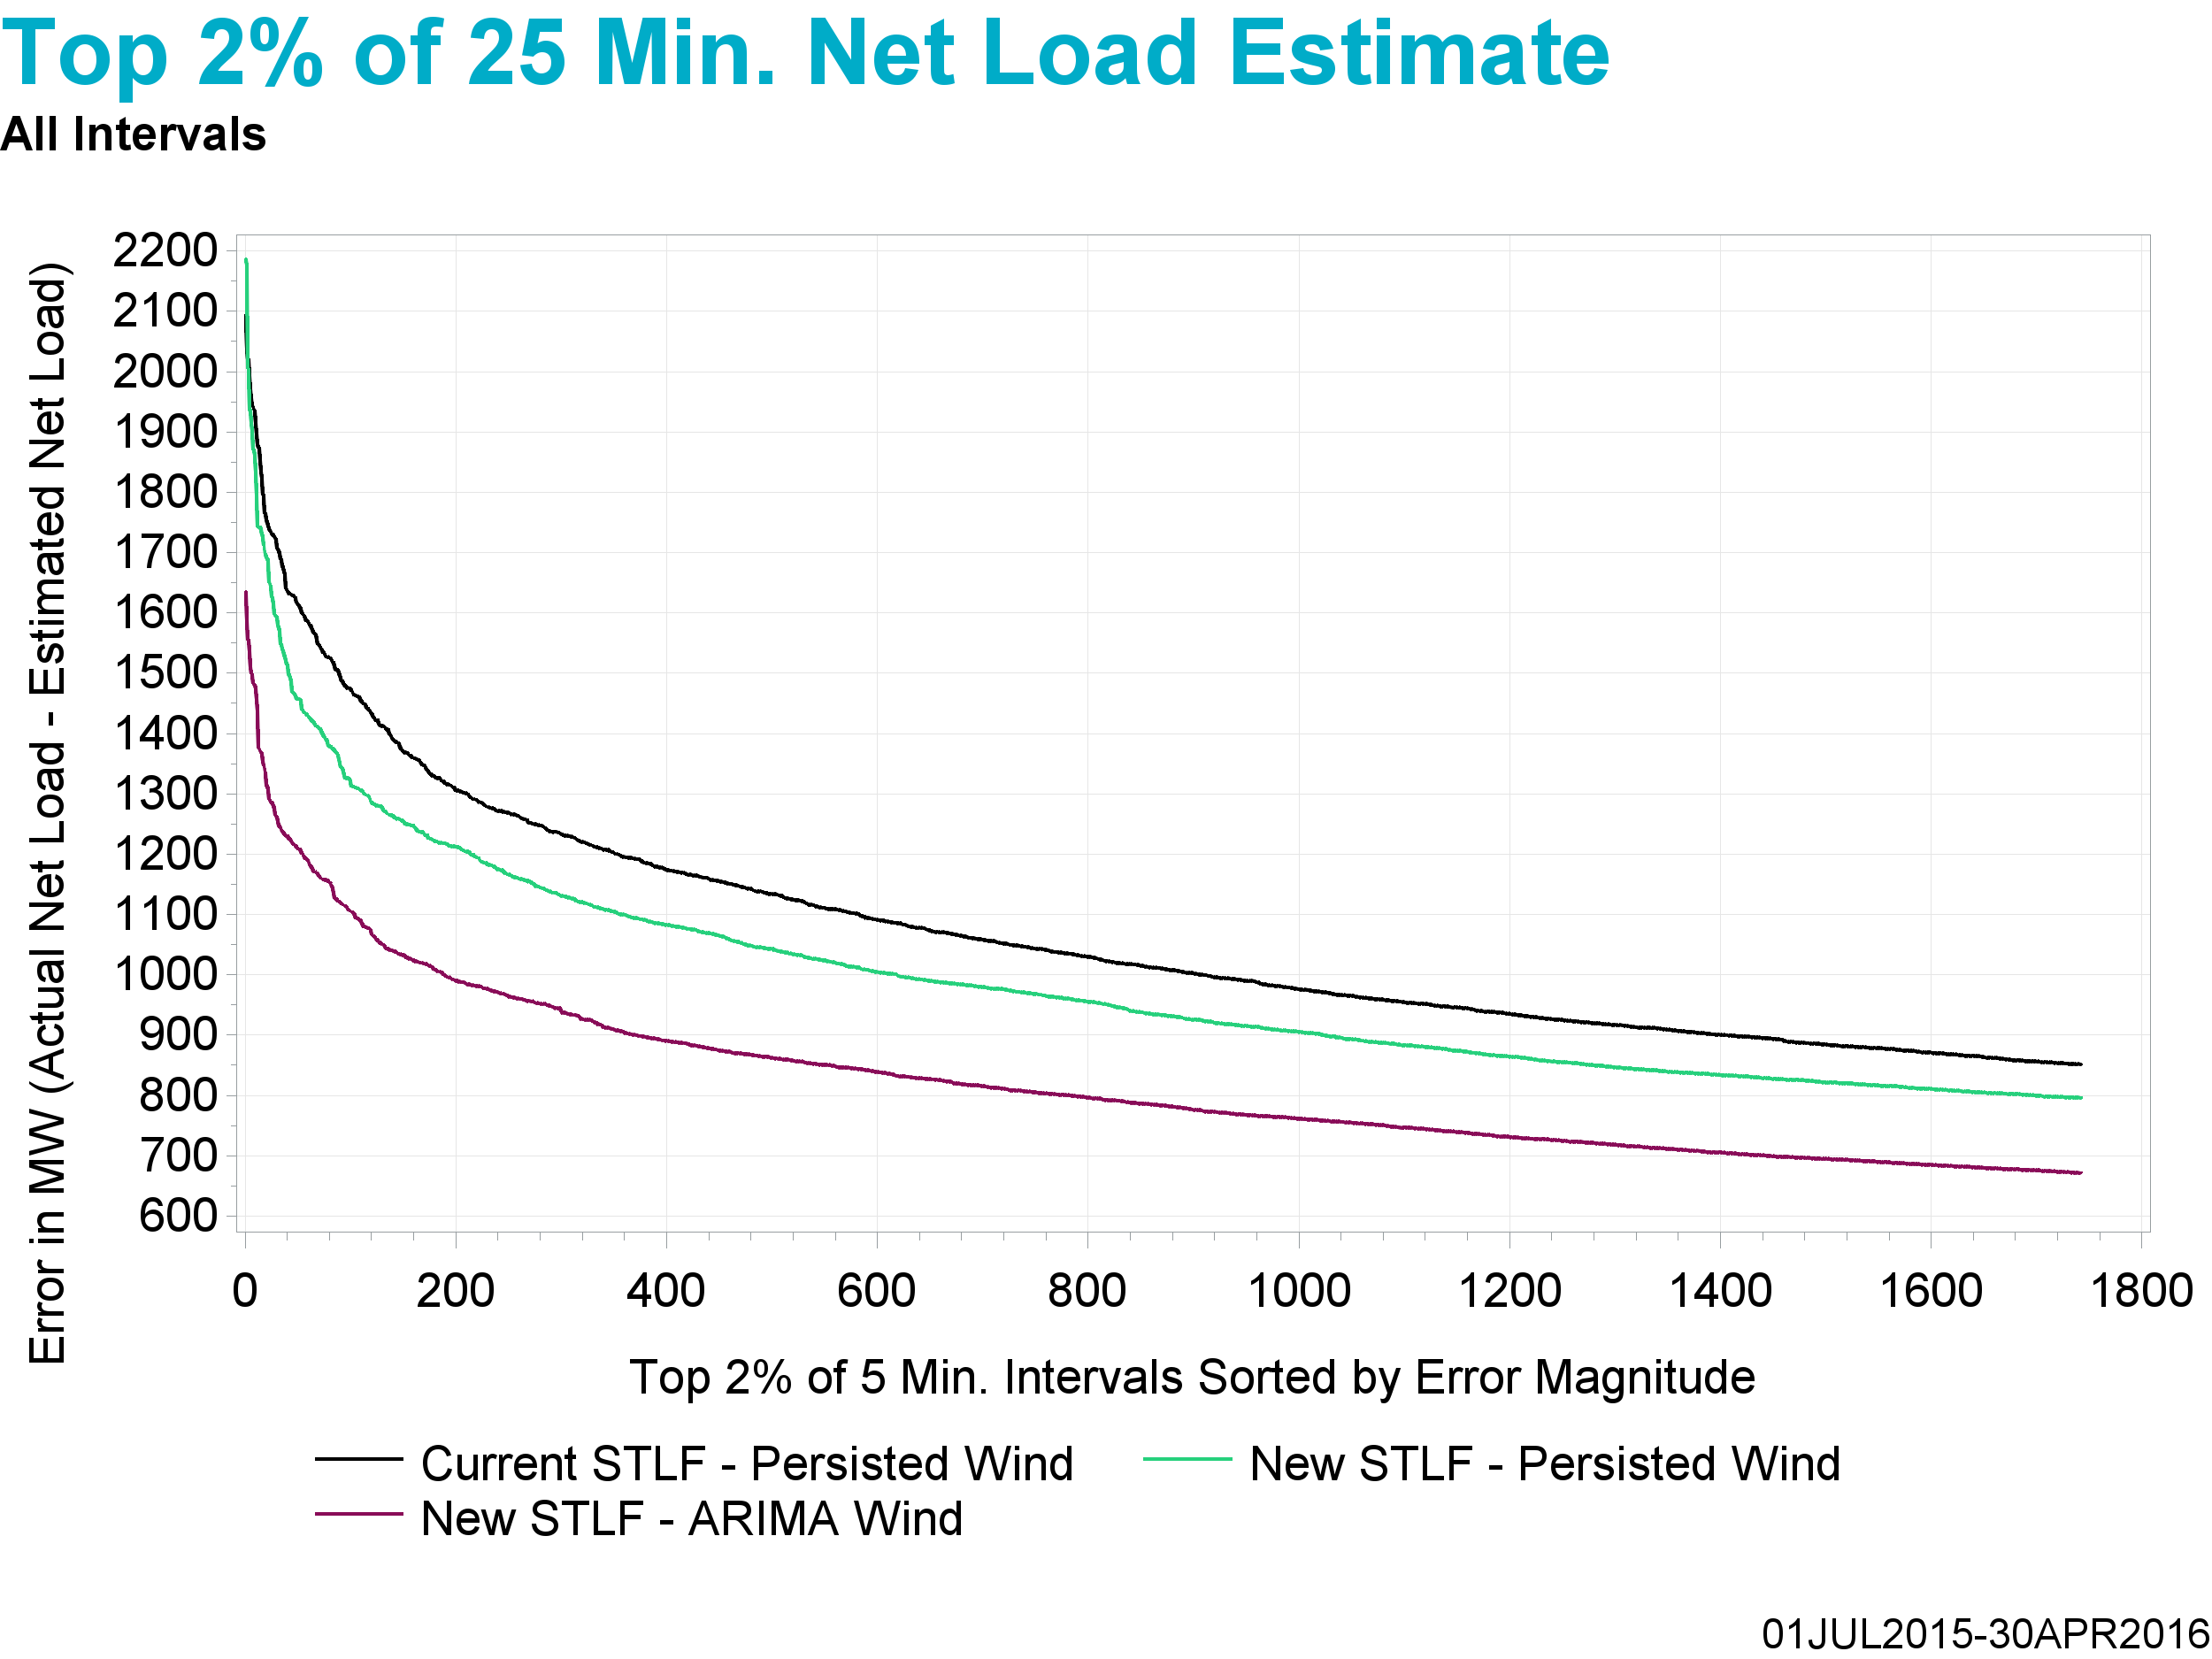
Underestimate

Slide 24
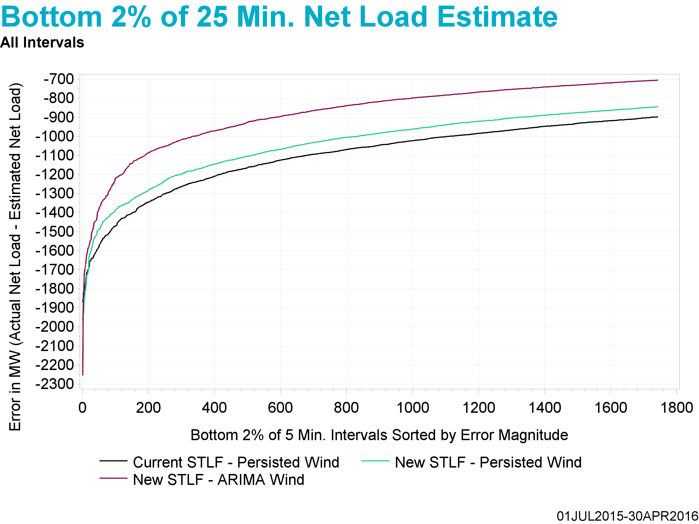
Overestimate

Slide 25
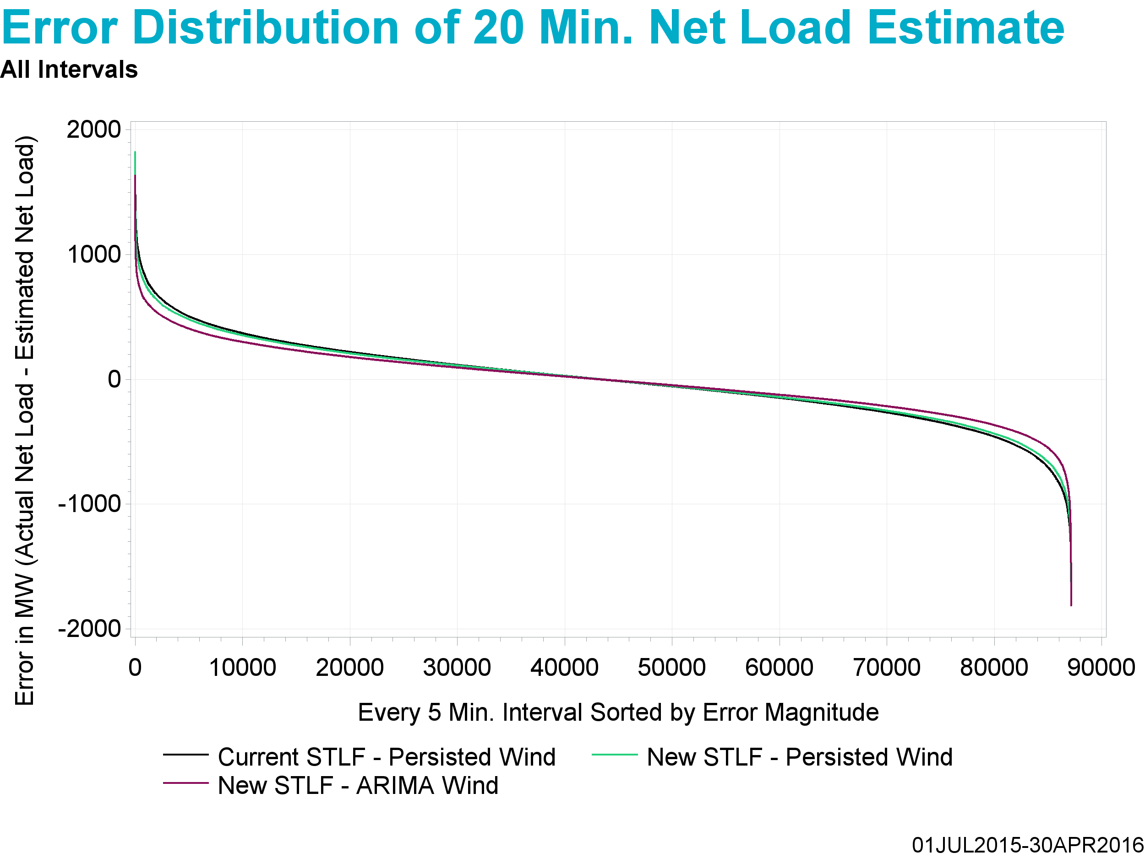
Underestimate
Overestimate

Slide 26
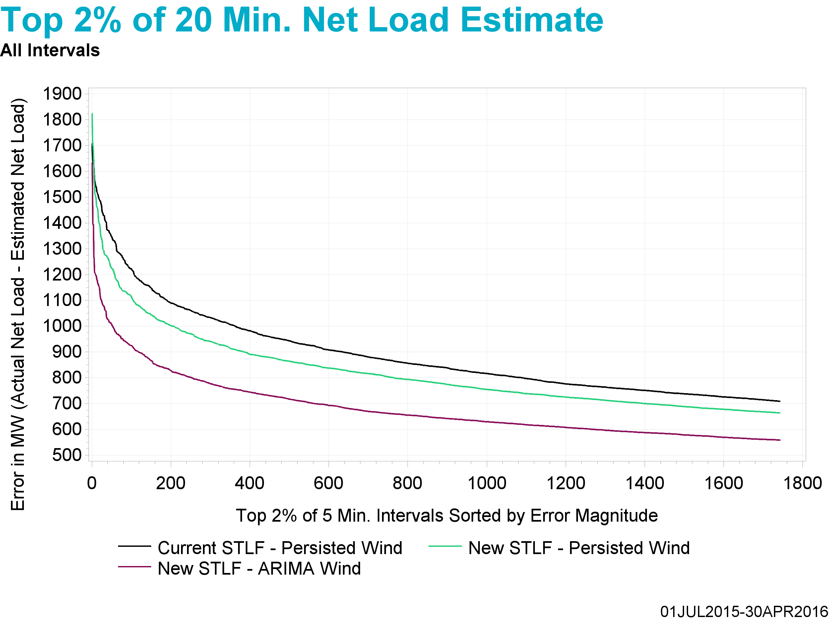
Underestimate

Slide 27
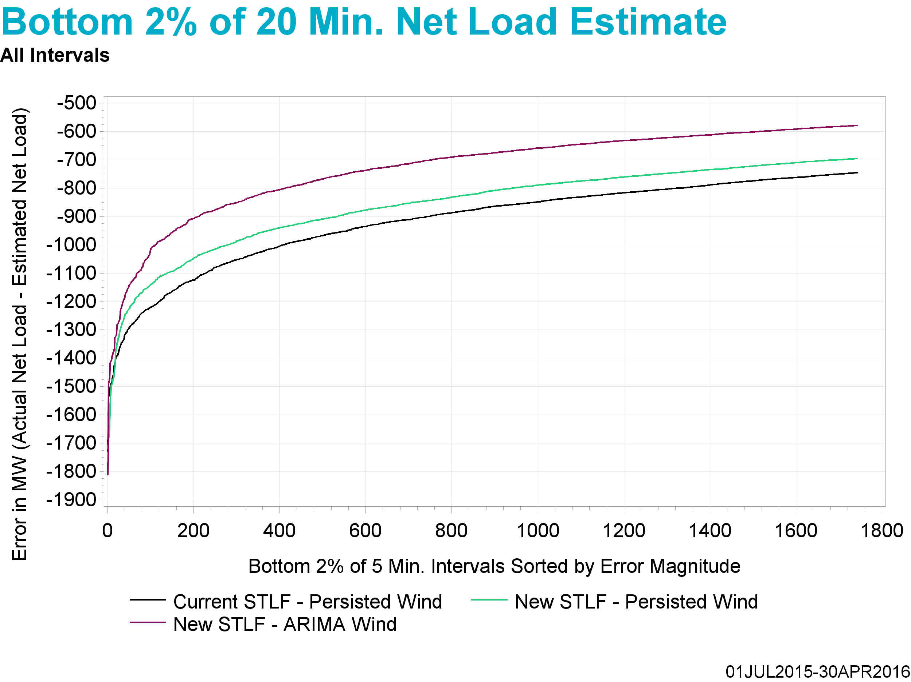
Overestimate

Slide 28
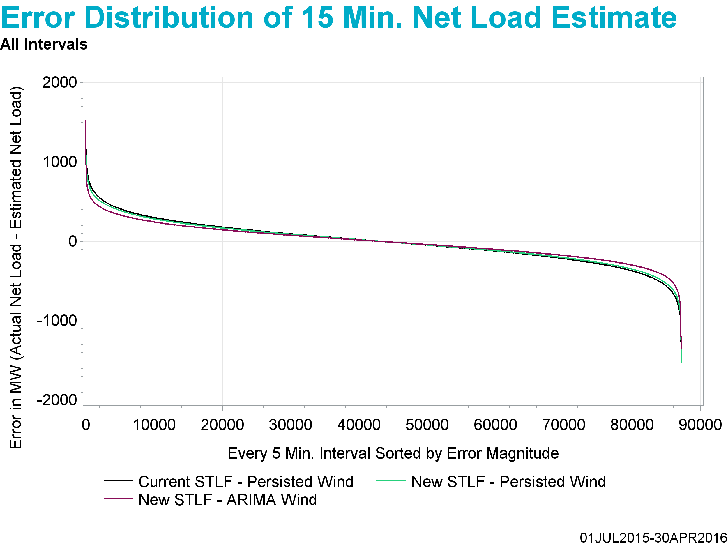
Underestimate
Overestimate

Slide 29

Underestimate

Slide 30
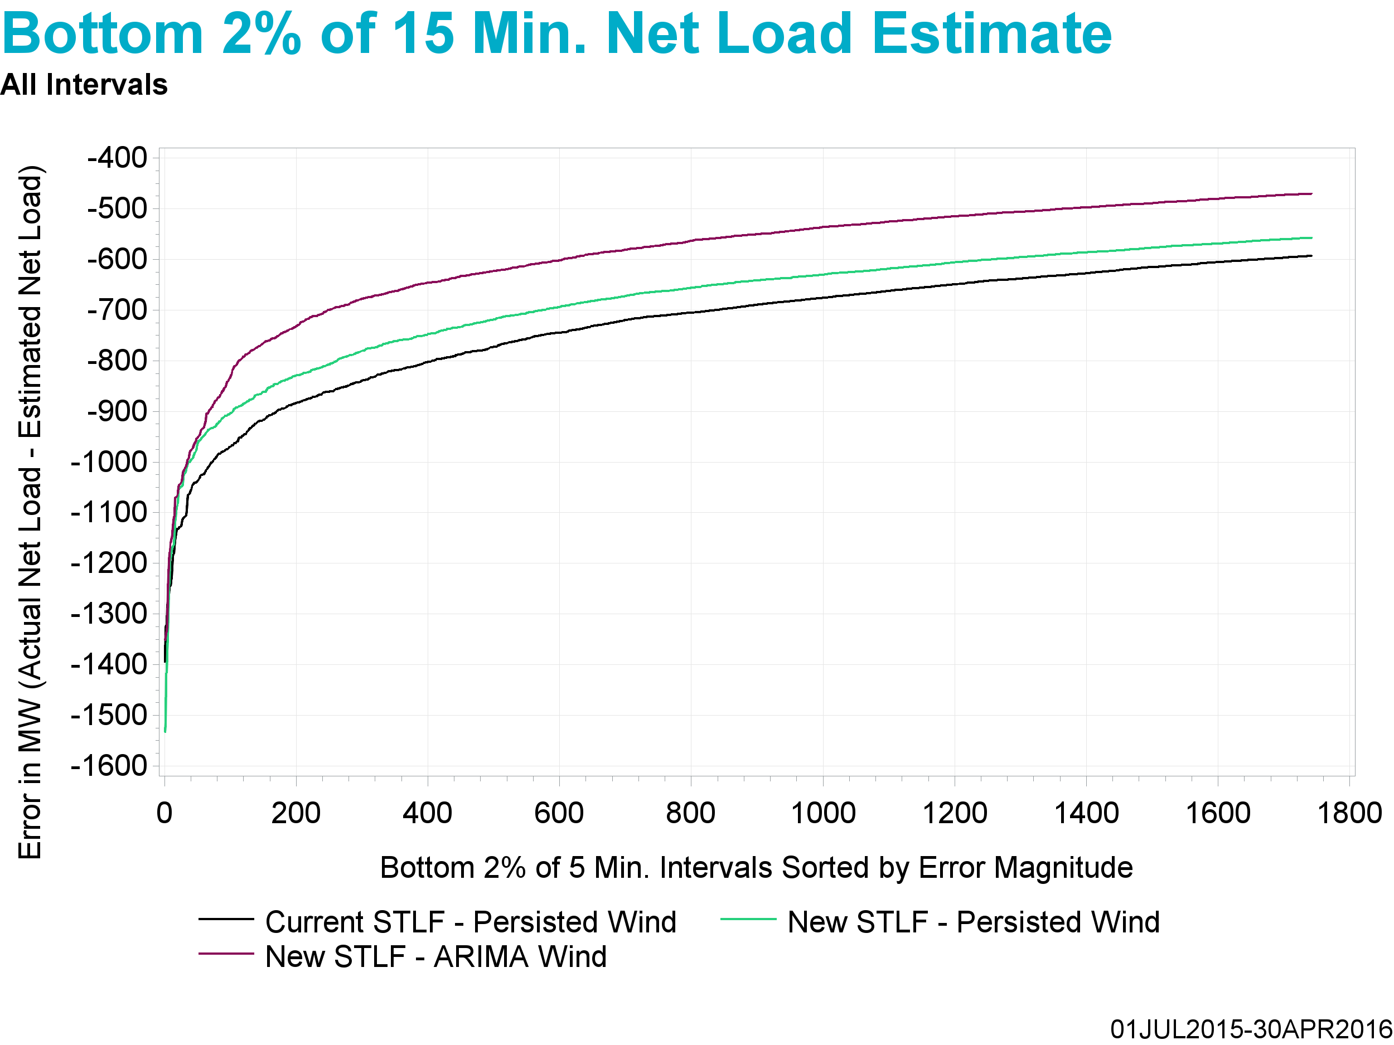
Overestimate

Slide 31
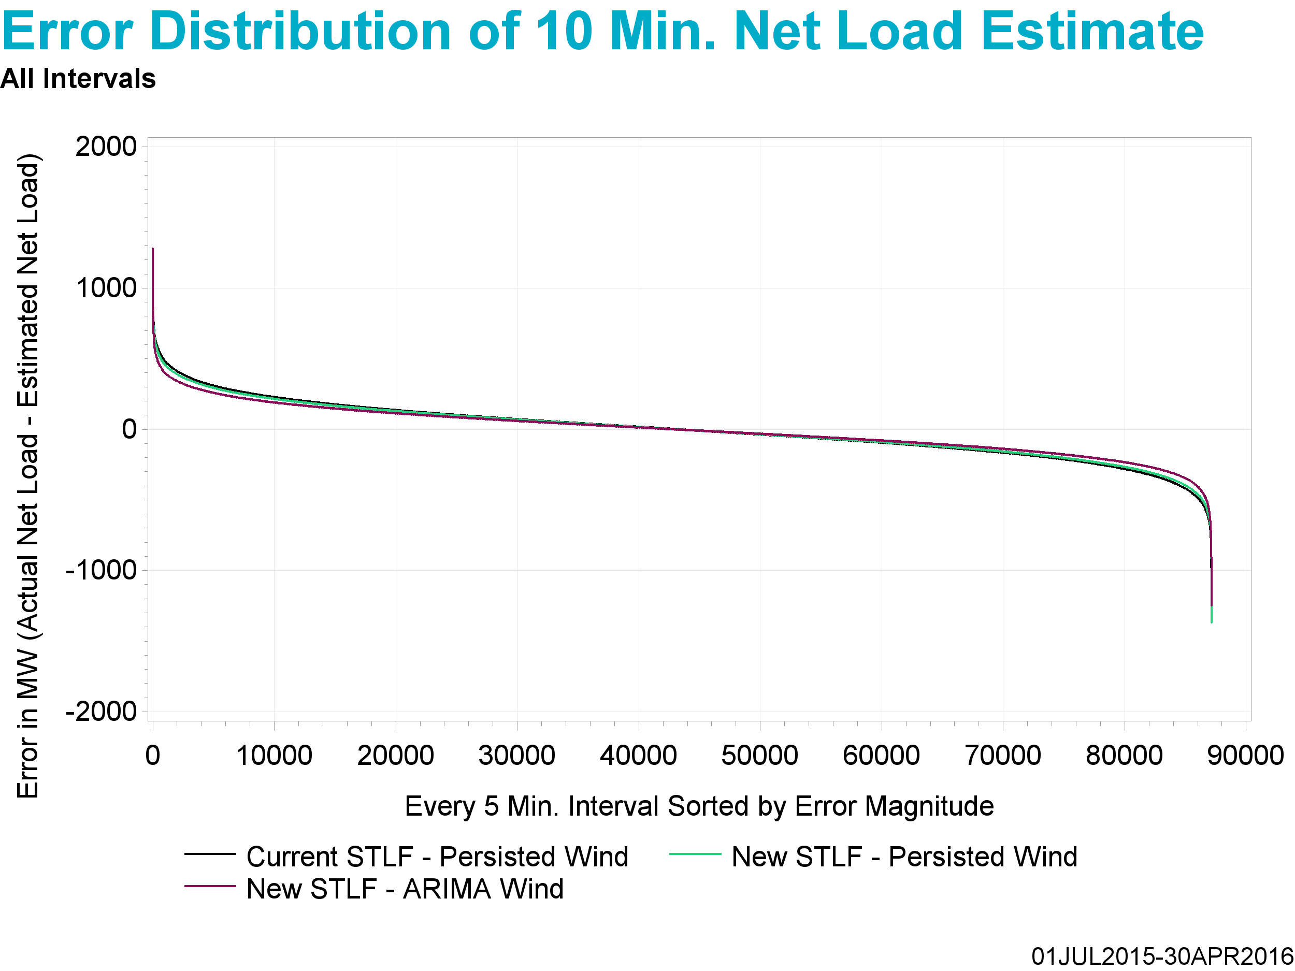
Underestimate
Overestimate

Slide 32
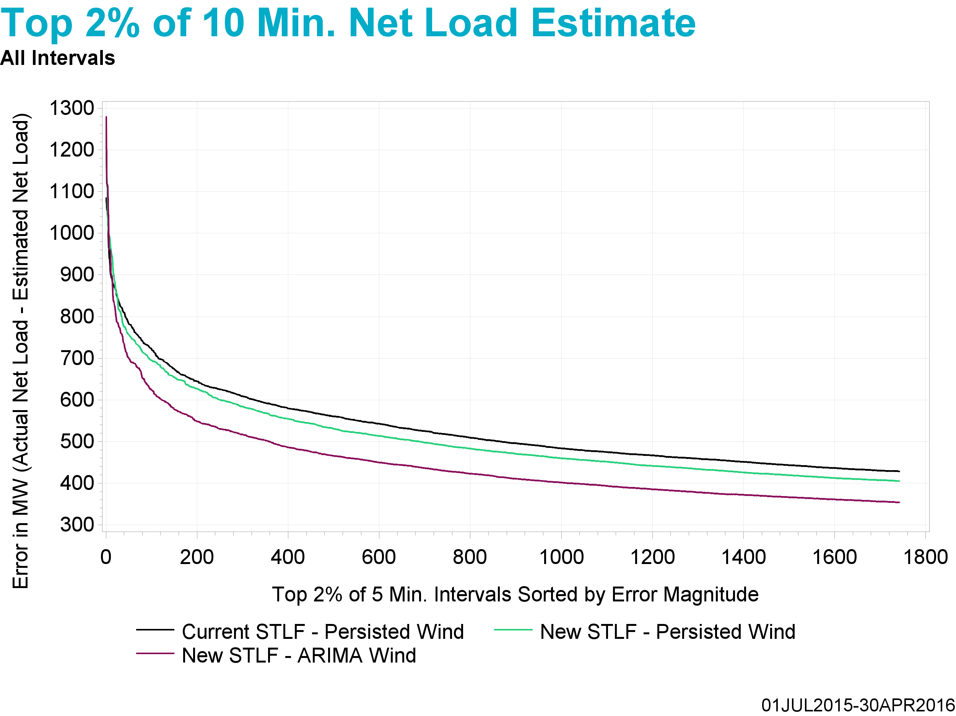
Underestimate

Slide 33
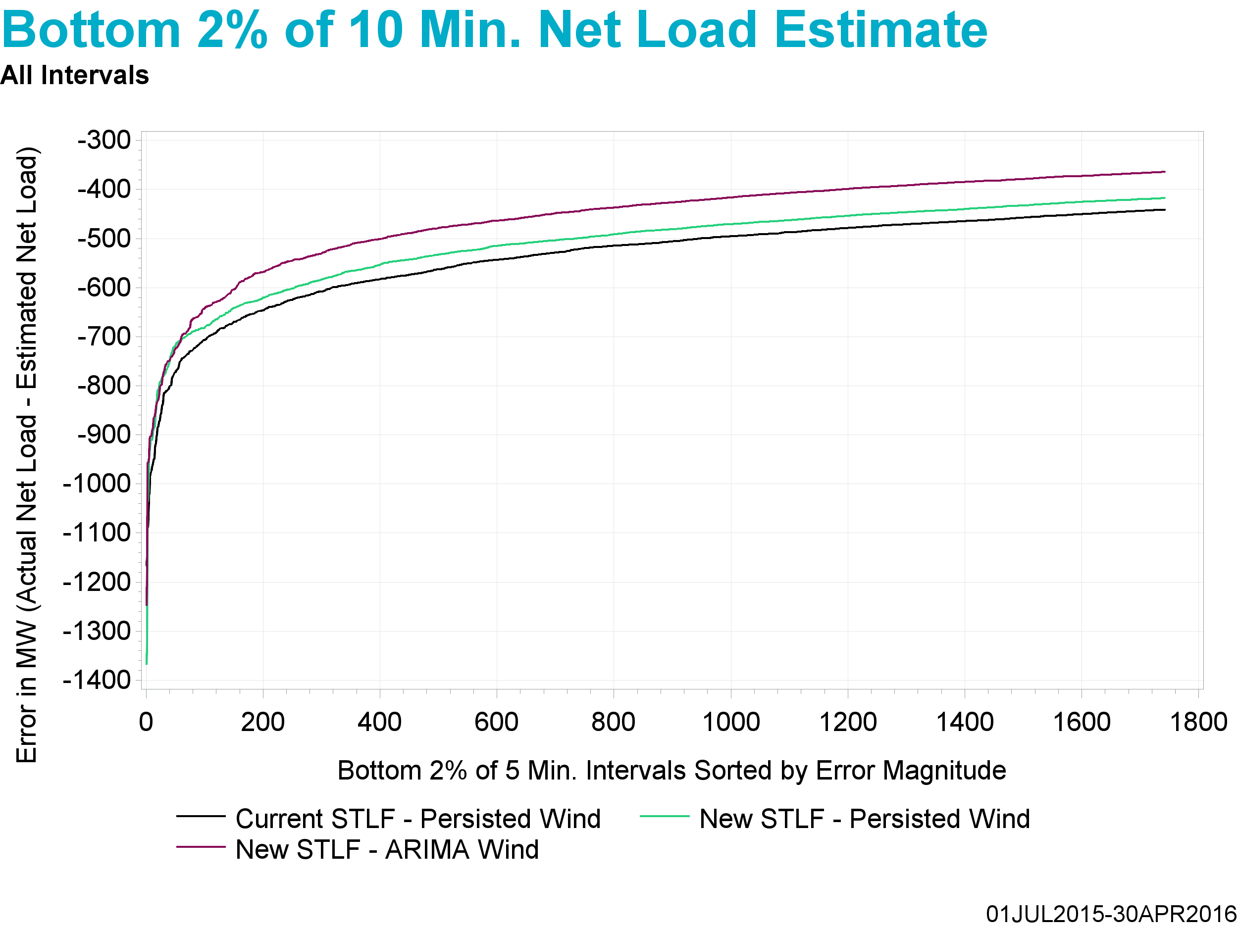
Overestimate

Slide 34
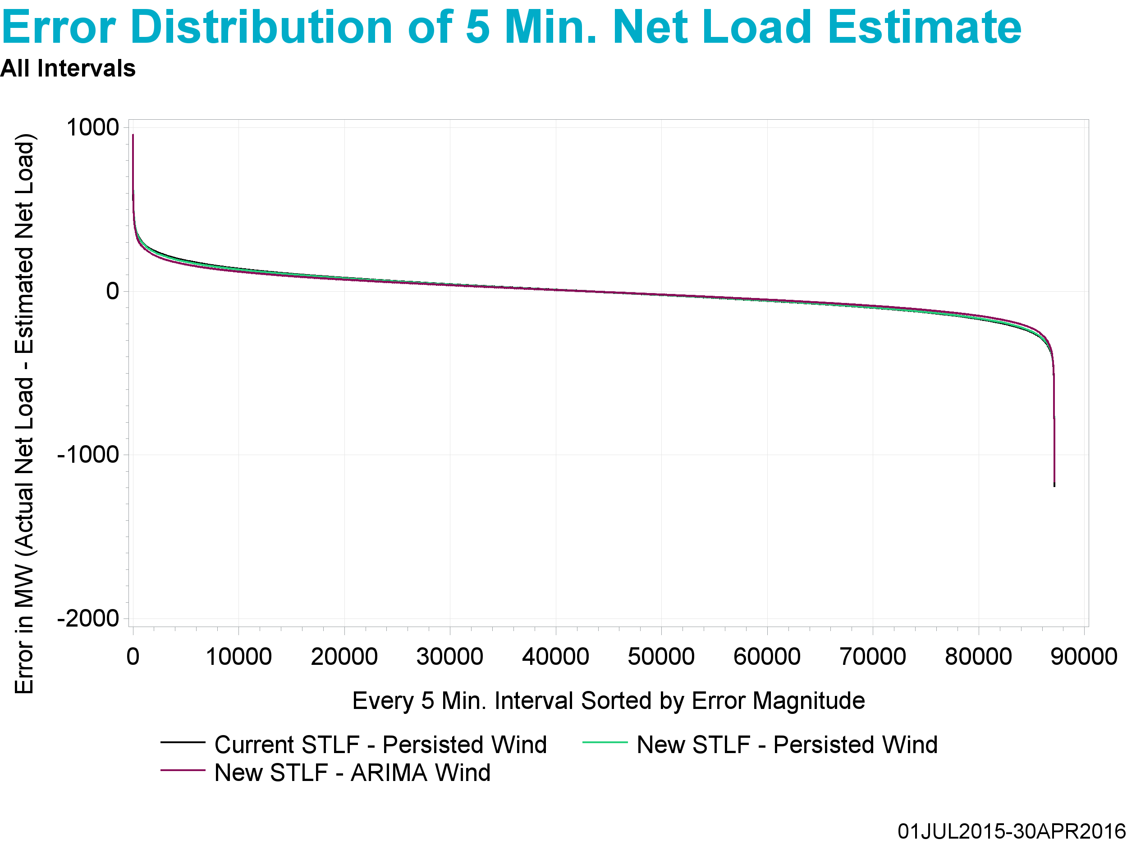
Underestimate
Overestimate

Slide 35
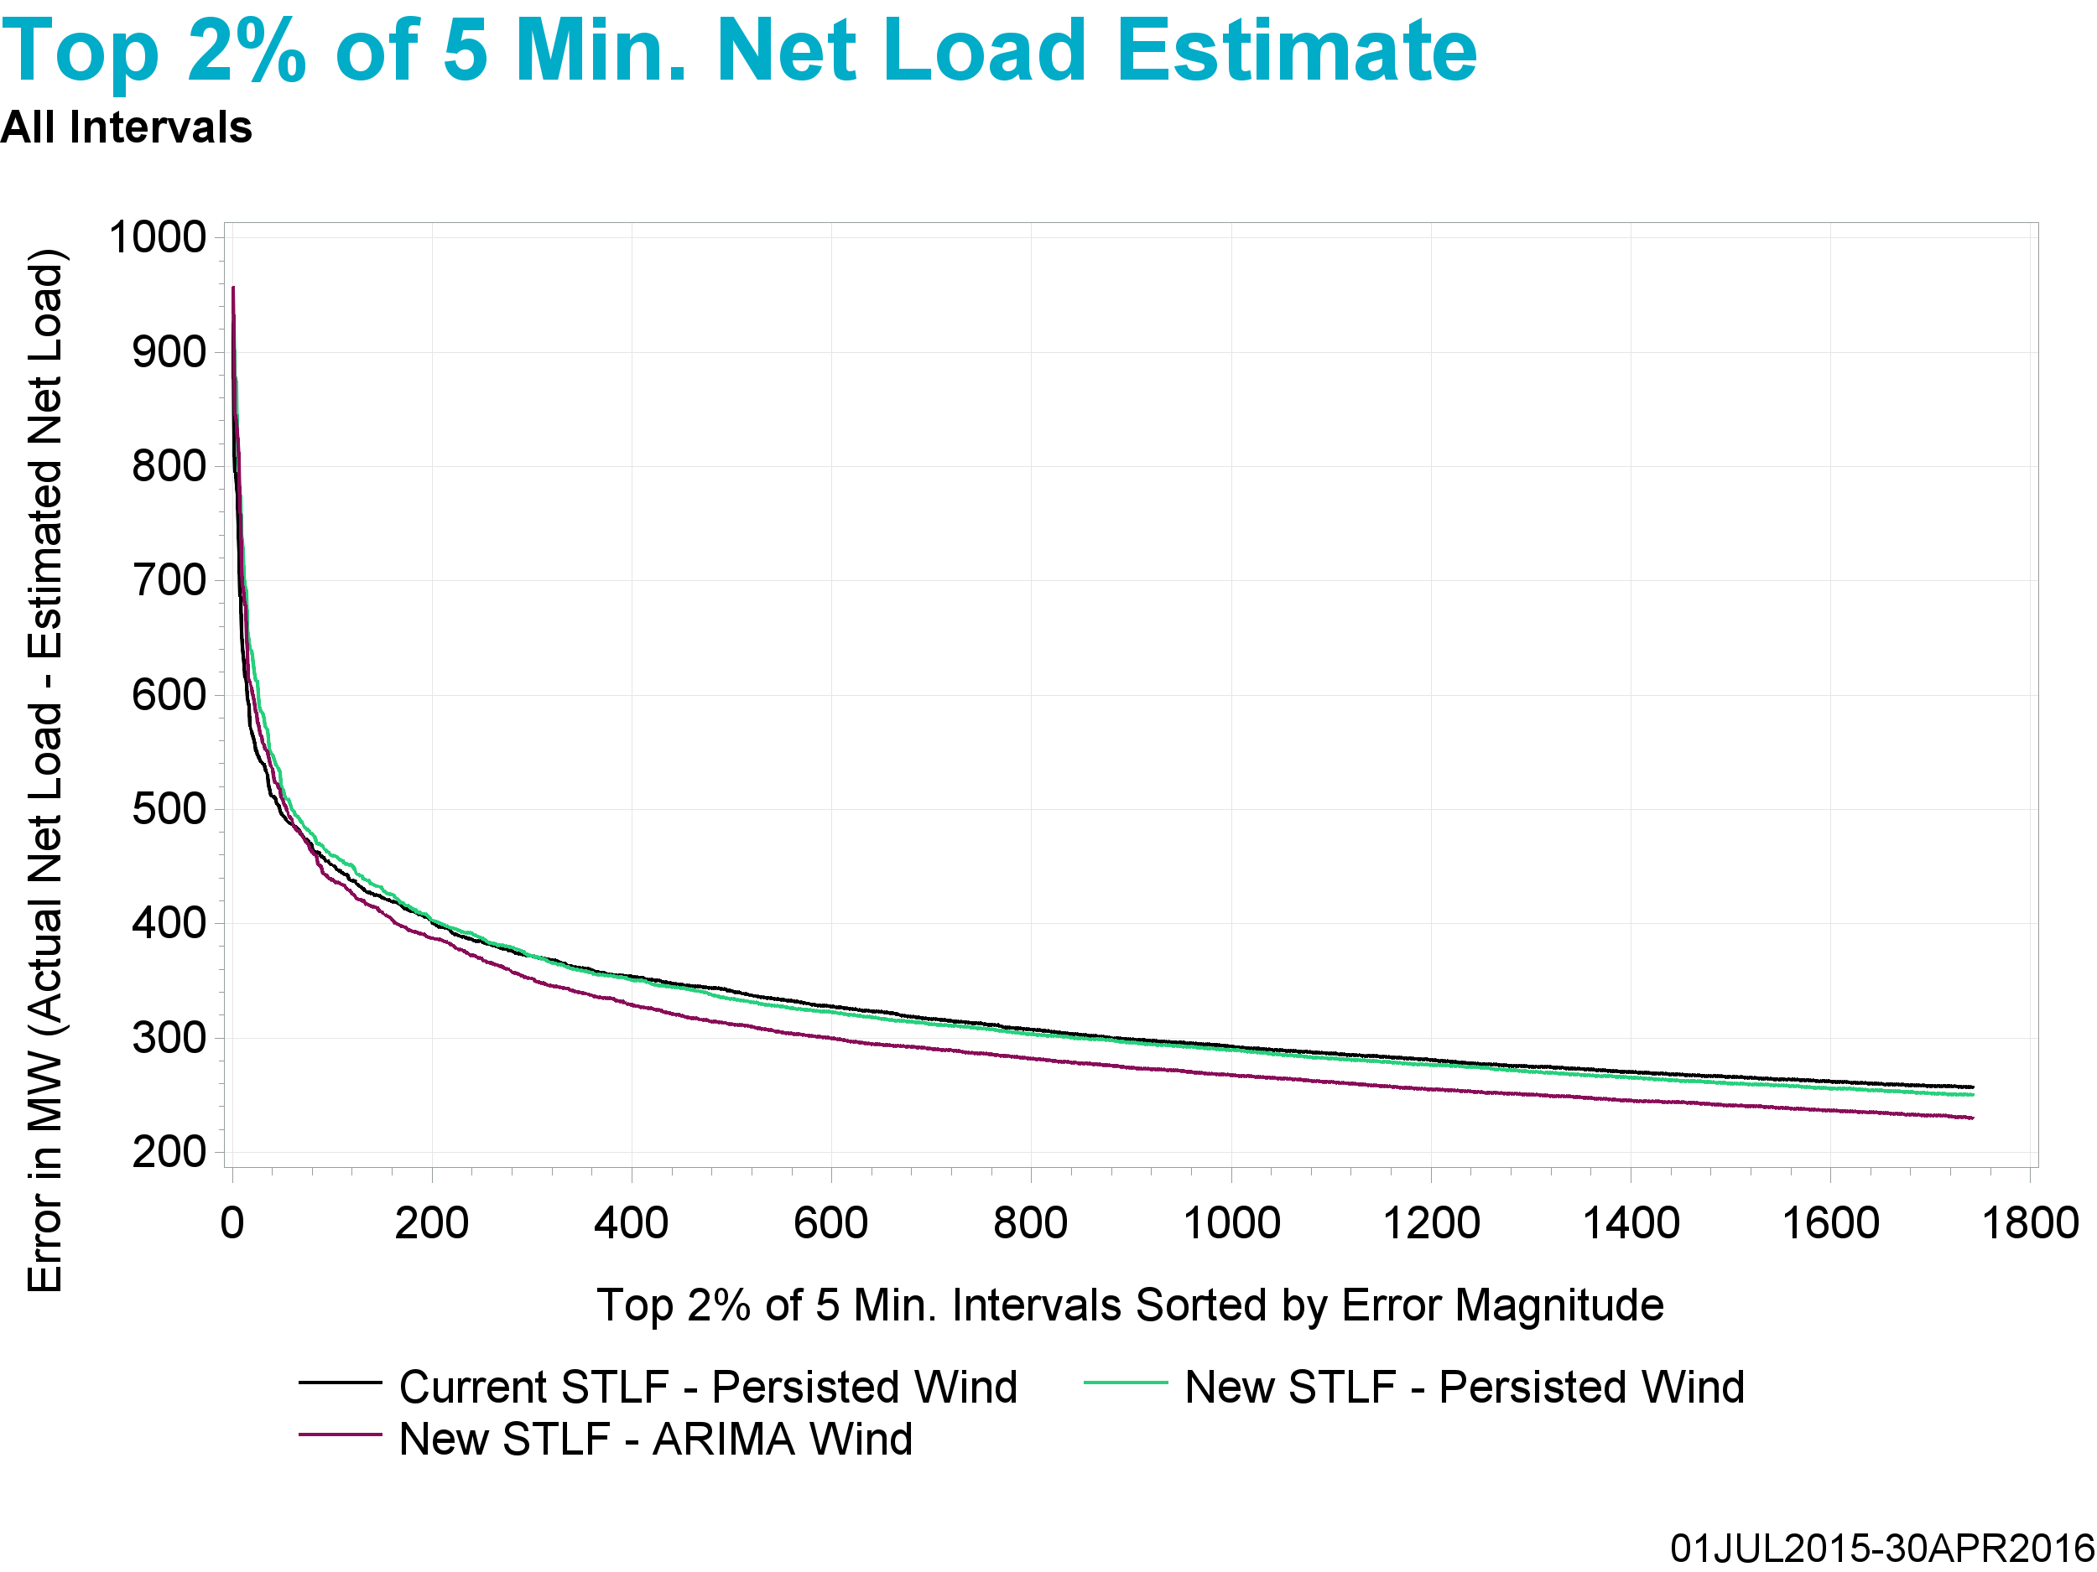
Underestimate

Slide 36
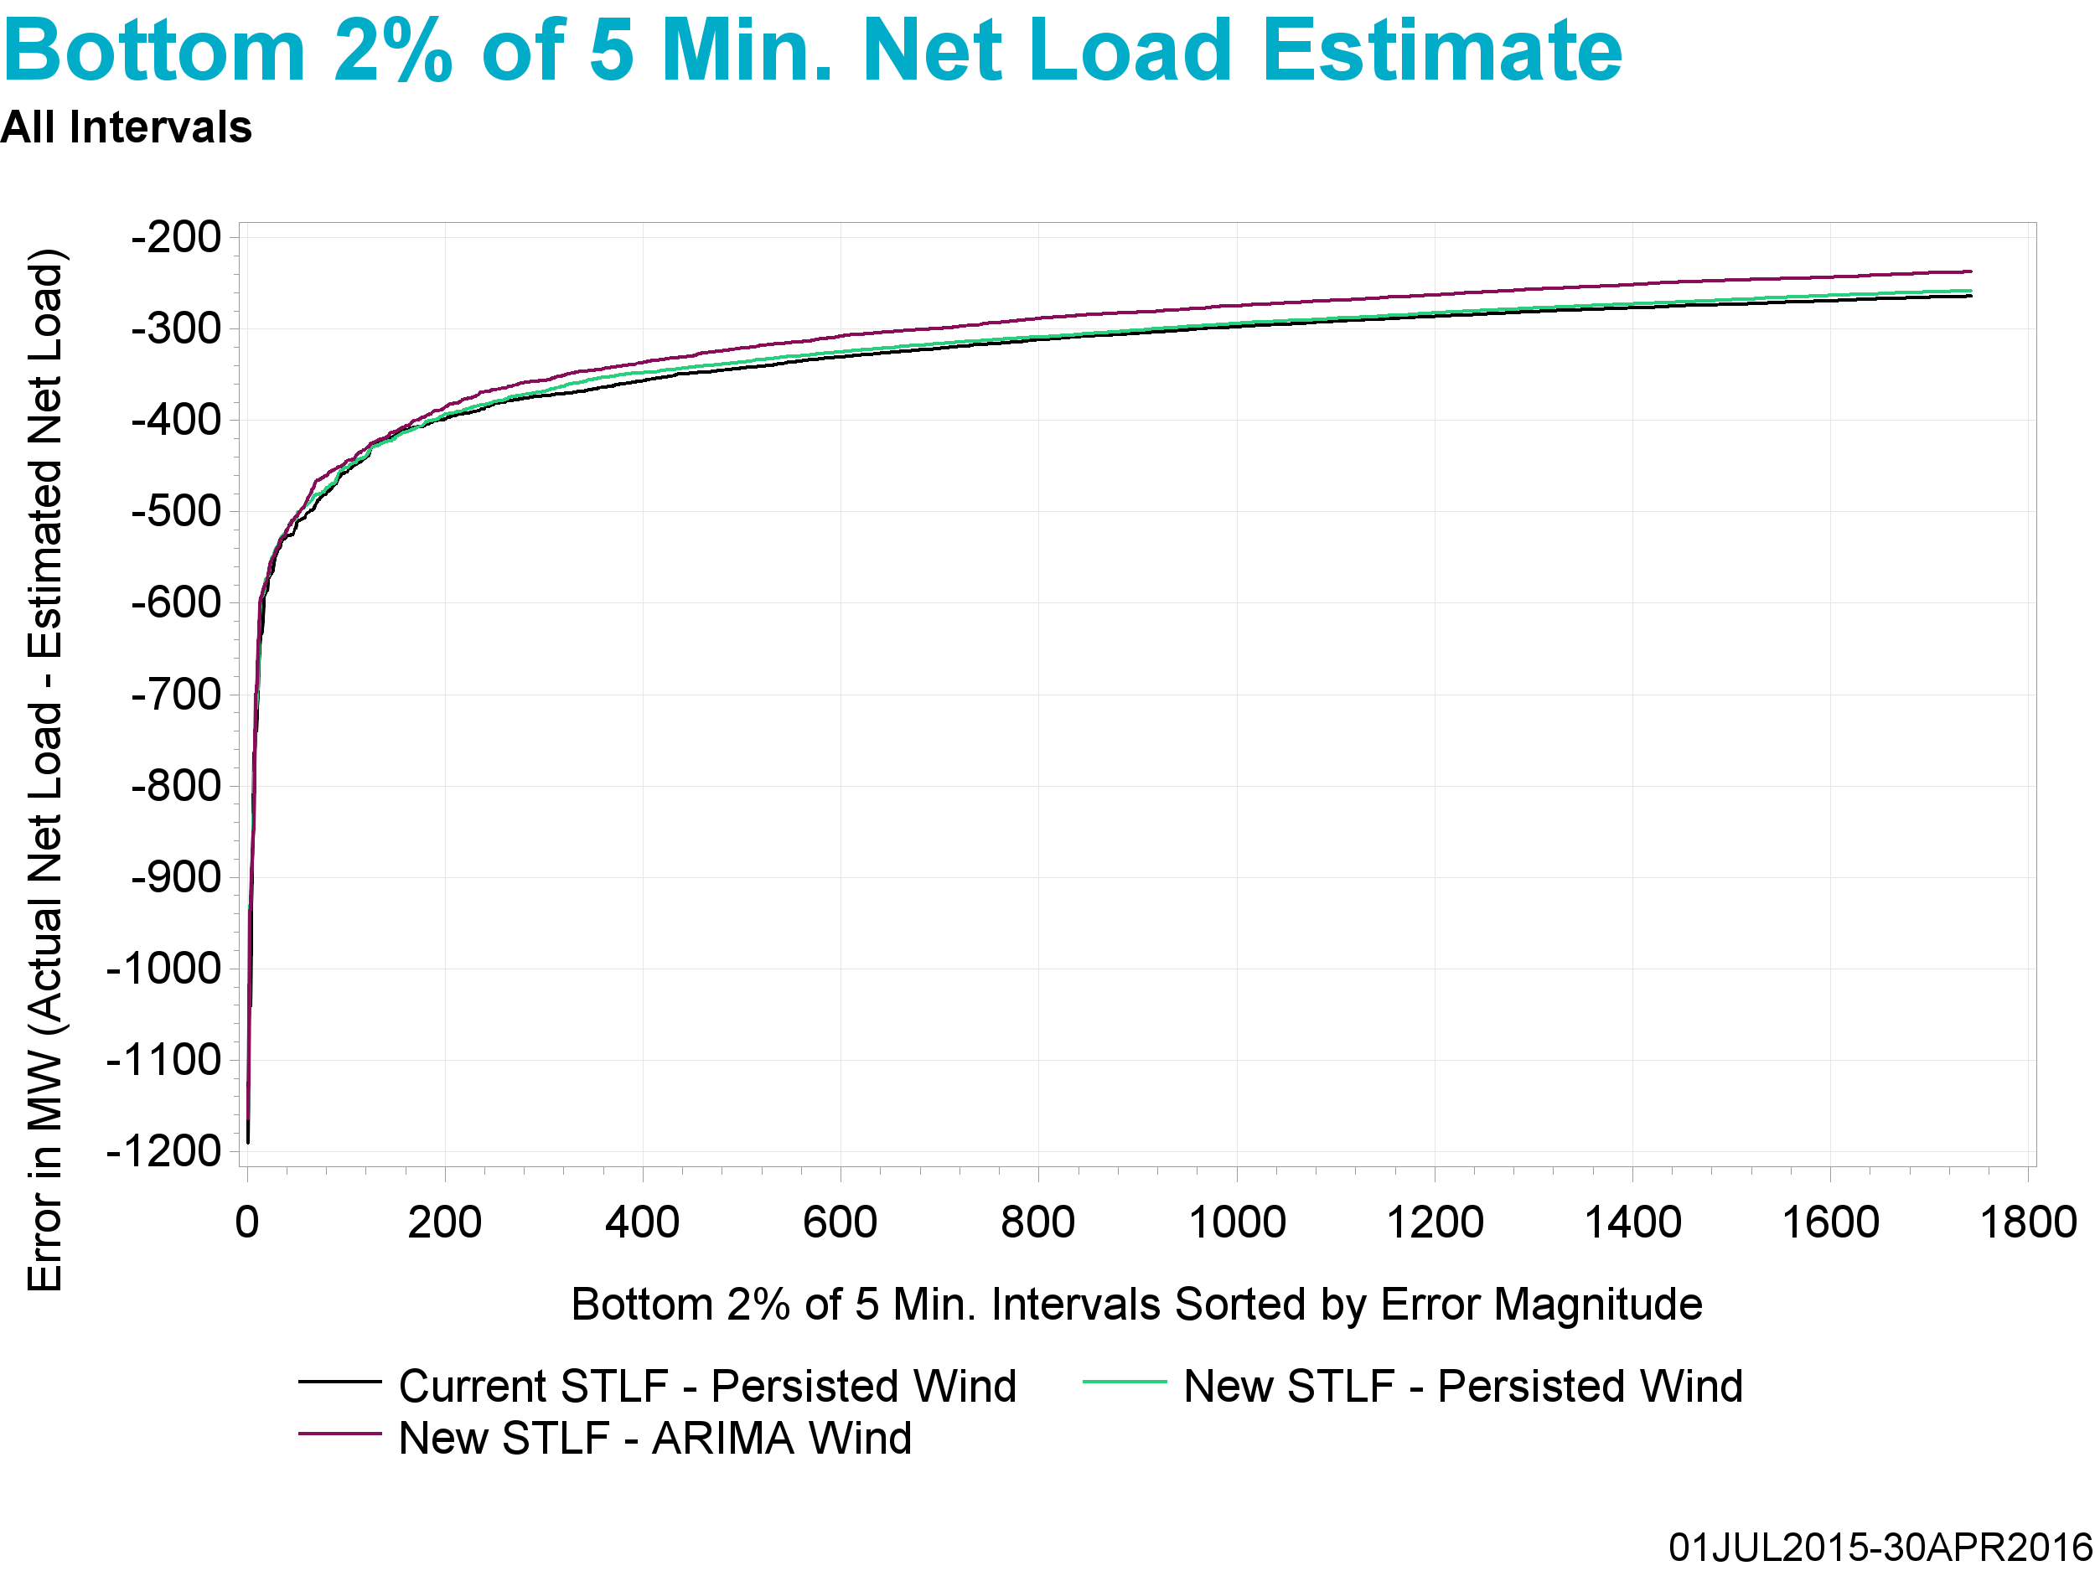
Overestimate

Slide 37
Observations
New STLF continues to outperform current STLF on average
Estimating wind HSL using ARIMA at the system-wide level continues to outperform persistence on average
Examining net load error distribution demonstrates that the combination of new STLF and estimating wind HSL using ARIMA at the system-wide level outperforms other methods even at the outliers

Slide 38
Conclusions and Next Steps
New STLF will be used in MIRTM studies
For now, persistence will be used to estimate wind HSL for MIRTM studies
ERCOT will conduct further studies on developing ARIMA models to estimate Wind HSL on a seasonal/time of day and regional/wind plant granularity
ERCOT is also engaged with AWS to see if they can create a 5 min. resolution Wind HSL forecast
Appendix contains detailed graphs in the same order and format of the February 22, 2016 SAWG meeting presentation

Slide 39
Questions?

Slide 40
Appendix

Slide 41
MIRTM Demand Estimation Performance
January 1, 2016 – April 30, 2016
All Intervals

Slide 42
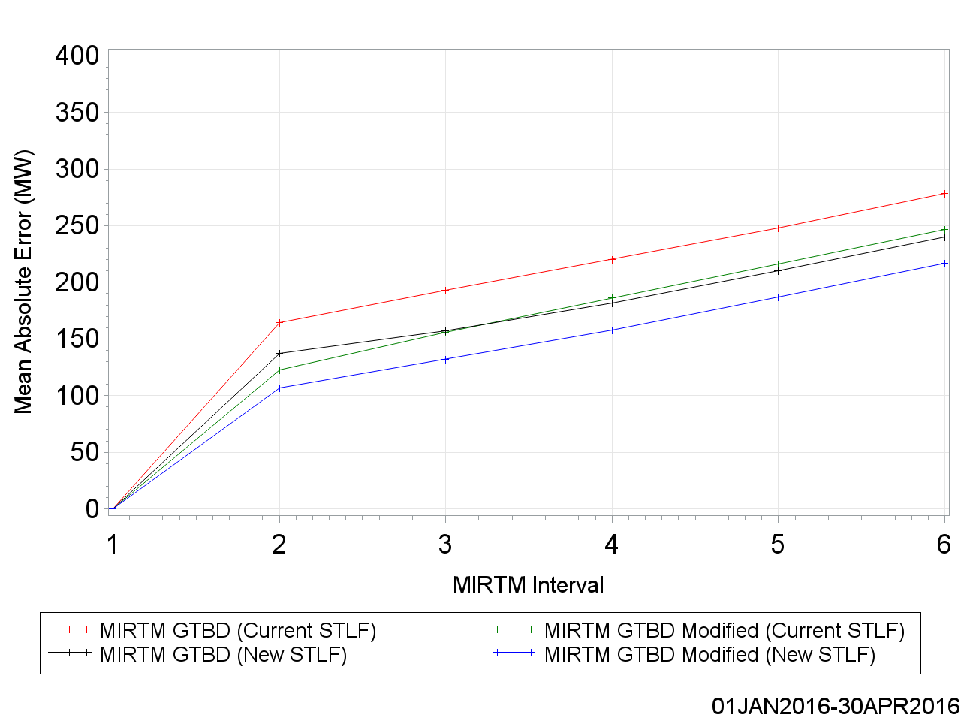
MAE of Estimated GTBD vs. Reference

Slide 43
MAE of Estimated GTBD vs. Reference

Slide 44
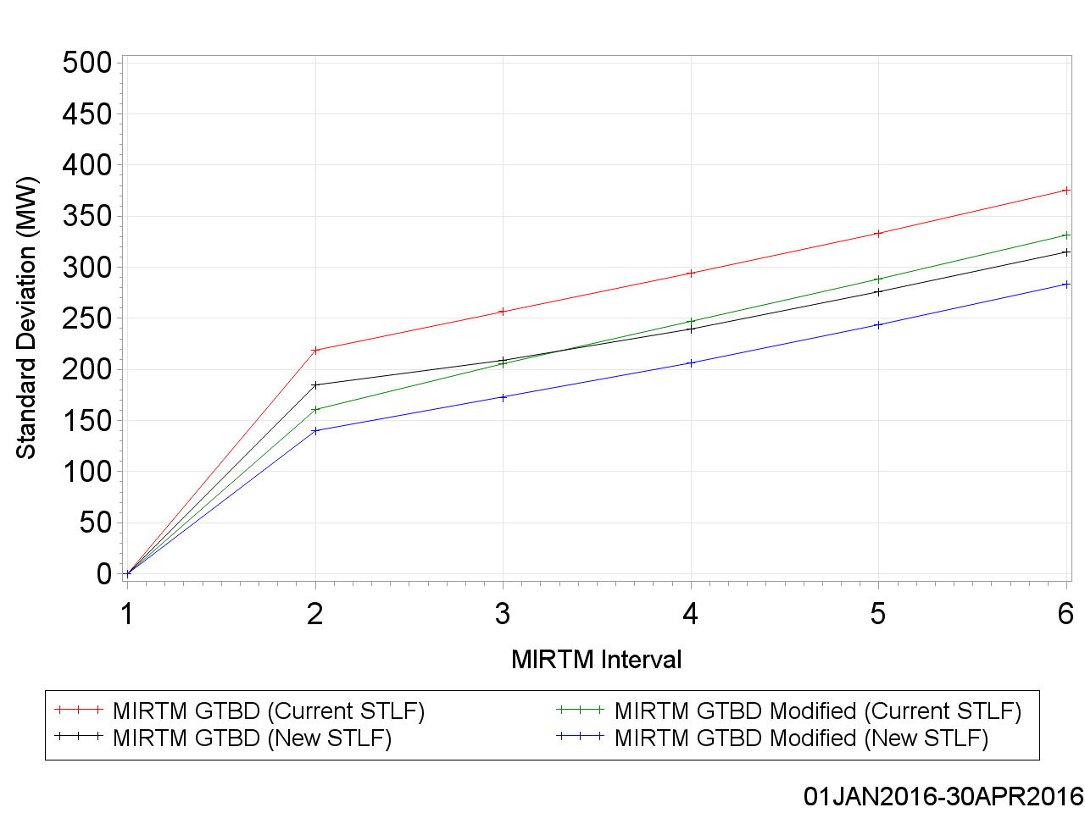
Standard Deviation of Estimated GTBD vs. Reference

Slide 45
Standard Deviation of Estimated GTBD vs. Reference

Slide 46
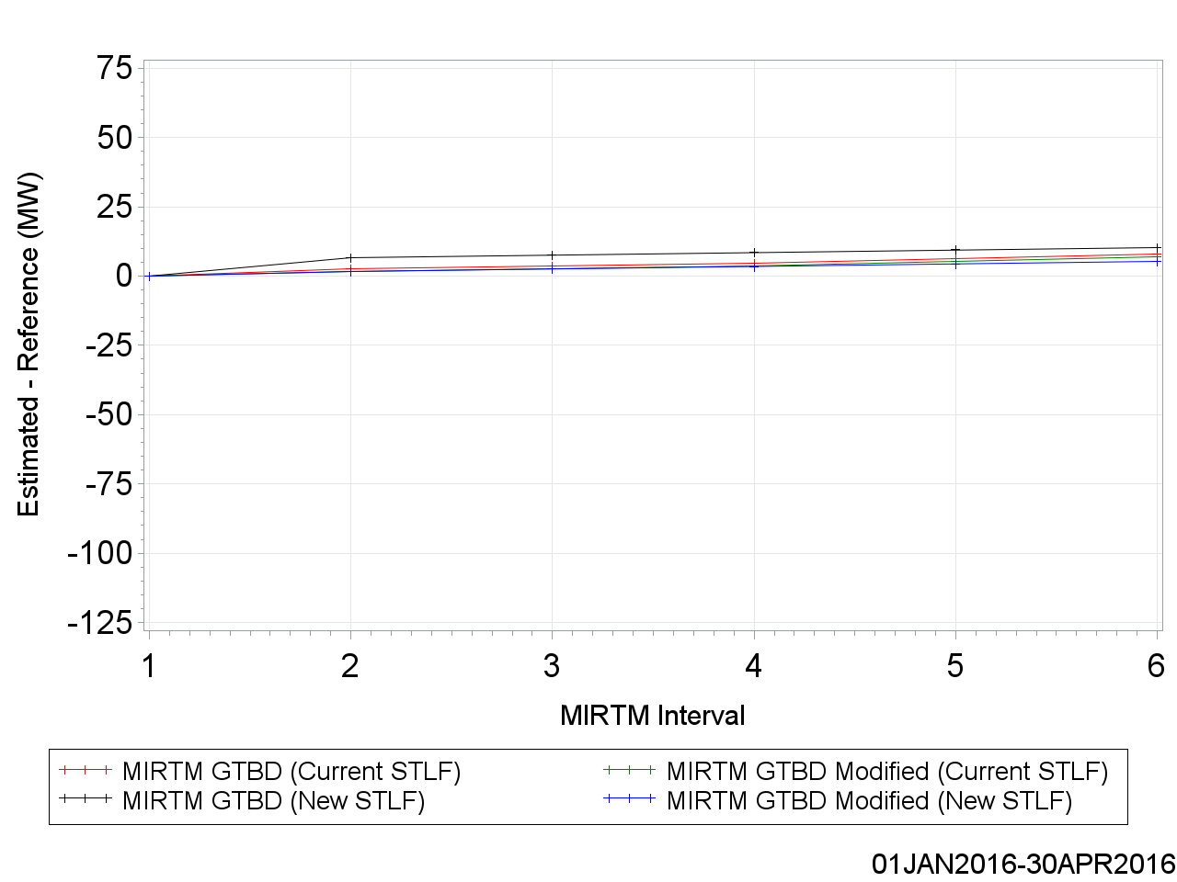
Mean of Estimated GTBD vs. Reference

Slide 47
Mean of Estimated GTBD vs. Reference

Slide 48
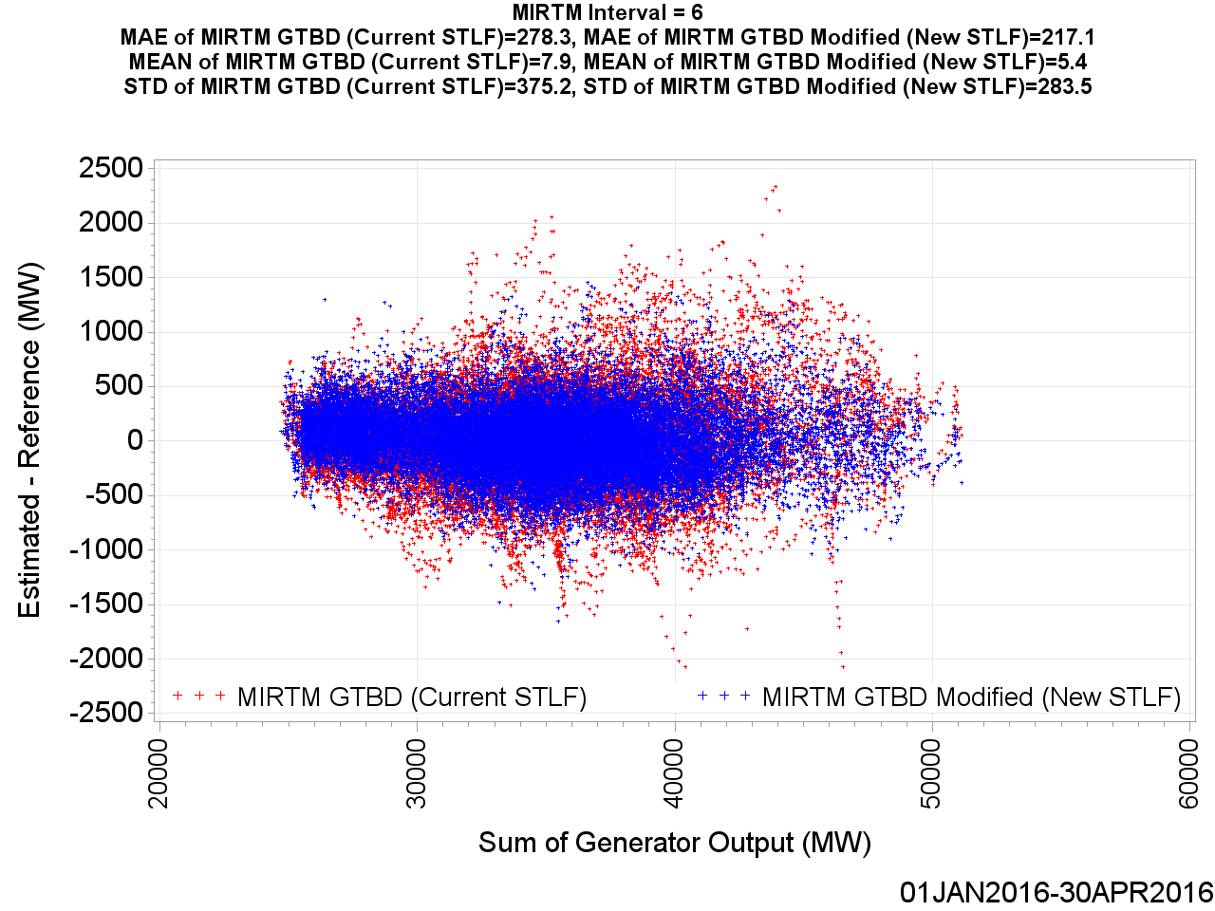
MIRTM GTBD Error by Reference (30 min. ahead)

Slide 49
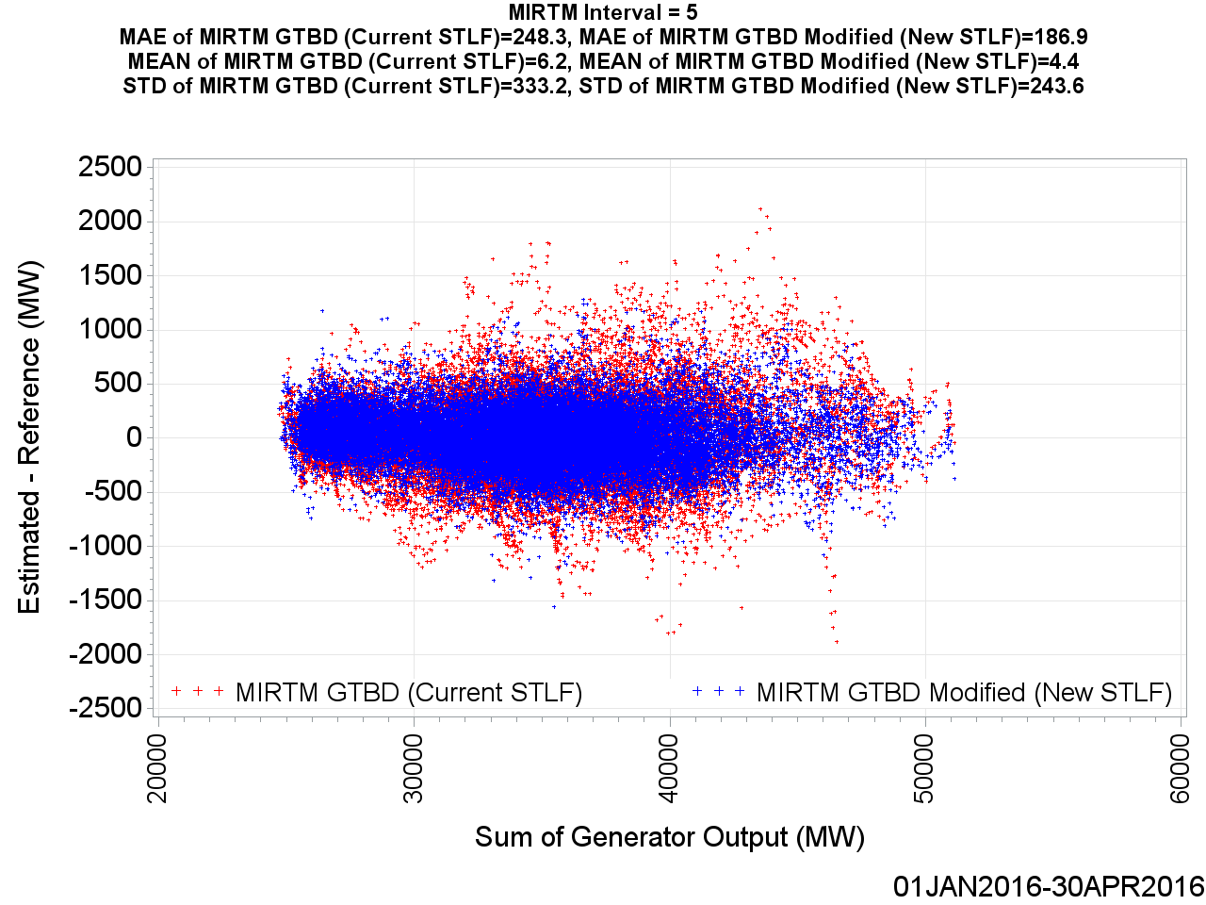
MIRTM GTBD Error by Reference (25 min. ahead)

Slide 50

MIRTM GTBD Error by Reference (20 min. ahead)

Slide 51
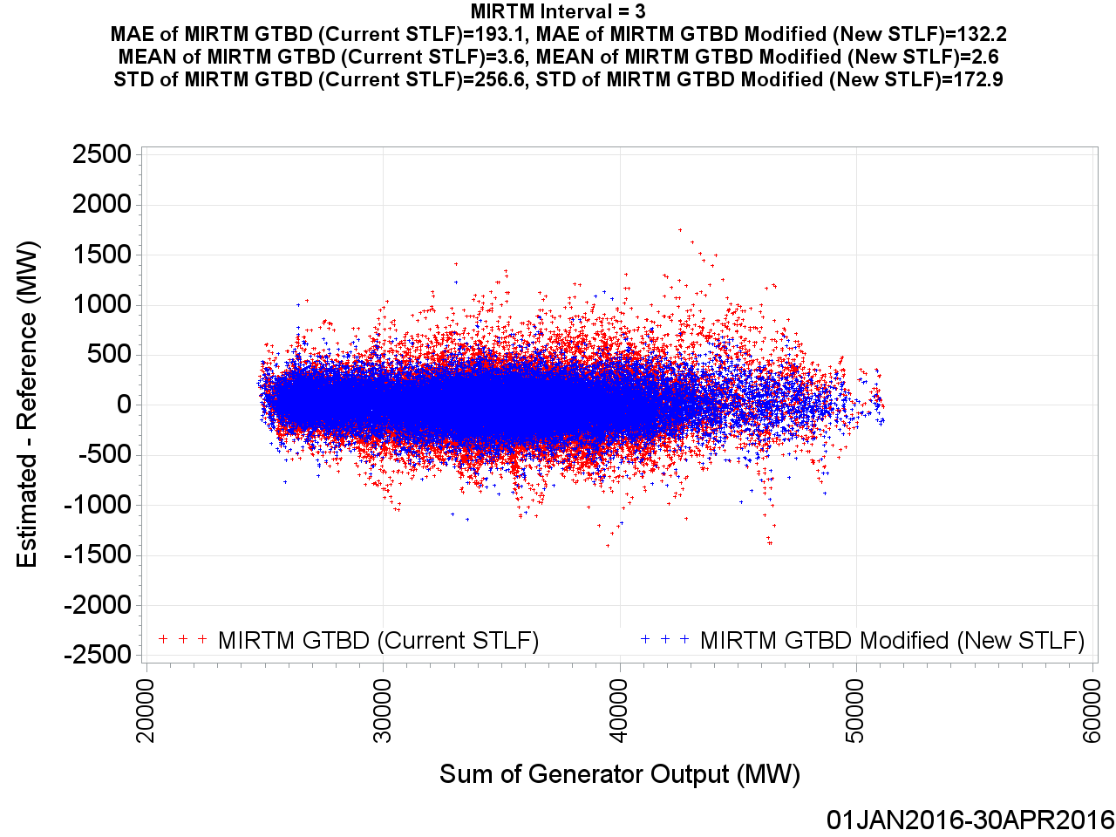
MIRTM GTBD Error by Reference (15 min. ahead)

Slide 52
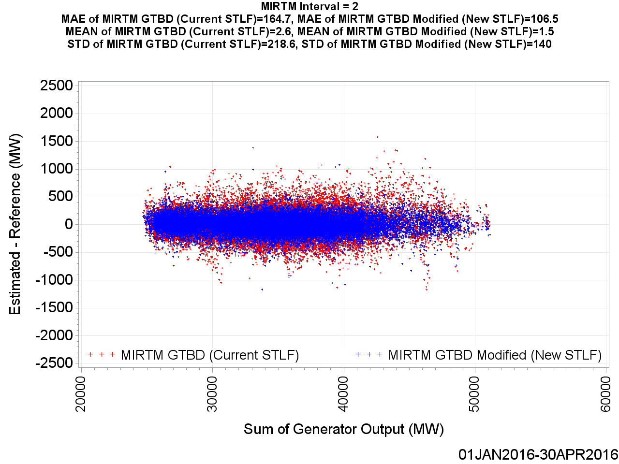
MIRTM GTBD Error by Reference (10 min. ahead)

Slide 53
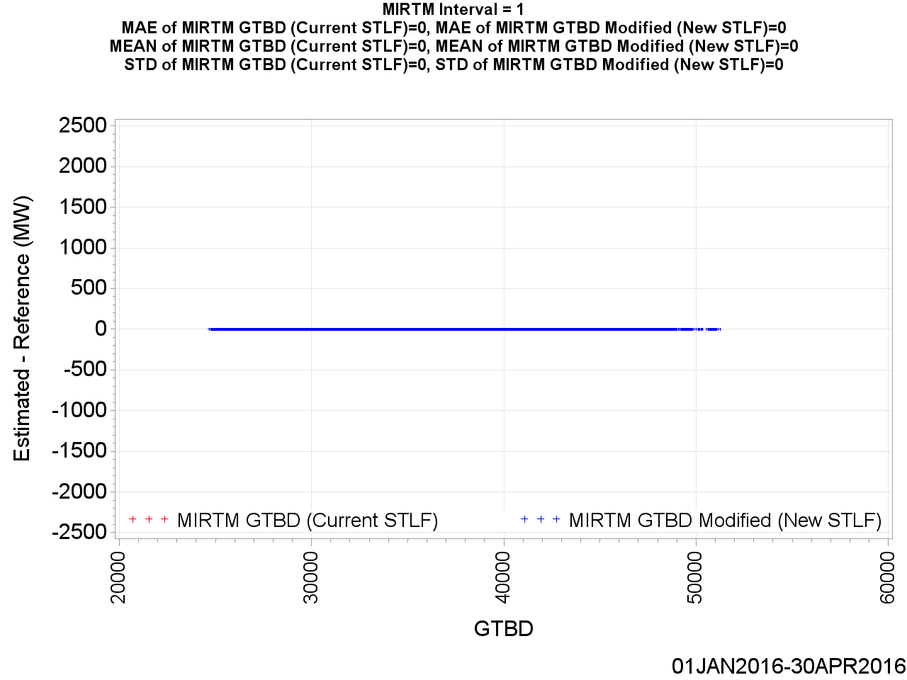
MIRTM GTBD Error by Reference (5 min. ahead)

Slide 54
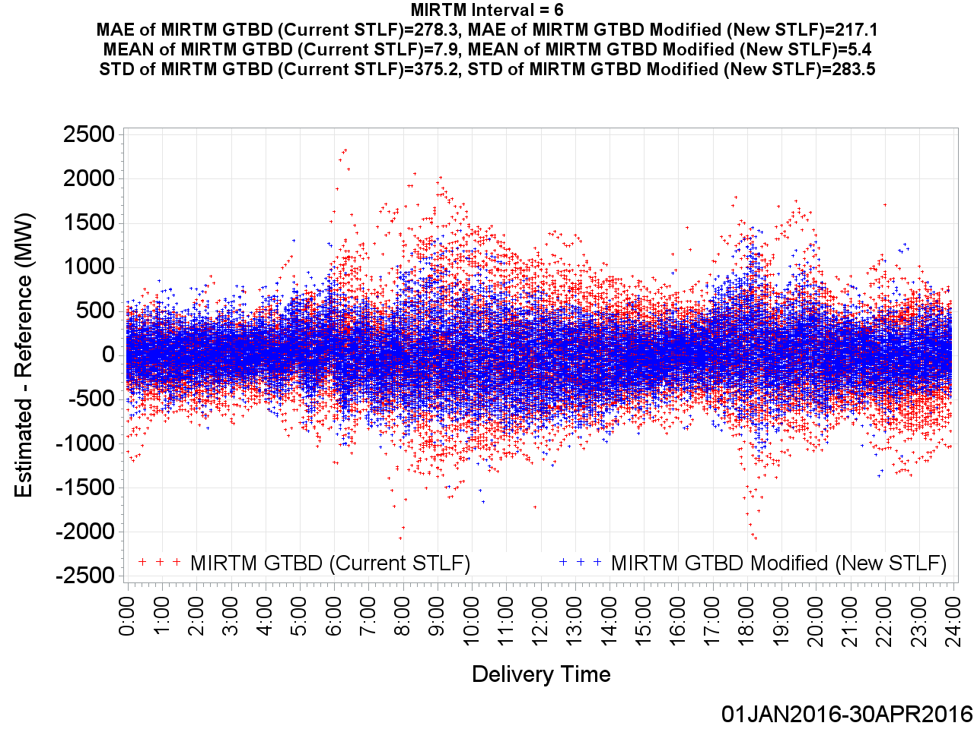
MIRTM GTBD Error by Delivery Time (30 min. ahead)

Slide 55
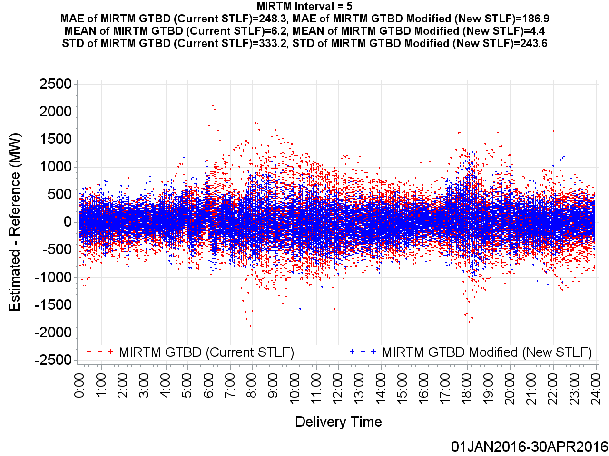
MIRTM GTBD Error by Delivery Time (25 min. ahead)

Slide 56
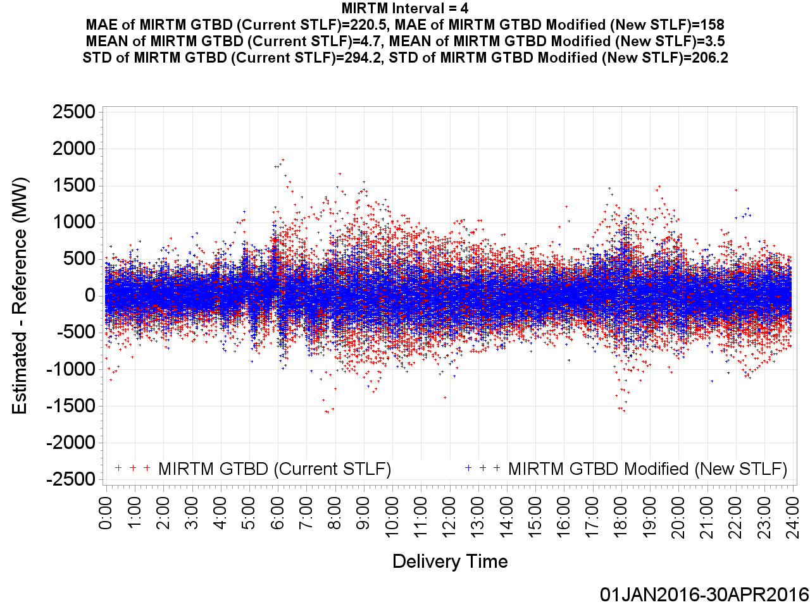
MIRTM GTBD Error by Delivery Time (20 min. ahead)

Slide 57
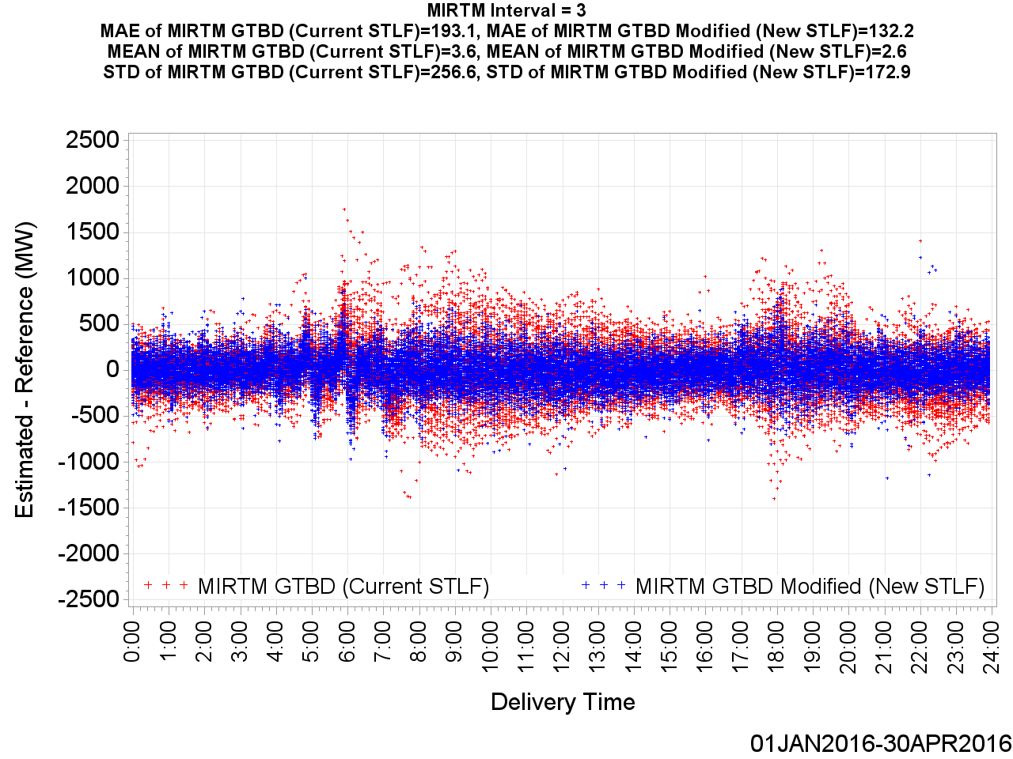
MIRTM GTBD Error by Delivery Time (15 min. ahead)

Slide 58
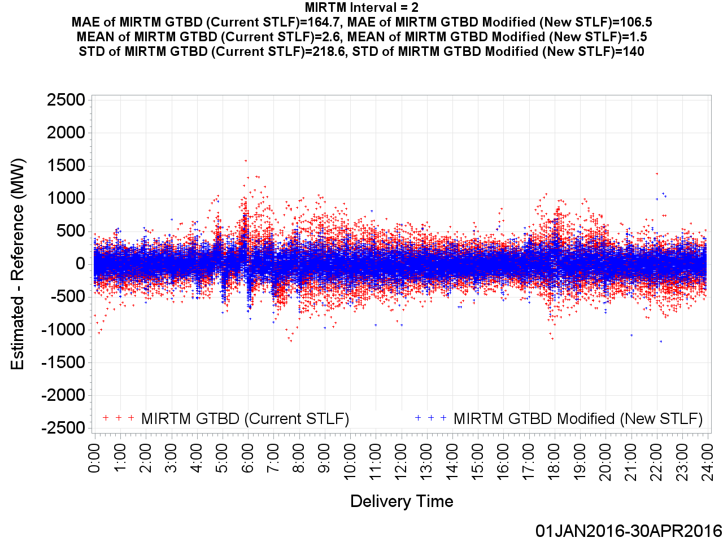
MIRTM GTBD Error by Delivery Time (10 min. ahead)

Slide 59
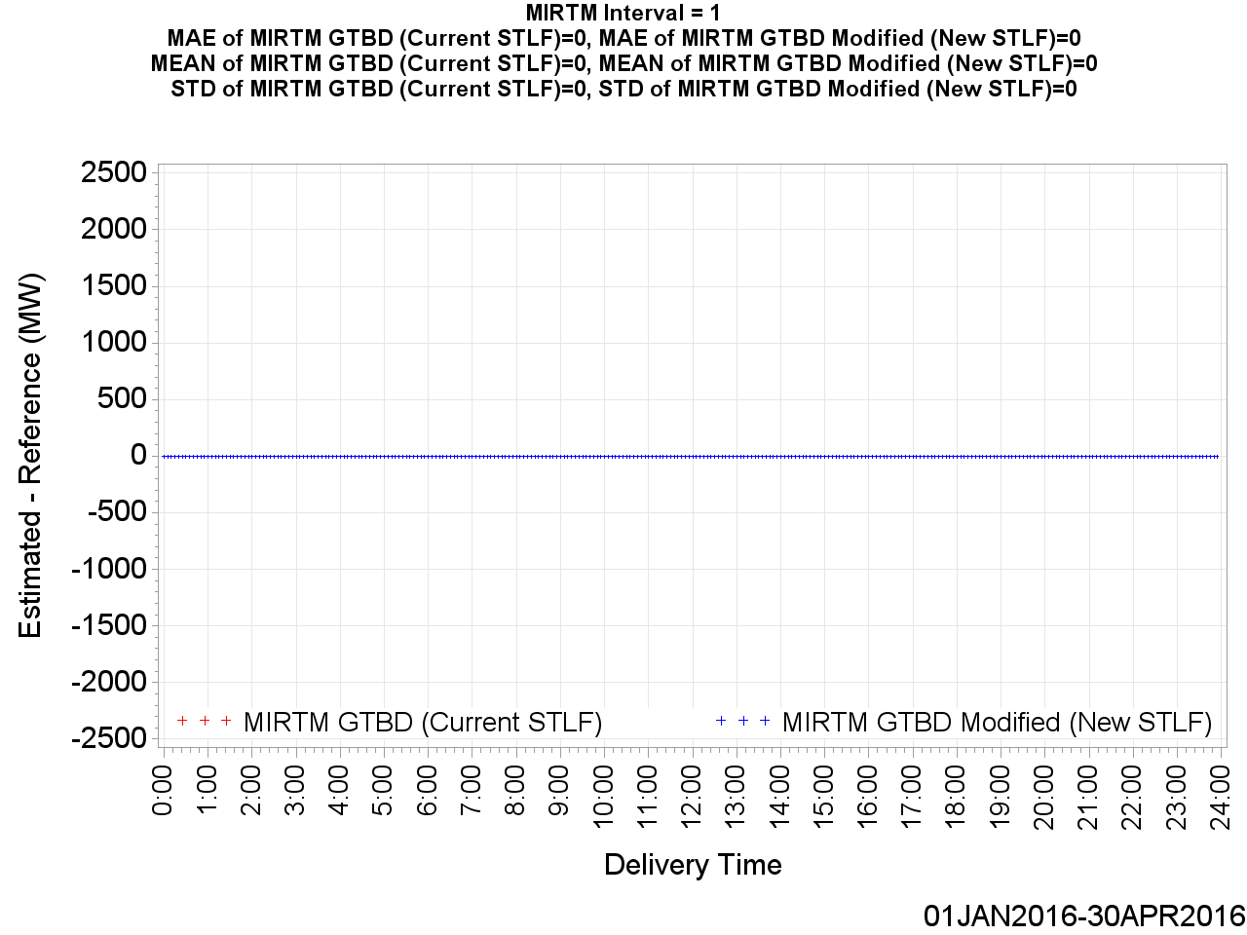
MIRTM GTBD Error by Delivery Time (5 min. ahead)

Slide 60
MIRTM Demand Estimation Performance
January 1, 2016 – April 30, 2016
239 Intervals when System Lambda >= $75/MWh

Slide 61
MAE of Estimated GTBD vs. Reference

Slide 62
MAE of Estimated GTBD vs. Reference

Slide 63
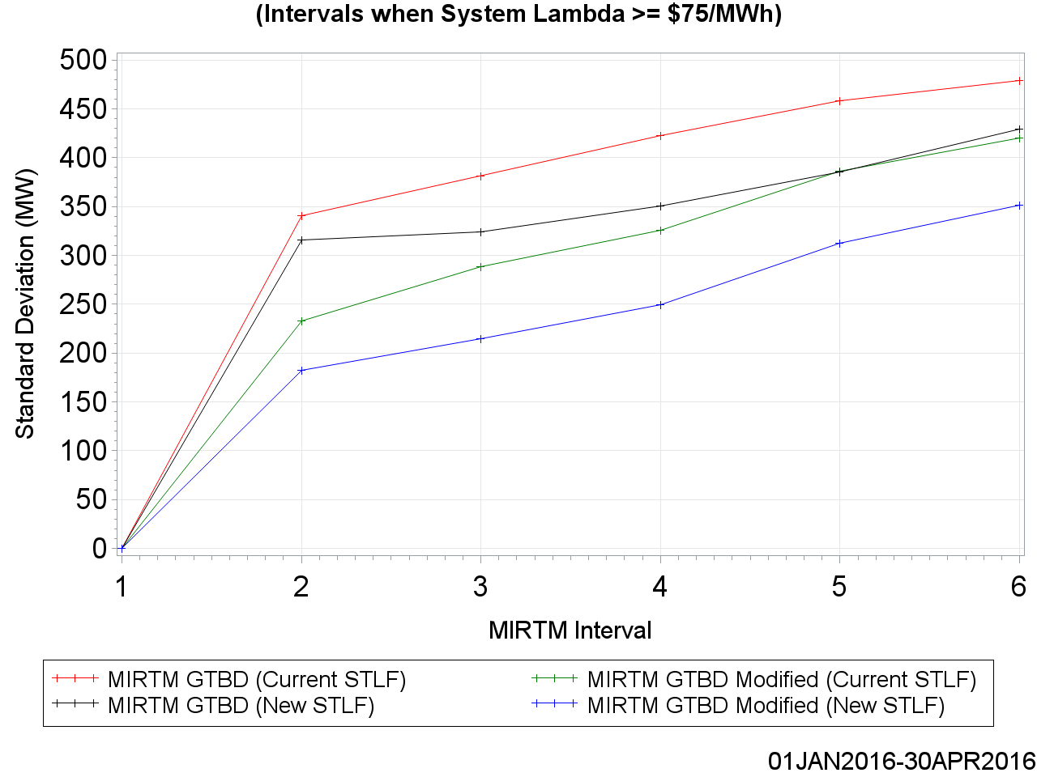
Standard Deviation of Estimated GTBD vs. Reference

Slide 64
Standard Deviation of Estimated GTBD vs. Reference

Slide 65
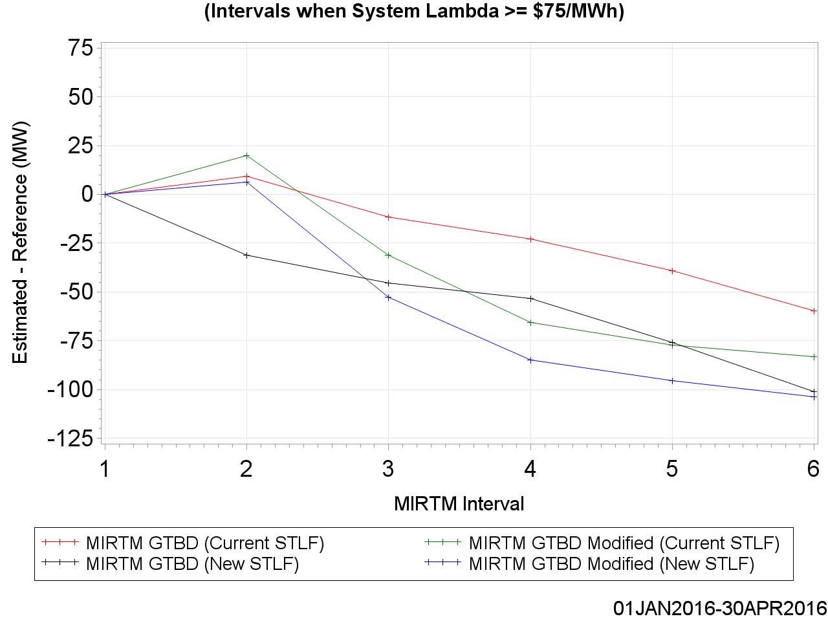
Mean of Estimated GTBD vs. Reference

Slide 66
Mean of Estimated GTBD vs. Reference

Slide 67
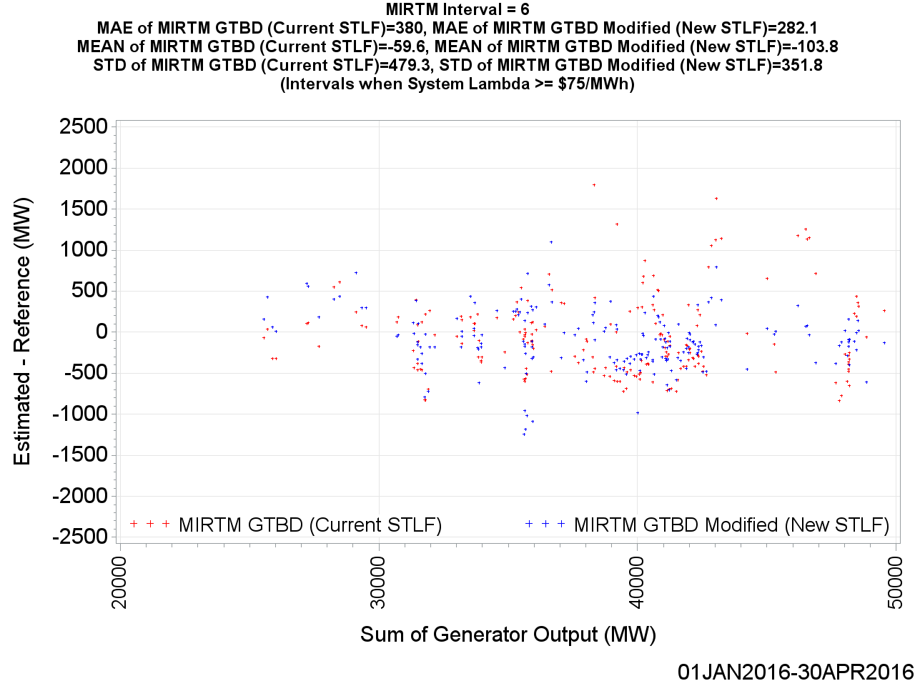
MIRTM GTBD Error by Reference (30 min. ahead)

Slide 68
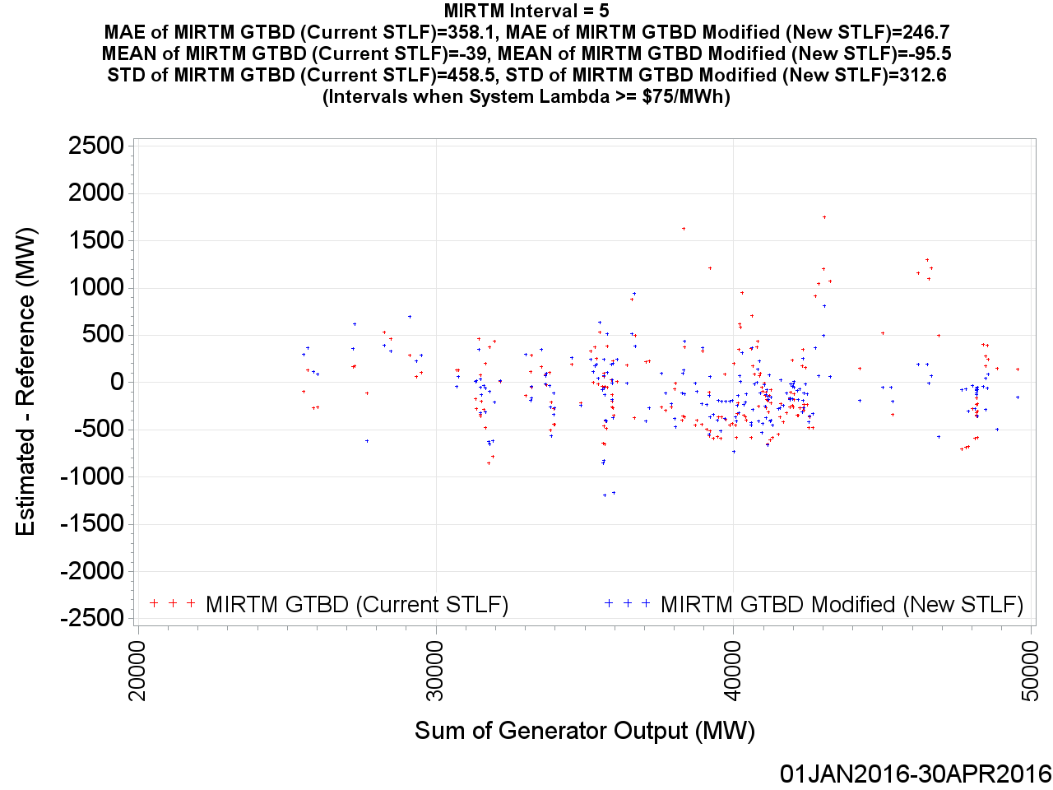
MIRTM GTBD Error by Reference (25 min. ahead)

Slide 69
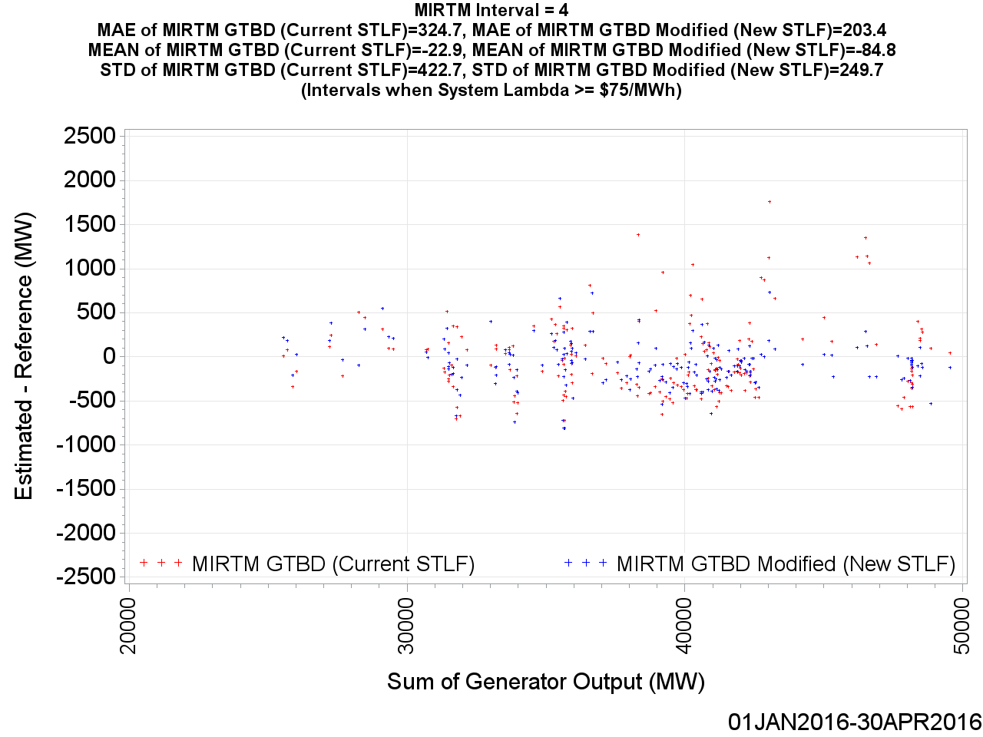
MIRTM GTBD Error by Reference (20 min. ahead)

Slide 70
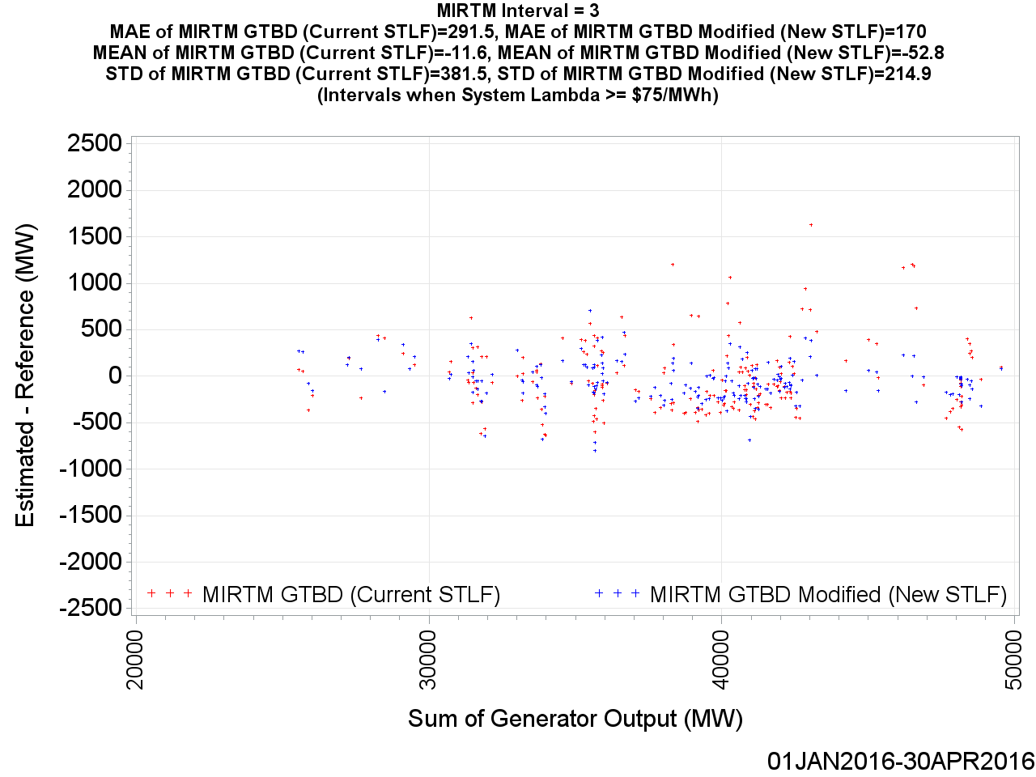
MIRTM GTBD Error by Reference (15 min. ahead)

Slide 71
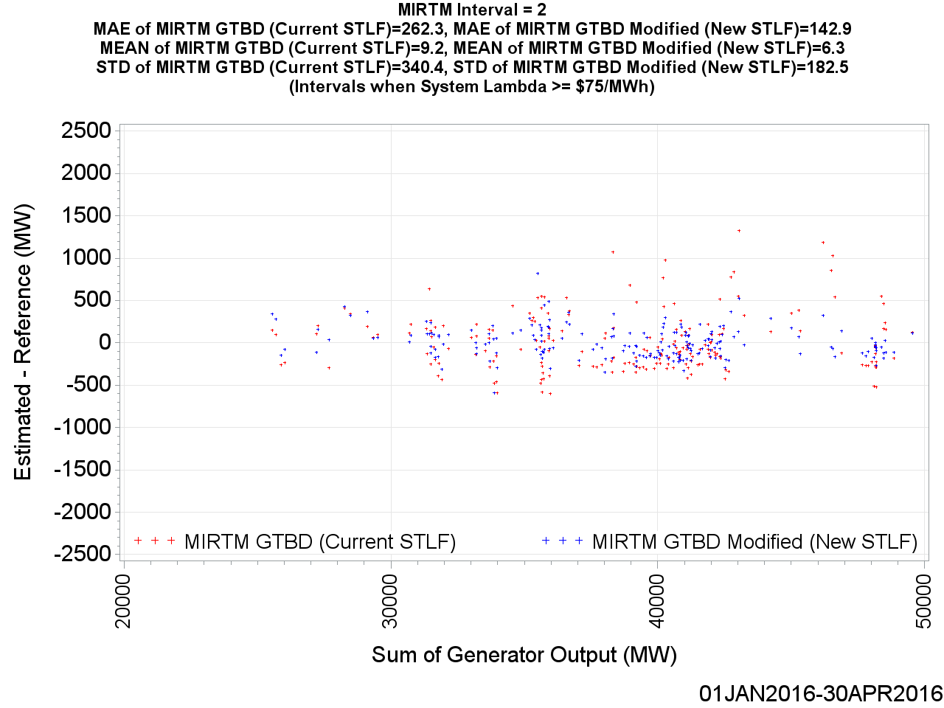
MIRTM GTBD Error by Reference (10 min. ahead)

Slide 72
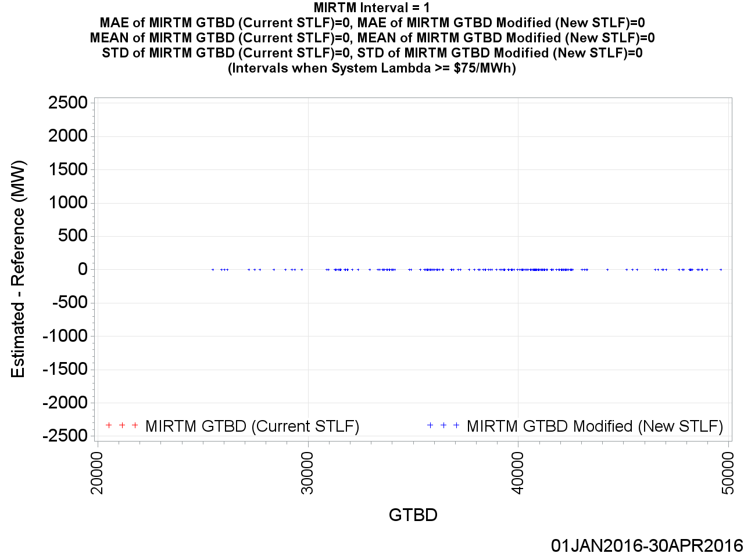
MIRTM GTBD Error by Reference (5 min. ahead)

Slide 73
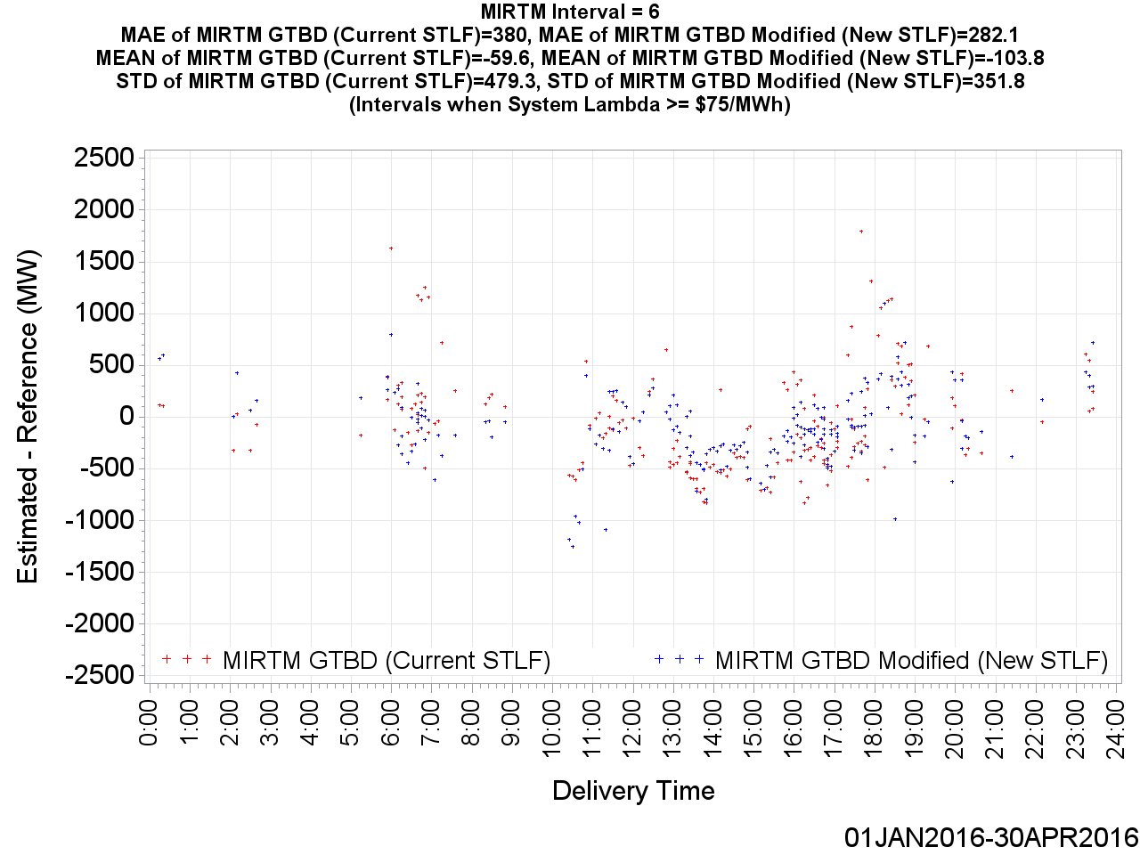
MIRTM GTBD Error by Delivery Time (30 min. ahead)

Slide 74

MIRTM GTBD Error by Delivery Time (25 min. ahead)

Slide 75
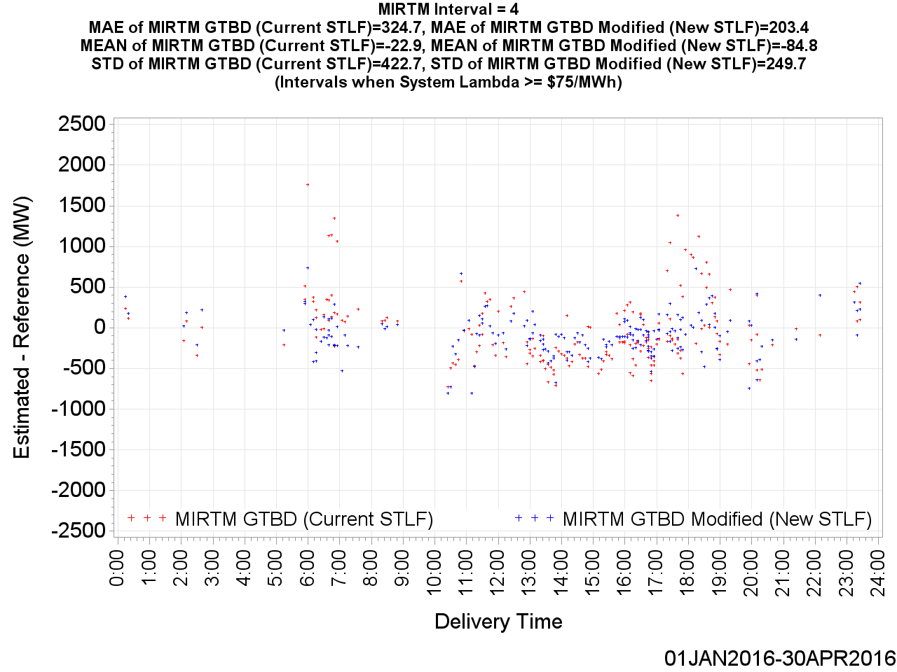
MIRTM GTBD Error by Delivery Time (20 min. ahead)

Slide 76
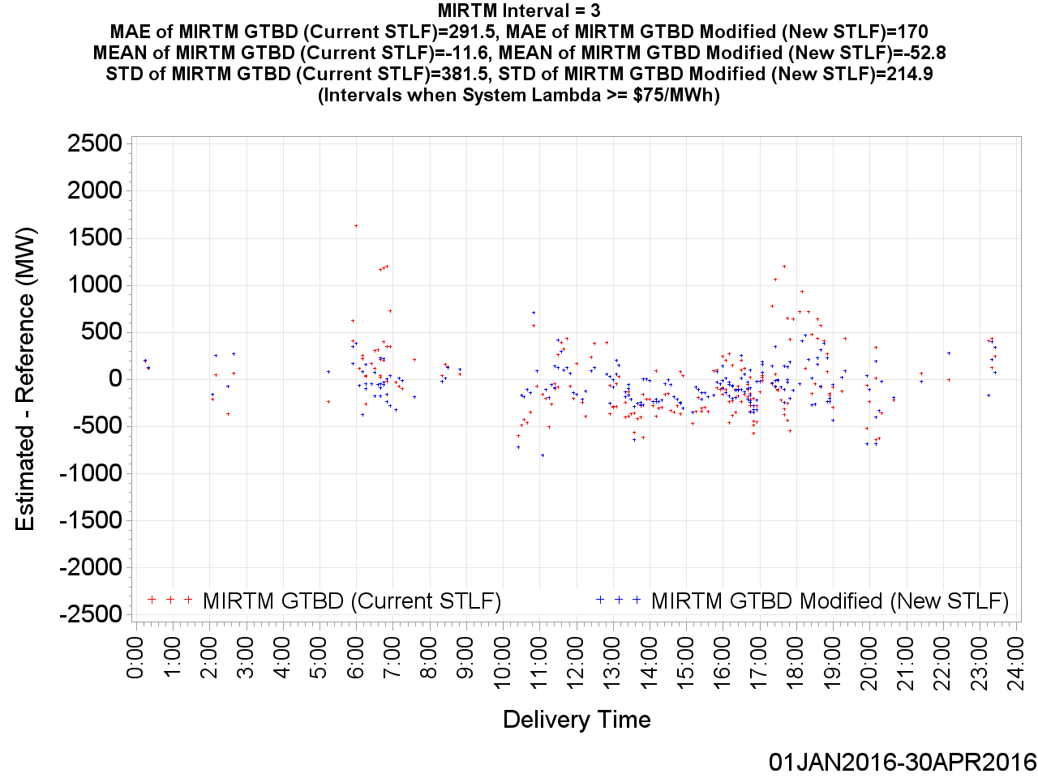
MIRTM GTBD Error by Delivery Time (15 min. ahead)

Slide 77
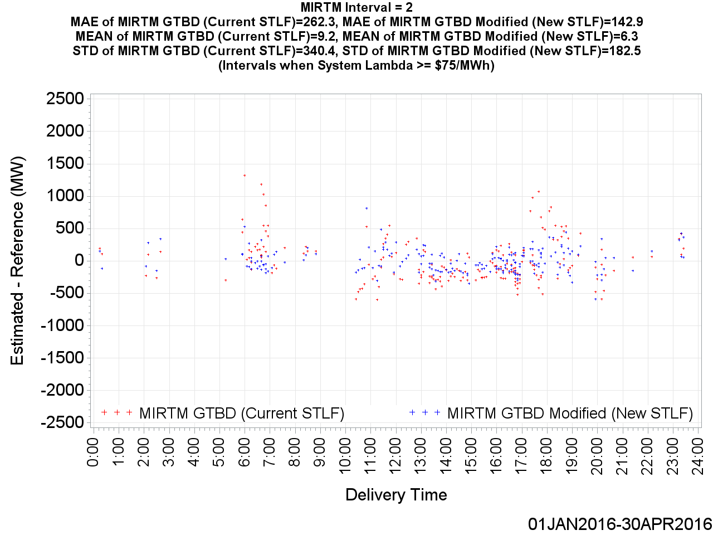
MIRTM GTBD Error by Delivery Time (10 min. ahead)

Slide 78
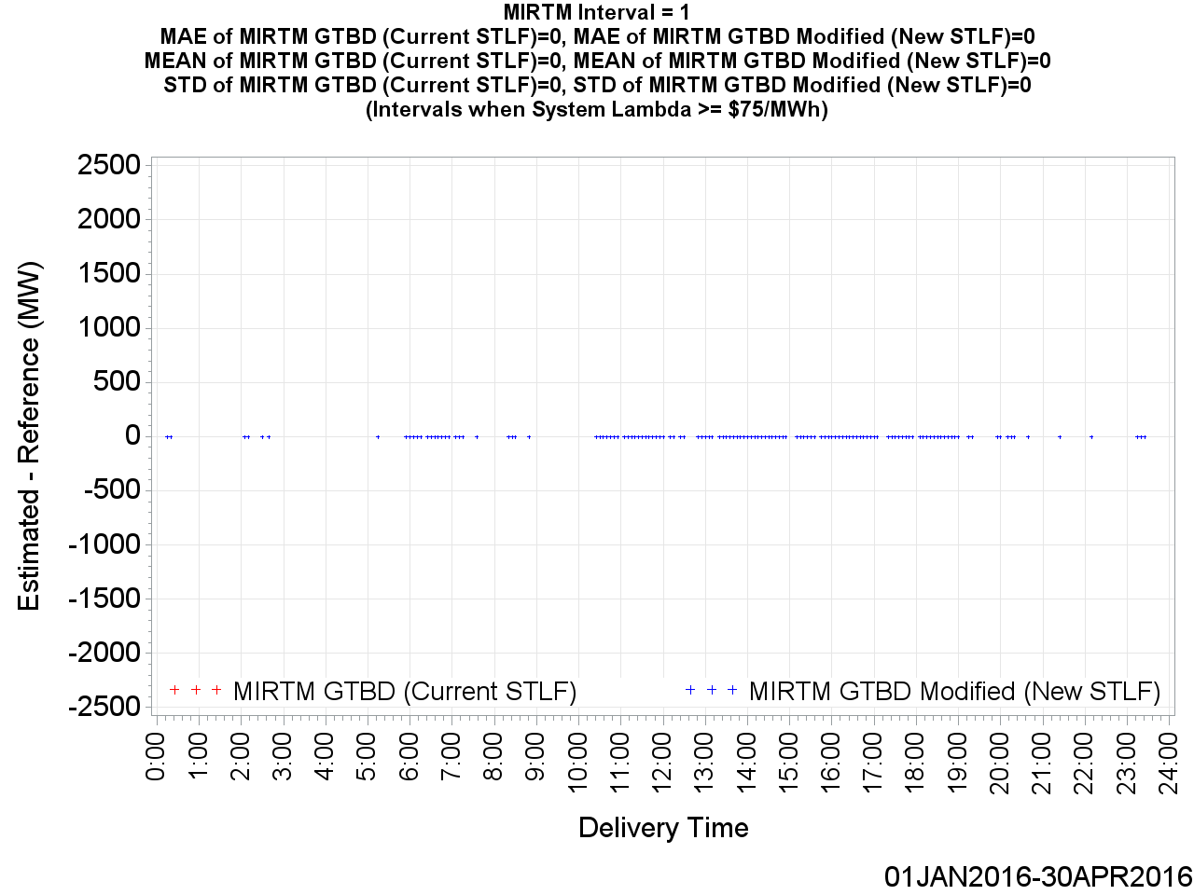
MIRTM GTBD Error by Delivery Time (5 min. ahead)

Slide 79
MIRTM Demand Estimation Performance on Speciic Days
In the following slides, the estimation performance of the following specific days are analyzed:
  January 16, 2016
  February 23, 2016
  March 31, 2016
For each of these three dates, two high priced SCED intervals are further examined.
The LDL-HDL energy offer curve is shown along with the effects that the New STLF and Modified GTBD Methodology have on the resulting price based the curve.
This is not the actual LDL-HDL curve MIRTM would use for each interval (i). It is the LDL-HDL curve at the SCED snapshot (i =1) simply to give a representation of how sensitive the energy offer curve is to differing GTBD values.

Slide 80
MIRTM Demand Estimation Performance
January 16, 2016

Slide 81
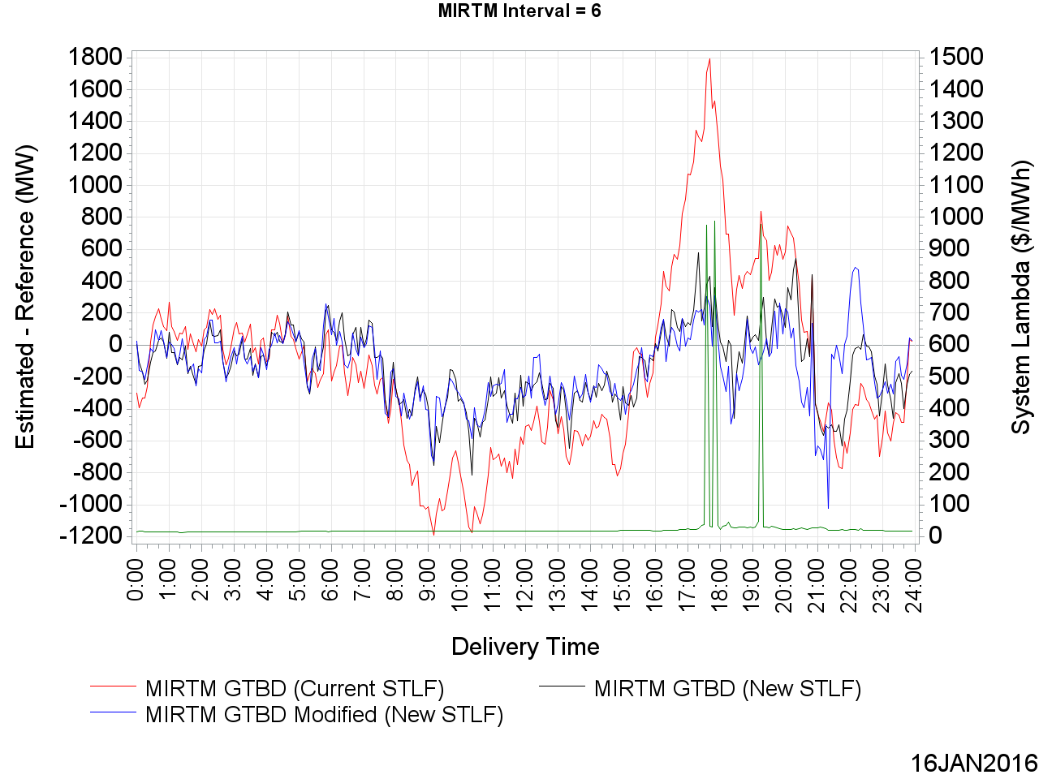
MIRTM GTBD Error on January 16, 2016 (30 min. ahead)

Slide 82
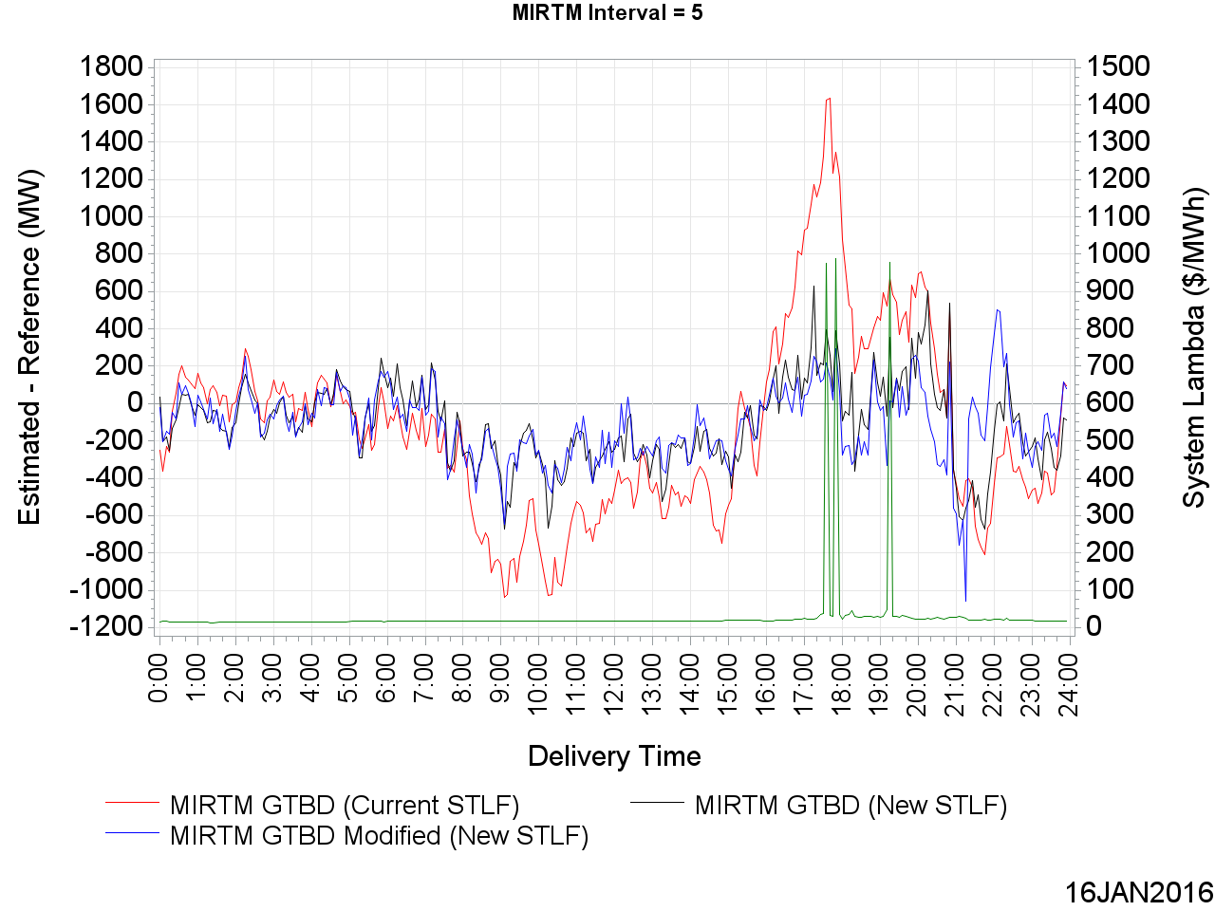
MIRTM GTBD Error on January 16, 2016 (25 min. ahead)

Slide 83

MIRTM GTBD Error on January 16, 2016 (20 min. ahead)

Slide 84

MIRTM GTBD Error on January 16, 2016 (15 min. ahead)

Slide 85

MIRTM GTBD Error on January 16, 2016 (10 min. ahead)

Slide 86

MIRTM GTBD Error on January 16, 2016 (5 min. ahead)

Slide 87

LDL to HDL Energy Offer Curve from January 16, 2016 17:50 SCED Run
At SCED Snapshot:
1.2 * 446 = 535.2 MW Load Ramp Component
0.35 * -114 = -39.9 MW Regulation Down Component
Recall that SCED GTBD = (at snapshot)
= Sum of Generator Output
+ K3 * Predicted Load Ramp
+ K4 * Regulation Deployed
At 17:55:
166 MW Regulation Down Deployed

Slide 88

LDL to HDL Energy Offer Curve from January 16, 2016 19:15 SCED Run
At SCED Snapshot:
1.2 * 56 = 67.2 MW Load Ramp Component
0.35 * 173 = 60.6 MW Regulation Up Component
At 19:20:
112 MW Regulation Down Deployed

Slide 89
MIRTM Demand Estimation Performance
February 23, 2016

Slide 90

MIRTM GTBD Error on February 23, 2016 (30 min. ahead)

Slide 91

MIRTM GTBD Error on February 23, 2016 (25 min. ahead)

Slide 92

MIRTM GTBD Error on February 23, 2016 (20 min. ahead)

Slide 93

MIRTM GTBD Error on February 23, 2016 (15 min. ahead)

Slide 94

MIRTM GTBD Error on February 23, 2016 (10 min. ahead)

Slide 95

MIRTM GTBD Error on February 23, 2016 (5 min. ahead)

Slide 96

LDL to HDL Energy Offer Curve from February 23, 2016 18:35 SCED Run
At SCED Snapshot:
1.2 * 212 = 254.4 MW Load Ramp Component
0.4 * 136 = 54.4 MW Regulation Up Component
At 18:40:
112 MW Regulation Down Deployed

Slide 97

LDL to HDL Energy Offer Curve from February 23, 2016 18:55 SCED Run
At SCED Snapshot:
1.2 * 36 = 43.2 MW Load Ramp Component
0.4 * 339 = 135.6 MW Regulation Up Component
At 19:00:
176 MW Regulation Up Deployed

Slide 98
MIRTM Demand Estimation Performance
March 31, 2016

Slide 99

MIRTM GTBD Error on March 31, 2016 (30 min. ahead)
Due to site failover, new STLF dropped out for two hours.

Slide 100

MIRTM GTBD Error on March 31, 2016 (25 min. ahead)
Due to site failover, new STLF dropped out for two hours.

Slide 101

MIRTM GTBD Error on March 31, 2016 (20 min. ahead)
Due to site failover, new STLF dropped out for two hours.

Slide 102

MIRTM GTBD Error on March 31, 2016 (15 min. ahead)
Due to site failover, new STLF dropped out for two hours.

Slide 103

MIRTM GTBD Error on March 31, 2016 (10 min. ahead)
Due to site failover, new STLF dropped out for two hours.

Slide 104

MIRTM GTBD Error on March 31, 2016 (5 min. ahead)

Slide 105

LDL to HDL Energy Offer Curve from March 31, 2016 14:20 SCED Run
At SCED Snapshot:
1.2 * 29 = 34.8 MW Load Ramp Component
0.4 * 226 = 90.4 MW Regulation Up Component
At 14:25:
154 MW Regulation Down Deployed

Slide 106

LDL to HDL Energy Offer Curve from March 31, 2016 16:20 SCED Run
At SCED Snapshot:
1.2 * 47 = 56.4 MW Load Ramp Component
0.4 * 130 = 52 MW Regulation Up Component
At 16:25:
159 MW Regulation Up Deployed

Slide 107
Wind HSL Estimation Performance
January 1, 2016 – April 30, 2016
All Intervals

Slide 108

MAE of Estimated Wind HSL vs. Actual Wind HSL

Slide 109
MAE of Estimated Wind HSL vs. Actual Wind HSL

Slide 110

Standard Deviation of Estimated Wind HSL vs. Actual Wind HSL

Slide 111
Standard Deviation of Estimated Wind HSL vs. Actual Wind HSL

Slide 112

Mean of Estimated Wind HSL vs. Actual Wind HSL

Slide 113
Mean of Estimated Wind HSL vs. Actual Wind HSL

Slide 114

MIRTM Wind HSL Error by Actual Wind HSL (30 min. ahead)

Slide 115

MIRTM Wind HSL Error by Actual Wind HSL (25 min. ahead)

Slide 116

MIRTM Wind HSL Error by Actual Wind HSL (20 min. ahead)

Slide 117

MIRTM Wind HSL Error by Actual Wind HSL (15 min. ahead)

Slide 118

MIRTM Wind HSL Error by Actual Wind HSL (10 min. ahead)

Slide 119

MIRTM Wind HSL Error by Actual Wind HSL (5 min. ahead)

Slide 120

MIRTM Wind HSL Error by Delivery Time (30 min. ahead)

Slide 121

MIRTM Wind HSL Error by Delivery Time (25 min. ahead)

Slide 122

MIRTM Wind HSL Error by Delivery Time (20 min. ahead)

Slide 123

MIRTM Wind HSL Error by Delivery Time (15 min. ahead)

Slide 124

MIRTM Wind HSL Error by Delivery Time (10 min. ahead)

Slide 125

MIRTM Wind HSL Error by Delivery Time (5 min. ahead)

Slide 126
Wind HSL Estimation Performance
January 1, 2016 – April 30, 2016
239 Intervals when System Lambda >= $75/MWh

Slide 127
MAE of Estimated Wind HSL vs. Actual Wind HSL

Slide 128
MAE of Estimated Wind HSL vs. Actual Wind HSL

Slide 129

Standard Deviation of Estimated Wind HSL vs. Actual Wind HSL

Slide 130
Standard Deviation of Estimated Wind HSL vs. Actual Wind HSL

Slide 131

Mean of Estimated Wind HSL vs. Actual Wind HSL

Slide 132
Mean of Estimated Wind HSL vs. Actual Wind HSL

Slide 133

MIRTM Wind HSL Error by Actual Wind HSL (30 min. ahead)

Slide 134

MIRTM Wind HSL Error by Actual Wind HSL (25 min. ahead)

Slide 135

MIRTM Wind HSL Error by Actual Wind HSL (20 min. ahead)

Slide 136

MIRTM Wind HSL Error by Actual Wind HSL (15 min. ahead)

Slide 137

MIRTM Wind HSL Error by Actual Wind HSL (10 min. ahead)

Slide 138

MIRTM Wind HSL Error by Actual Wind HSL (5 min. ahead)

Slide 139

MIRTM Wind HSL Error by Delivery Time (30 min. ahead)

Slide 140

MIRTM Wind HSL Error by Delivery Time (25 min. ahead)

Slide 141

MIRTM Wind HSL Error by Delivery Time (20 min. ahead)

Slide 142

MIRTM Wind HSL Error by Delivery Time (15 min. ahead)

Slide 143

MIRTM Wind HSL Error by Delivery Time (10 min. ahead)

Slide 144

MIRTM Wind HSL Error by Delivery Time (5 min. ahead)

Slide 145
Wind HSL Estimation Performance
January 16, 2016

Slide 146

Wind HSL on January 16, 2016

Slide 147

MIRTM Wind HSL Error on January 16, 2016 (30 min. ahead)

Slide 148

MIRTM Wind HSL Error on January 16, 2016 (25 min. ahead)

Slide 149

MIRTM Wind HSL Error on January 16, 2016 (20 min. ahead)

Slide 150

MIRTM Wind HSL Error on January 16, 2016 (15 min. ahead)

Slide 151

MIRTM Wind HSL Error on January 16, 2016 (10 min. ahead)

Slide 152

MIRTM Wind HSL Error on January 16, 2016 (5 min. ahead)

Slide 153
Wind HSL Estimation Performance
February 23, 2016

Slide 154

Wind HSL on February 23, 2016

Slide 155

MIRTM Wind HSL Error on February 23, 2016 (30 min. ahead)

Slide 156

MIRTM Wind HSL Error on February 23, 2016 (25 min. ahead)

Slide 157

MIRTM Wind HSL Error on February 23, 2016 (20 min. ahead)

Slide 158

MIRTM Wind HSL Error on February 23, 2016 (15 min. ahead)

Slide 159

MIRTM Wind HSL Error on February 23, 2016 (10 min. ahead)

Slide 160

MIRTM Wind HSL Error on February 23, 2016 (5 min. ahead)

Slide 161
Wind HSL Estimation Performance
March 31, 2016

Slide 162

Wind HSL on March 31, 2016

Slide 163

MIRTM Wind HSL Error on March 31, 2016 (30 min. ahead)

Slide 164

MIRTM Wind HSL Error on March 31, 2016 (25 min. ahead)

Slide 165

MIRTM Wind HSL Error on March 31, 2016 (20 min. ahead)

Slide 166

MIRTM Wind HSL Error on March 31, 2016 (15 min. ahead)

Slide 167

MIRTM Wind HSL Error on March 31, 2016 (10 min. ahead)

Slide 168

MIRTM Wind HSL Error on March 31, 2016 (5 min. ahead)

