Slide 1
Fast Responding Regulation Service (FRRS)
Overview
ERCOT
Operations Planning
QMWG
May 13th, 2016

Slide 2
FRRS Parameters
FRRS deployment parameters currently set in ERCOT EMS.

Slide 3
FRRS Parameters

Slide 4
Scenario 1: Frequency below 59.97 Hz
60.00
59.99
)
z
H
59.97
(
y
BAND
c
1
n
e
u
59.96
q
e
BAND
r
2
F
59.95
BAND
3
59.91
t
n
e
Up
m
y
o
40%
l
p
e
Idle
D
S
Y minutes
R
R
Down
F
Time
(minutes)
<=1
0+
Using a Max deployment Time/Band = 1 minute

Slide 5
Scenario 2: Frequency below 59.96 Hz
60.00
59.99
)
z
H
59.97
(
y
BAND
c
1
n
e
59.96
u
q
e
BAND
r
2
F
59.95
BAND
3
59.91
t
70%
n
e
Up
m
40%
y
o
l
p
e
Idle
D
S
R
R
Down
F
<=1
0+
Time
(minutes)
<=2
Using a Max deployment Time/Band = 1 minute

Slide 6
Scenario 3: Frequency below 59.95 Hz
60.00
59.99
)
z
H
59.97
(
y
BAND
c
1
n
e
59.96
u
q
e
BAND
r
2
F
59.95
BAND
3
59.91
100%
t
70%
n
e
Up
m
40%
y
o
l
p
e
Idle
D
S
R
R
Down
F
0+
<=1
<=2
<=3
Time
(minutes)
Using a Max deployment Time/Band = 1 minute

Slide 7
Scenario 4: Frequency below 59.91 Hz (Unit trip)
60.00
59.99
)
z
H
59.97
(
y
BAND
c
1
n
e
u
59.96
q
e
BAND
r
2
F
59.95
BAND
3
59.91
100%
t
n
e
Up
m
y
o
l
p
e
Idle
D
S
R
R
Down
F
Time
(minutes)
<=1
0+
Using a Max deployment Time/Band = 1 minute

Slide 8
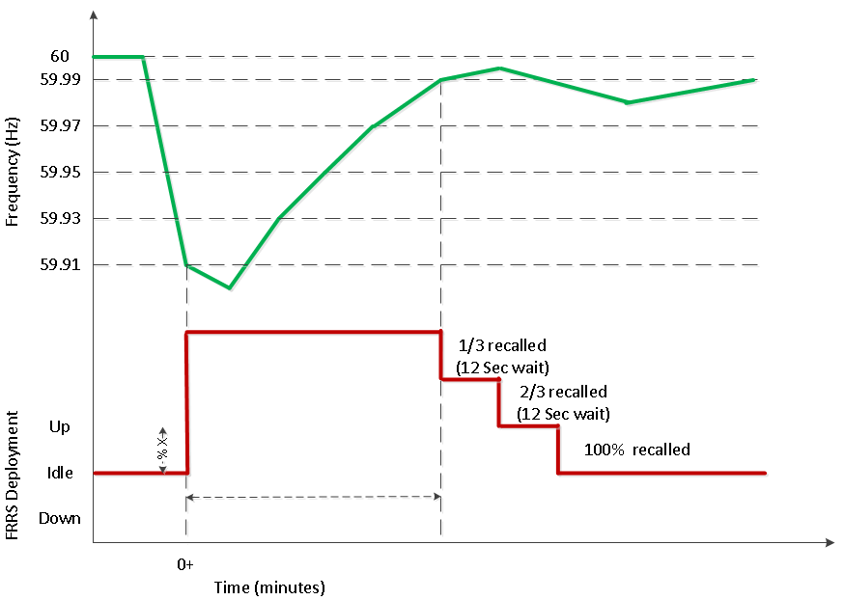
FRRS-Up Recall (Always Based on Duration or Frequency)
Using a Max deployment Time/Band = 1 minute

Slide 9
FRRS Deployment Statistics
How FRRS is being deployed.

Slide 10
FRRS Up Deployments

Slide 11
FRRS Down Deployments

Slide 12
FRRS Deployments per Hour

Slide 13
FRRS Up Deployments per Hour
Deployments per Hour
 | FRRS-Up | FRRS-Dn
40% | 1.75 | 1.04
70% | 1.28 | 0.45
100% | 0.30 | 0.06
Total | 3.33 | 1.55
*Data from Jan-15 to Apr-16

Slide 14
FRRS Down Deployments per Hour
Deployments per Hour
 | FRRS-Up | FRRS-Dn
40% | 1.75 | 1.04
70% | 1.28 | 0.45
100% | 0.30 | 0.06
Total | 3.33 | 1.55
*Data from Jan-15 to Apr-16

Slide 15
Frequency Events
Evaluating battery performance during ERCOT frequency events.

Slide 16
1/21/2016 11:14:45 PM

Slide 17
1/26/2016 11:25:07 PM

Slide 18
2/8/2016 10:31:08 AM

Slide 19
3/8/2016 5:03:11 AM

Slide 20
2/11/2016 9:09:19 PM

Slide 21
FRRS Performance
How do FRRS carrying units respond to ERCOT deployment signals?

Slide 22
2/18/2016 HE16

Slide 23
1/7/2016 HE18

Slide 24
1/8/2016 HE23

Slide 25
1/20/2016 HE23

Slide 26
3/3/2016 HE14

