Slide 1
Project Update and Summary of
Project Priority List (PPL) Activity
May 12, 2016

Slide 2
Project Update Agenda
Project Portfolio Update p. 3-7
  Recent/Upcoming Project Highlights
  2016 Release Targets
  2016 Project Spending Forecast
  Revision Request Funding Placeholder Status
  Priority/Rank Options for Revision Requests with Impacts
Appendix
  Project Portfolio Gantt Chart p. 8-14
Location of Project Priority List (PPL): http://www.ercot.com/services/projects/index

Slide 3
Recent / Upcoming Project Highlights
2016 April Release – Week of 4/12/2016 Complete
  NPRR419 – Revise Real-Time Energy Imbalance and RMR Adjustment Charge
  NPRR728 – Removal of Language Related to NPRR484
    Section 16.11.4.7 (2)
EMS Upgrade – Target go-live date is now 6/16/2016 In Flight
2016 June Release – Week of 6/21/2016 In Flight
  NPRR515 – Day-Ahead Market Self-Commitment of Generation Resources
  NPRR617 – Energy Offer Flexibility
  NPRR700 – Utilizing Actual Fuel Costs in Startup Offer Caps
Note: Projected Go-Live dates are subject to change.
Please watch for market notices as the effective dates approach.

Slide 4
2016 Release Targets – Board Approved NPRRs / SCRs / xGRRs
February 2/2 – 2/4 | April 4/12 – 4/14 | June 6/21 – 6/23 | August 8/16 – 8/18 | October 10/18 – 10/20 | December 12/6 – 12/8
NPRR588 NPRR615 NPRR686(b) | NPRR419 NPRR728 | NPRR515 NPRR617 NPRR700 EMS Upgrade | NPRR495 NPRR662 NPRR712 NPRR736 RMGRR126 | NPRR219 NPRR495 NPRR736 SCR783 NOGRR050 | NPRR272 NPRR573 NPRR714 NOGRR143 NOGRR147 RRGRR003 RRGRR006 RRGRR007 RMGRR127 SCR786
3 | 2 | 3 | 3 | 5 | 10
E
E
E
E
E
NS
P
E
I
I
E
E
P
H
NS
NS
NS
NS
NS
NS
P
P
May 26 June 16
7/23 – 7/24
12/10 – 12/11
EMS Upgrade “Chill”
2016 TBD Items (and point at which they became “TBD”)
2014 | 2015 | February 2016 | April 2016
NOGRR084, NPRR664 | NPRR679 | NPRR210, SCR781 H | NPRR649, NPRR741, NPRR744, NPRR746, NPRR749, SCR787
Go-live dates can differ from Protocol effective dates – Please refer to market notices for more details
APPENDIX
Red Text: New additions and target release changes
Strike-Through Text: Previous target release changes
(a), (b), etc. indicates multiple phases
NPRR686(b) – Solar portion
In-Flight Items Planned for 2017 Delivery
CMM bundle (Planning): NPRR439, NPRR519, NPRR620, NPRR683, NPRR702, NPRR741, NPRR743
CRR Upgrade (Planning): SCR777
Release targets are subject to change
Project Status Codes: NS = Not Started, I = Initiation, P = Planning, E = Execution, H = On Hold

Slide 5
2016 Project Spending Forecast
2016 PPL Budget = $22.5M
“Potential Demand” represents internal ERCOT projects that have not been fully approved

Slide 6
Revision Request Funding Placeholder Status
In 2016 and 2017, ERCOT forecasted $4.4M for Revision Request work
Yearly Revision Request Spending Forecast Summary
Project Status | 2016 | 2017
Approved and In-Flight | $2.31M | $1.11M
Approved and On Hold | $0.04M | $0.90M
Approved and Not Started | $0.43M | $0.24M
Remaining Funding | $1.62M | $2.15M
Total Allocation | $4.40M | $4.40M

Slide 7
Priority / Rank Options for Revision Requests with Impacts
Options for…
Revision Request | Description | Priority | Rank | Comments
NOGRR050 | Resolution of Reporting Issues Related to NPRR219 [CenterPoint Energy] | 2016 | 1240 | Consistent with NPRR219 and SCR783 (in-flight project includes NOGRR050)
NPRR754 | Revise Load Distribution Factors Report Posting Frequency [ERCOT] | 2016 | 1650 | Add to end of current year queue and plan to work it in with other changes after the EMS Upgrade stabilization period
NPRR755 | Data Agent-Only QSE Registration [ERCOT] | 2016 | 1558 | Consistent with items in the in-flight CMM project bundle – try to include in the CMM project since it is still in Planning
NPRR758 | Improved Transparency for Outages Potentially Having a High Economic Impact [ERCOT] | 2017 | 1800 | Primarily a 2017 project since current OS project goes live in October 2016
NPRR764 | QSE Capacity Short Calculations Based on an 80% Probability of Exceedance (P80) [ERCOT] | 2016 | 1365 | Place NPRR764 ahead of NPRR714 in the S&B work queue – try to get done this year
SCR790 | Wind Resource Power Production and Forecast Transparency [DC Energy] | 2016 | 1660 | Add to end of current year queue and plan to work it in with other changes after the EMS Upgrade stabilization period

Slide 8
Appendix
  4/30/2016 Project Gantt
    In-flight items sorted by Project End Date
    “On Hold” projects listed separately
    “Not Started” items sorted by Project Start Date

Slide 9
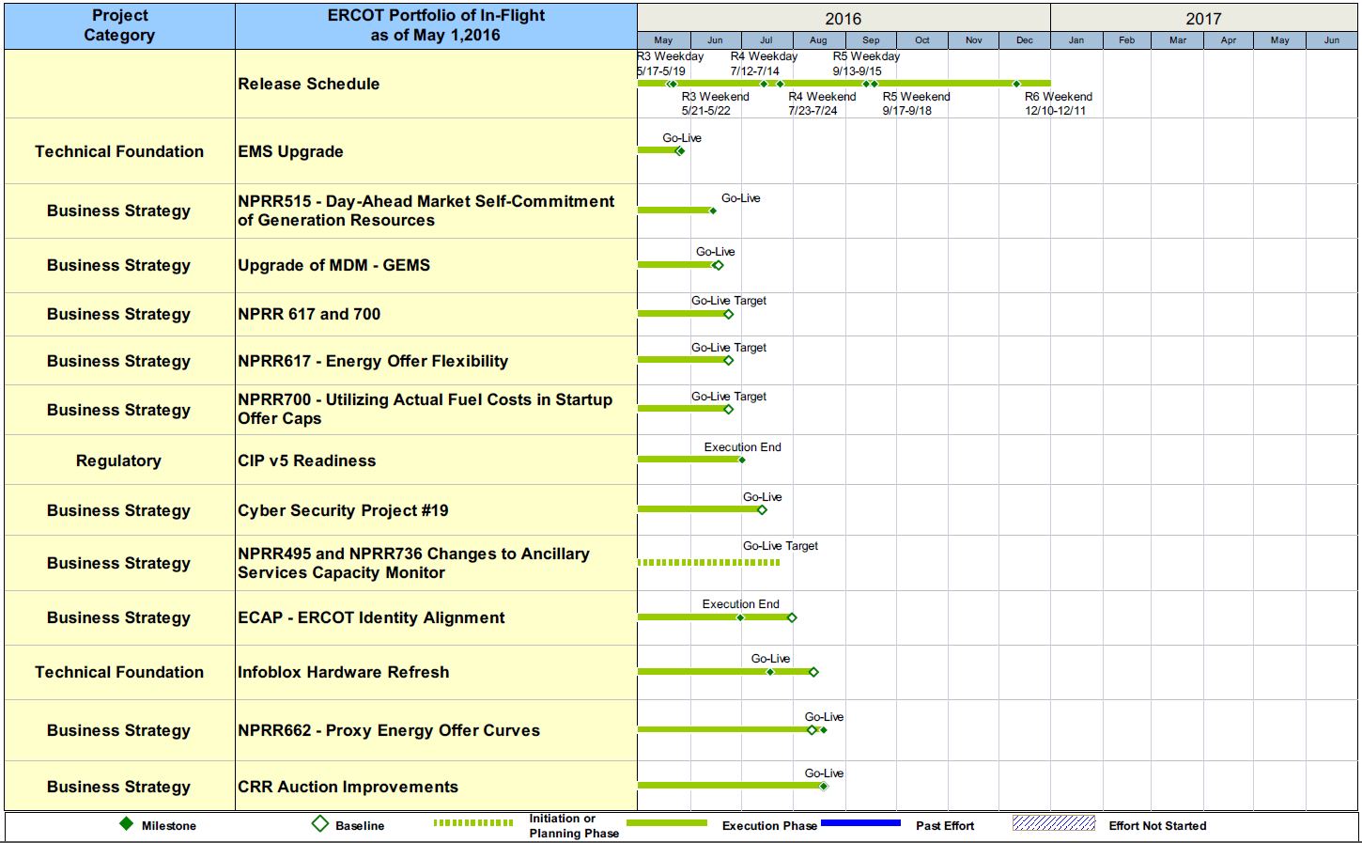
Project Portfolio Status – as of 4/30/2016

Slide 10
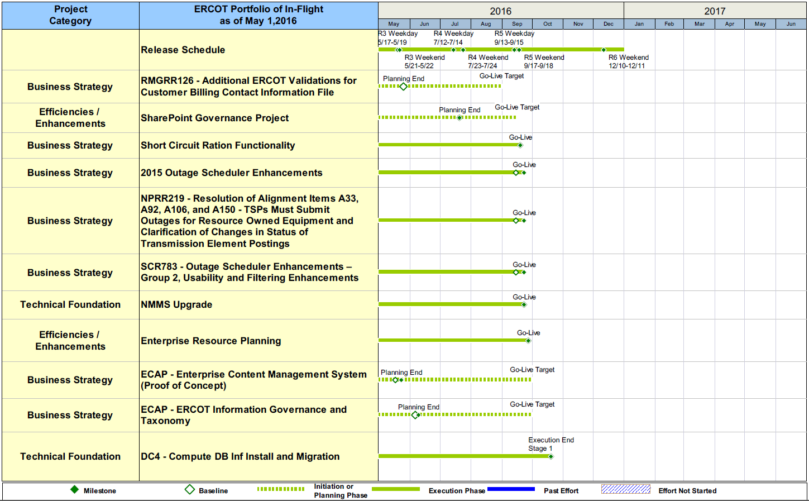
Project Portfolio Status – as of 4/30/2016

Slide 11
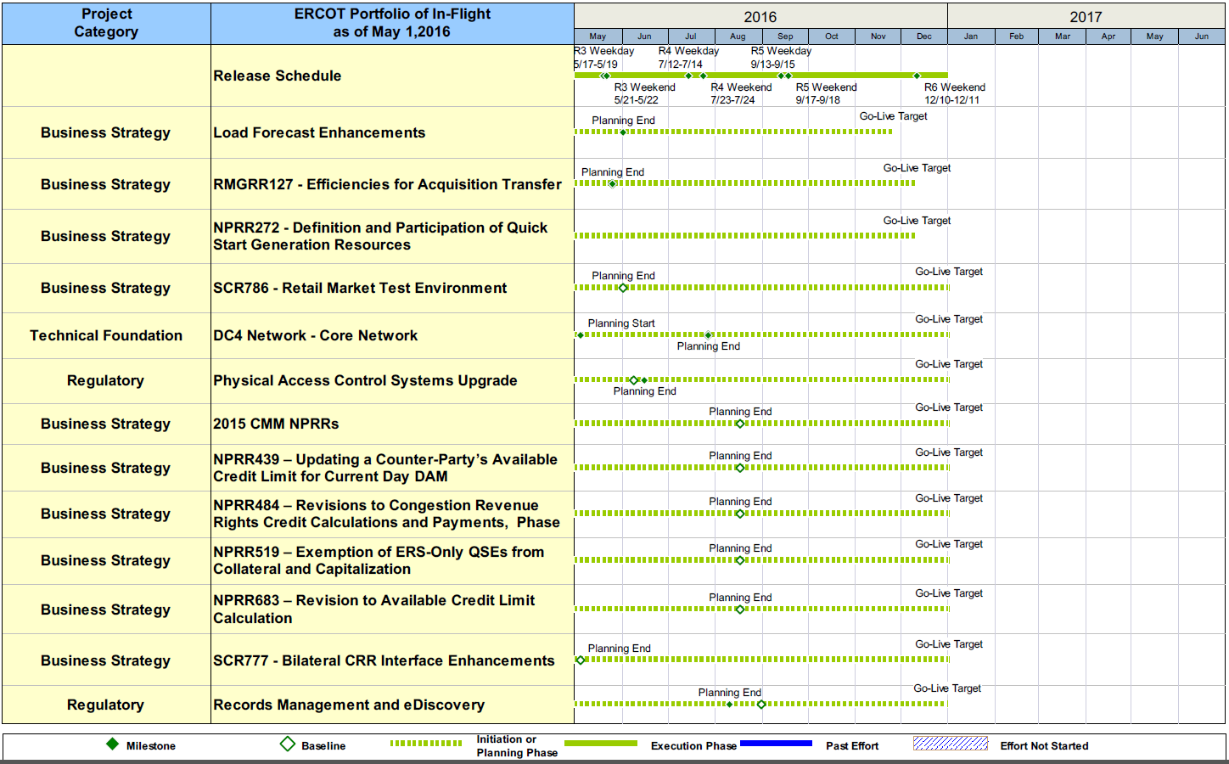
Project Portfolio Status – as of 4/30/2016

Slide 12
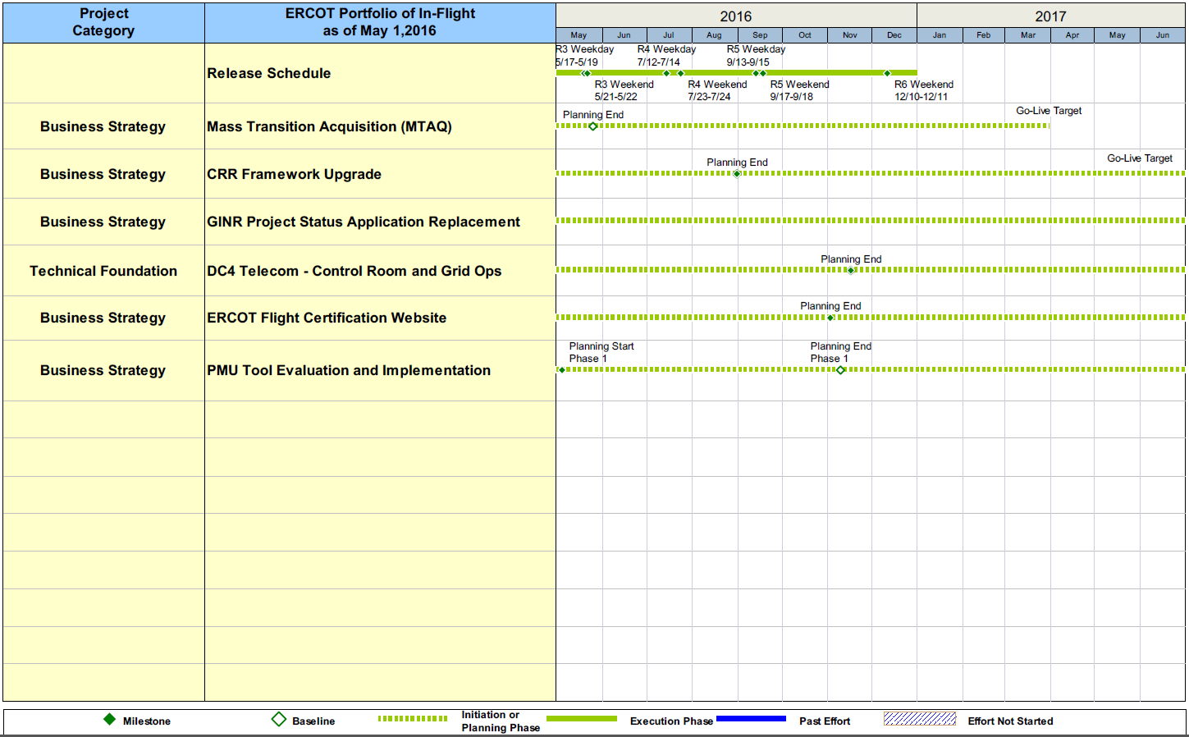
Project Portfolio Status – as of 4/30/2016

Slide 13
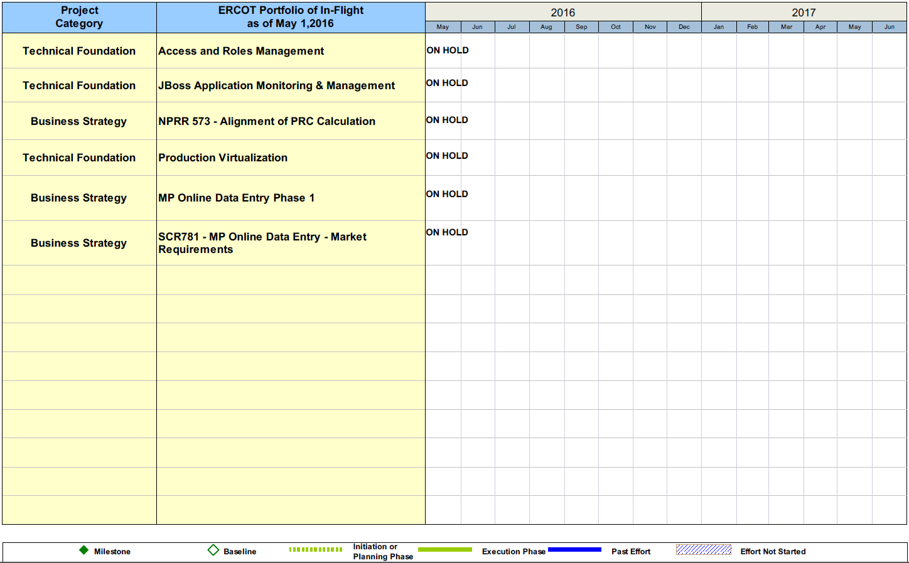
Project Portfolio Status – as of 4/30/2016

Slide 14
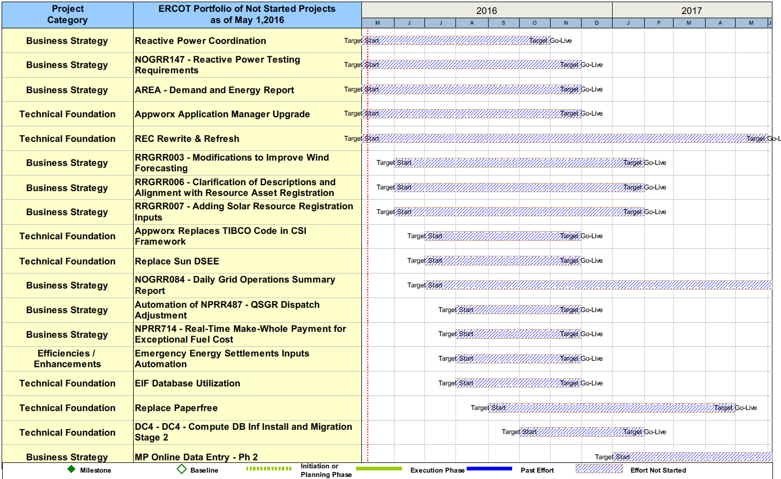
Project Portfolio Status – as of 4/30/2016

