Slide 1
Credit Exposure Analysis using ICE Prices
Suresh Pabbisetty, FRM, ERP, CQF, CSQA.
Lead Technical Analyst, Credit
May 18, 2016

Slide 2
Agenda
Suggested Methodology
  Options considered
Credit Exposure Analysis
  Data Inputs & Transformations
  Assumptions & Limitations
  Results
    Forward Adjustment Factors
    Market-wide Exposure Summary
    Generation-Only Exposure Summary
    Load-Only Exposure Summary
    Load & Generation Exposure Summary
    Trader-Only Exposure Summary

Slide 3
Credit Exposure Analysis using ICE Prices
Suggested Methodology

Slide 4
Credit Exposure Analysis using ICE Prices
Suggested methodology by CRIM to use ICE Futures prices:
  Utilize Daily Peak futures (END) and Daily Off-Peak futures (NED) contract prices from ICE for determining projected forward price
  Calculate daily average futures price as (16 * Peak price + 8* Off-peak price) / 24 with substitution of most recent price for missing prices
  Apply forward adjustment factors to MCE, RTLE and DALE
  Use weight factors for 3 forward weeks to determine the numerator of forward adjustment factor for MCE, RTLE and DALE
  Use 14 RTM settled operating days in the current calculation to determine denominator of forward adjustment factor for MCE and RTLE
  Use 7 DAM settled operating days in the current calculation to determine denominator of forward adjustment factor for DALE

Slide 5
Credit Exposure Analysis using ICE Prices
Suggested Forward Adjustment Factor Calculations:
  Calculate PFDAP (Projected Forward Daily Average Price) as [FW1 * (ICE Average Price of Forward Week 1) + FW2 * (ICE Average Price of Forward Week 2) + FW3 * (ICE Average Price of Forward Week 3)]
  Calculate RFAF (Real Time Forward Adjustment Factor) as PFDAP / (North Hub RTSPP Average of 14 RTM settled operating days);
    apply RFAF to MCE and RTLE or MAXRTLE
  Calculate DFAF (Day Ahead Forward Adjustment Factor) as PFDAP / (North Hub DASPP of 7 DAM settled operating days)
    apply DFAF to DALE

Slide 6
Credit Exposure Analysis using ICE Prices
Suggested Methodology – Options considered:
Option 1:
  PFDAP using 14 forward days ICE price average
  look back for finding Maximum RTLE
Option 2:
  PFDAP using 21 forward days ICE price average
  look back for finding Maximum RTLE
Option 3:
  PFDAP using 14 forward days ICE price average
  No look back for finding Maximum RTLE
Option 4:
  PFDAP using 21 forward days ICE price average
  No look back for finding Maximum RTLE

Slide 7
Credit Exposure Analysis using ICE Prices
Assumptions & Limitations

Slide 8
Credit Exposure Analysis using ICE Prices
Assumptions & Limitations:
  North Hub Price is a representation of Market wide price movements
  Very minimal testing/validation has been performed due to time and resource constraints. Results shall be viewed as indicative only.

Slide 9
Credit Exposure Analysis using ICE Prices
Data Inputs & Transformations

Slide 10
Credit Exposure Analysis using ICE Prices
Data Inputs & Transformations:
  ICE Futures prices pertaining to North Hub Settlement Point for Daily Peak (END) and Off-peak (NED) contracts
  ICE doesn’t have new pricing information available on weekends and holidays. The most recent available price of the same contract is substituted if a price is missing
  ICE Prices from early Nov 2012 through Mar 2016
  Daily Average Price is calculated as (16 * Peak Price + 8 * Off-peak Price)/24
  North Hub RTSPP and DASPP from early Nov 2012 through Mar 2016
  Daily Average Price is calculated using simple average of all interval RTSPPs in an Operating Day
  Daily Average Price is calculated using simple average of all interval DASPPs in an Operating Day

Slide 11
Credit Exposure Analysis using ICE Prices
Data Inputs & Transformations :
  Counter-Parties’ participation and their representation of QSEs and or CRR Account Holders could change from time to time
  A snapshot Counter-Parties’ information is taken as of March 24th, 2016 and used for the overall analysis
  MCE was implemented in Nov 2012
  As the suggested methodology includes applying RFAF to MCE also, the period used for analysis starts from Nov 2012
  Other Exposure Components
  Suggested methodology has changes to only MCE, RTLE and DALE, hence all the other exposure components used were as calculated/adjusted with respect to corresponding historical business date

Slide 12
Credit Exposure Analysis using ICE Prices
Results
Forward Adjustment Factors

Slide 13
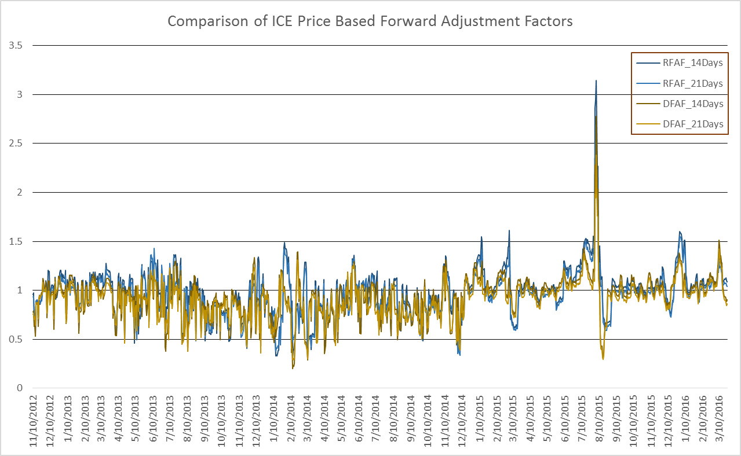
Credit Exposure Analysis using ICE Prices
Results – Forward Adjustment Factors:

Slide 14
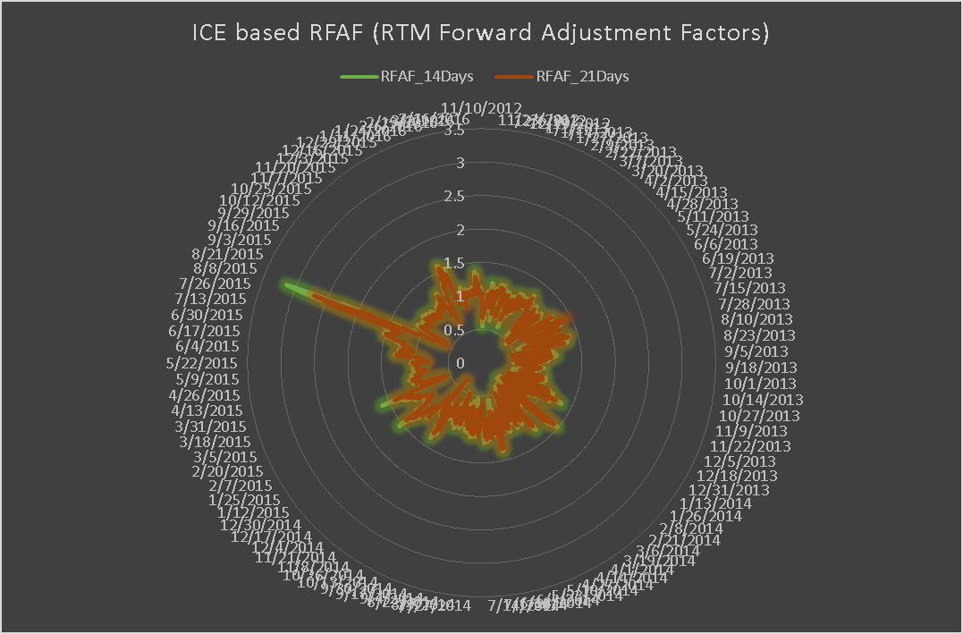
Credit Exposure Analysis using ICE Prices
Results – RFAF (RTM Forward Adjustment Factor):

Slide 15
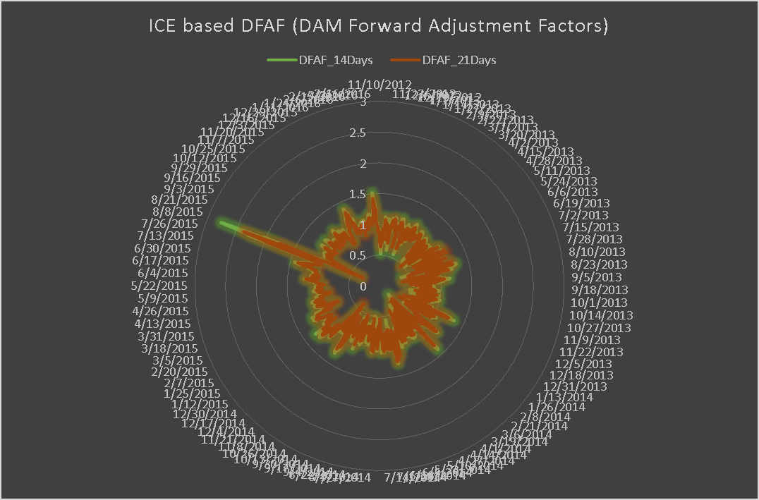
Credit Exposure Analysis using ICE Prices
Results – DFAF (DAM Forward Adjustment Factor):

Slide 16
Credit Exposure Analysis using ICE Prices
Results – Forward Adjustment Factor Summary:
  Average Forward Adjustment Factors are less than 1
  This implies a reduction in aggregate market exposure

Slide 17
Credit Exposure Analysis using ICE Prices
Results
Market-wide Exposure Summary

Slide 18
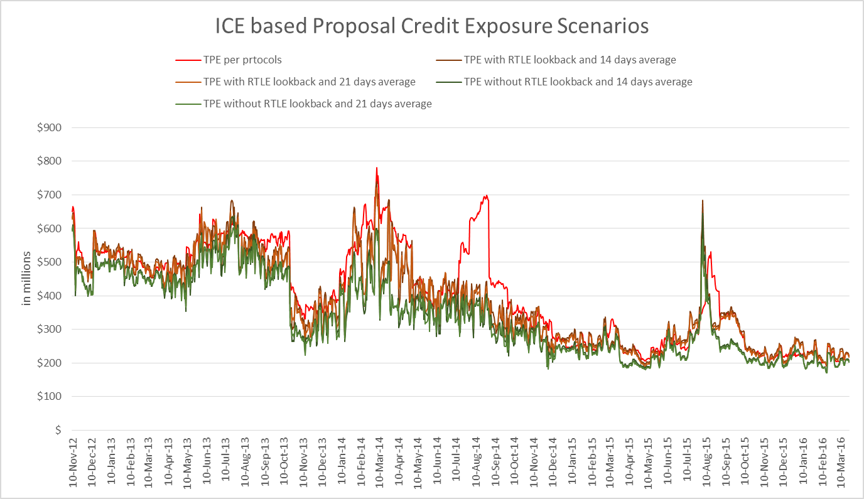
Credit Exposure Analysis using ICE Prices
Results – Exposure Summary:

Slide 19
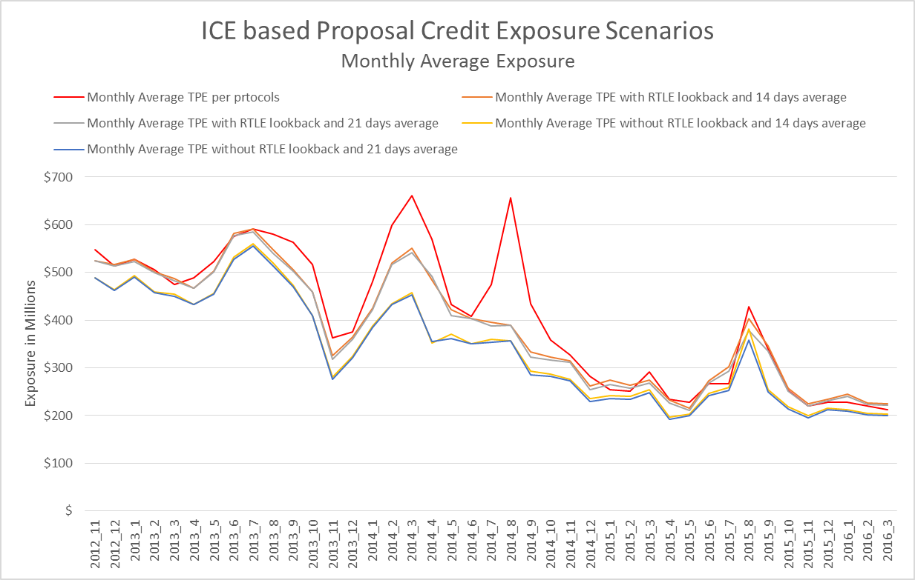
Credit Exposure Analysis using ICE Prices
Results – Monthly Average Exposure:

Slide 20
Credit Exposure Analysis using ICE Prices
Results – Market-wide Exposure options descriptive statistics:
  Average exposure under all proposed options is significantly lower
  There is high correlation between exposure under proposed options to exposure under current protocols
  Relative Variability is similar across all options

Slide 21
Credit Exposure Analysis using ICE Prices
Results – Average Market-wide Aggregate Exposure by Category:

Slide 22
Credit Exposure Analysis using ICE Prices
Results – Change in Average Market-wide Aggregate Exposure by Category:

Slide 23
Credit Exposure Analysis using ICE Prices
Results – Percentage Change in Average Market-wide Aggregate Exposure by Category:
  Exposure under any of the proposed scenarios is significantly lower

Slide 24
Credit Exposure Analysis using ICE Prices
Results
Generation-Only Exposure Summary

Slide 25
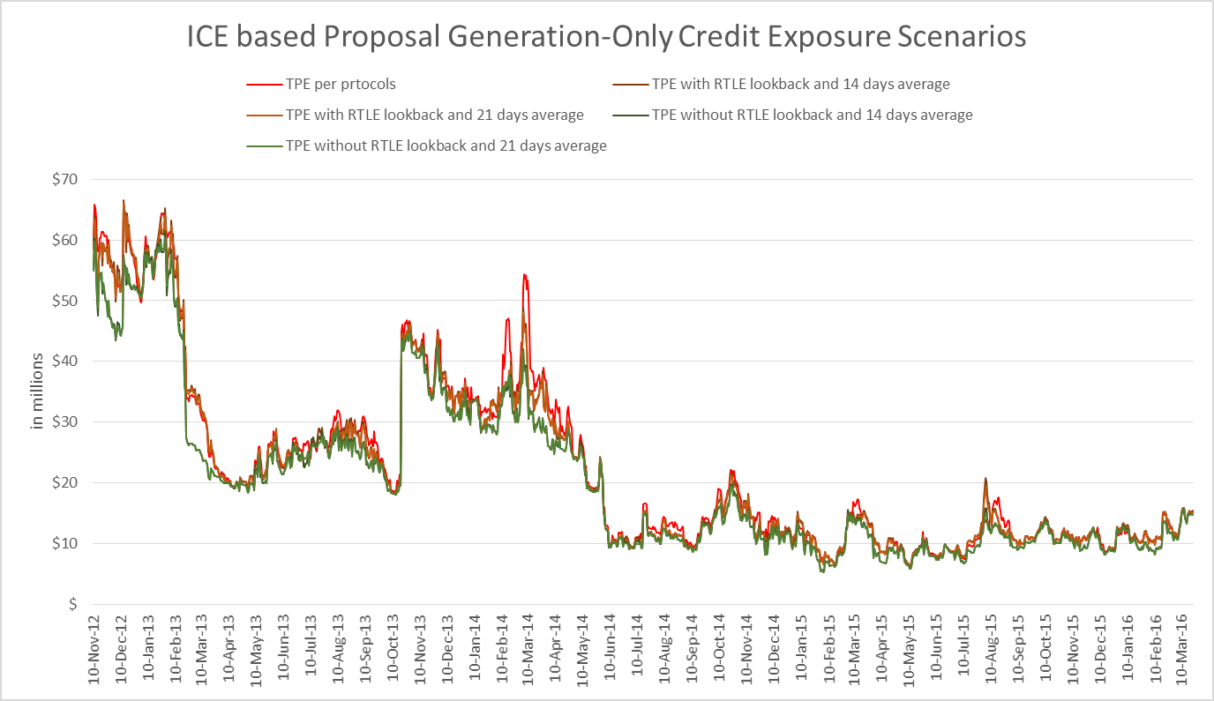
Credit Exposure Analysis using ICE Prices
Results: Generation-Only Exposure Summary

Slide 26
Credit Exposure Analysis using ICE Prices
Results: Generation-Only Exposure options descriptive statistics:
  Average exposure under all proposed options is significantly lower
  There is high correlation between exposure under proposed options to exposure under current protocols
  Relative Variability is similar across all options

Slide 27
Credit Exposure Analysis using ICE Prices
Results: Generation-Only Exposure options descriptive statistics:
  On average there is a reduction of $1 million to $2 million in Generation-Only aggregate exposure

Slide 28
Credit Exposure Analysis using ICE Prices
Results
Load-Only Exposure Summary

Slide 29
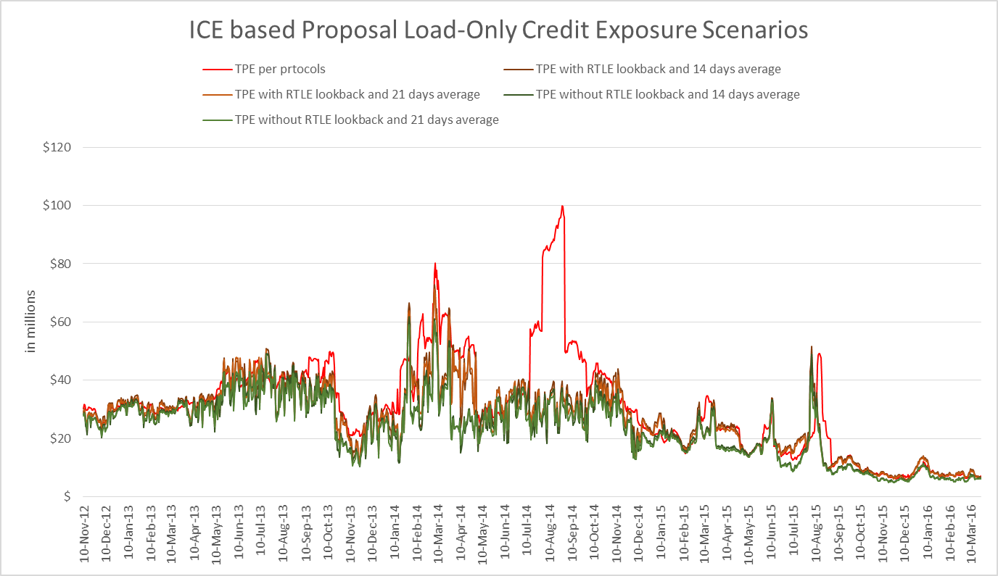
Credit Exposure Analysis using ICE Prices
Results: Load-Only Exposure Summary

Slide 30
Credit Exposure Analysis using ICE Prices
Results: Load-Only Exposure options descriptive statistics:
  Average exposure under all proposed options is significantly lower
  There is high correlation between exposure under proposed options to exposure under current protocols
  Relative Variability is similar across all options

Slide 31
Credit Exposure Analysis using ICE Prices
Results: Load-Only Exposure options descriptive statistics:
  On average there is a reduction of $4 million to $8 million in Load-Only aggregate exposure

Slide 32
Credit Exposure Analysis using ICE Prices
Results
Load & Generation Exposure Summary

Slide 33
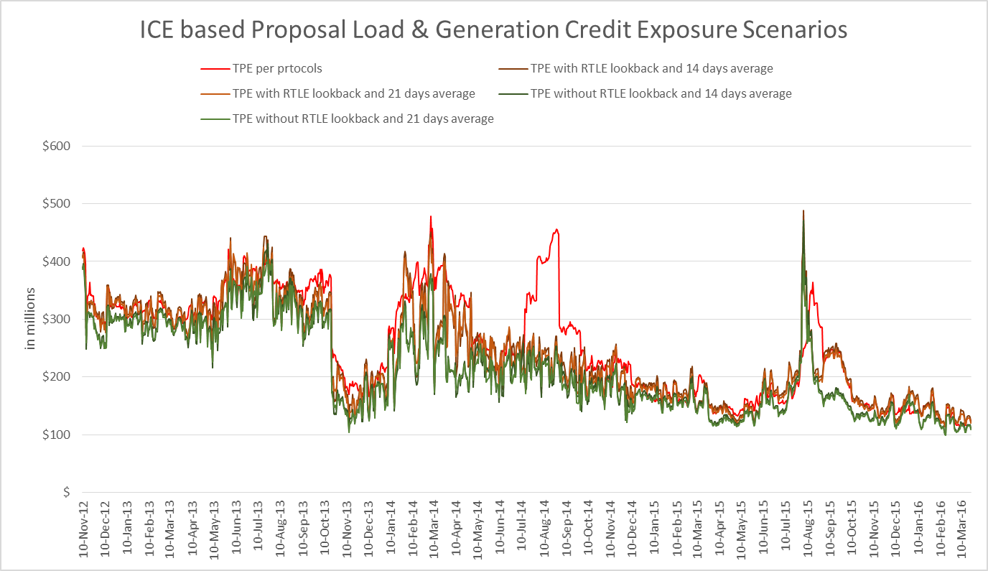
Credit Exposure Analysis using ICE Prices
Results: Load & Generation Exposure Summary

Slide 34
Credit Exposure Analysis using ICE Prices
Results: Load & Generation Exposure options descriptive statistics:
  Average exposure under all proposed options is significantly lower
  There is high correlation between exposure under proposed options to exposure under current protocols
  Relative Variability is similar across all options

Slide 35
Credit Exposure Analysis using ICE Prices
Results: Load & Generation Exposure options descriptive statistics:
  On average there is a reduction of $16 million to $44 million in Load & Generation aggregate exposure

Slide 36
Credit Exposure Analysis using ICE Prices
Results
Trader-Only Exposure Summary

Slide 37
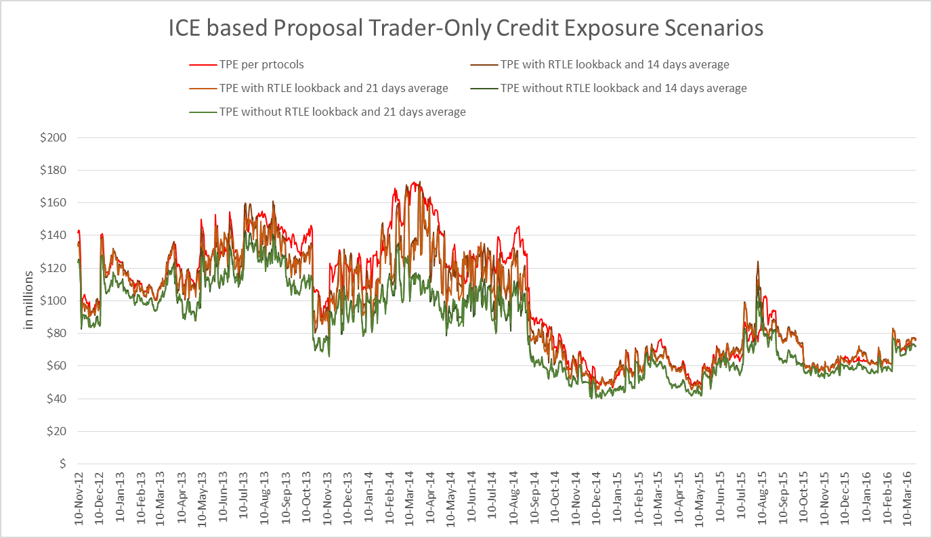
Credit Exposure Analysis using ICE Prices
Results: Trader-Only Exposure Summary

Slide 38
Credit Exposure Analysis using ICE Prices
Results: Trader-Only Exposure options descriptive statistics:
  Average exposure under all proposed options is significantly lower
  There is high correlation between exposure under proposed options to exposure under current protocols
  Relative Variability is similar across all options

Slide 39
Credit Exposure Analysis using ICE Prices
Results: Trader-Only Exposure options descriptive statistics:
  On average there is a reduction of $5 million to $17 million in Load-Only aggregate exposure

Slide 40
Credit Exposure Analysis using ICE Prices
Questions

