Slide 1
Settlement Stability
2016 Q1 Update to COPS
Blake Holt
ERCOT
5/11/16

Slide 2
8.2(c)(i) Track number of price changes
Reporting Period: 2016 Q1
Operating Day | # of Corrected Settlement Point Prices |  |  |  | # of Intervals Affected
 | DASPP | RTSPP | RTRMPR | ORDC Adders | DASPP | RTSPP | RTRMPR | ORDC Adders
- | - | - | - | - | - | - | - | -
Notes:
There were no price corrections in Q1.

Slide 3
8.2(c)(ii) Track number and types of disputes submitted
YEAR | 2016
QUARTER | Q1
Row Labels | Denied | Granted | Granted w/Exc. | Open | Total Submitted
Energy-RTM | 2 | 1 | 0 | 0 | 3
Invoice | 1 | 0 | 0 | 0 | 1
Grand Total | 3 | 1 | 0 | 0 | 4

Slide 4
8.2(c)(iii) Compliance with timeliness of response to disputes
YEAR | 2016
QUARTER | Q1
Row Labels | FINAL | TRUE-UP | GRAND TOTAL
Energy-RTM | 100% | 100% | 100%
Invoice | 100% |  | 100%
Grand Total | 100% | 100% | 100%

Slide 5
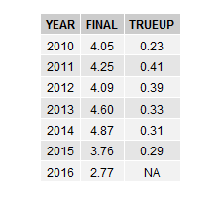
8.2(c)(iv) Other Settlement metrics
NOTE: ERS Final settlement OD data is not represented in graph.
Average percent change

Slide 6
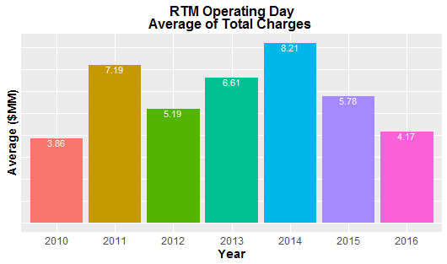
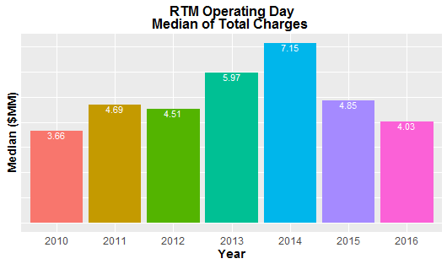
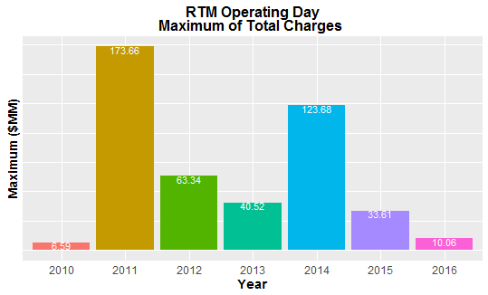
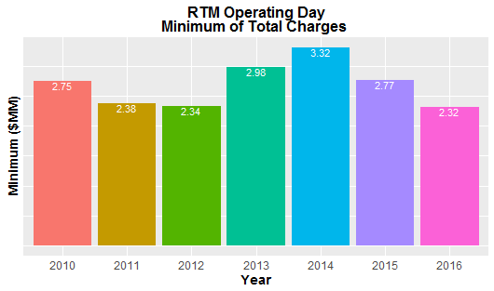
8.2(c)(iv) Other Settlement metrics

Slide 7
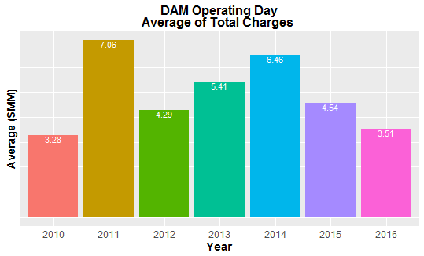
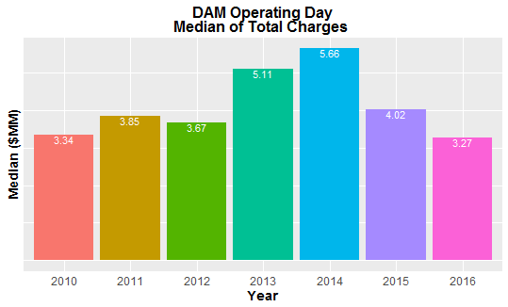
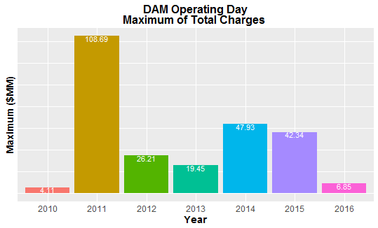
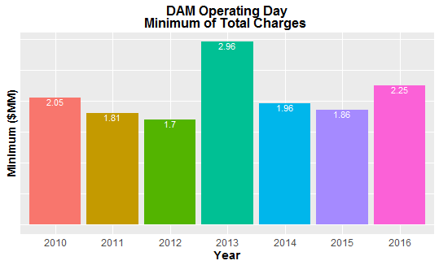
8.2(c)(iv) Other Settlement metrics

Slide 8
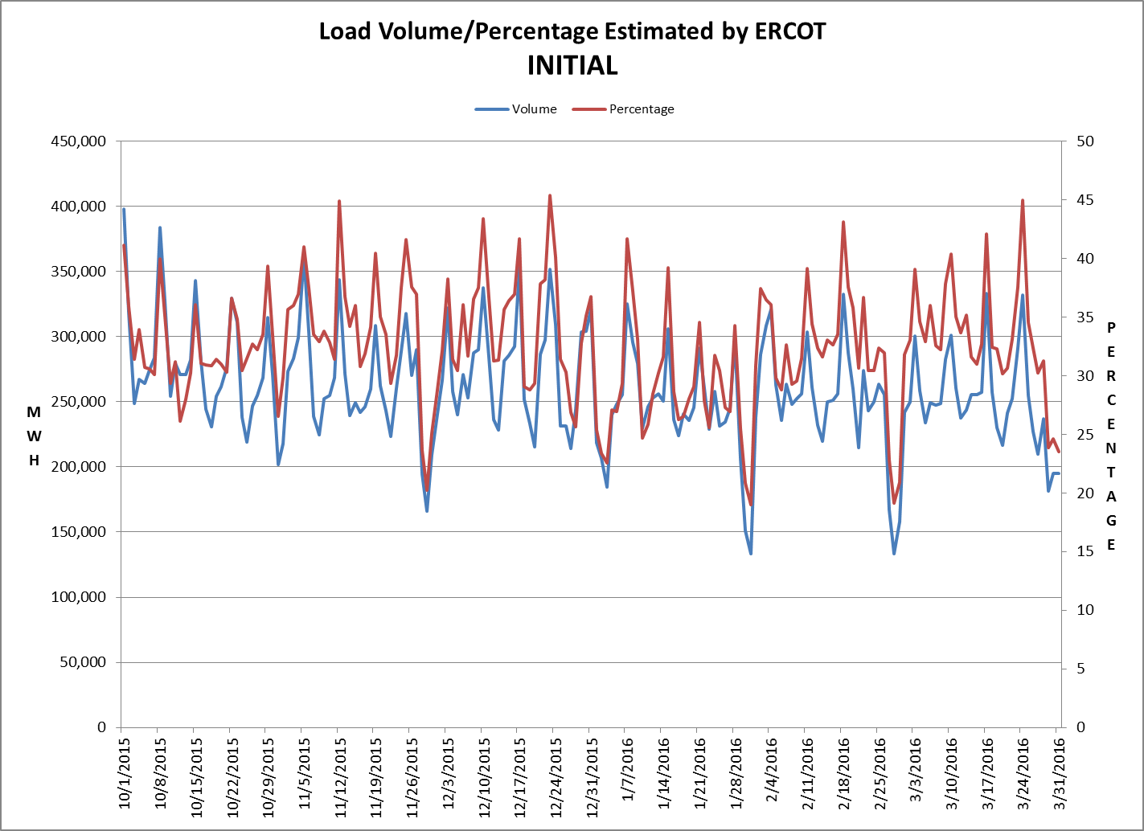
8.2(c)(v) Availability of ESIID consumption data

Slide 9
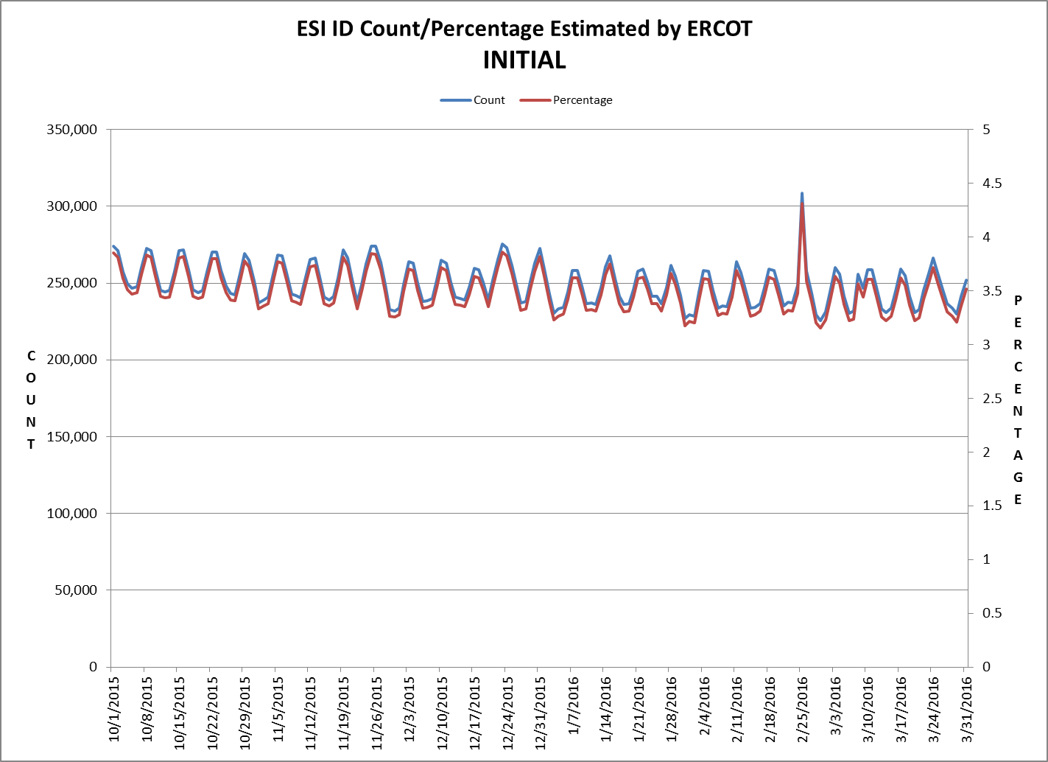
8.2(c)(v) Availability of ESIID consumption data

Slide 10
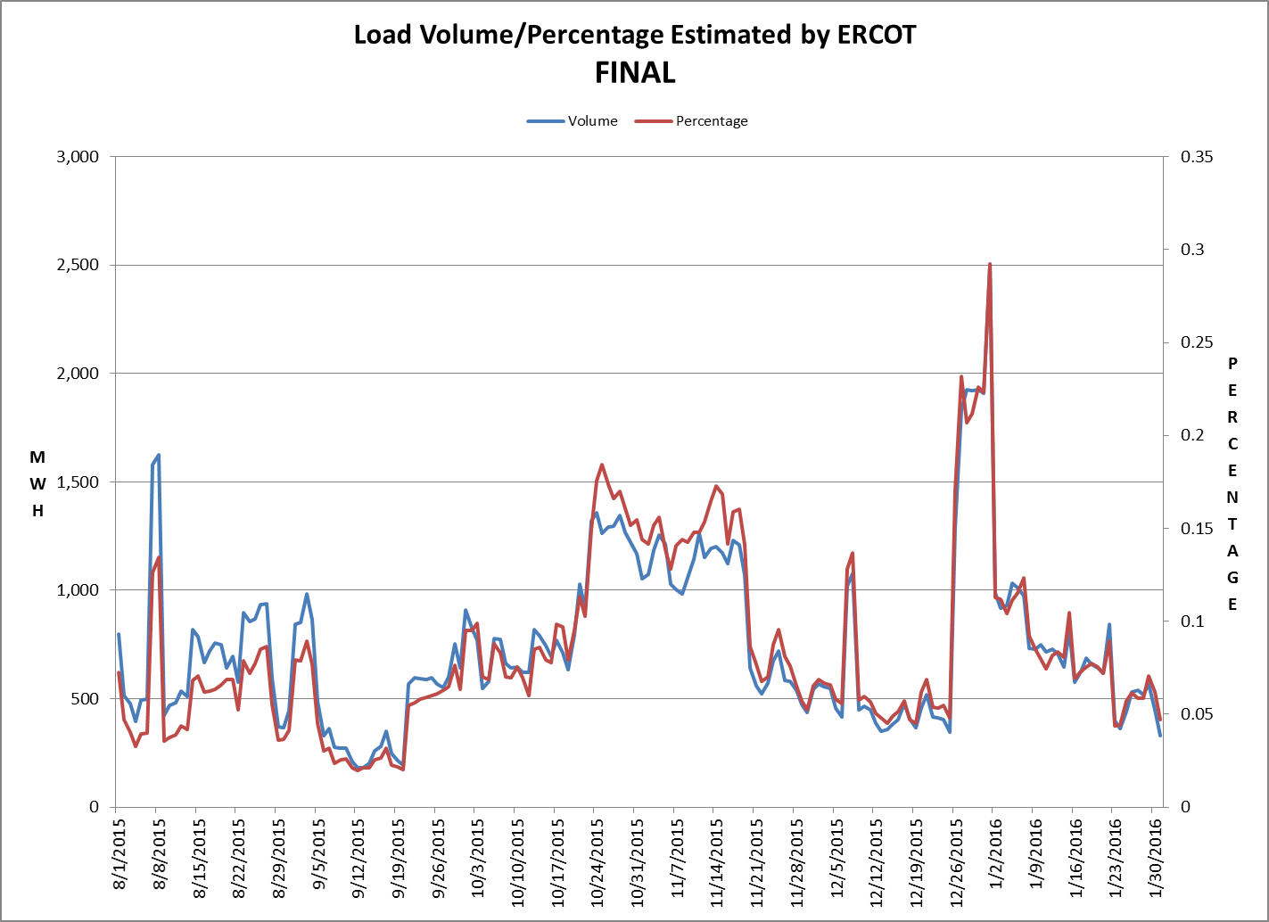
8.2(c)(v) Availability of ESIID consumption data

Slide 11
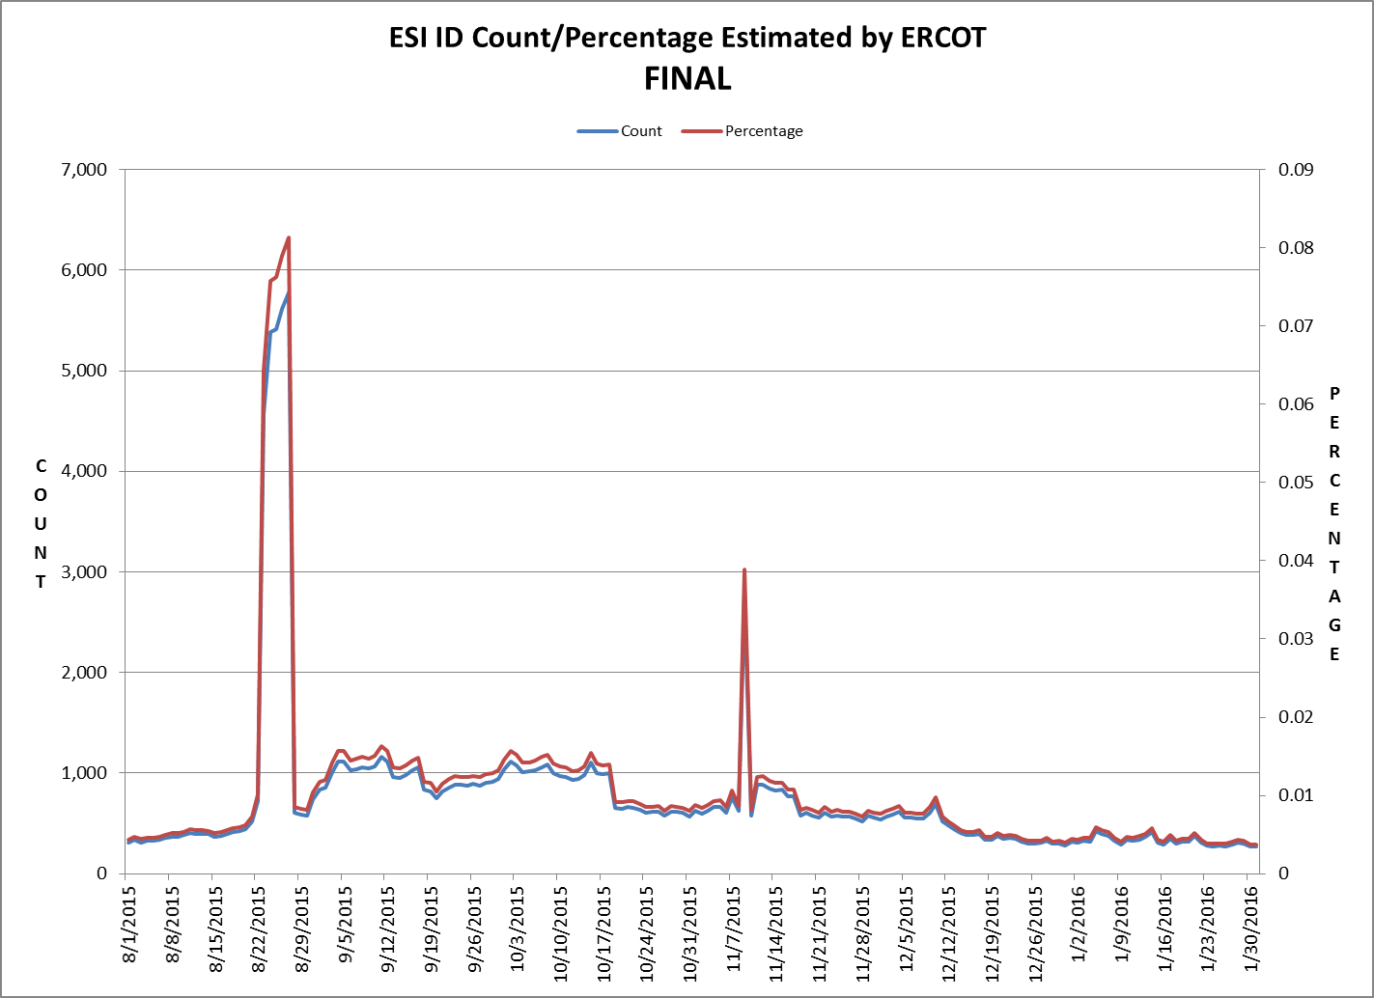
8.2(c)(v) Availability of ESIID consumption data

Slide 12
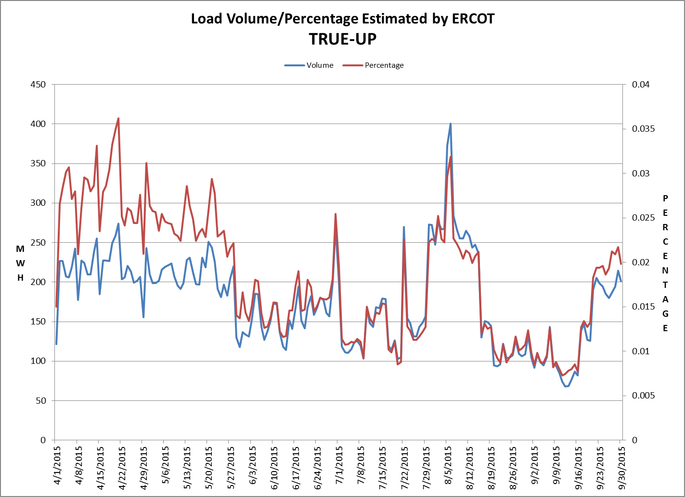
8.2(c)(v) Availability of ESIID consumption data

Slide 13
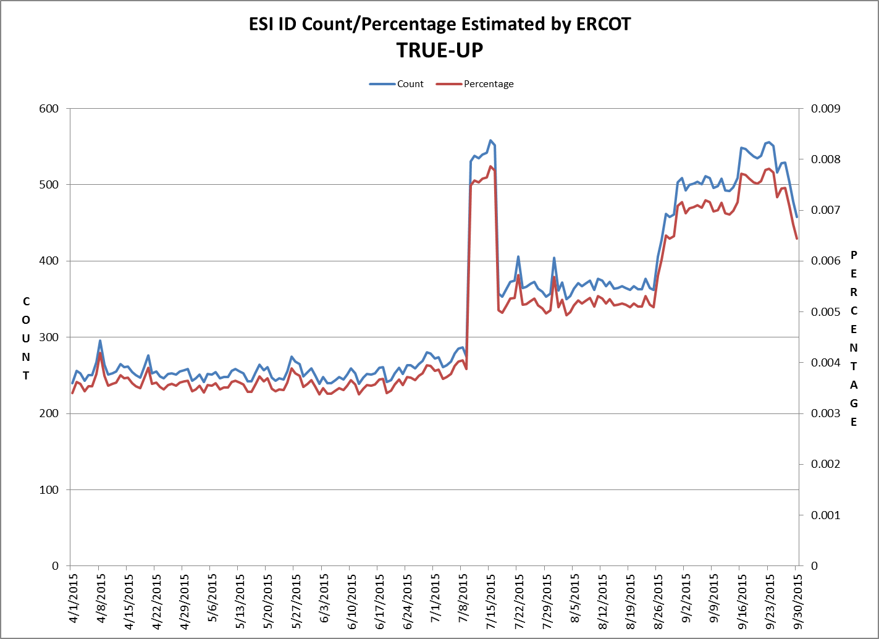
8.2(c)(v) Availability of ESIID consumption data

Slide 14
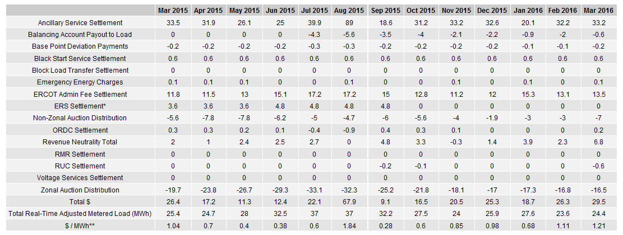
8.2(g) Net Allocation to Load (Board Report)- Totals and $/MWh
NET ALLOCATION TO LOAD (MM)
AUCTION REVENUE PER CONGESTION MANAGEMENT ZONE ($MM)
* The total ERS charges have been evenly allocated across the contract period.
** The $/MWh value as calculated per PR 8.2 (2) g

