Slide 1
PDCWG Report to ROS
Chair: Percy Galliguez, Brazos Electric Power Cooperative, Inc.
Vice Chair: Stewart Rake, Luminant
ROS
May 5th, 2016

Slide 2
Report Overview & Notes
Report Overview
Meeting Minutes
BAL-001-TRE-1 FMEs & IMFR
No FME’s in the month of March
Frequency Control Report

Slide 3
Meeting Minutes
PDCWG Meeting 4/13/16
Regulation & Frequency Control Reports
GREDP Performance Analysis
BAL-001-TRE-1 Mitigation Plan Requirements
Section C 2.1 of Regional Standard
Assessing Historical Frequency Response Demands & Assessing Reliability Issues, Ongoing Costs, and Concerns
Mike Potishnak asked for volunteers within PDCWG to participate in a survey.
Reviewed 2 (non-FME) ERCOT Frequency Disturbance
3/15/2016 @ 1000
Loss of 425 MW
977 MW/0.1HZ Response
3/22/2016 @ 0929
Loss of 276 MW
544 MW/0.1HZ Response
4/9/2016 @ 0500
Loss of 234 MW
498 MW/0.1HZ Response

Slide 4
Frequency Measurable Events Performance
April & May 2016

Slide 5
Frequency Measurable Events
There were 3 FMEs during the month of April.
4/17/2016 23:30:44
Loss of 663 MW
Interconnection Frequency Response: 872 MW/0.1 Hz
6 of 41 Generation Resources had less than 75% of their expected Initial Primary Frequency Response.
5 of 41 Generation Resources had less than 75% of their expected Sustained Primary Frequency Response.
4/23/2016 1:54:22
Loss of 402 MW
Interconnection Frequency Response: 687 MW/0.1 Hz
7 of 44 Generation Resources had less than 75% of their expected Initial Primary Frequency Response.
7 of 44 Generation Resources had less than 75% of their expected Sustained Primary Frequency Response.

Slide 6
Frequency Measurable Events
4/30/2016 1:16:20
Loss of 432 MW
Interconnection Frequency Response: 584 MW/0.1 Hz
4 of 39 Generation Resources had less than 75% of their expected Initial Primary Frequency Response.
3 of 39 Generation Resources had less than 75% of their expected Sustained Primary Frequency Response.
There has been 1 FME so far in May.
5/1/2016 12:32:30
Loss of 562 MW
Interconnection Frequency Response: 906 MW/0.1 Hz
5 of 48 Generation Resources had less than 75% of their expected Initial Primary Frequency Response.
4 of 48 Generation Resources had less than 75% of their expected Sustained Primary Frequency Response.

Slide 7
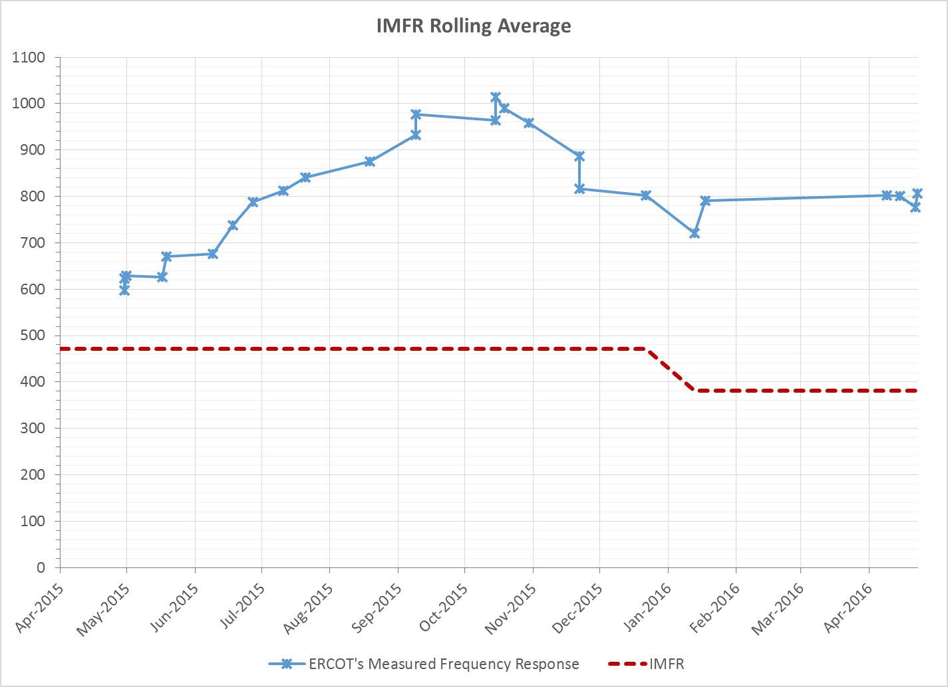
Interconnection Minimum Frequency Response (IMFR) Performance

Slide 8
Frequency Control Report
January 2016

Slide 9
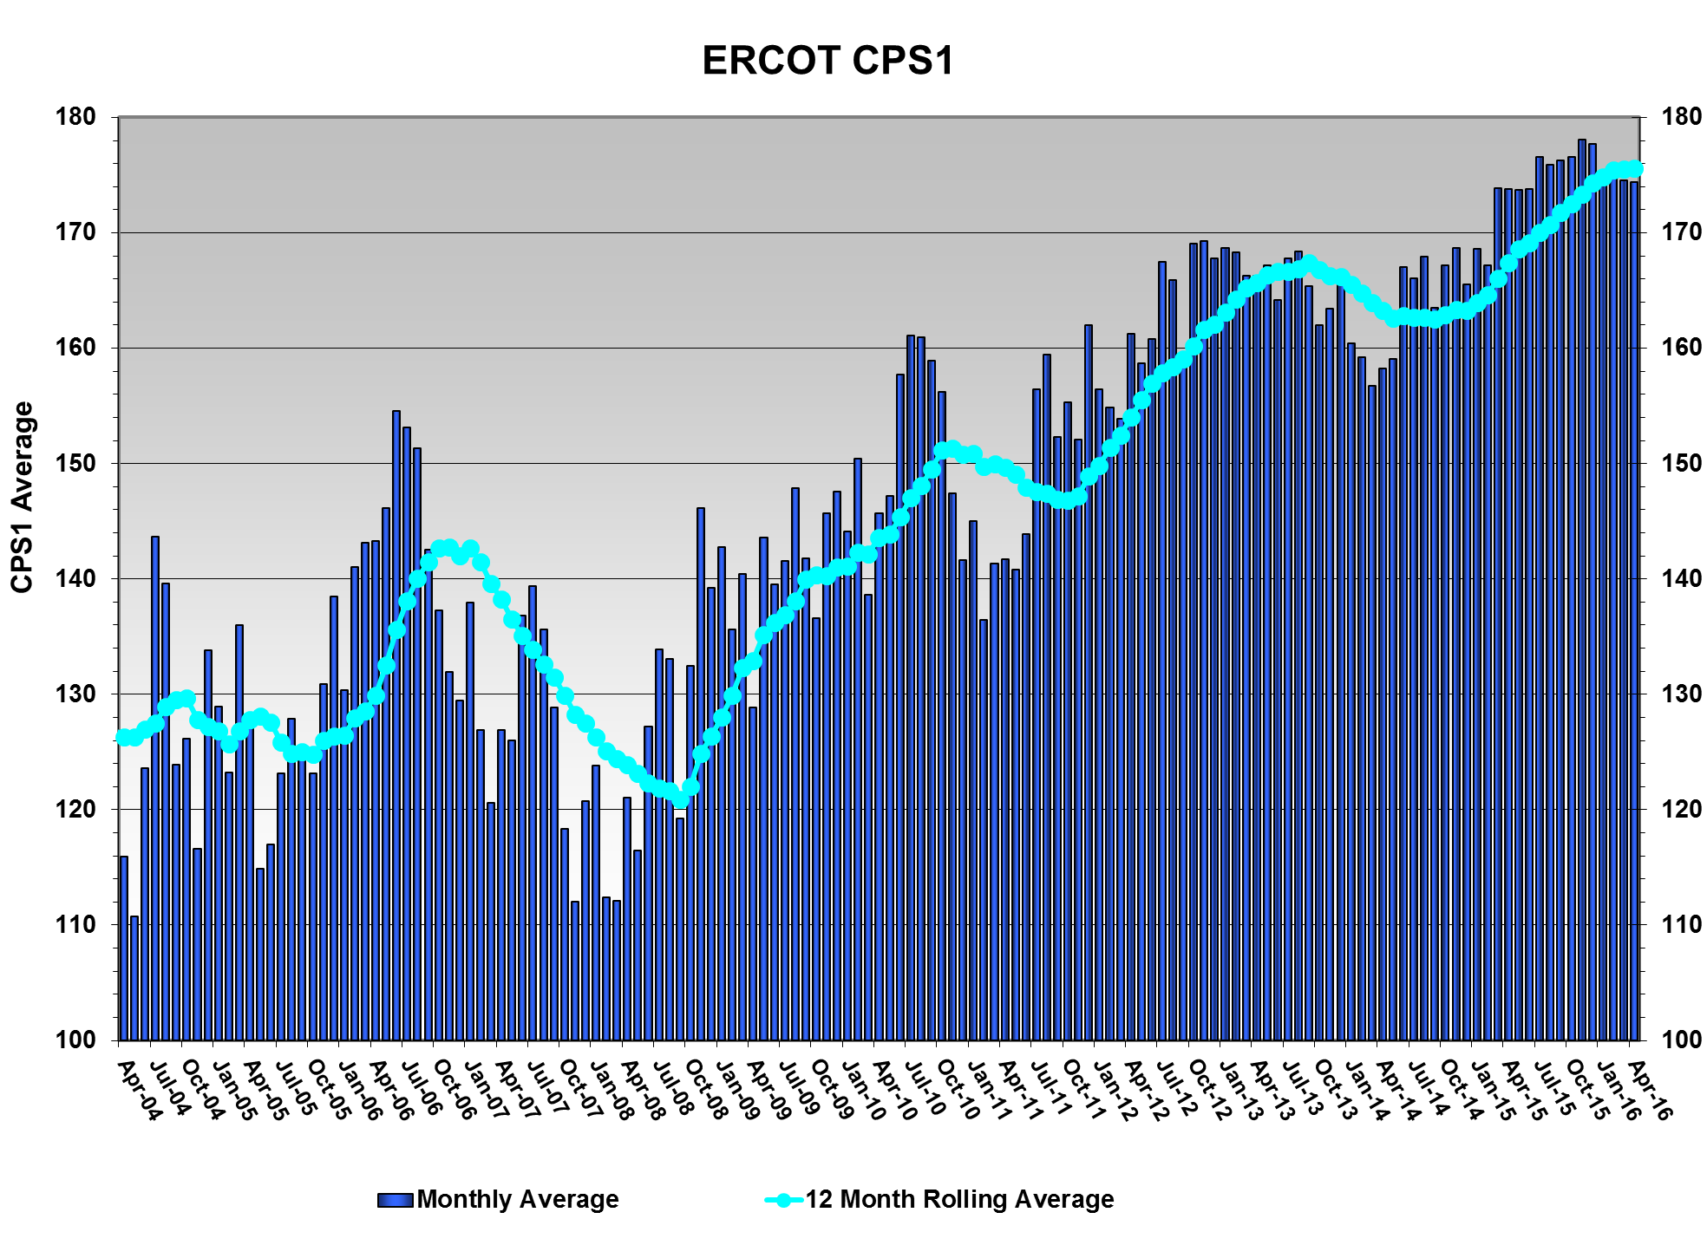
CPS1 Performance
CPS1 12 Month Rolling Average = 175.57%

Slide 10
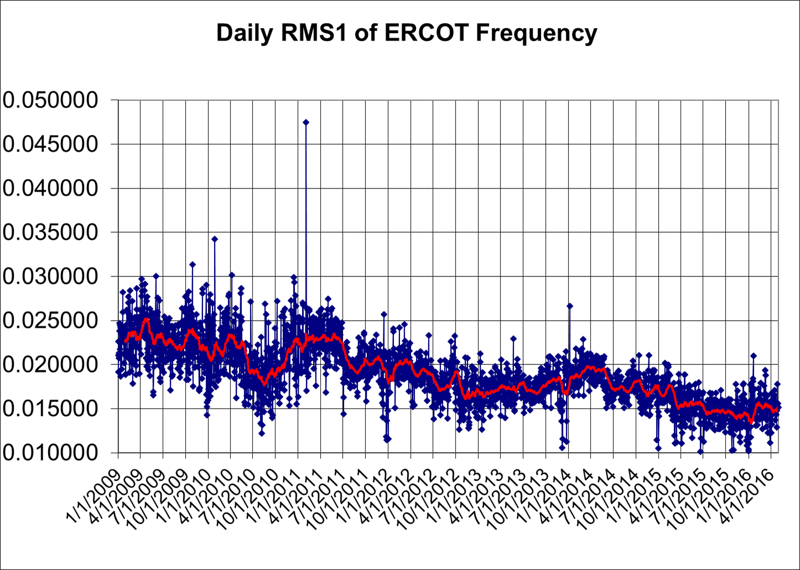
RMS1 Performance of ERCOT Frequency

Slide 11
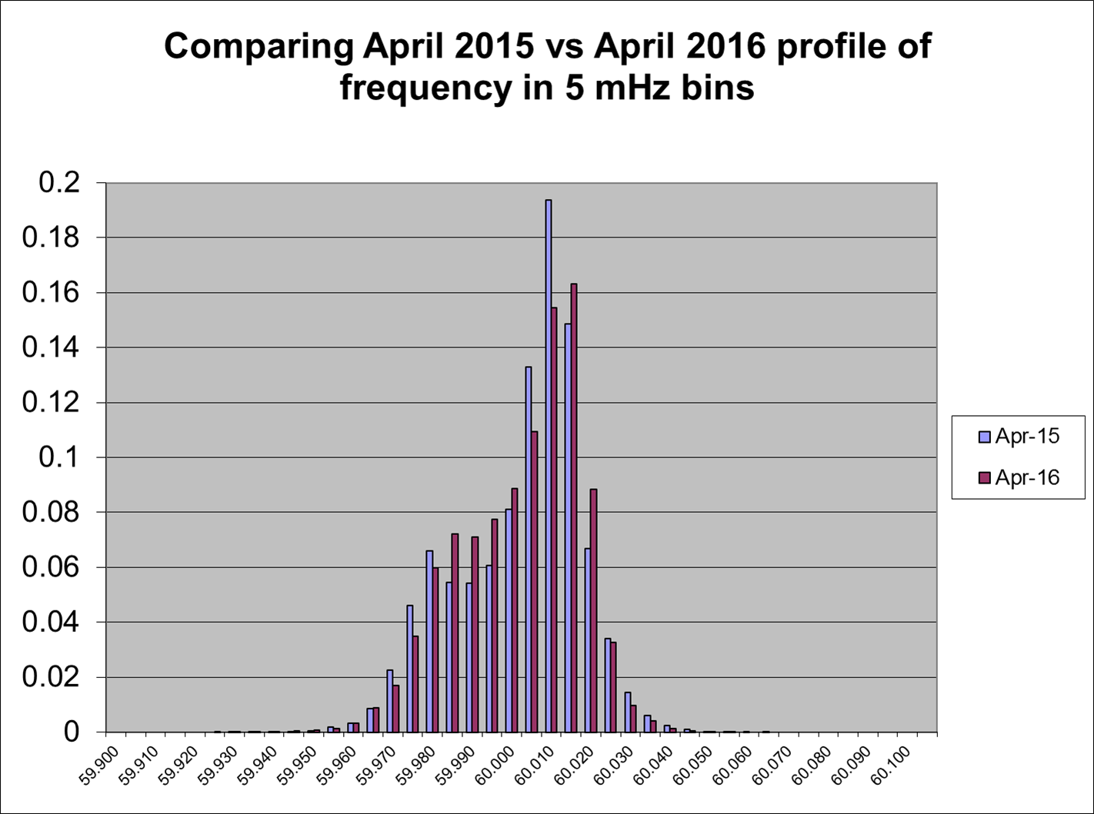
Frequency Profile Analysis

Slide 12
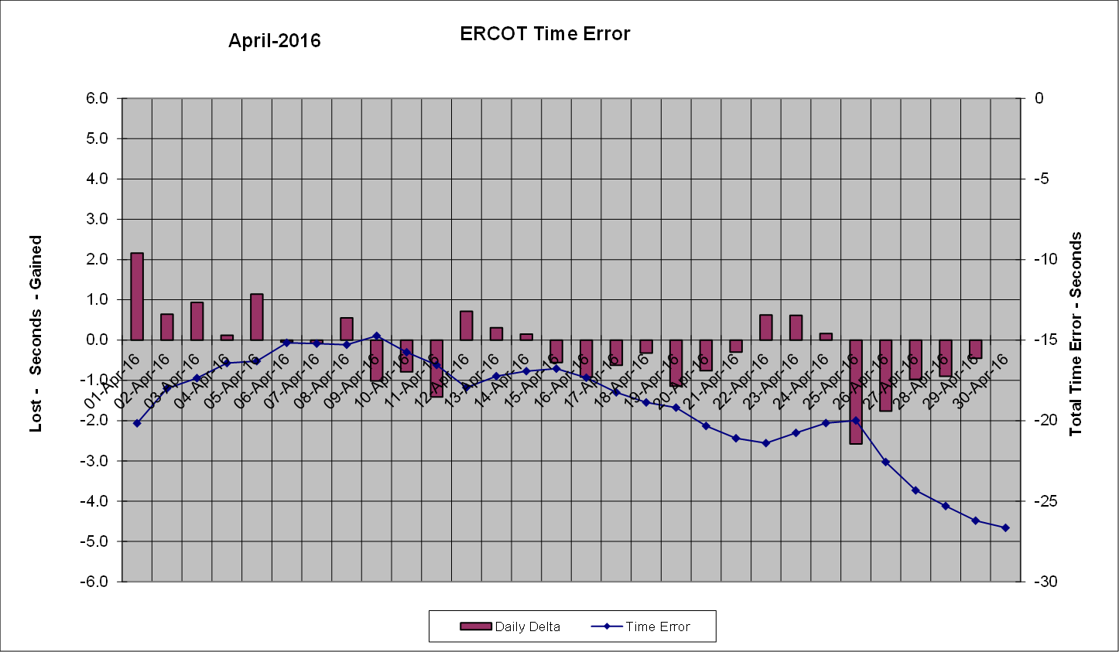
Time Error Corrections
There was noTime Error Corrections (TEC) in April.

Slide 13
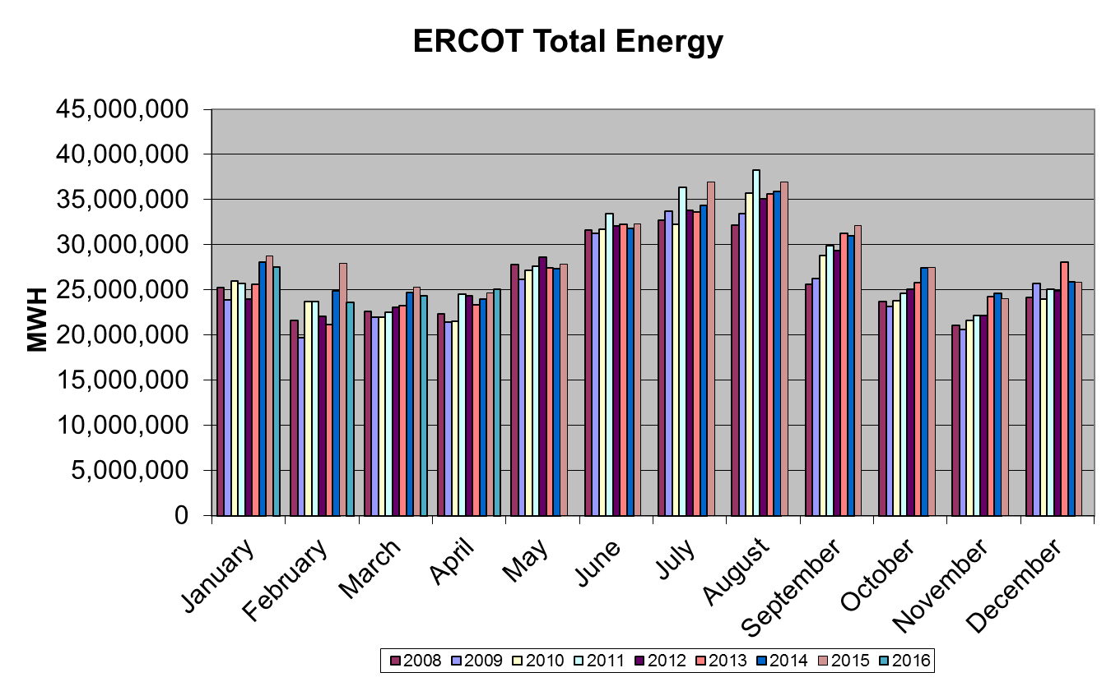
Wind Generation Performance

Slide 14
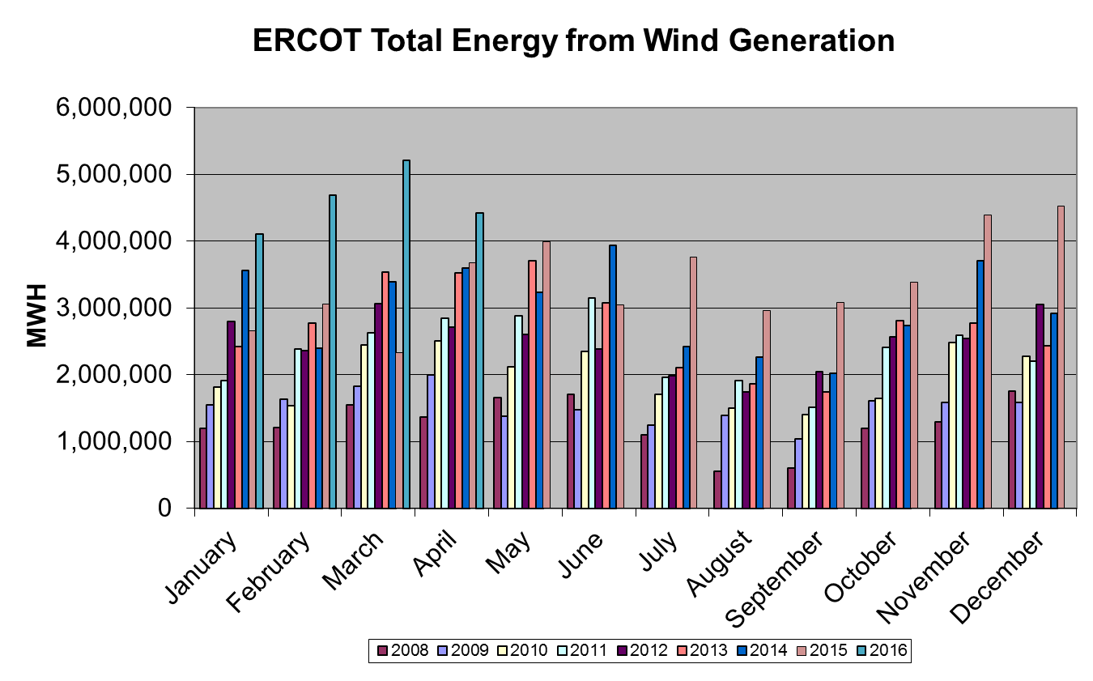
Wind Generation Performance

Slide 15
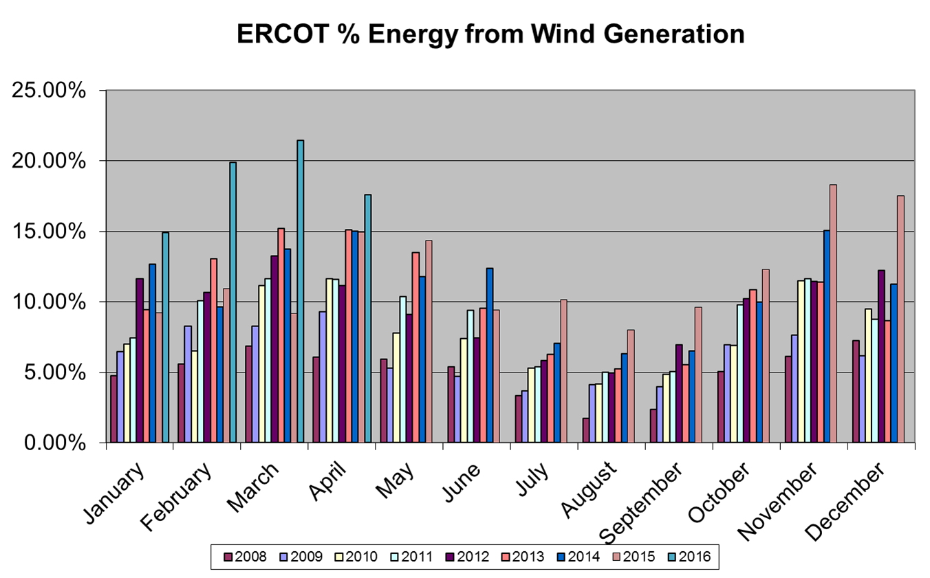
Wind Generation Performance

Slide 16
Questions?

