Slide 1
Market Credit Working Group update to the Wholesale Market Subcommittee
5/02/2016

Slide 2
MCWG update to WMS
Joint meeting of MCWG and CWG on Wednesday, April 20th
8 NPRRs reviewed for credit impacts
  7 NPRRs had no credit impact
  The Credit WG reached the consensus that, with regard to NPRR755, the Credit WG recognizes that Entities that receive the Data Agent-Only Qualified Scheduling Entity (QSE) designation are exempt from certain credit requirements, but that these Entities are not expected to incur any credit risks since they are not allowed to participate in the ERCOT markets. ERCOT Staff will continue to monitor any potential credit implications which may arise related to the activities of such Counter-Parties and will inform the market of any identified issues or concerns.

Slide 3
MCWG update to WMS
Review of Counter-Party Credit Application
Minor clarifications
Daily percentage of energy sales vs. generated
Financial statements by Applicant or its Guarantor

Slide 4
MCWG update to WMS
ERCOT Forward Curve Data Review -Liquidity

Slide 5
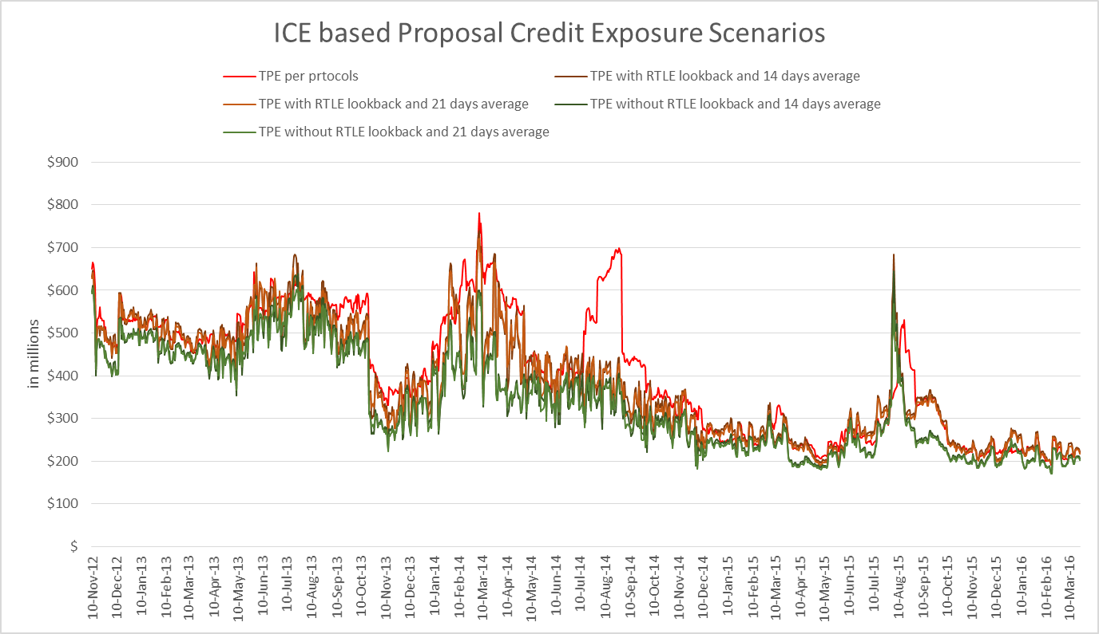
MCWG update to WMS

