Slide 1
Overview on EMP
Dan Woodfin
Director of System Operations
ERCOT
GRWG
April 26, 2016

Slide 2
Electromagnetic Pulse Types
High-altitude EMP
Source Region EMP
Intentional Electromagnetic Interference
Others

Slide 3
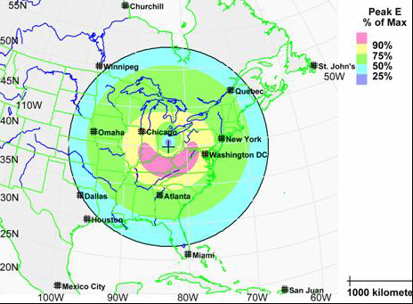
High-Altitude Electromagnetic Pulse (HEMP)
Any nuclear detonation produces an electromagnetic pulse; the effects of the EMP on electrical and electronic systems are generally along the line of sight
  For low-altitude detonations, the effects of the EMP are localized and generally eclipsed by other effects
  For a high altitude detonation, the line of sight may cover a majority of the US
  HEMP strength may not be correlated with device yield
Exposure area for E1 HEMP burst at 100 mi. over Ohio

Slide 4
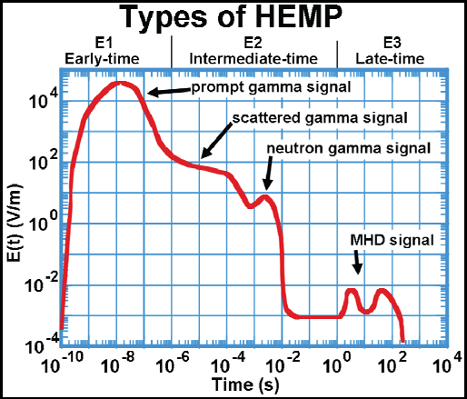
Three Types of HEMP Effects
E1 Component – energy pulse that disrupts or damages electronics simultaneously over a large area within a few billionths of a second after detonation
E2 Component – effect similar to lightning but over widespread area and at a lower magnitude
E3 Component – slower effect that produces ground-induced currents similar to a extremely severe geomagnetic storm but with a limited duration

Slide 5
HEMP Impacts on Power Systems
E1 Component could damage electronic equipment, including that used for power system control, monitoring and protection (in addition to similar damage to electronics at end-use customer loads), as well as distribution line insulators and transformers
E2 Component may have lower risk to power system components that are protected against nearby lightning strikes
E3 Component could produce high ground induced currents (GICs), similar to a severe GMD storm. The geographic impact would be based on proximity to detonation, rather than latitude (effecting areas not typically thought to be vulnerable to GMD). The GICs would be much shorter in duration.
Impacts from E2 and E3 Components may be compounded by loss of electronics (e.g. electronic relays) already damaged by E1 effects

Slide 7
Future Topics

Slide 8
Questions?

