Slide 1
Emergency Response Service
Mark Patterson
Manager, Demand Integration
April 22, 2016

Slide 2
ERS Test Failures

Slide 3
February 2nd-3rd 2011 Deployment Event Event
VDI 1
5:48:59
VDI 2
8:53:17
HHS
14:37:08
Recall
10:01:00
Load Response (MWs)

Slide 4
August 4, 2011 Deployment Event (10-Minute Only)
Baseline Load
Actual Load
Load Reduction
Obligation

Slide 5
Timeline for the Demand Response Deployments on 1/6/14
  6:53:39 Operator initiates an All QSE call at 6:51:53 to go to EEA Level 1 and deploys Group 1 (546.4 MW) of the Load Resources providing RRS
  7:03:26 Operator initiates an All QSE call at 7:01:38 to go to EEA Level 2 and deploys Group 2 (536.2 MW) of the Load Resources providing RRS and 30 minute ERS (111.5 MW)
  7:07:27 Operator initiates an All QSE call at 7:05:46 and deploys 10 minute ERS (508.6 MW)
  7:53:16 Operator initiates an All QSE call at 7:51:02 to go from EEA Level 2 to EEA Level 1 and recalls all Load Resources, 10 minute ERS and 30 minute ERS
  9:12:00 Operator initiates an All QSE call to terminate EEA Level 1

Slide 6
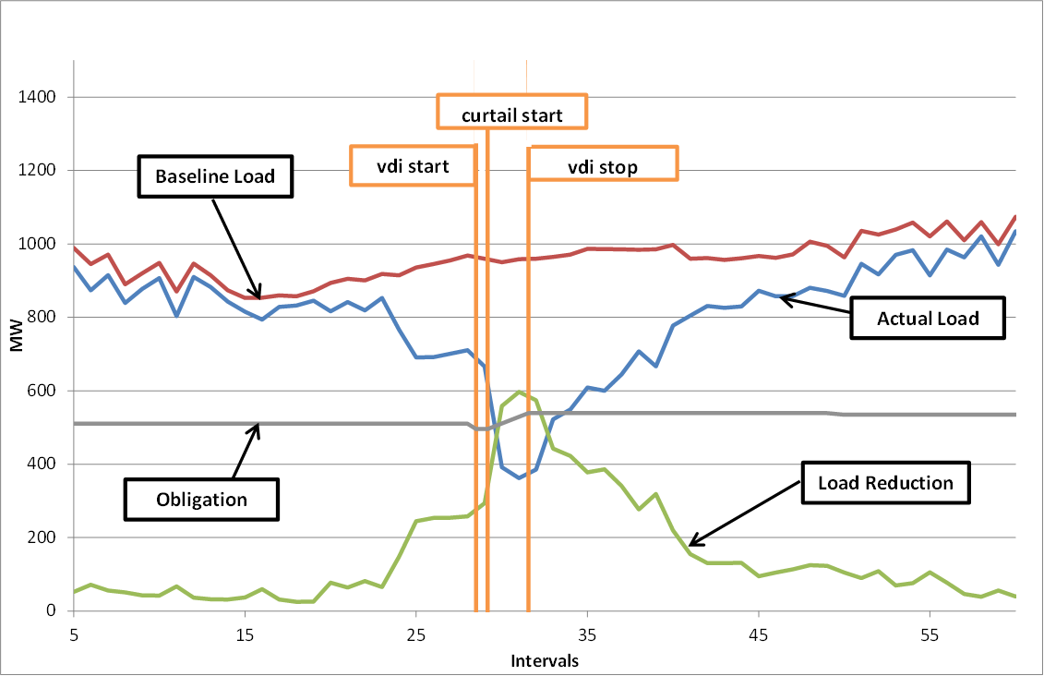
January 6, 2014 deployment Event (10-minute only)

Slide 7
30 Minute ERS
January 6, 2014 ERS Deployment Event
During a cold weather event on the morning of January 6, 2014, ERCOT deployed 30-Minute ERS Pilot Resources obligated during the Business Hours 1 time period. During this event there were 111.671 MW obligated to provide 30-minute ERS. Following the 30-Minute ramp period, these resources were deployed for a duration (sustained response period) of just under 20 minutes, and therefore the deployment spanned only two partial intervals. The fleet level event performance was determined by analyzing the first partial interval only which was approximately 11 ½ minutes long and therefore the time weighted obligation for that partial interval was 86.111 MWs. The fleet response during the event was 94.831 MW, which exceeded the fleet’s combined obligation by 10%. As per the…..

