Slide 1
ERCOT – LP&L Study Status Update
Regional Planning Group
April 21, 2016
Ben Richardson

Slide 2
Cost Estimate Comparison with Upgrades
(Preliminary Results)
Case | Upgrade | Capital Cost Estimate | Relative Annual Capital | Production Cost ($Million) | % of Relative Capital
LP&L Option 1 | McKenzie-North 115 kV & CO-OP-McKenzie 69 kV | $311,818,800 | 0 | 0
LP&L Option 4 |  | $344,443,600 | +$32.6 | -$0.4 | -1.2%
LP&L Option 4ow | McKenzie-North 115 kV & CO-OP-McKenzie 69 kV | $364,081,400 | +$52.3 | -$10.3 | -19.7%
LP&L Option 4ow_dbckt_Grass | McKenzie-North 115 kV, Ogallala-Grassland 345 kV Double Ckt | $408,682,900 | +$96.9 | -$14.5 | -15.0%
LP&L Option 8A |  | $426,107,200 | +$114.3 | -$10.5 | -9.2%
LP&L Option 8A_dbckt_Grass | Ogallala-Grassland 345 kV Double Ckt | $470,708,700 | +$158.9 | -$14.1 | -8.9%
LP&L Option 8B |  | $338,096,600 | +$26.3 | -$3.6 | -13.6%
LP&L Option 11 |  | $492,368,200 | +$180.5 | -$3.7 | -2.0%
LP&L Option 11 | McKenzie-North 115 kV | $492,368,200 | +$180.5 | -$4.7 | -2.6%
Note: Increased capital expenditure meets economic criteria per ERCOT Protocols 3.11.2(5)

Slide 3
Cost Estimate Comparison with Upgrades
(Preliminary Results)
Case | Upgrade | Capital Cost Estimate | Relative Annual Capital | Production Cost ($Million) | % of Relative Capital
LP&L Option 12 |  | $397,751,918 | +$85.9 | +$1.1 | +1.3%
LP&L Option 12 | Holly-Wadsworth 115 kV | $397,751,918 | +$85.9 | -$0.3 | -0.3%
LP&L Option 12c |  | $391,751,918 | +$79.9 | +$0.8 | +1.0%
LP&L Option 20 |  | $466,552,338 | +$154.7 | -$0.8 | -0.5%
SHY Option 1-2a |  | $383,800,200 | +$72.0 | -$0.7 | -1.0%
SHY Option 1-2b |  | $365,076,200 | +$53.3 | -$0.3 | -0.6%

Slide 4
Next Steps/Timeline
Finalize Assessment of Short-listed Options
Explore Option variations in order to optimize
Complete Dynamic Stability Analysis
  Lubbock
  Panhandle Export
Perform SSR Assessment
Final Report (May 26)

Slide 5
?

Slide 6
Appendix
Capital Cost Estimate Assumptions
Panhandle Interface Definitions and WSCR Ratings

Slide 7
Capital Cost Estimate Assumptions
Item | Cost Estimate | Unit | Source
345 kV Substation (Ring bus 6 line terminals) | $15,940,000.00 | 1 Substation | 2012 ERCOT Study
Land Acquisition for New 345/115 kV Substation | $500,000.00 | 1 Substation | Lubbock Power & Light
345 kV Substation Expansion | $700k to $4 Million | 1 - 345 kV Line Terminal | ERCOT TSPs
345 kV Double Line on Double Ckt Structure | $1,840,000.00 | $/Mile | Sharyland
345 kV Single Line on Double Ckt Structure | $1,660,000.00 | $/Mile | White River to Abernathy 345 kV Line
345 kV Add 2nd Line to Double Ckt Structure | $350,000.00 | $/Mile | Sharyland
345/115 kV 350 MVA Transformer | $6,000,000.00 | 1 Unit | TPIT 345/138 kV 600 MVA Auto Transformer
115 kV Substation (Ring bus 6 line terminals) | $9,050,000.00 | 1 Substation | 2012 ERCOT Study (138 kV Substation)
115 kV Line | $1,600,000.00 | $/Mile | Lubbock Power & Light

Slide 8
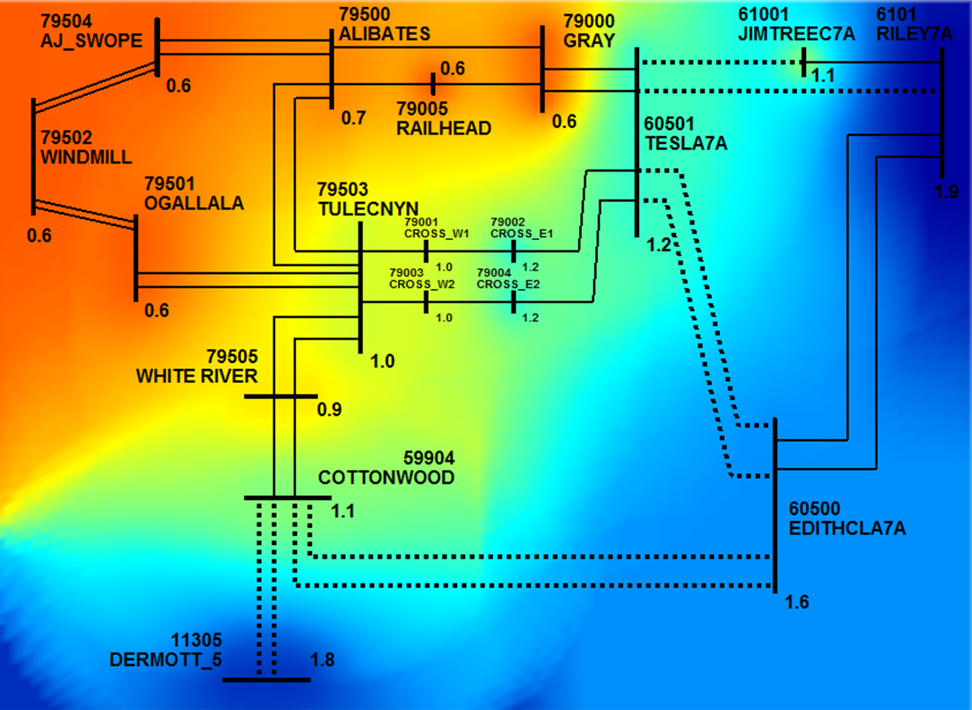
Base Case

Slide 9
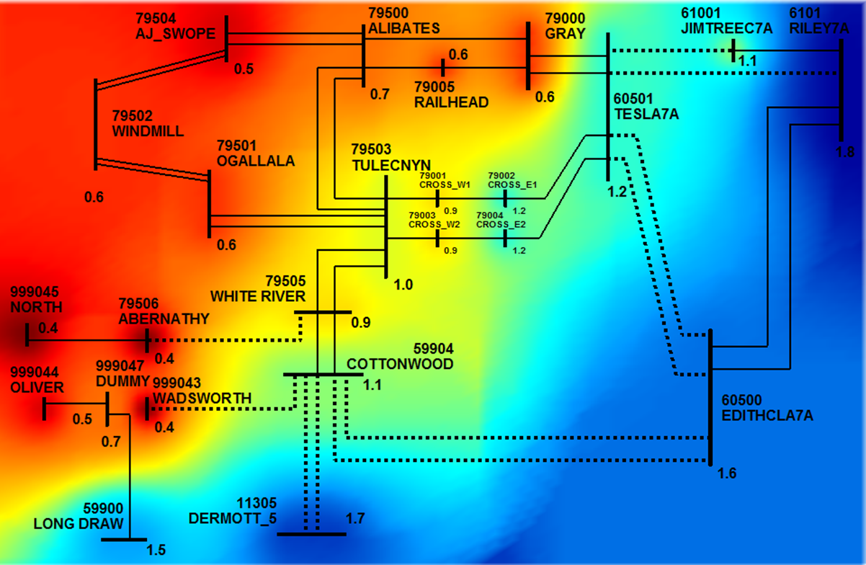
Option 1

Slide 10
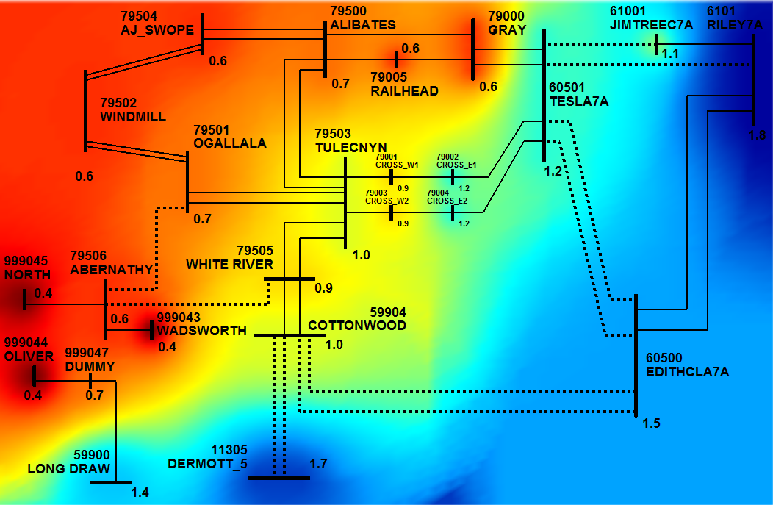
Option 4

Slide 11
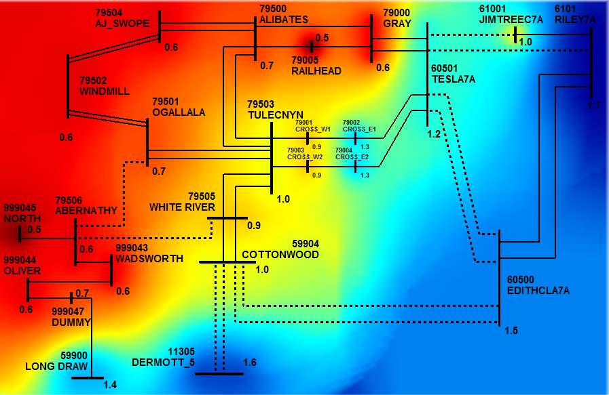
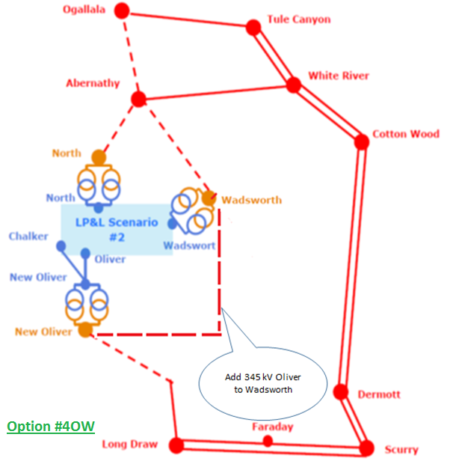
Option 4ow

Slide 12
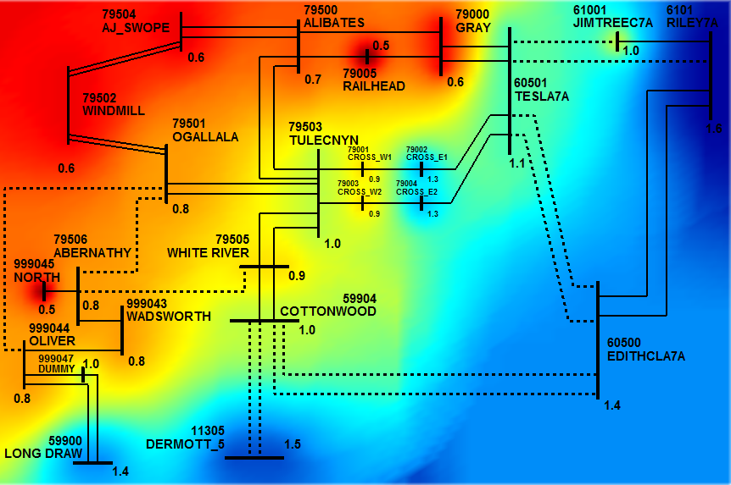
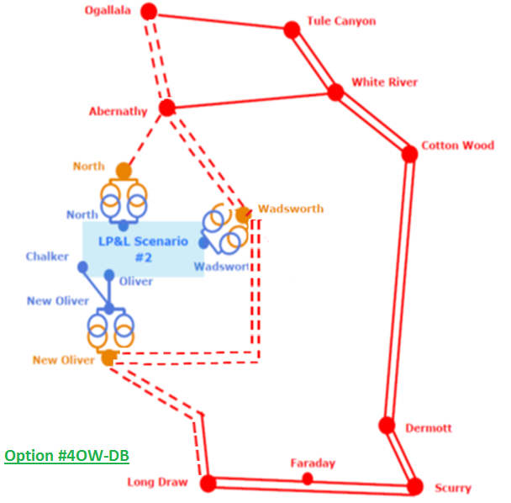
Option 4ow_DB

Slide 13
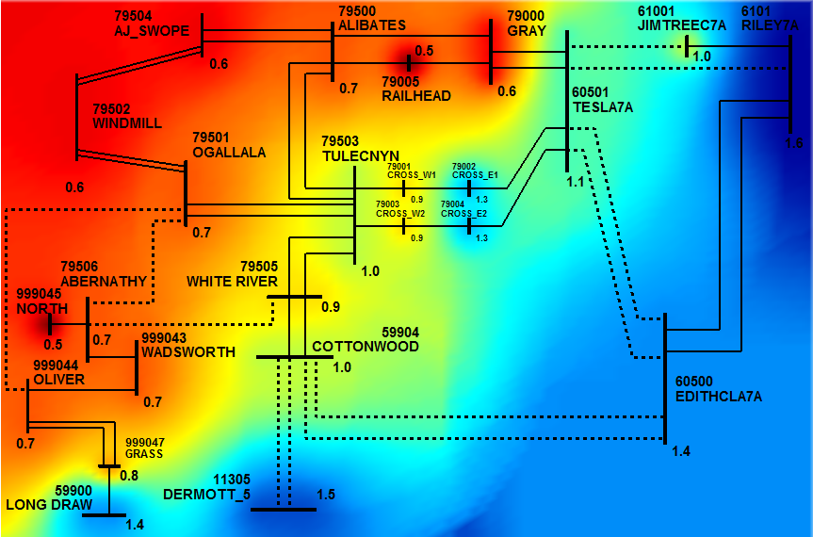
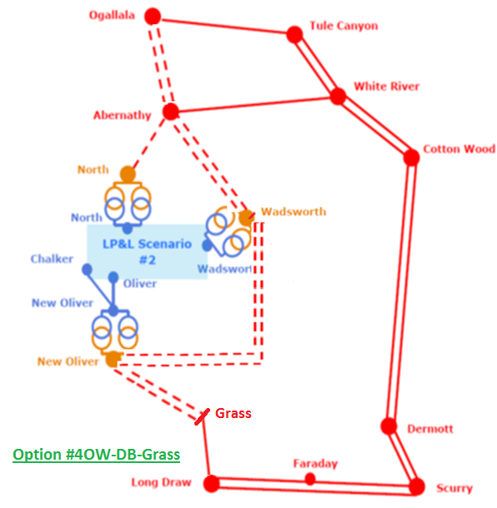
Option 4ow_DB_Grass

Slide 14
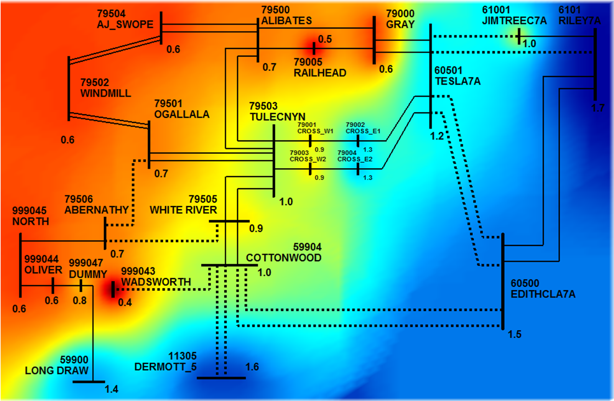
Option 8A

Slide 15
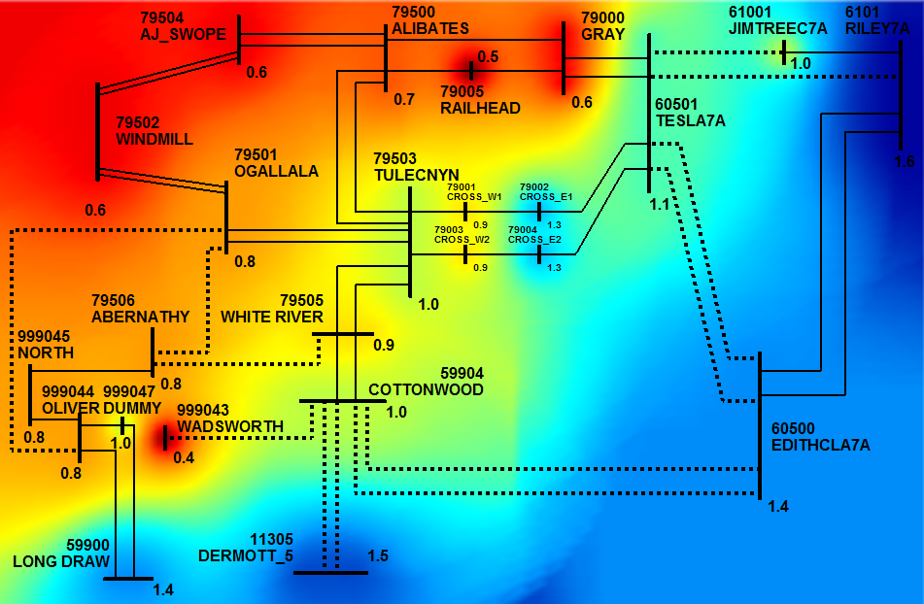
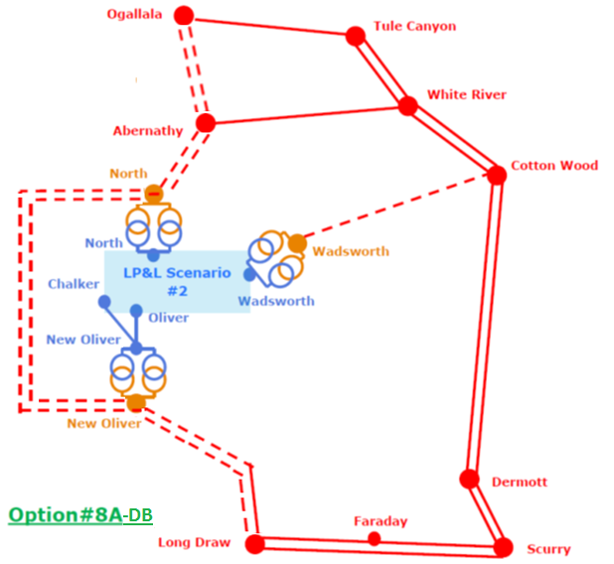
Option 8A_DB

Slide 16
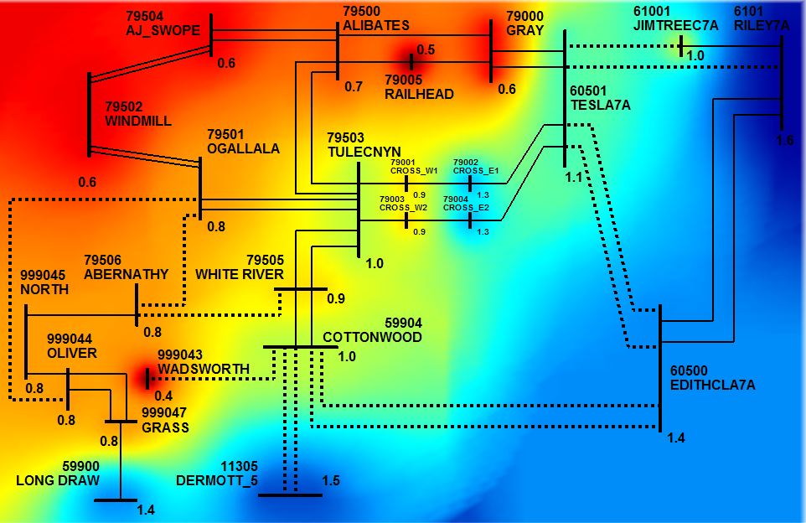
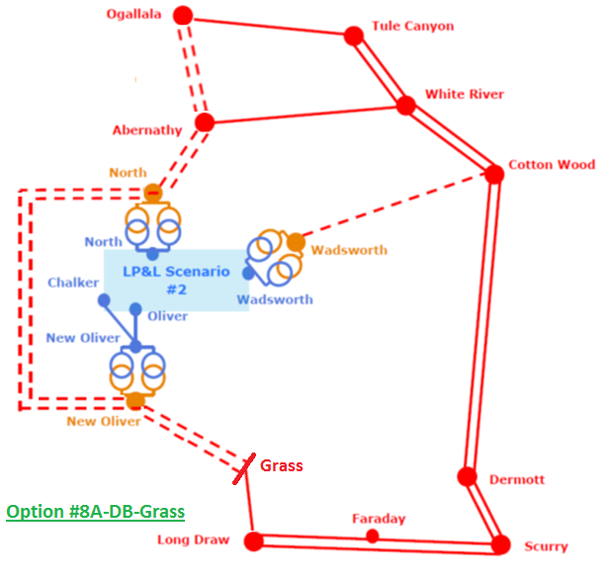
Option 8A_DB_Grass

Slide 17
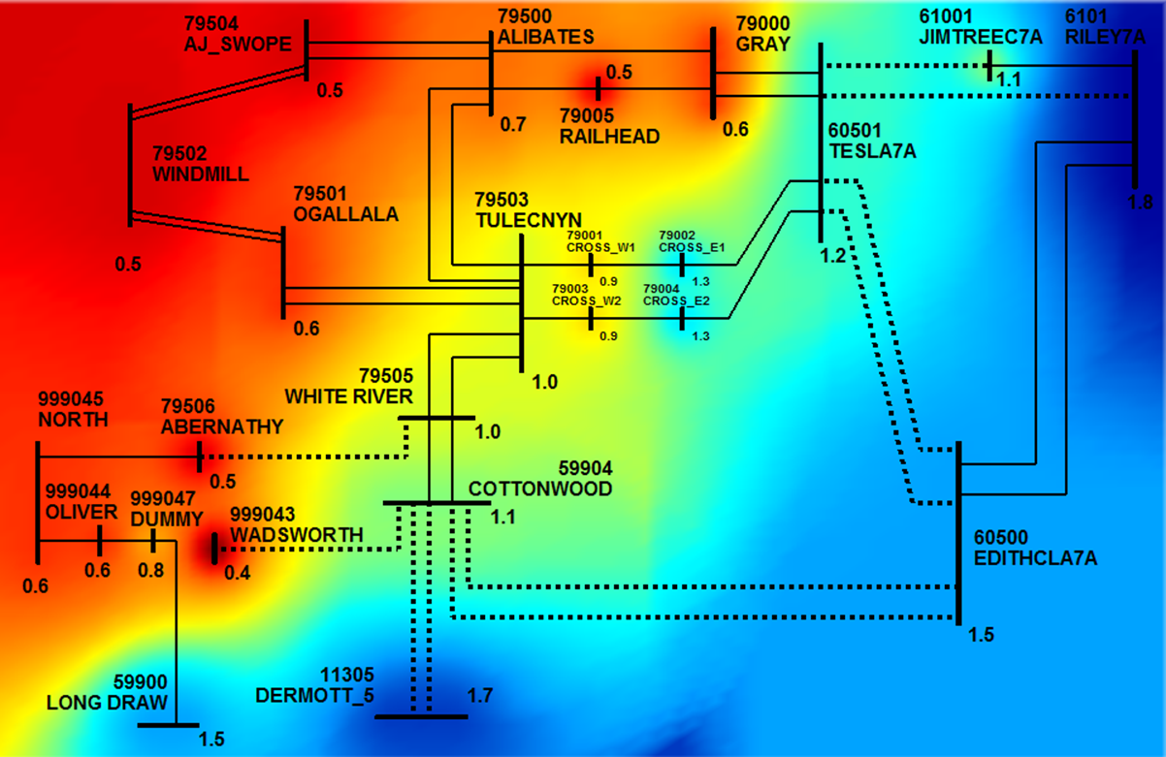
Option 8B

Slide 18
Option 11

Slide 19
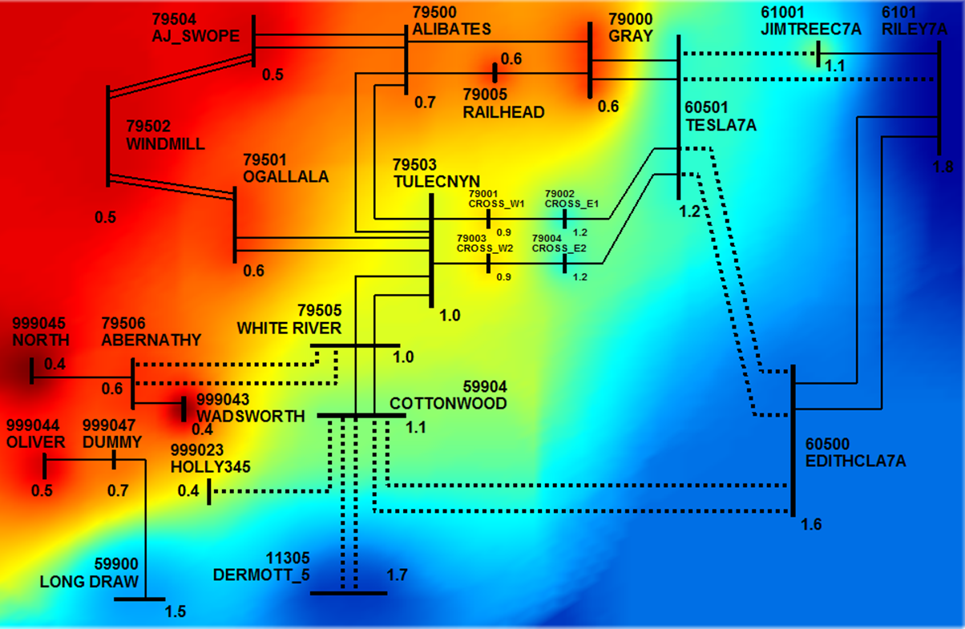
Option 12

Slide 20
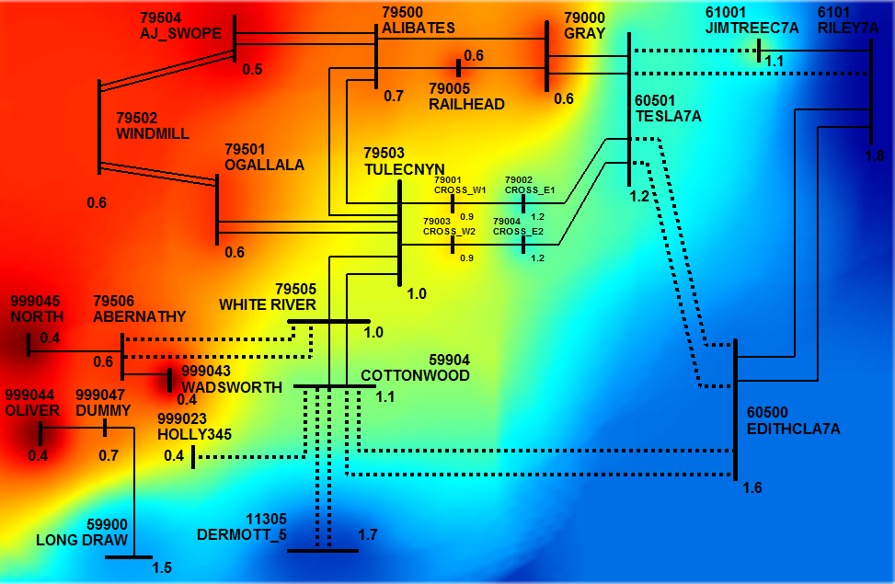
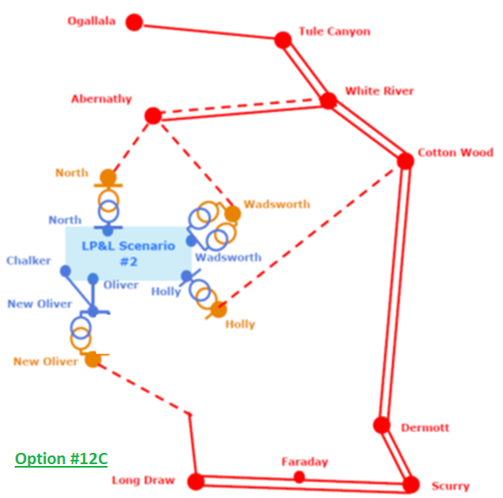
Option 12c

Slide 21
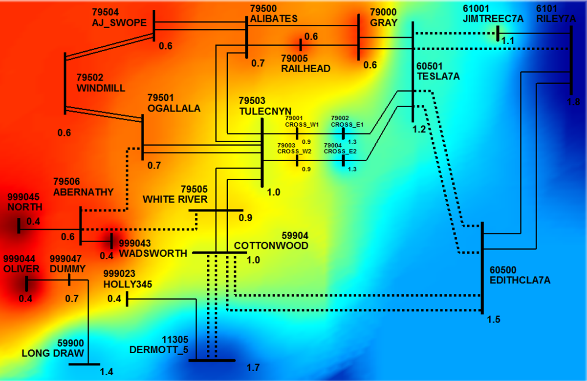
Option 20

Slide 22
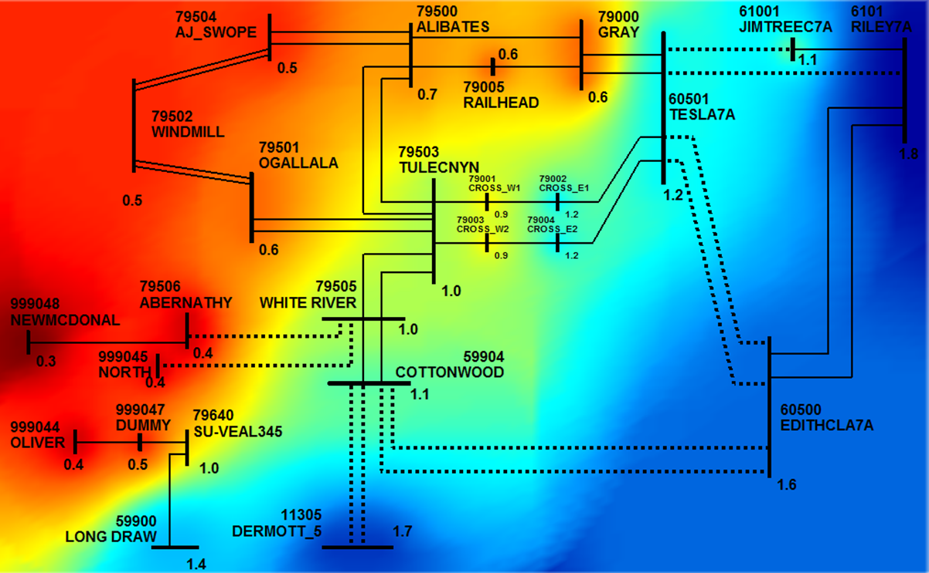
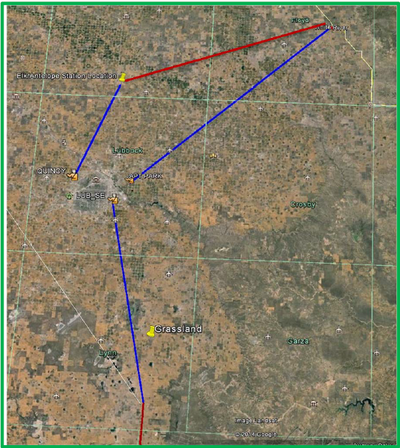
Opt. 1-2a
White River
Abernathy
McDonald instead of Quincy
North instead of Airport Park
Oliver instead of Southeast
To Vealmoor
Notes:
According to Ben:
1. Connected to North rather than Airport Park
2. Connected to McDonald rather than Quincy
3. 1-2a is from Vealmoor just as Sharyland proposed but 1-2b is from Long Draw instead of Vealmoor since Long Draw is closer.

Slide 23
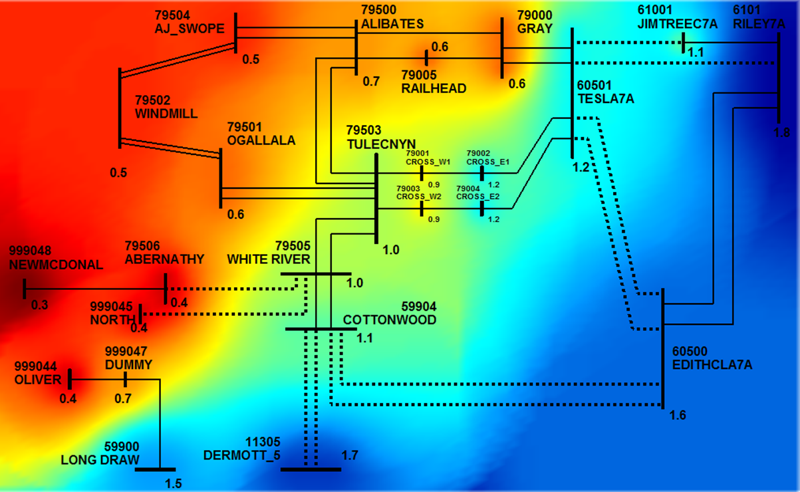
Opt. 1-2b
White River
Abernathy
McDonald instead of Quincy
North instead of Airport Park
Oliver instead of Southeast
To Long Draw
Notes:
According to Ben:
1. Connected to North rather than Airport Park
2. Connected to McDonald rather than Quincy
3. 1-2a is from Vealmoor just as Sharyland proposed but 1-2b is from Long Draw instead of Vealmoor since Long Draw is closer.

Slide 24
Panhandle Transfer Limit with WSCR=1.5
WSCR Panhandle Transfer Limit Summary
LP&L Interconnection Impacts on WSCR

