Slide 1
New Equipment Modeling Expectations
Stephen Solis
April 19, 2016

Slide 2
Agenda
Overview
NOMCR Submission date to Model Ready date
Model Ready date to Field Energization date
System Operator Awareness
Questions

Slide 3
Agenda
Overview
NOMCR Submission date to Model Ready date
Model Ready date to Field Energization date
System Operator Awareness
Questions

Slide 4
Overview
Previously there has been some confusion that has occurred relative to new equipment in the model but not yet energized.
ERCOT has implemented EMS functionality in its one-lines to overlay Outage information.
ERCOT is attempting outreach to Market Participants to highlight the impact of not adhering to modeling expectations.

Slide 5
Agenda
Overview
NOMCR Submission date to Model Ready date
Model Ready date to Field Energization date
System Operator Awareness
Questions

Slide 6
NOMCR Submission date to Model Ready date
ERCOT expects requests to modify the Network Model to meet the Protocol timelines for Network Model changes ERCOT Nodal Protocols 3.10.1
(3) TSPs and Resource Entities shall submit Network Operations Model updates at least three months prior to the physical equipment change.
Any NOMCRs submitted less than 21 day (except for ratings changes) will not be approved as the final production models are being validated for use in production
While not highlighted in this presentation retirement/removal of elements from the Network Model should proceed in accordance with the Modeling Expectation document

Slide 7
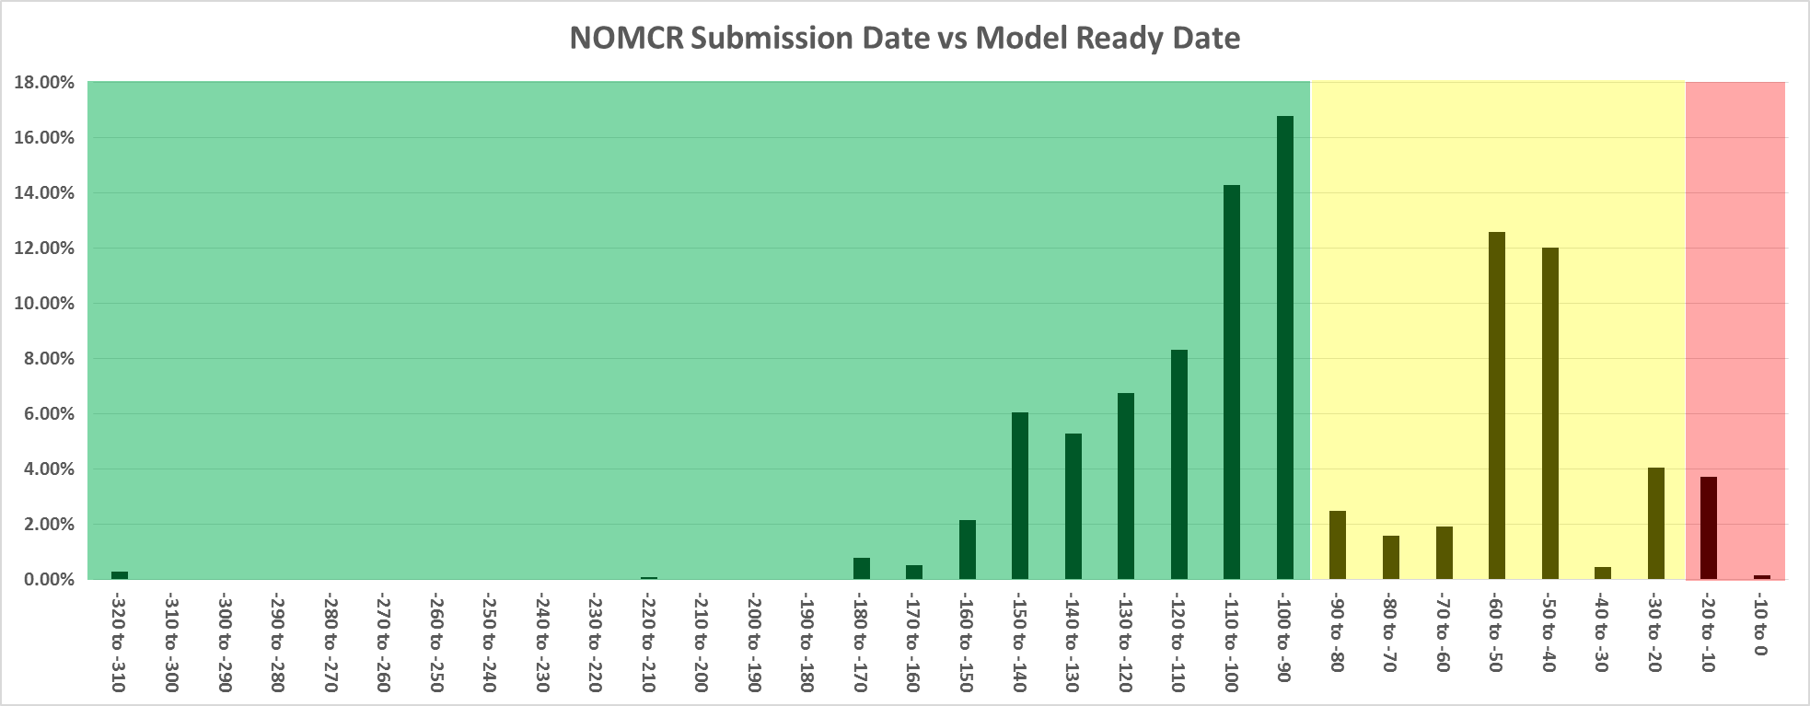
NOMCR Submission date to Model Ready date
61% of NOMCRs have been submitted greater than 90 days of the Model Ready Date
35% of NOMCRs have been submitted more than 21 days but less than 90 days of the Model Ready Date
4% of NOMCRs have been submitted less than 21 days of the Model Ready Date (typically ICCP, ratings, or RAP/SPS changes)

Slide 8
Impacts of not making timelines
Missing the 90 day timeline
CRR models may not reflect latest topology
Additional work by ERCOT to revalidate Operational Models
Missing the 21 day timeline
NOMCR will be rejected and equipment not approved to energize
Emergency DB loads are required to accommodate a critical NOMCR that missed timeline.
Substantial amount of rework and manpower reallocation on ERCOT staffing pulling resources away from normal timeline model validation and other maintenance activities to support validating the emergency DB model
Classified as an Interim Update and reported to PUCT Staff, TRE, and IMM.
ICCP, dynamic ratings, or RAP/SPS changes are not Interim Updates

Slide 9
Agenda
Overview
NOMCR Submission date to Model Ready date
Model Ready date to Field Energization date
System Operator Awareness
Questions

Slide 10
Model Ready date to Field Energization date
ERCOT expects the Model Ready date to precede the Field Energization date by at least 7 days
ERCOT expects the equipment to be modeled in its normal state.
ERCOT expects a Planned Outage to be entered and maintained that corresponds with the time period of the Model Ready date and the Field Energization date
Ideally the equipment will be energize between 14 days and 28 days after the Model Ready date to allow for sufficient time to execute the Approval to Energize process.
ERCOT expects any instances where the Field Energization date slips beyond 120 days of the Model Ready date for the TSP to submit a NOMCR removing the equipment from the model and another NOMCR with a new model ready and field energization date.

Slide 11
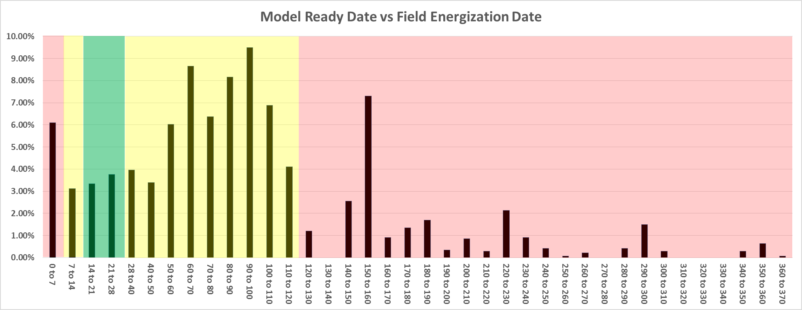
Model Ready date to Field Energization date
6% of Field Energization dates were less than 7 days from Model Ready date
3% of Field Energization dates were between 7 and 14 days from Model Ready date
10% of Field Energization dates were between 14 and 28 days from Model Ready date
57% of Field Energization dates were between 28 and 120 days from Model Ready date
23% of Field Energization dates were greater than 120 days from Model Ready date

Slide 12
Impacts of not making timelines
Field Energization date less than 7 days from Model Ready date
Insufficient time to conduct the Approval to Energize Process
Field Energization date between 7 days and 14 days from Model Ready date
May be insufficient time to conduct the Approval to Energize Process and coordination depending on complexity of change
Field Energization date between 28 days 120 days from Model Ready date
Additional time where equipment is in the model and but not energized in the field. More risk for error if Outage Scheduler is not maintained to reflect that equipment is not yet energized.
Field Energization date over 120 days from Model Ready date
NOMCR should be submitted to undo previous model change and a new NOMCR should be submitted with new dates to minimize the time that equipment not energized in the field is in the model

Slide 13
Agenda
Overview
NOMCR Submission date to Model Ready date
Model Ready date to Field Energization date
System Operator Awareness
Questions

Slide 14
System Operator Awareness
System Operators utilize displays based off of the Network Operations Model.
If System Operator is unaware that equipment in the model is New Equipment not yet energized, confusion can occur when troubleshooting real time issues.
ERCOT has modified the one-lines to include outage information providing indication on what type of outage and when the outage ends. This gives them awareness that a piece of equipment is new and not yet energized.
This makes the maintenance of outages associated with new equipment to address the time period between the model ready date and field energization date very important.
Failure to keep the outages updated can result in inaccurate information being provided to System Operators which could result in confusion when troubleshooting.
Long durations between Field Energization dates and Model Ready dates increase the risk for outages not being updated and the above potential confusion factor in addition to less accurate models.

Slide 15
Example one line
Equipment with outages are color coded (yellow) to indicate an outage exists on that piece of equipment
Equipment with outages can be clicked on to pull up a pop up window with additional outage details.
This information is driven from Outage Scheduler information.

Slide 16
Agenda
Overview
NOMCR Submission date to Model Ready date
Model Ready date to Field Energization date
System Operator Awareness
Questions

Slide 17

Questions?

