Slide 1
Line Length
Chris Ngai
Network Model Engineer
NDSWG
April 19, 2016

Slide 2
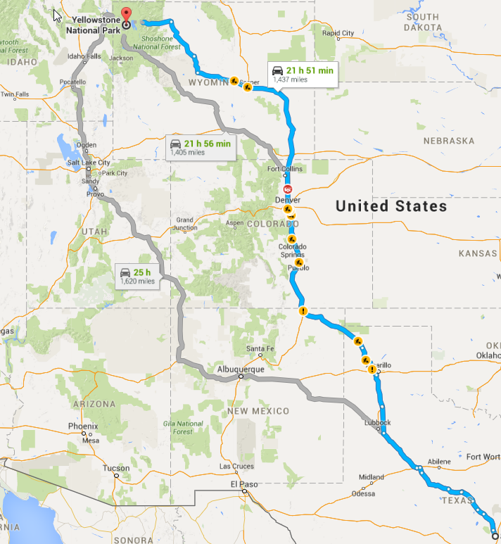

Slide 3
R X L

Slide 5
Proposal
AC Line Segment | required
B | Yes
G | Yes
R | Yes
X | Yes
Length | Yes

Slide 6
?
Q

