Slide 1
ICE Futures ERCOT North Hub Liquidity Analysis
Suresh Pabbisetty, FRM, ERP, CQF, CSQA.
Lead Technical Analyst, Credit
April 20, 2016

Slide 2
Agenda
ICE Settlements Methodology
Assumptions & Limitations
Data Inputs & Transformations
Results
Liquidity in Settlement Window
Liquidity in Trading Day

Slide 3
ICE Futures ERCOT North Hub Liquidity Analysis
ICE Settlements Methodology

Slide 4
ICE Futures ERCOT North Hub Liquidity Analysis
Every business day, the ICE settlement committee will monitor all ICE system trading activity including trades, bids and offers for the ICE Cleared products during a settlement window (between 2:28 pm and 2:30pm Eastern time).
ICE volume-weighted trade prices that occur during the settlement window will be the primary consideration for determining settlement prices.
In the absence of a traded price, midpoints of the best bids and offers that are posted during the settlement window will be the primary determinants of the final settlement price.

Slide 5
ICE Futures ERCOT North Hub Liquidity Analysis
If a two-sided market is not found during the settlement window, one-sided bids or offers will be used as a primary determinant to set a respective floor or ceiling for the settlement price.
On some occasions, the ICE trading activity during the settlement window may not be sufficient for determining settlement(s) price(s) for the respective ICE Cleared products in one or more months. During these instances, the ICE settlement committee will determine a settlement price based on a combination of the best available ICE trading activity, spread relationships as well as the best available market information.

Slide 6
ICE Futures ERCOT North Hub Liquidity Analysis
Assumptions & Limitations

Slide 7
ICE Futures ERCOT North Hub Liquidity Analysis
Assumptions & Limitations:
Analysis is limited to the Settlement Window and Trading Day
Liquidity is the aggregated volume of cleared bids and cleared offers
ICE Peak futures and ICE Off-Peak futures prices are considered for Credit Exposure Methodology
Traded volume of ICE Peak futures and ICE Off-Peak futures for North Hub are used for liquidity analysis
Other cleared ICE products like spreads involving ERCOT North Hub are not used in this analysis
“Days with Trades” are the trading days consisting trade volumes greater than 0

Slide 8
ICE Futures ERCOT North Hub Liquidity Analysis
Data Inputs & Transformations

Slide 9
Credit Exposure Analysis using ICE Prices
Data Inputs & Transformations:
ICE cleared trades, bids and offers for the ERCOT North Hub
ICE Peak Futures
ICE Off-Peak Futures
Operating Days OD+1 through OD+21
Block trades are split into individual future Operating Days.
Volumes of multiple trades are aggregated to per hour of Operating Day
All the volumes mentioned are per hour of Peak or Off-Peak products per Operating Day
Period used in this analysis
ICE Trading data used in this analysis is from the trading period 11/01/2012 through 03/24/2016
A total period of 1240 days which contains approximately 826 trading days and approximately 414 non trading days. Non trading days are excluded from analysis

Slide 10
Credit Exposure Analysis using ICE Prices
Data Inputs & Transformations:
Cleared Volume in Settlement Window that was used to set price
Settlement Window is between 2:28PM and 2:30PM of the trading day
Aggregate bids and offers volume of ERCOT North-Hub Peak Futures for each of future Operating Days OD+1 through OD+21
Aggregate bids and offers volume of ERCOT North-Hub Off-Peak Futures for each of future Operating Days OD+1 through OD+21
Cleared Volume in Trading Day:
Trading Day is after 2:30PM of previous Business Day to 2:30PM of current Business Day
Aggregate bids and offers volume of ERCOT North-Hub Peak Futures for each of future Operating Days OD+1 through OD+21
Aggregate bids and offers volume of ERCOT North-Hub Off-Peak Futures for each of future Operating Days OD+1 through OD+21

Slide 11
ICE Futures ERCOT North Hub Liquidity Analysis
Results
Liquidity in Settlement Window

Slide 12
ICE Futures ERCOT North Hub Liquidity Analysis
Peak Futures - Settlement Window Trading Participation:
1% to 6% days have some cleared trades within Settlements Window

Slide 13
ICE Futures ERCOT North Hub Liquidity Analysis
Peak Futures - Settlement Window Trading Volume:
Statistics are calculated only for the Days with trading volumes
All the volumes mentioned are per hour of Operating Day

Slide 14
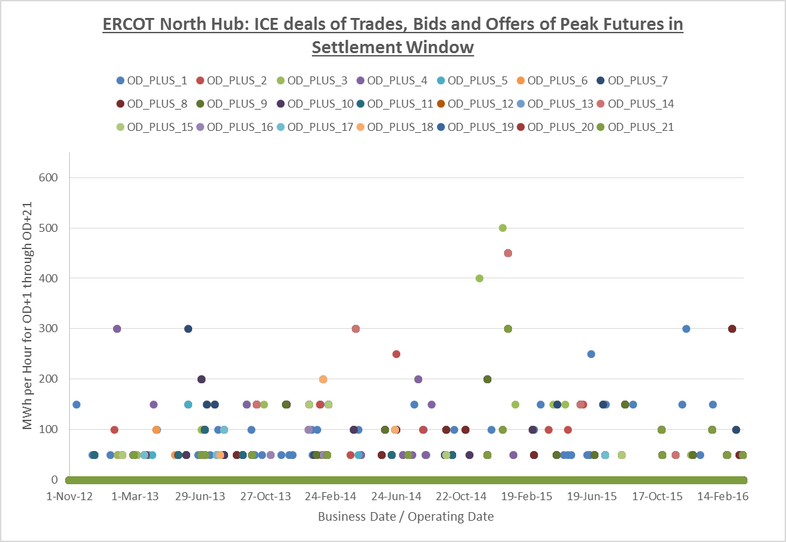
ICE Futures ERCOT North Hub Liquidity Analysis
Peak Futures - Settlement Window Trading Volume:

Slide 15
ICE Futures ERCOT North Hub Liquidity Analysis
Off-Peak Futures - Settlement Window Trading Participation:
0% to 1% days have some cleared trades during Settlements Window

Slide 16
ICE Futures ERCOT North Hub Liquidity Analysis
Off-Peak Futures - Settlement Window Trading Volume:
Statistics are calculated only for the Days with trading volumes
All the volumes mentioned are per hour of Operating Day

Slide 17
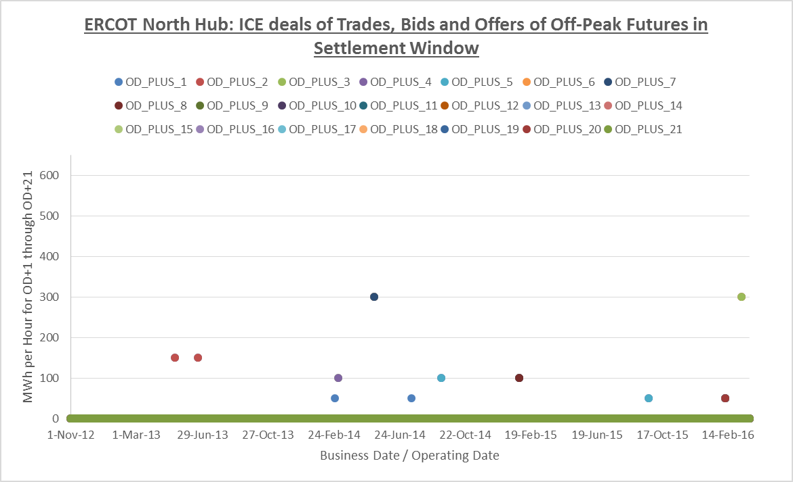
ICE Futures ERCOT North Hub Liquidity Analysis
Off-Peak Futures - Settlement Window Trading Volume:

Slide 18
ICE Futures ERCOT North Hub Liquidity Analysis
Results
Liquidity in Trading Day

Slide 19
ICE Futures ERCOT North Hub Liquidity Analysis
Peak Futures – Trading Day Trade Participation:
58% to 94% days have some cleared trades during Trading Day

Slide 20
ICE Futures ERCOT North Hub Liquidity Analysis
Peak Futures – Trading Day Trading Volume:
Statistics are calculated only for the Days with trading volumes
All the volumes mentioned are per hour of Operating Day

Slide 21
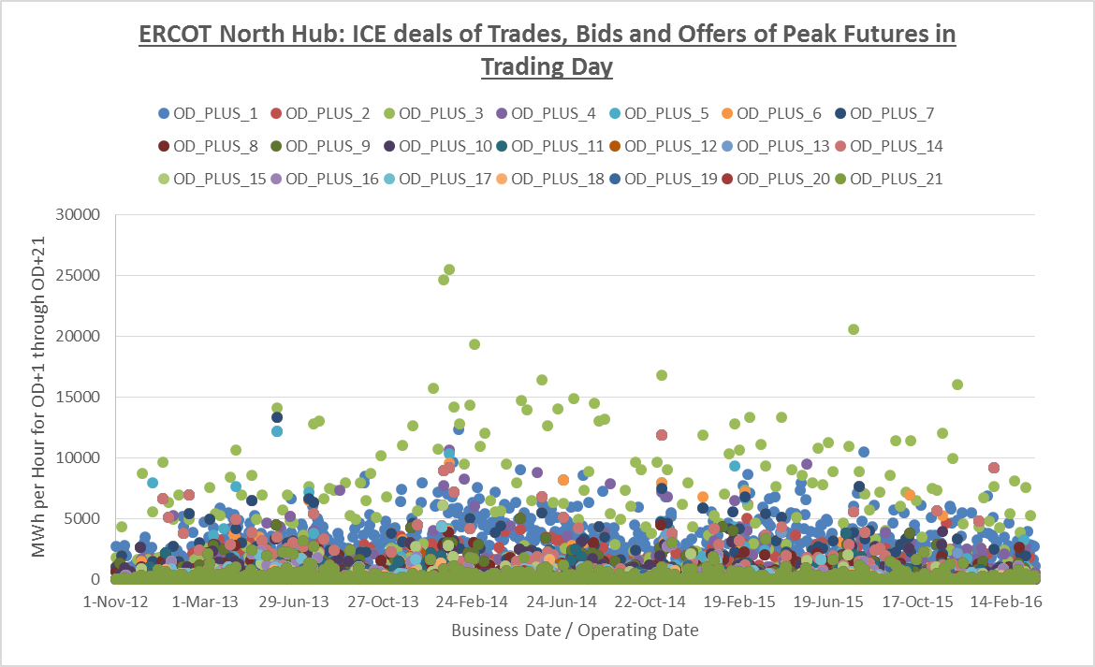
ICE Futures ERCOT North Hub Liquidity Analysis
Peak Futures – Trading Day Trading Volume:

Slide 22
ICE Futures ERCOT North Hub Liquidity Analysis
Off-Peak Futures – Trading Day Trade Participation:
18% to 86% days have some cleared trades during Trading Day

Slide 23
ICE Futures ERCOT North Hub Liquidity Analysis
Off-Peak Futures – Trading Day Trading Volume:
Statistics are calculated only for the Days with trading volumes
All the volumes mentioned are per hour of Operating Day

Slide 24
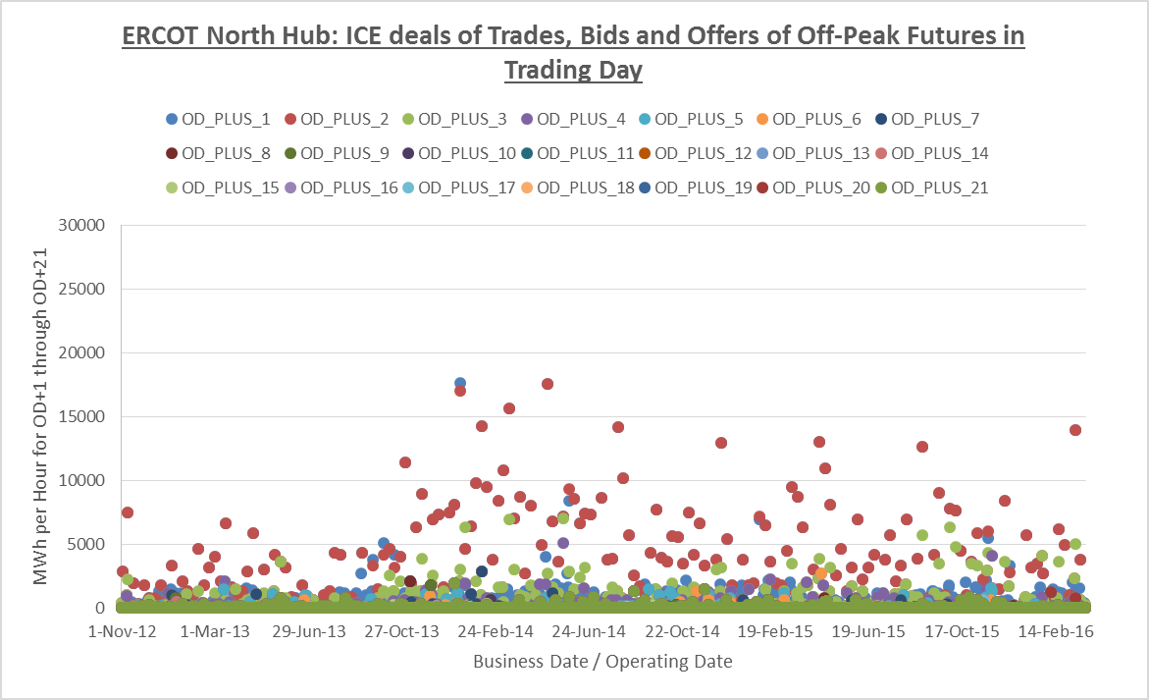
ICE Futures ERCOT North Hub Liquidity Analysis
Off-Peak Futures – Trading Day Trading Volume:

Slide 25
Credit Exposure Analysis using ICE Prices
ERCOT North Hub – ICE Futures Liquidity Summary:
ERCOT will not be able to shadow all the rules of ICE Settlements, only confirmed deals/trades are used for this analysis
Liquidity summary is based on forward 21 day period (from November 2012 to March 2016);
Trading Participation and Trading Volume
Better for the whole Trading Day as compared to Settlement Window
Relatively very low during Settlement Window

Slide 26
ICE Futures ERCOT North Hub Liquidity Analysis
Questions

