Slide 1
CSWG GOALS and other items
April 18, 2016

Slide 2
Goals – 2016 (approved by COPS)
Support COPS Goals:
Maintain settlements stability in alignment with Protocol Section 8.2, ERCOT Performance Monitoring (2) Paragraphs (c), Settlement Stability and (g) Load Uplift Amounts
Improve Commercial Operations processes to accommodate changes in the ERCOT Market design
Work with Market Participants and ERCOT staff to develop Market improvements and Protocols that support increased Commercial Operations data transparency and data availability
Maintain and update the Commercial Operations Market Guide and the Nodal Settlements Handbook
Work with Market Participants and ERCOT staff to review Market Communications/Notifications and identify process improvements
Work with Market Participants and ERCOT staff, and coordinate with MDWG, to implement improvements to the Market Information System (MIS) and External Web Services (EWS) and market data access for market participants, information security classifications, data extracts and Commercial Operations reports
Review any revision request language with impacts to Settlement
Nodal Settlements Handbook
Monitoring:
Distributed Generation
Market Continuity

Slide 3
Scope of MDWG
Proposed scope
The Market Data Working Group (MDWG) reporting to Commercial Operating Subcommittee (COPS) provides a forum for discussion, input and comment on issues related to ERCOT market data, including data output, data access, data accuracy, and data classification.
Scope
Data Output
Data Access
Data Accuracy
Data Classification
Audience: All Market Participants who would access ERCOT market data.

Slide 4
MDWG Coordination
CRR BA User Guide feedback
Listserves
Data Transparency/EMIL
How to use/data definitions
New ERCOT website look & feel
??

Slide 5
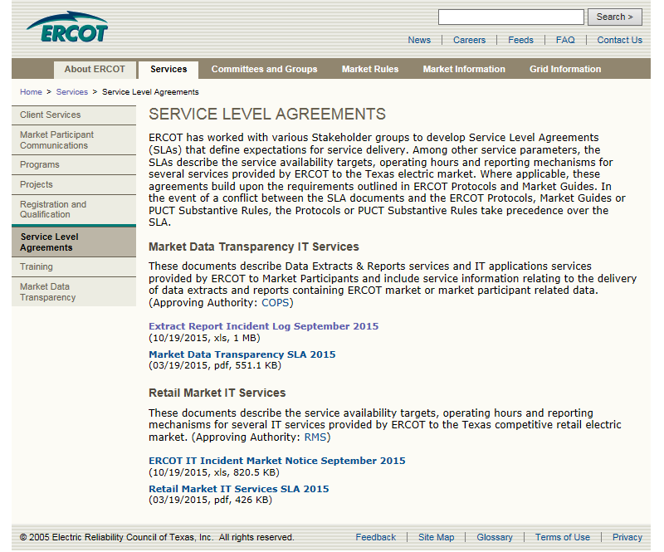
MDWG/CSWG Market Data Transparency Updates
IT Services SLAs are approved, however
How often are the logs updated on ercot.com?
“How To Use” tab
Document Definition: This document is a summary of ERCOT IT incidents, or service delivery failures related to Data Extracts & Reports that have been designated as Priority 1 extracts & reports by the Settlements and Extracts Working Group
The notion of Priority 1 is gone, as is the ranking by SEWG, now CSWG
“Extract & Report Info” tab from zonal. Has EMIL has taken over from the report list in the incident log? Can the log point there?
MIS Extracts Listserve vs Settlements: how do we want CODE MODE PRDE disruptions communicated?
Other “Priority 1” data sources?

Slide 6
Nodal Settlement Handbook
Help Wanted: graphic artist and volunteers
Non-binding, collaborative work-in-progress
Flexibility to incorporate Protocol grey-boxes and work ahead, or wait for efficient time to add
Broaden scope to include shadow techniques for charge types not in the ERCOT matrix, e.g. ERS
Further broaden to include Settlement-related workflows, not on Settlement statements, e.g. ERO Fee

Slide 7
Next CSWG Meetings
2016 schedule:
May 16
June 20
July 25
August 22
September 19
October 24
November 14
December 19

