Slide 1
Distribution of RRS Among Generation Resources
ERCOT
Operations Planning
March 30, 2016

Slide 2
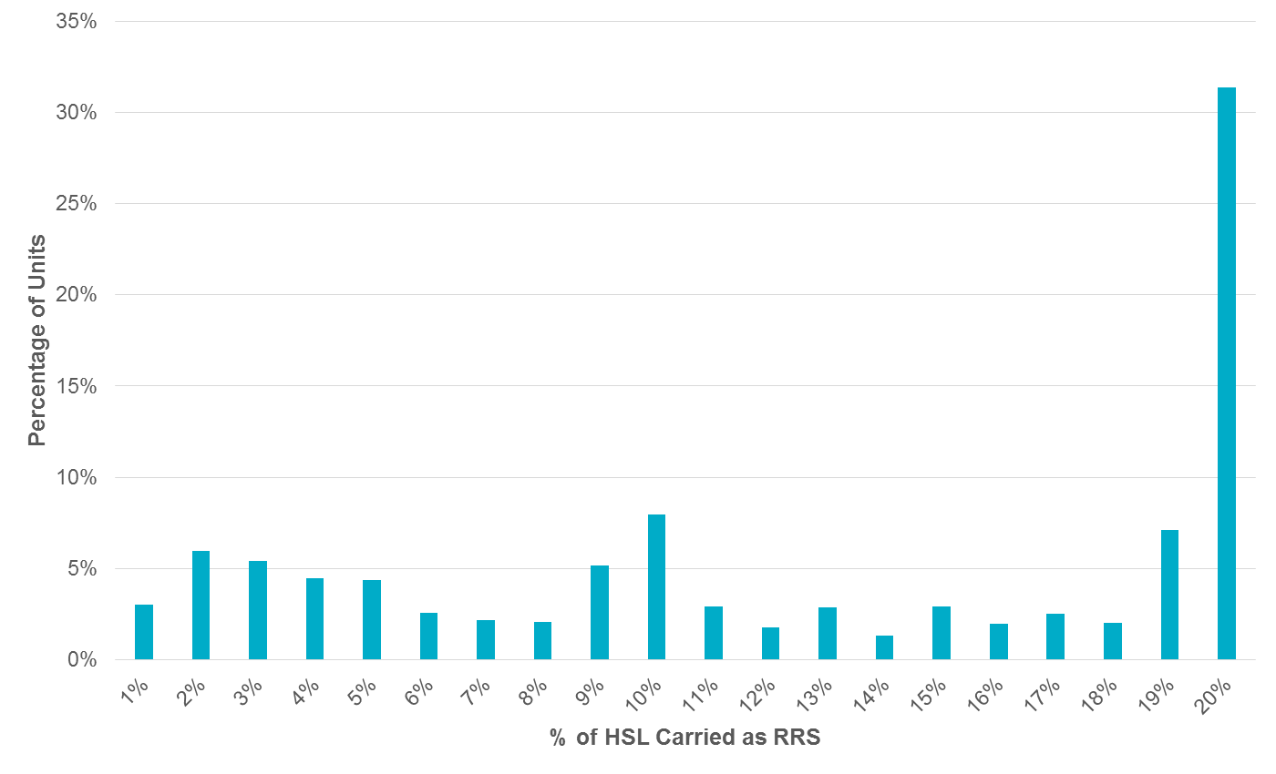
How RRS is Distributed Among Resources

Slide 3
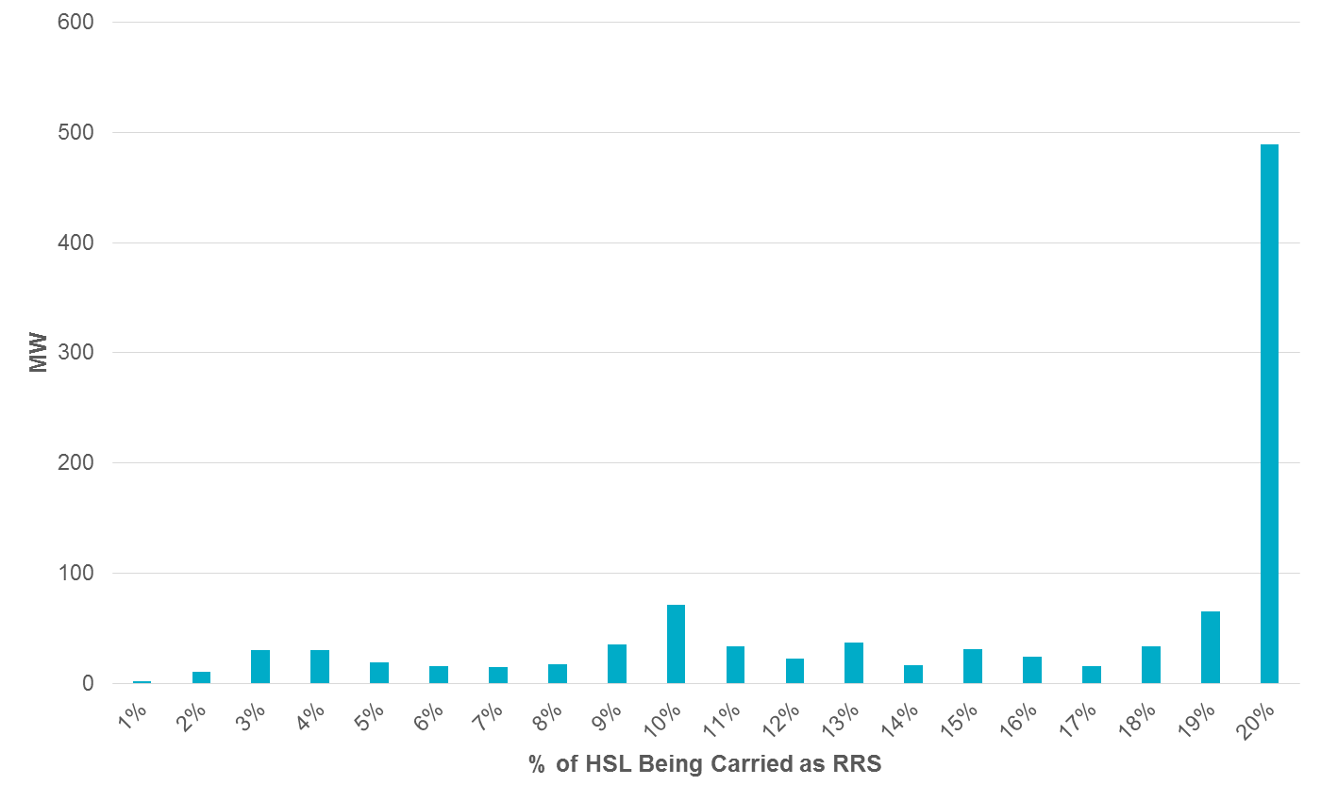
How RRS is Distributed Among Resources
Majority (>30%) of Generation Resources carry >19% of their HSL as RRS.
Most RRS capacity held by these resources (48%.)

Slide 4
How RRS is Distributed Among Resources
For HE15 – HE18…
>30% of Generation Resources Carry >19% of their HSL as RRS.
Of the total (average) ~1,020MW of RRS purchased, 489MW (48%) of it is carried by Resources carrying >19% of their HSL’s as RRS.
That 48% of RRS is carried most often by 12 different Generation Resources*.
Represented by two separate QSE’s.
Do they also carry Regulation-Up?
*will refer to them as “Top Resources”

Slide 5
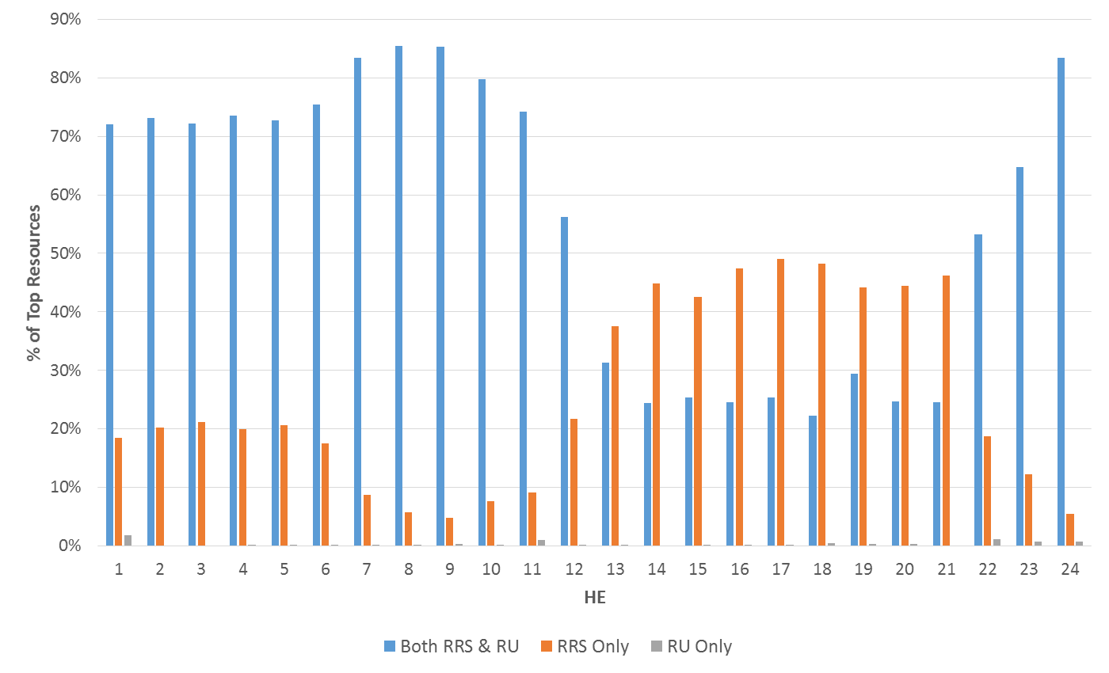
Top Resources Carrying RRS & Regulation-Up
24% of Top Resources carry both RRS and REGUP between HE15 – HE16.

Slide 6
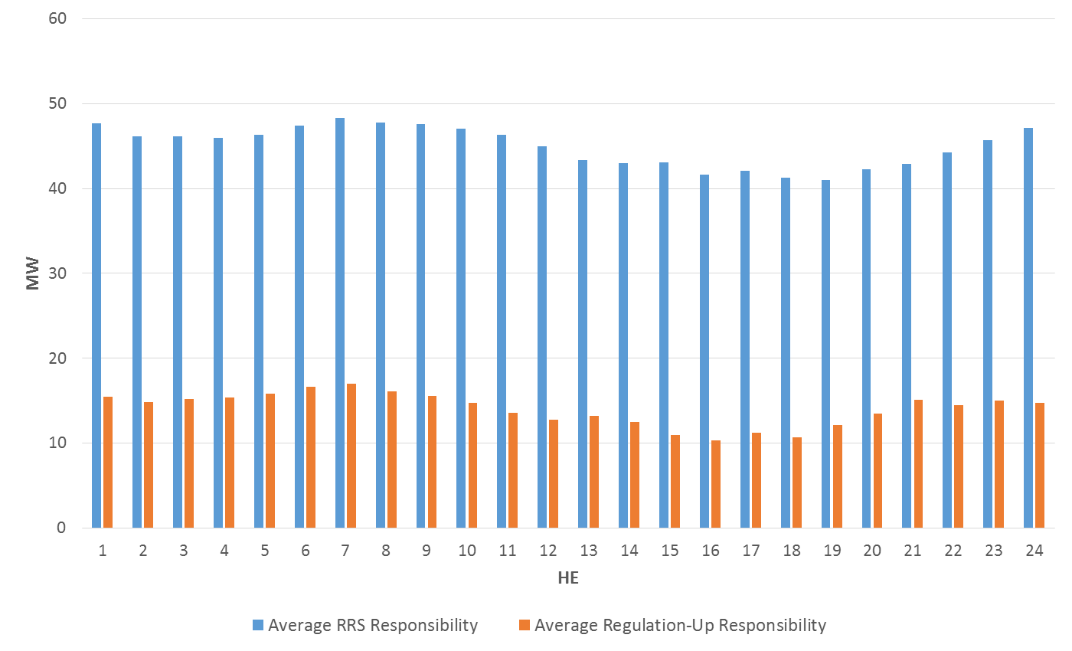
Amount of RRS & Regulation-Up Carried by Top Resources
During Peak hours (H15 – HE18), average…
RRS: 42MW
REGU: 13MW

