Slide 1
ERCOT Browser Support Roadmap Update
David Forfia
Director, Enterprise Architecture &
IT Transformation

Slide 2
ERCOT Browser Support
  Microsoft ended support for Internet Explorer (IE) browser versions below IE 11.
    Previous versions such as IE 7 and IE 8 are no longer receiving security patches.
  In April 2015, ERCOT verified that all market facing applications worked in both IE 8 and IE 11 or greater in “Enterprise Mode”.
  ERCOT would support both browsers for an interim period of time.
  ERCOT would announce to the Market prior to beginning the projects to migrate the applications to browsers other than IE8 in advance.

Slide 3
ERCOT End of Support Announcement
September 2016
Release 5
Begin Migration to IE11+

Slide 4



What does ERCOT End of Support mean ?
  All current User Interfaces will continue to work in IE 8 and in IE 11 in “Enterprise Mode”.
  Any project that develops or substantially redesigns the User Interface will be built to utilize IE 11 or greater in native mode and will not work in any version of IE less than 11.
  Market participants will need to upgrade to IE 11 or greater as their standard browser for ERCOT applications before the projects go live.

Slide 5
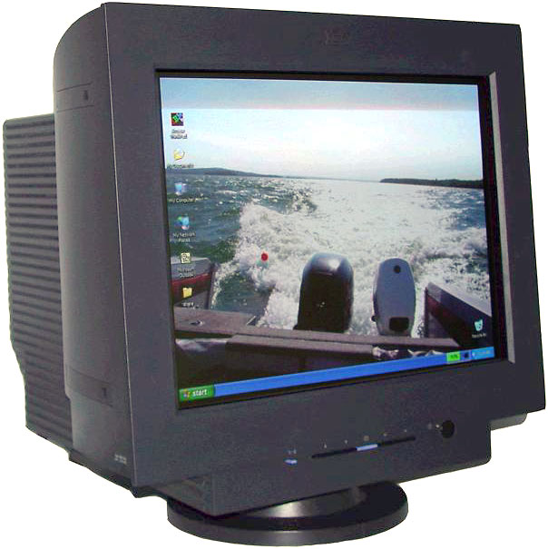

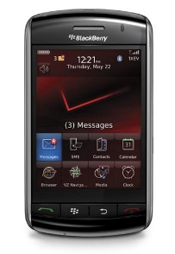


Why now ?
2008
2016
  User Experience expectations have changed
  Developing the easiest to use interfaces requires the capabilities of a newer browser
  Technology has changed
  IE 8 is now 7 years old and not supported
  Economic
  Developing two different user interfaces for every project is cost prohibitive.
Notes:
Responsive Design - Your Application will fit and be designed for 17, 19 and 24 inch monitors - no more horizontal scroll on small screens or postage stamp size screens in the middle of a 24 inch monitor
Search – Your application can support type ahead search – which means you no longer have to select operating company, requesting company and then stations. You can just select a station by typing the letters you know exist in the station name
Grouping Data – Your application can group and display data such as outage groups in a tree view that can be expanded and collapsed
Error messaging – significantly improved error messaging – in most cases, you will know if the information you entered in a field is correct when you exit out of the field – no more I’ve got a secret, and I’ll tell you what’s wrong when you submit an outage.

Slide 6
Affected projects 2016 – Market Projects

Slide 7
Affected projects 2017+

Slide 8
Questions ?
Questions ?

