Slide 1
PDCWG Report to ROS
Chair: Percy Galliguez, Brazos Electric Power Cooperative, Inc.
Vice Chair: Stewart Rake, Luminant
ROS
April 7th, 2016

Slide 2
Report Overview & Notes
Report Overview
  Meeting Minutes
  BAL-001-TRE-1 FMEs & IMFR
    No FME’s in the month of March
  Frequency Control Report

Slide 3
Meeting Minutes
PDCWG Meeting 3/9/16
  Regulation & Frequency Control Reports
  GREDP Performance Analysis
  BAL-001-TRE-1 Mitigation Plan Requirements
    Section C 2.1 of Regional Standard
  Reviewed 3 (non-FME) ERCOT Frequency Disturbance
    2/2/2016 @ 1217
      Loss of 375 MW
      648 MW/0.1HZ Response
    2/18/2016 @ 2107
      Loss of 468 MW
      665 MW/0.1HZ Response
    3/8/2016 @ 1018
      Loss of 468 MW
      588 MW/0.1HZ Response
  FRRS Deployment Discussion

Slide 4
Frequency Measurable Events Performance
March 2016

Slide 5
Frequency Measurable Events
No FMEs during the month of March.

Slide 6
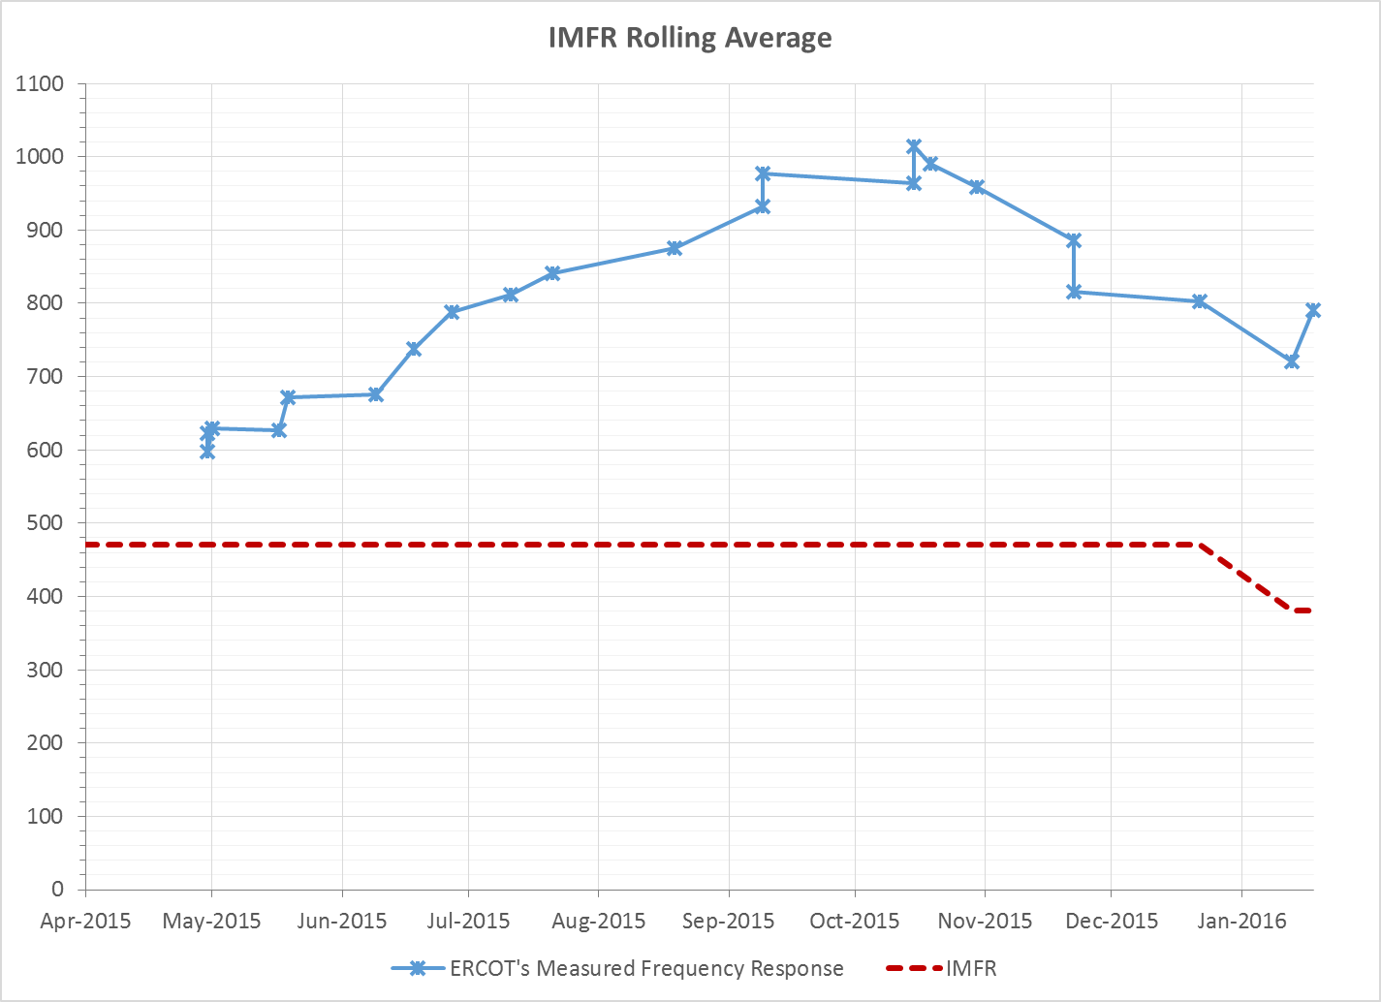
Interconnection Minimum Frequency Response (IMFR) Performance

Slide 7
Frequency Control Report
January 2016

Slide 8
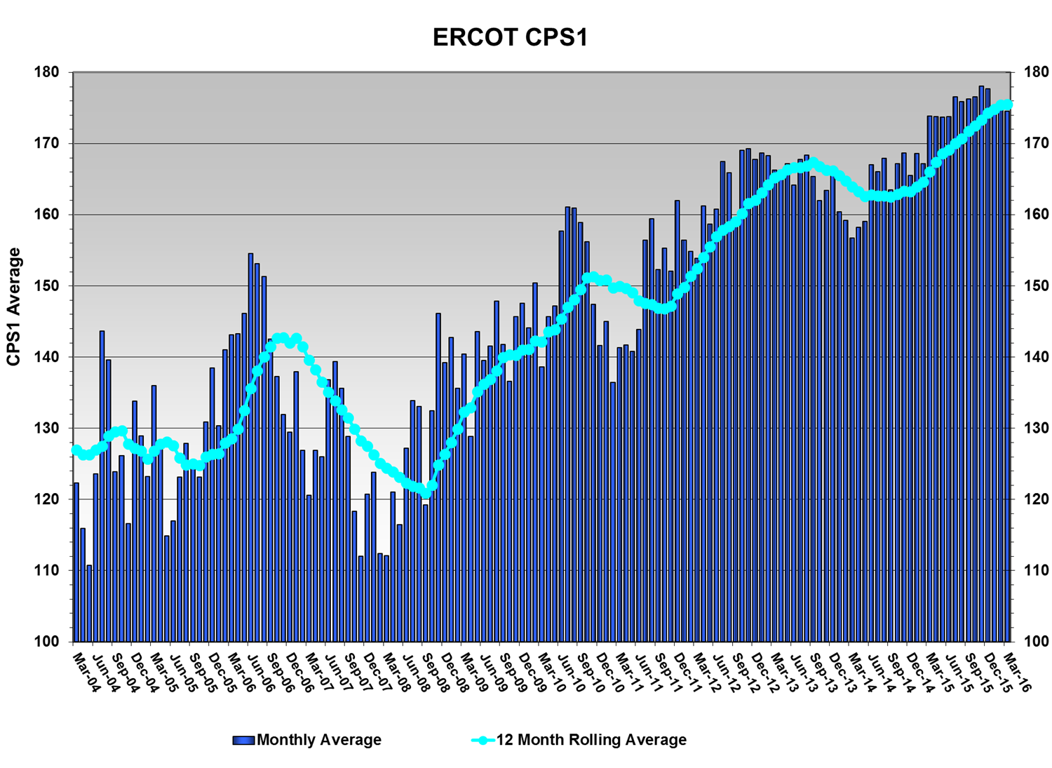
CPS1 Performance
CPS1 12 Month Rolling Average = 175.53%

Slide 9
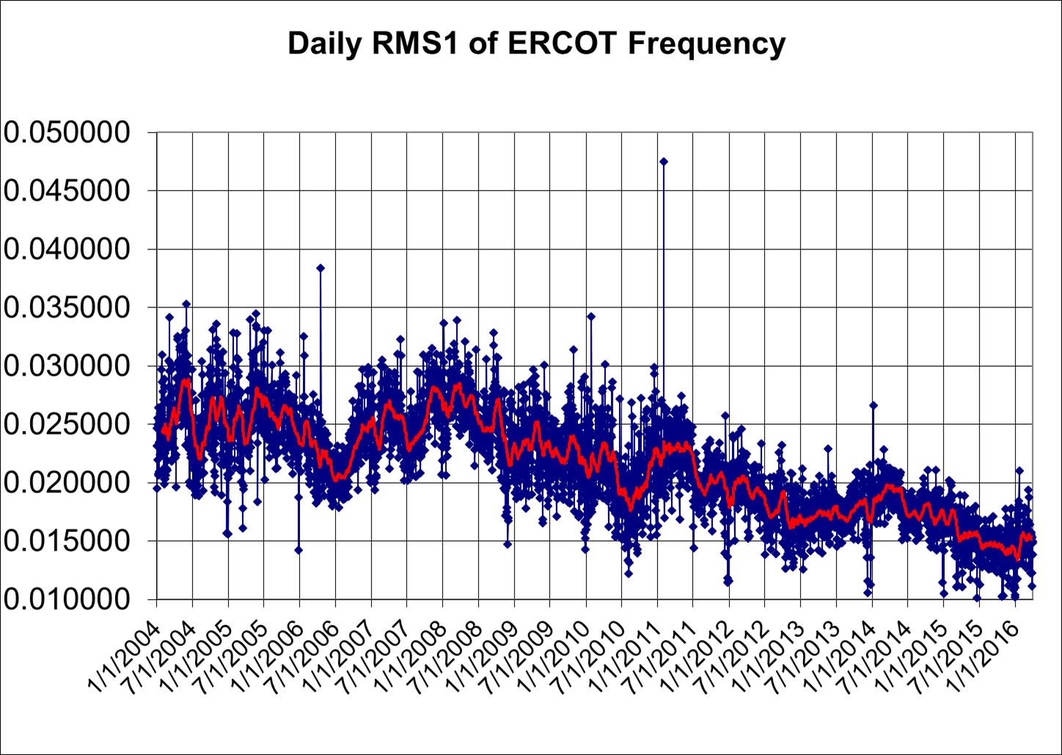
RMS1 Performance of ERCOT Frequency

Slide 10
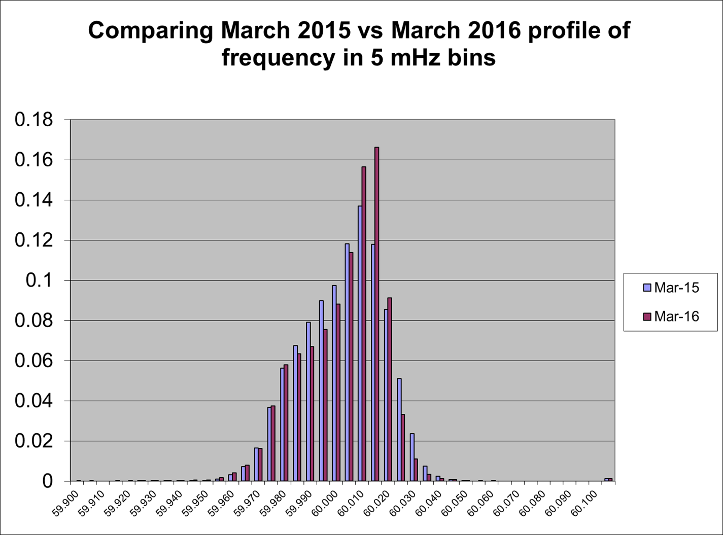
Frequency Profile Analysis

Slide 11
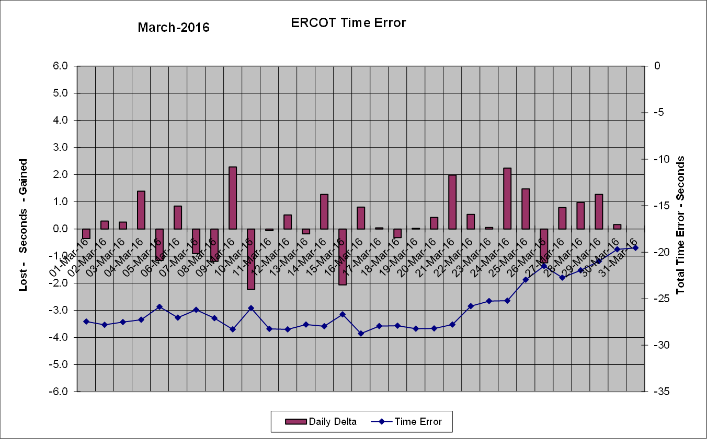
Time Error Corrections
There was two Time Error Corrections (TEC) in March.

Slide 12
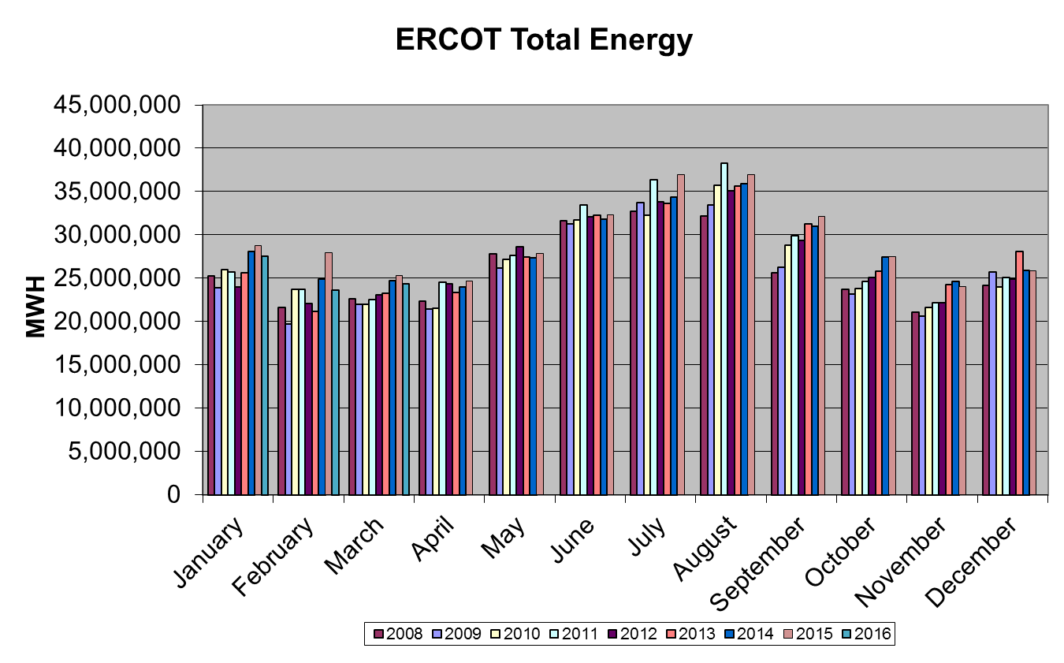
Wind Generation Performance

Slide 13
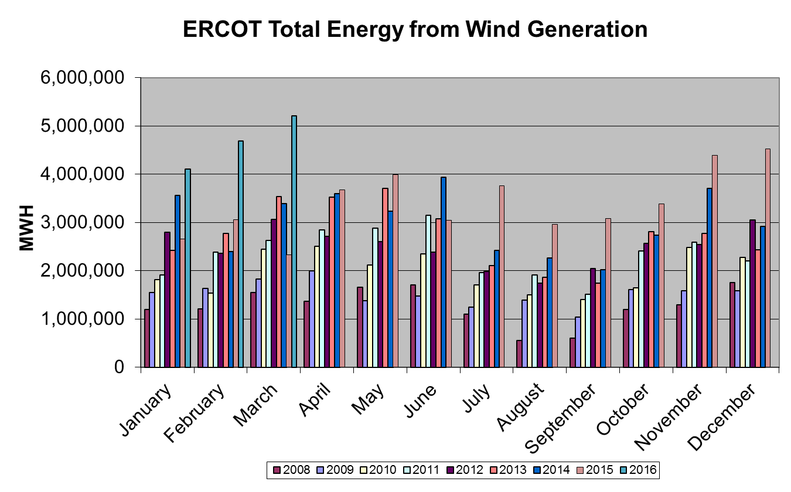
Wind Generation Performance

Slide 14
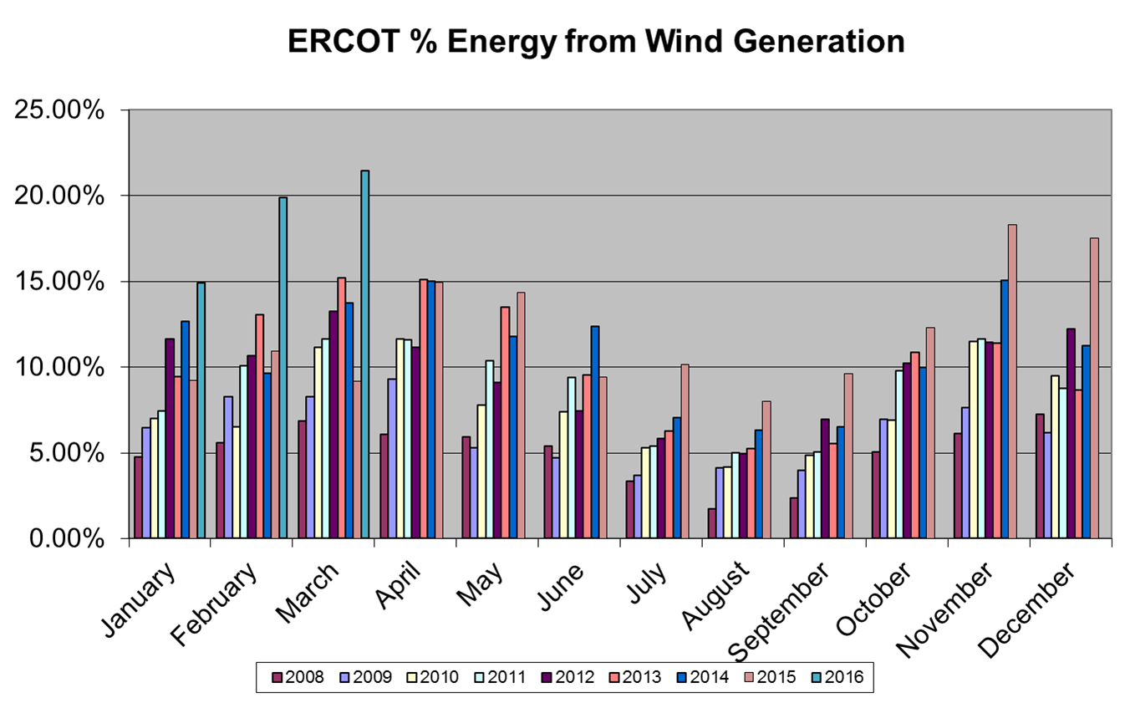
Wind Generation Performance
Record: 21.43% Wind Penetration
(previous record 19.87% in February 2016)

Slide 15
Questions?

