Slide 1
Market Update
Wholesale Market Subcommittee
Jeff Gilbertson
ERCOT Market Analysis
4/6/2016

Slide 2
February 18, 2016 Day Ahead Market (DAM) Pricing Event
RRS MCPC of $125/MWh for Hour Ending 1
Contributing factors:
Lower quantity of RRS AS offers
Lower quantity of Three-part offers
Higher quantity of Energy-only offers

Slide 3
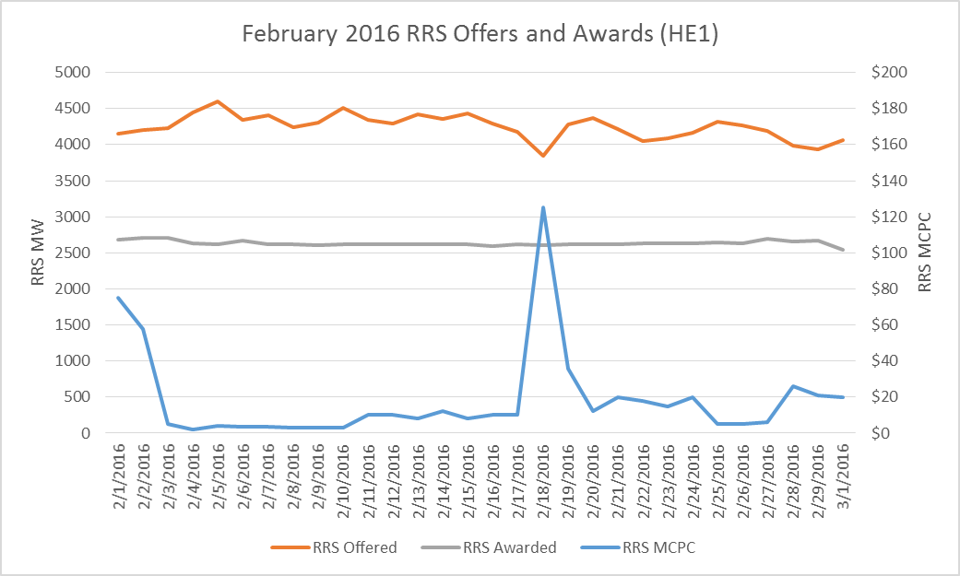
February 18, 2016 Day Ahead Market (DAM) Pricing Event
RRS Offer Quantity for HE1 > 300MW less than previous day
RRS Awarded about the same

Slide 4
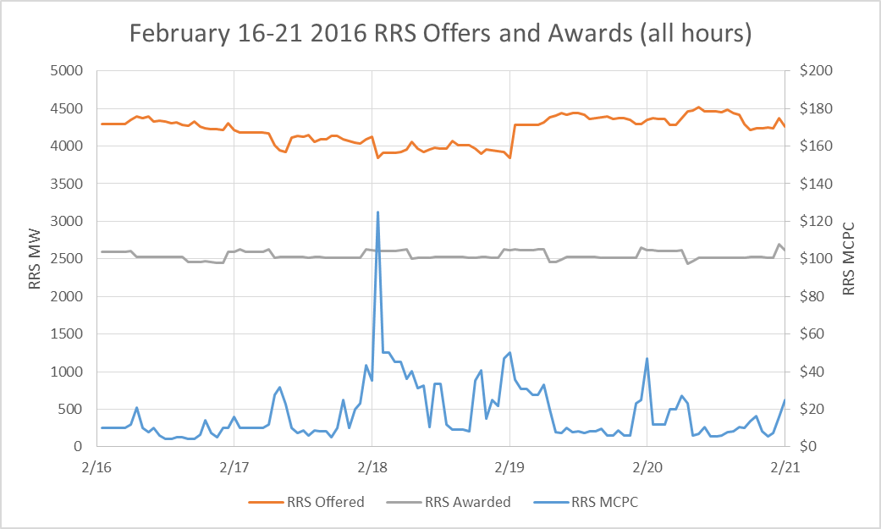
February 18, 2016 Day Ahead Market (DAM) Pricing Event
RRS MCPC elevated for all of February 18
RRS Offer quantity lower for all of February 18
RRS awarded quantity roughly the same for all days

Slide 5
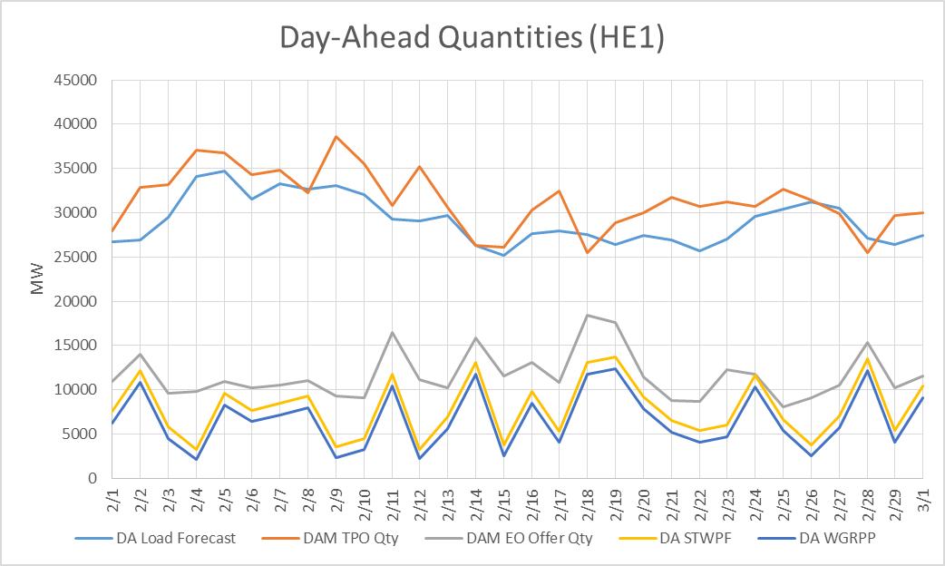
February 18, 2016 Day Ahead Market (DAM) Pricing Event
TPO quantity offered ~7,000 MW lower than previous day
Energy-Only quantity offered ~7,600 MW higher
Load forecast about the same

Slide 6
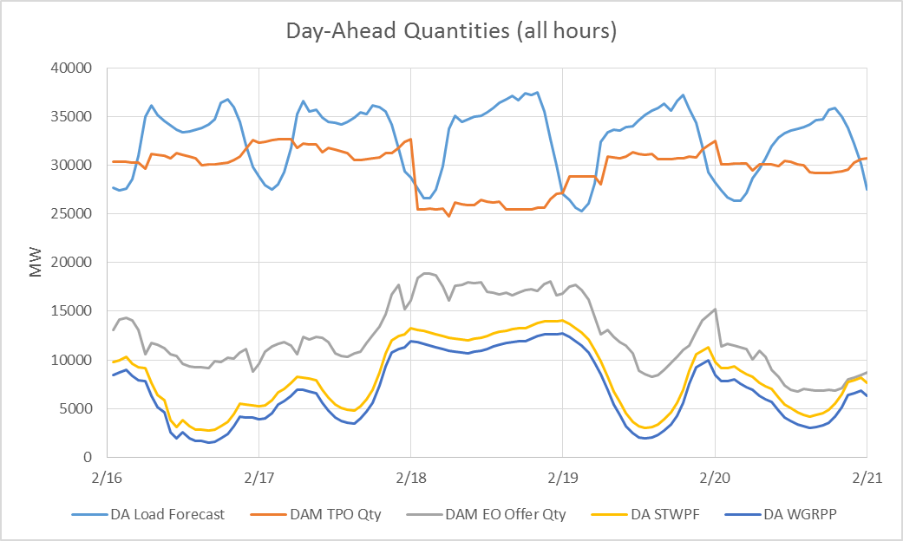
February 18, 2016 Day Ahead Market (DAM) Pricing Event
TPO quantity offered lower for all of February 18
Energy-Only Offer higher for all of February 18
Wind forecast high for all of February 18

