Slide 1
Project Update and Summary of
Project Priority List (PPL) Activity
RMS
April 5, 2016

Slide 2
Project Update Agenda
Project Portfolio Update p. 3-6
Retail Project Highlights
2016 Release Targets
2016 Project Spending Forecast
Questions?
Location of Project Priority List (PPL): http://www.ercot.com/services/projects/index

Slide 3
Retail Project Highlights
RMGRR126 – Additional ERCOT Validations for CBCI File In Flight
In Planning phase
July go-live target (to be confirmed during Planning)
RMGRR127 – Efficiencies for Acquisition Transfer In Flight
In Planning phase
December go-live target (to be confirmed during Planning)
ERCOT Flight Certification Website In Flight
In Planning phase
SCR786 – Retail Market Test Environment In Flight
In Initiation phase, gating to Planning on 4/13
December go-live target (to be confirmed during Planning)
Note: Projected Go-Live dates are subject to change. Please watch for market notices as the effective dates approach.

Slide 4
2016 Release Targets – Board Approved NPRRs / SCRs / xGRRs
February 2/2 – 2/4 | April 4/12 – 4/14 | June 6/21 – 6/23 | August 8/16 – 8/18 | October 10/18 – 10/20 | December 12/6 – 12/8
NPRR588 NPRR615 NPRR686(b) | NPRR419 NPRR728 | NPRR515 NPRR617 NPRR700 EMS Upgrade | NPRR495 NPRR662 NPRR736 RMGRR126 | NPRR219 SCR783 | NPRR272 NPRR573 NPRR714 RRGRR003 RRGRR006 RRGRR007 RMGRR127 SCR786
3 | 2 | 3 | 4 | 2 | 8
E
E
E
E
E
E
NS
E
NS
P
E
E
NS
H
NS
NS
NS
NS
P
I
May 26
7/23 – 7/24
12/10 – 12/11
EMS Upgrade “Chill”
2016 TBD Items (and point at which they became “TBD”)
2014 | November 2015 | December 2015 | February 2016
NOGRR084, NPRR664 | NPRR679 | SCR786 | NPRR210, SCR781 H, NOGRR147
Go-live dates can differ from Protocol effective dates – Please refer to market notices for more details
APPENDIX
Red Text: New additions and target release changes
Strike-Through Text: Previous target release changes
(a), (b), etc. indicates multiple phases
NPRR686(b) – Solar portion
In-Flight Items Planned for 2017 Delivery
CMM bundle (Planning): NPRR439, NPRR519, NPRR620, NPRR683, NPRR702
CRR Upgrade (Planning): SCR777
Release targets are subject to change
Project Status Codes: NS = Not Started, I = Initiation, P = Planning, E = Execution, H = On Hold

Slide 5
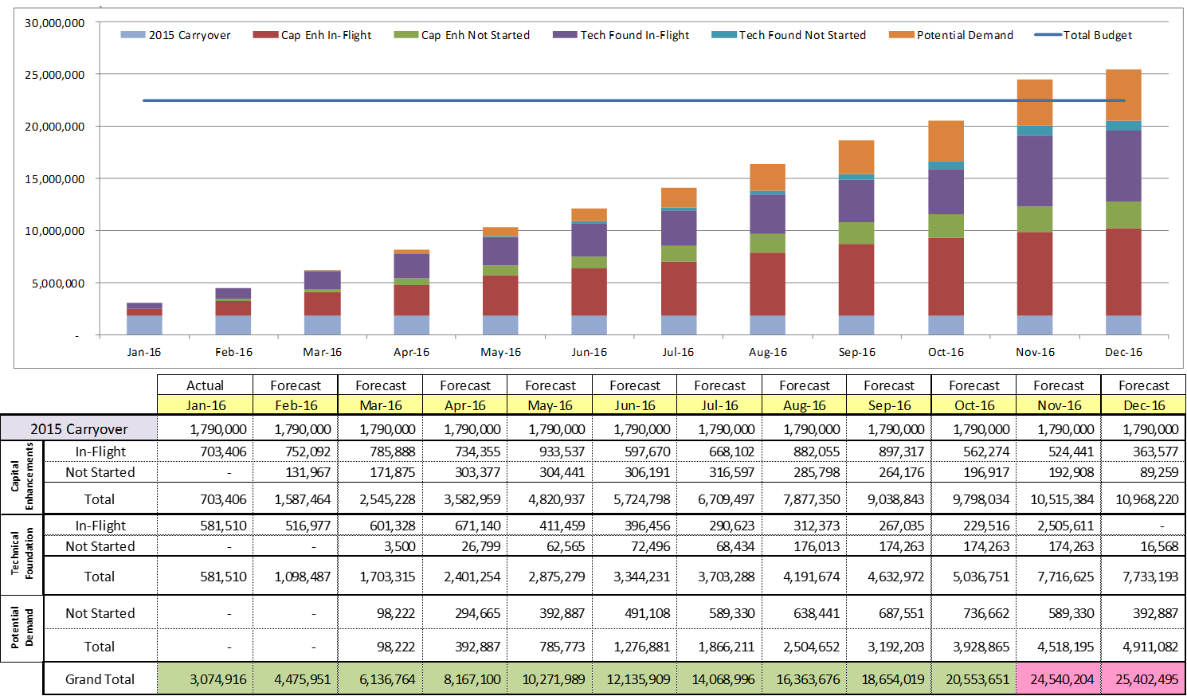
2016 Project Spending Forecast
2016 PPL Budget = $22.5M
“Potential Demand” represents internal ERCOT projects that have not been fully approved

Slide 6
Questions?

