Slide 1
SMT Update To AMWG
FEB 2016

Slide 2
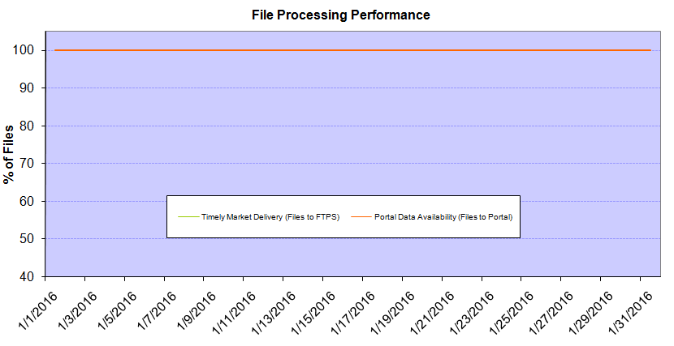
Monthly SMT Data Timelines AMWG CR 2014 002 End to End File Processing Completeness – FEB 2016
% Timely Market Delivery - % of files posted to market (FTPS) by 11:00pm out of # of files received by SMT by 11:00pm.
% Portal Data Availability - % of files loaded to the database for data availability on portal by 6:00am next day for the files received by 11:00pm
* A LSE file includes usage data for up to 50,000 ESIIDs.
Observed Anomalies:
2

Slide 3
SMT API and FTPS Services Availability – FEB 2016
The service availability is measured as a percentage of number of minutes the service was available out of the total number of minutes in a month, excluding planned outages.
Observed Anomalies:
Mar-Apr 2015: SMT outage and subsequent recovery/catch-up impacted API availability. FTPS was available for most of the part except on 03/21-03/22 for 36 hours.
26 Jul 2015: Services were unavailable for 12 hours due to Flash storage issue
25 Jan 2016: Services were unavailable for 19 hours due to storage configuration issue
Notes:
3

Slide 4
SMT Number of Accounts by Type AMWG CR 2014 009 – FEB 2016
Registered Users | ONC | CNP | AEPN | AEPC | TNMP | TOTAL
Active Residential Accounts | 34955 | 21962 | 2027 | 5271 | 2435 | 66650
Active Residential English Accounts | 34765 | 21810 | 2023 | 5161 | 2426 | 66185
Active Residential Spanish Accounts | 190 | 152 | 4 | 110 | 9 | 465
Non Active Residential Accounts | 17127 | 11957 | 1342 | 2935 | 598 | 33680
Total Residential Accounts | 52082 | 33919 | 3369 | 8206 | 3033 | 100330
TDSP User | 353 | 39 | 12 | 17 | 2 | 423
TDSP Admin | 4 | 4 | 4 | 4 | 3 | 19
Small Business User | 86 | 44 | 0 | 4 | 2 | 136
Small Business Admin | 2438 | 1310 | 74 | 261 | 83 | 4273
Total Agreements (Includes Active and Pending) | 1994 | 891 | 1 | 0 | 0 | 2886
Energy Data Agreements (Includes Active and Pending) | 1899 | 596 | 1 | 0 | 0 | 2496
Han Device Agreements (Includes Active and Pending) | 95 | 294 | 0 | 0 | 0 | 389
Han Service Agreements (Includes Active and Pending) | 0 | 1 | 0 | 0 | 0 | 1
IN SMT
ESI IDs | 3466316 | 2391560 | 197318 | 856427 | 217835 | 7129456
Meters | 3397559 | 2391527 | 198109 | 856637 | 217669 | 7061501
HAN Devices | 3936 | 5344 | 140 | 289 | 38 | 9747
Acknowledgement | 0 | 0 | 0 | 0 | 0
Pending | 0 | 1 | 0 | 0 | 0
Meter Ready | 20 | 6 | 44 | 118 | 25
Provisioned | 3916 | 5337 | 96 | 171 | 13
HAN Messages (MTD) | 0 | 0 | 0 | 0 | 0 | 0
HAN Messages (YTD) | 0 | 0 | 0 | 0 | 0 | 0
HAN Messages (Cumulative) | 322 | 7397 | 0 | 0 | 0 | 7719
Simple Text Messages | 98 | 2922 | 0 | 0 | 0
Load Control Messages | 88 | 2658 | 0 | 0 | 0
Pricing Messages | 92 | 53 | 0 | 0 | 0
Cancellation Messages | 44 | 1764 | 0 | 0 | 0
Supplemental – (Friends)
Total Agreements | 1582 | 1246 | 73 | 84 | 57 | 3042
Accepted Agreements | 701 | 490 | 32 | 29 | 18 | 1270
Pending Agreements | 11 | 1 | 0 | 0 | 0 | 12
Revoked Agreements | 232 | 234 | 9 | 7 | 6 | 488
Expired Agreements | 612 | 494 | 30 | 48 | 33 | 1217
Terminated Agreements | 26 | 27 | 2 | 0 | 0 | 55
 | TDSPs | REP | NRC | Regulatory | Third Party
Registered Entities | 5 | 108 | 4154 | 2 | 86
Registered Users | 423 | 830 | 136 | 7 | 16
Registered Admins | 19 | 169 | 4166 | 3 | 90
HAN Messages Sent By | 312 | 7383

Slide 5
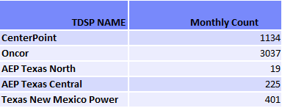
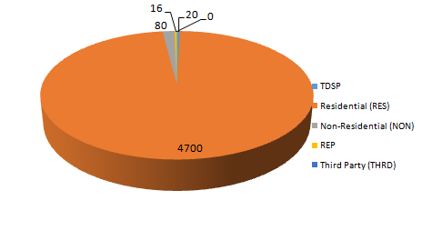
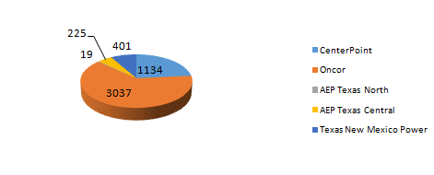
SMT ODR Details – FEB 2016
Total ODR Requests TDSP wise statistics:
Total ODR Requests User type statistics:

