Slide 1
Vector Series Security & Operations Events Viewed in Context
24 March 2016
ERCOT Reliability and Operations Subcommittee - Operations Working Group
Kevin Mikalsen – Quantum Technology Sciences
Proprietary: quantum Technology Sciences
Notes:
FLOW NOTES:
Vision: A way over the problem
Quick History
Global to Tactical detection and scale
Capabilities
Classifiers
Algorithms
Seismographic pictures
Detection / Implementation
Active Deterrent
Gunshot detection with intrusion detection – one system
Screen shot of UI
Reporting Up – Reporting Out
Infernally rerouting service teams upon intrusion/gunshot detection
System Security Response Group (SSRG)
Reactive to Prediction – Pattern of Life
Anomalies
Get out in Front instead of Reacting
IoT – internet of Things

Slide 2
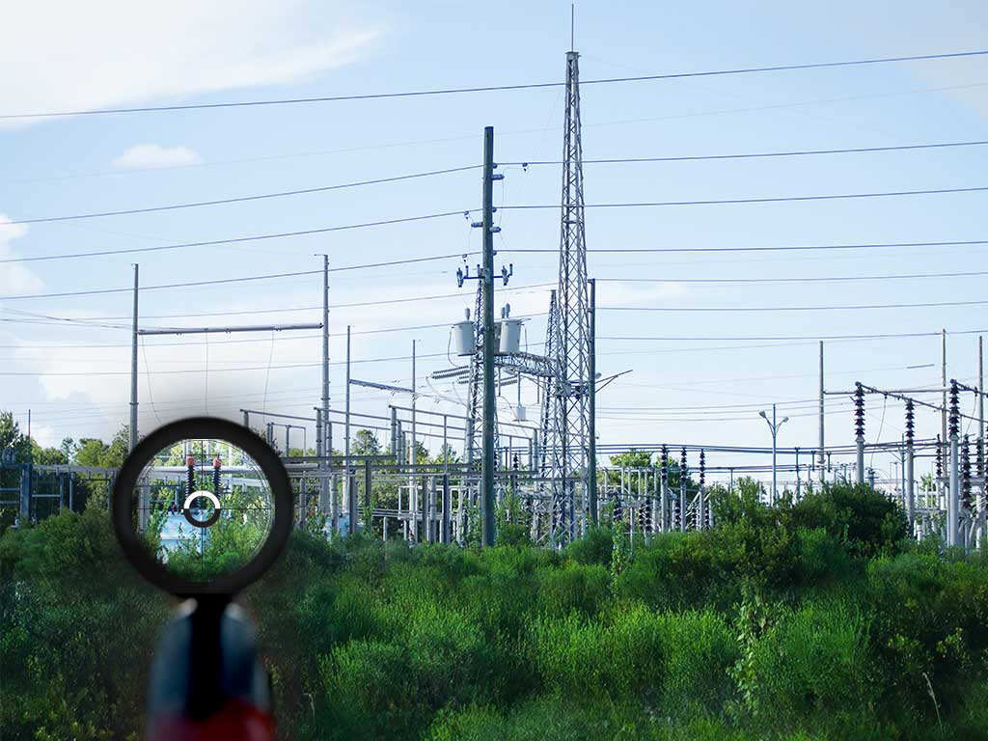
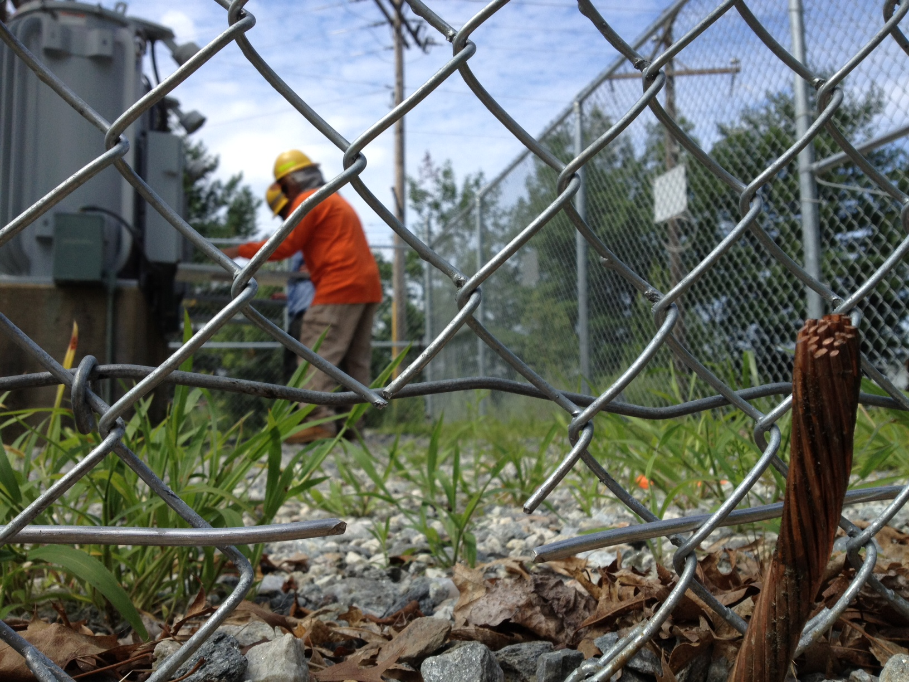
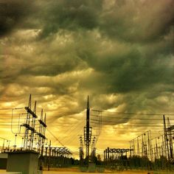
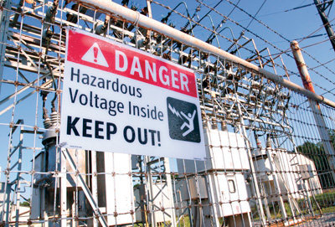
Current Situation… Many Systems
2015 – 44 Reported Physical Attacks, est. 16 w/gunshots
100+/year - $10-30m annually
$33-$70B in economic losses
LTD/Wrongful Death - $150k to $2.5m, each
quantum Technology Sciences | Where We Are Today
Notes:
Economic Benefits of Increasing Electric Grid Resilience to Weather Outages, 2013
Electric Disturbance Events (OE-417) Annual Summaries, 2015
http://legacy.wcnc.com/story/news/crime/2015/04/01/5-charged-for-copper-theft-at-local-substations/70760678/
FLOW NOTES:
Many events, many teams, different tools
Weather cannot be controlled; we can mitigate man-made events
Metcalf – showed vulnerability, but black swan… so Compliance is important but its one factor
Day -to-Day Reality of manmade events – copper theft, civilian and employee safety-litigation, gunshot damage
Some of these sites are remote and consumes a lot of man power
Disparate technology, high costs
Quietly unreported – approximately 16 gunshot attacks in US to various degrees- no serious outages
Height of Copper Theft – 360 incidents between 2011 and 2014 – Still a nuisance and at $30-$100k for replacement, damages, crew costs – that’1 $10 to $36m – plus the inconvenience to customers.
Employee LTD or Civilian Wrongful death litigation – on average $150k to $1.25 million per case
Estimated some $33-$70 billion per year in economic losses due to power loss in the BES.

Slide 3
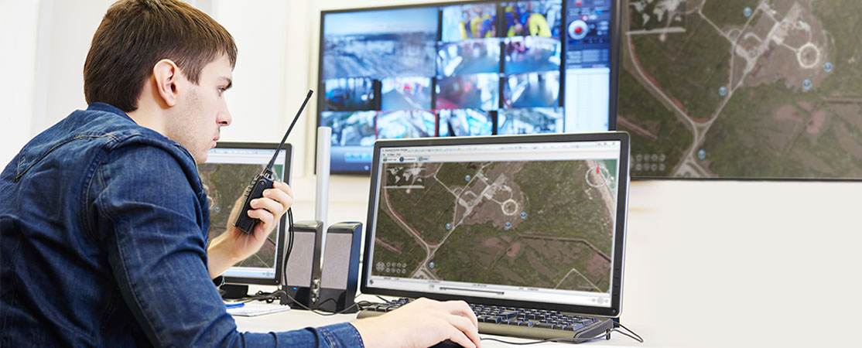
Evolving Mission of Security & Ops
Responsive Era
Preventive Era
predictive Era
Legacy model where Security and Safety are simply cost centers
Watch & respond only
Security & Safety are now rationalized as needed in Post 9/11 era
Aggressive prevention justifies purchases
Future where analysis adds corporate strategic value
Potentially identify / predict issues before they occur
Adds operational & bottom line benefits
quantum Technology Sciences | Product Overview
Notes:
FLOW NOTES:
Hurdle We Face
Industry is still by and large Reactive, however, we want to Become more Predictive
Security & Ops collaboration – moving from reaction and now preventative to predictive
Be more Collaborative – supply chain security as well as peer-to-peer
Deter negative events from happening
Drive the business forward with scarce resources - ROI
Competitive Advantage? Yes, Intelligence can be used as a risk mitigation to reduce exposure, risk of failure; lower cost of operation – allow the enterprise to penetrate, secure and operate in high-risk areas more effectively than competition – AFRICA/ASIA
CSO’s C-Suite Role Elevating
Security is becoming an ally in securing the enterprise’s goals and objectives
Operational/Physical Security is no longer an island or a “necessary expense”
Security as a growth accelerator in new/emerging/insecure markets provides advantages over competitors who can’t safely enter a geographic region

Slide 4
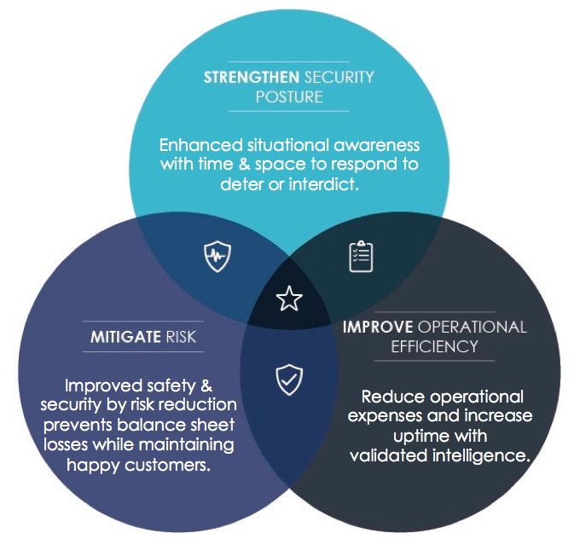
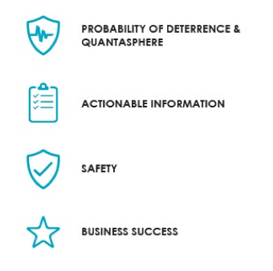
Driving Business Forward…
Remember, it is not our job to just secure the asset or just secure the network…
– Our job is to secure the business!
Enhanced situational awareness with time & space to respond to deter or interdict.
Improved safety & security by risk reduction prevents balance sheet losses while maintaining happy customers.
Reduce operational expenses and increase uptime with
validated intelligence.
quantum Technology Sciences | Business Drivers
Notes:
FLOW NOTES:
Pictorially, the Desired Outcme align here…
Use just Icons and black text to create the Key, and talk to them…
BREAK APART the Key from the three circles…
Remember, it is not our job to just secure the asset or just secure the network…
– Our job is to secure the business!
Reduce repairs, service interruptions, and other resource consuming tasks. Improve prosecutions and reputation management
Information sooner and with greater accuracy establishes confidence, the confidence to act, and this builds a better defense.
Enhancing situational awareness reduces a host of risk elements resulting in improved safety.
Ultimately, the goal is to deliver security and operational tools to improve and grow the overall business.

Slide 5
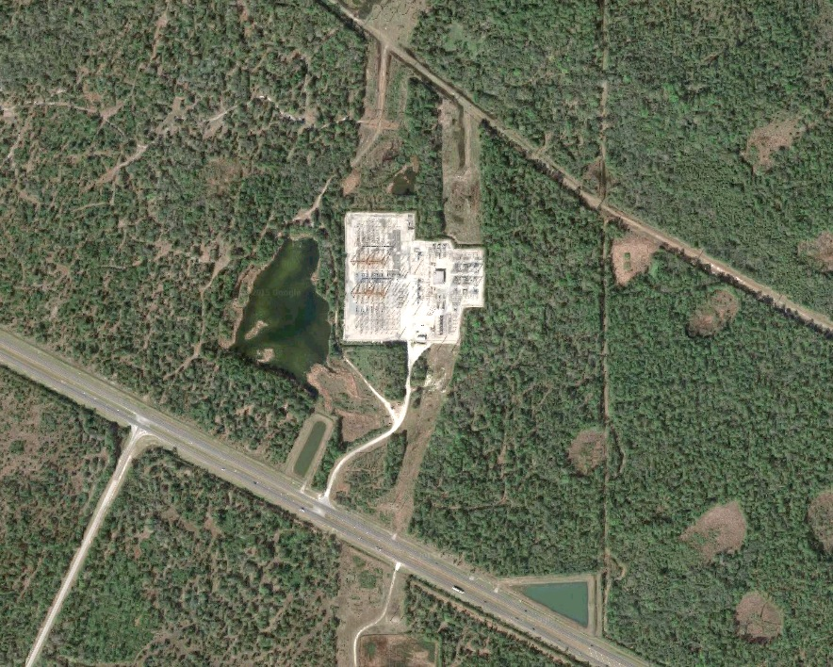
Case Study: Substation #33
Strategic – Supply Chain
500kV serves:
17,000 residences
Water treatment plant
Chemical refinery
High value asset / target
Tactical
Remote location
Chain-link, padlock
Cameras – turned off
Electronic access control
LEO response, 10+ min
Line of sight restrictions
Easy highway access
Operational – Site Integrity
Equipment & vehicle maintenance yard
Citizen / employee safety
Respond to trespassing
Respond to gunshots
“Locals”
ATV Path
Hunting blind, corn feeder
Shotgun & rifle casings
“Bad Actors”
Copper thieves
Environmental activists
Vandals / homeless
Traffickers
quantum Technology Sciences | Competitive Landscape
Notes:
FLOW NOTES:
Discuss Patterns of Life in Context of Site and it’s Importance
Bad Actors will “scope” out a site long before they move on it…
Hunters move through all the time
Gunshots may be “harmless”
The challenge is determining what is normal, what is acceptable with what is out of the ordinary?
Need a Pattern of Life and Detection system capable of discriminating and reporting

Slide 6
Events Viewed in Context - Pathways
Patterns of Life
Intent – Behavior
Activities - Seasons
Hiking / ATV / mountain biking
Human / Drug trafficking
Entertainment
Current Events
Price of copper
Environmental protests
Social Media – threat monitoring
Operations
Scheduled inspections
After hours access
Equipment & material storage
Mitigate theft, vandalism, injury
Mitigate “inside jobs”
Improved LEO relationships
Economizes spending
Improved compliance reporting – SSRG daisy-chain theft deterrence
Prior Planning
Observation - probing for reaction
Direction of ingress/egress
Timing of events
Attractive Nuisance
Climbing the fence
Throwing objects into bushings
Challenge: not all traffic is “threatening”
POL: Monitor out-of-band traffic, times, frequency, loitering
Optimize inspection or security patrols
Increase cameras
Use active deterrence devices
Notes:
FLOW NOTES: Tailor to Ped/Vehicles
Discuss Patterns of Life in Context of Site and it’s Importance
Bad Actors will “scope” out a site long before they move on it…
Hunters move through all the time
Gunshots may be “harmless”
The challenge is determining what is normal, what is acceptable with what is out of the ordinary?
Need a Pattern of Life and Detection system capable of discriminating and reporting

Slide 7
Events Viewed in Context - Gunshots
Patterns of Life
Intent – Behavior
Activities - Seasons
Hunting
Human / Drug trafficking
Entertainment
Current Events
Environmental protests
Social media – threat monitoring
Corp operational policies
Operations
Equipment damage or environmental impacts
Customer impact /reaction
Employee safety
Perform a controlled shutdown, rerouting of power
Initiate tighter security around other substations or key assets
Find potential damages earlier and repair before extensive damage occurs
Mitigate environmental issues – spills, fires
Improved Compliance Reporting – SSRG Daisy-chain attack deterrence
Attack or Prior Planning
Observation prior to attack - transformers
Probing for reaction
Direction of ingress /egress
Timing, rate of fire
Attractive Nuisance
Plinking at bushings
Direction of fire – impact on asset
Challenge: shooting is “dangerous” but hard to determine intent
SCADA may not initially indicate issues
POL: seasonal, timing and frequency
Alert operational & service crews to local gunfire
Roll LEO with better situational awareness
Schedule spot inspections
Notes:
FLOW NOTES: Tailor to Gunshots
Discuss Patterns of Life in Context of Site and it’s Importance
Bad Actors will “scope” out a site long before they move on it…
Hunters move through all the time
Gunshots may be “harmless”
The challenge is determining what is normal, what is acceptable with what is out of the ordinary?
Need a Pattern of Life and Detection system capable of discriminating and reporting

Slide 8
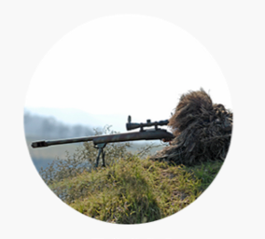
Earlier Detection – Pattern of Life
Classifiers
“Ears – to – Eyes”
Vector is constantly listening in all directions, all the time.
It detects, classifies and even tracks the diverse potential threats present today to deliver actionable intelligence.
300m Gunshots
200m Vehicles
80-120m Pedestrian
quantum Technology Sciences | Competitive Landscape
Notes:
FLOW NOTES:
Discuss Patterns of Life in Context of Site and it’s Importance
Bad Actors will “scope” out a site long before they move on it…
Hunters move through all the time
Gunshots may be “harmless”
The challenge is determining what is normal, what is acceptable with what is out of the ordinary?
Need a Pattern of Life and Detection system capable of discriminating and reporting

Slide 9
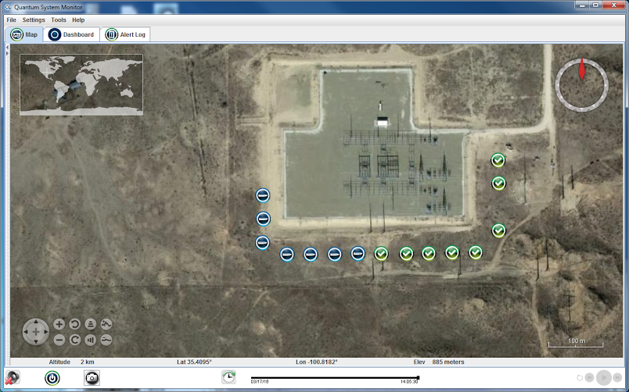
Detect, Communicate, Respond, Report
Security
GUI Visual Alert - Location
Alert Is Logged
Slew Camera – Visual
Response: SOC => LEO
Export Incident to SSRG
Operations
SOC => Maint. Alert
Ops => Damage Assmt.
Close SSRG - KPI Review
Gunshot
- logged
- replay
Data / POL
Gunshot at Substation #44
Notes:
FLOW NOTES:
Vision: A way over the problem
Quick History
Global to Tactical detection and scale
Capabilities
Classifiers
Algorithms
Seismographic pictures
Detection / Implementation
Active Deterrent
Gunshot detection with intrusion detection – one system
Screen shot of UI
Reporting Up – Reporting Out
Infernally rerouting service teams upon intrusion/gunshot detection
System Security Response Group (SSRG)
Reactive to Prediction – Pattern of Life
Anomalies
Get out in Front instead of Reacting
IoT – internet of Things

Slide 10
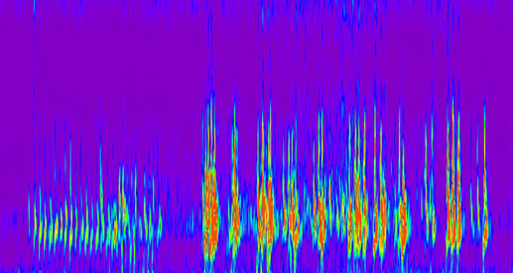
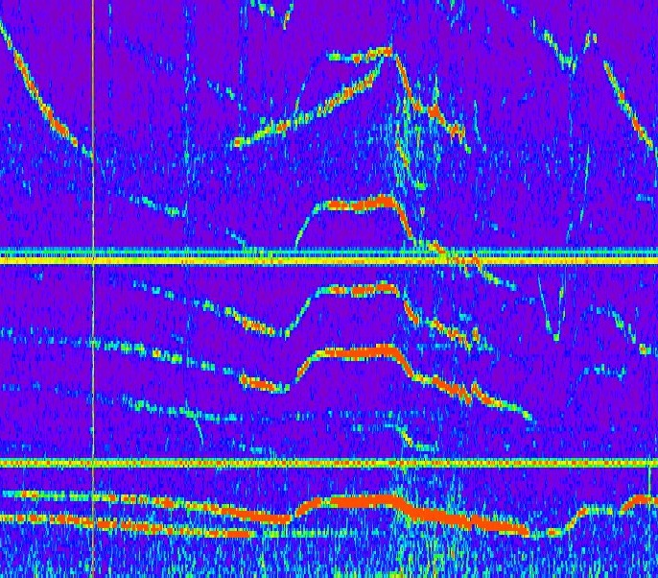
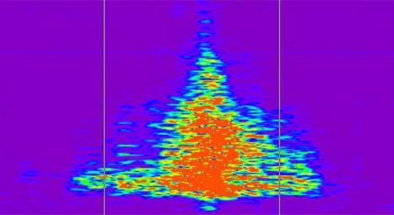
VOICE RECOGNITION FOR THE EARTH
Impulsive Transients
Frequency Modulated & Continuous Wave Tones
Digging
Aircraft
Walking
Frequency
60Hz Electricity
Frequency
Time
Emergent Signal
Boat 1
Light Truck
Generator
Frequency
Boat 2
Time
Time
45 seconds
5 minutes
quantum Technology Sciences | Classifiers
Notes:
And we discovered something remarkable.
We discovered the earth is brimming with information. Vast amounts of it going this way and that way and through hills and under buildings, and not just footsteps, but shovels and even neater, things that hum like generators and electricity and air conditioning units. and the beating heart off a pipeline. And then things that hum and move, like cars and trucks, and trains, Even crazier, it is also grabbing energy out of the air and water and making it its own. Yes, boats and airplanes and rockets.

Slide 11
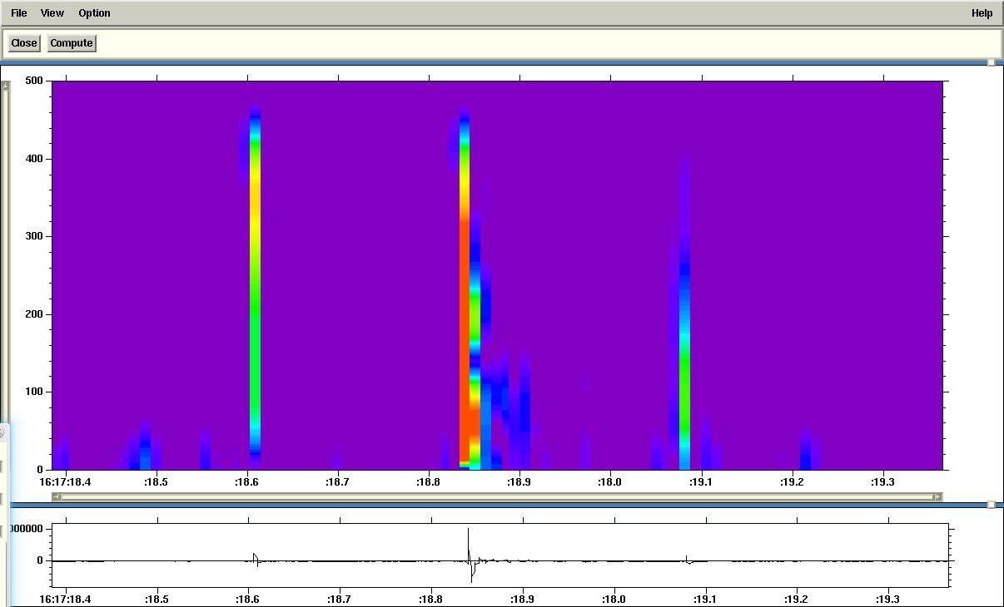
Gunshot information
N-wave or Shockwave of passing bullet
Muzzle Blast
Target Impact
quantum Technology Sciences | Classifiers

Slide 12
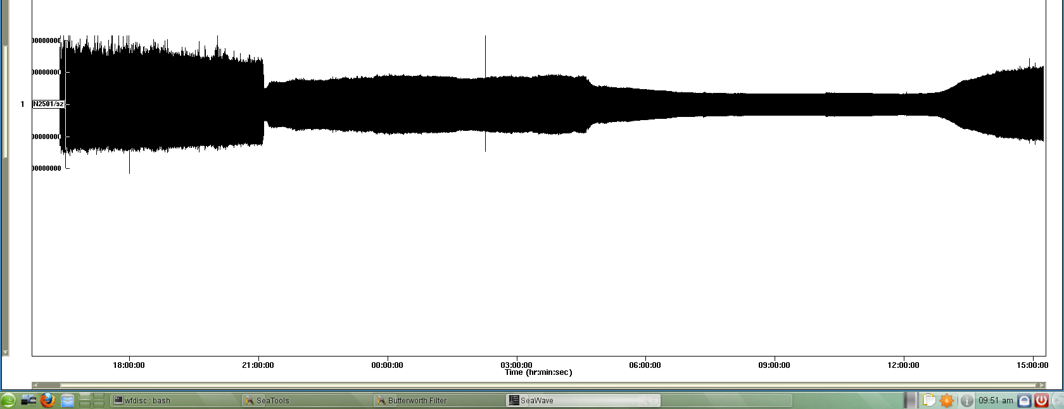
Energy from Power lines
This is signal from the 500 kV lines as recorded on a Vector QM-100 system
4:00pm local
midnight
8:00 am local
24 Hour Period, Raw Data (combination of mechanical/electromagnetic)
Proprietary: quantum Technology Sciences
12
Notes:
FLOW NOTES:
Kicker – Oh By the Way
We’re leaning more about what we can see and do…
INSERT WINDOWS/QUESTIONS… do you find this interesting? What would they do with this typei of information… applicable to existing reporting or tools – how could we use it to improve?
Additional Hook – Power Line Harmonics
Power Line Seismograph
NASPI - Synchrophasor – enhance/augment data collected?
Faults Traveling Waves / Arch Flash Protection / Lightning Detectin & Location / Line Protection
Help with other operational harmonics – renewables/turbines/equip failure
Impact to Operational Improvements
NASPI – Synchrophasor – Harmonics – EMP - Lightning

Slide 13
Unifying Operations & Security
Operational Efficiency
Scheduling & reporting
Improve efficiency
Security Posture
Situational awareness
One step ahead
Mitigate Risk
Meeting compliance
Constrain costs/losses

Slide 14
Vector Series Security & Operations Events Viewed in Context
Resources for ERCOT-OWG:
www.qtsi.com/ERCOT
Presentation
Gunshot App Note
Articles
White Papers
Kevin Mikalsen – Quantum Technology Sciences
kmikalsen@qsti.com
407.448.7159
Proprietary: quantum Technology Sciences

Slide 15
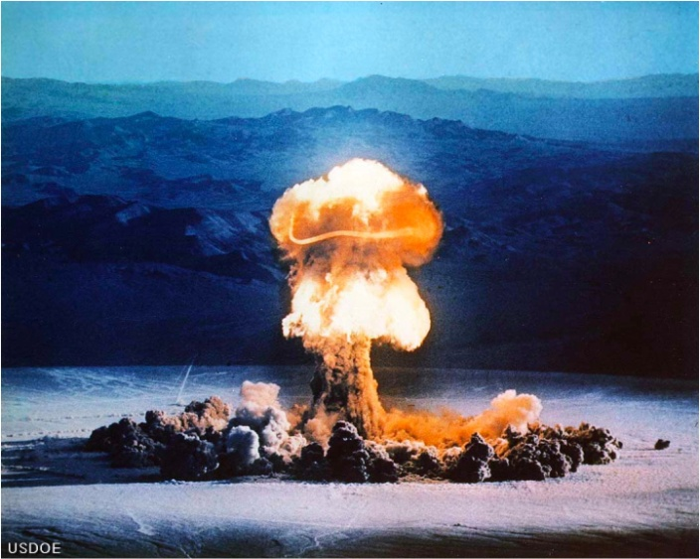
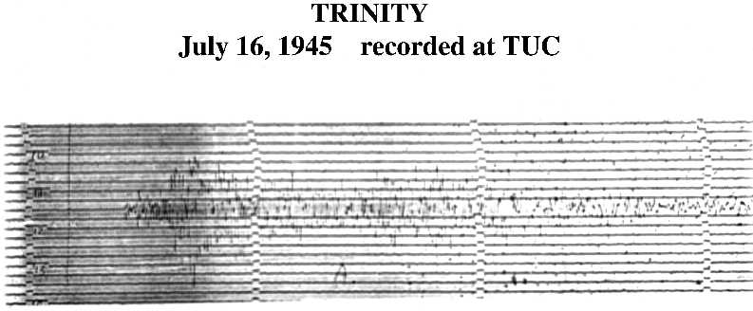
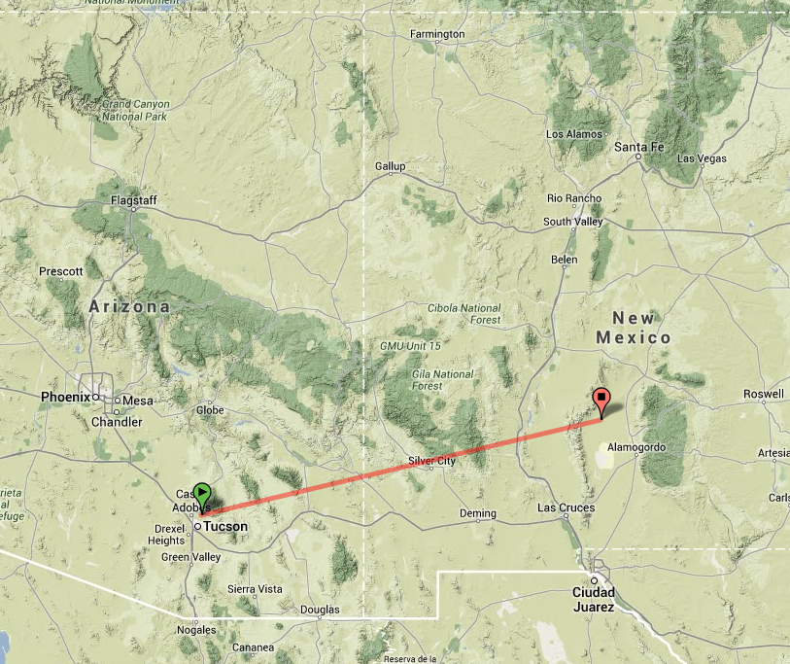
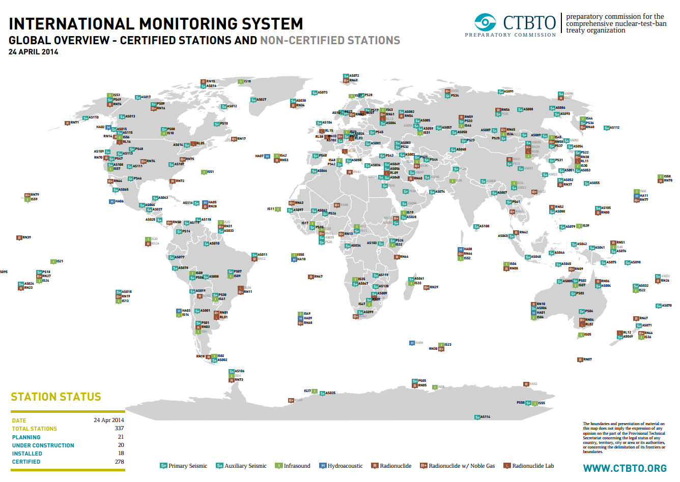
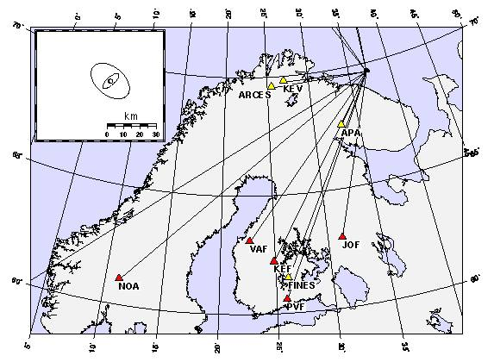
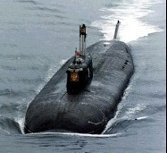
From Shaking to Information
FLOW NOTES:
May not need this…
270 miles
quantum Technology Sciences | Historical Background
Notes:
Guttenberg

Slide 16
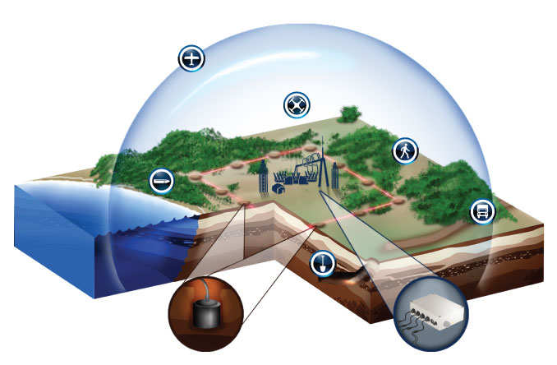
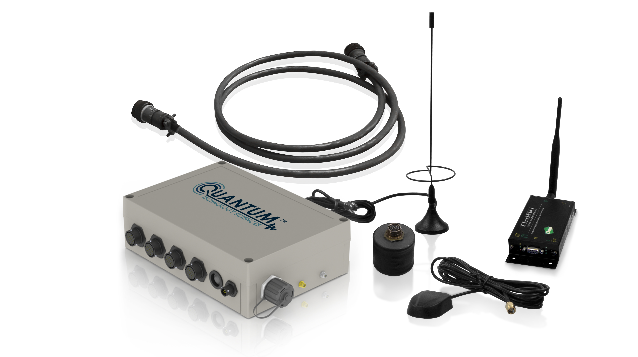
Quantasphere
Security
Operations
Center
quantum Technology Sciences | Product Overview

Slide 17
Maximize Your Investment
For every $1 invested, a return on…
Deterrence
Damage & Theft
Public Safety
Operational Efficiency
Improve Operations
Reduce Operational Costs
Employee Safety
Risk Mitigation & Resilience
Proactive Resilience
Litigation & Reputation
CIP-014
Proprietary: quantum Technology Sciences
Notes:
$49 Billion Valuation – 2% => $980,000,000 // .05% => $245,000,000

Slide 18
Who’s Using Quantum Products
Commercially
Electrical Utilities
Oil & Gas
Military & Government
AFRL
Special Operations
Industry Recognition
ASIS Security Product Awards
Proprietary: quantum Technology Sciences

