Slide 1
NPRR 219 & SCR 783
Outage Scheduler Enhancement Project
Leo Castillo – Project Manager
Operations Working Group
March 2016

Slide 2
Introduction
The purpose of the PR174-01 2015 Outage Scheduler Enhancements Project is to combine the release of the NPRR 219 requirements and the SCR 783 Enhancements into one project.
NPRR 219 was implemented in 2010 due to an issue with the initial Nodal Outage Scheduler program which did not allow QSEs to submit outages on Transmission Facilities which they operated. This NPRR was created as a temporary stop-gap with ERCOT or a designated TSP submitting a QSEs Transmission Facility Outage Requests on their behalf.
In early 2014, workshops to enhance the Outage Scheduler were held with interested Market Participants. SCR 783 (approved by the ERCOT Board of Directors in February 2015) was the result of the Workshops.

Slide 3
Market Notifications
ERCOT will begin notifications to Market Participants about the Outage Scheduler Enhancement Project beginning in January 2016 through:
Periodic Updates to OWG, OTWG and QMWG
Updated XML Schema Definitions (XSD) files posted to ERCOT.Com
Outage Scheduler Training Classes posted on ERCOT.Com>Services>Training
Market Operations Notices pertaining to:
Outage Scheduler Market Operations Testing Environment (MOTE)
Outage Scheduler Go-Live Implementation

Slide 4
March 4th Market Notice
NOTICE DATE: March 4, 2016
NOTICE TYPE: M-A030416-01 Education/Training
SHORT DESCRIPTION: Upcoming Outage Scheduler training sessions
INTENDED AUDIENCE: QSE & TSP Outage Coordination and Real-Time Management Personnel
DAYS AFFECTED: See course schedule below
LONG DESCRIPTION: The PR174-01 2015 Outage Scheduler Enhancements Project combines the release of Nodal Protocol Revision Request (NPRR) 219 (Resolution of Alignment Items A33, A92, A106, and A150 - TSPs Must Submit Outages for Resource Owned Equipment and Clarification of Changes in Status of Transmission Element Postings) and System Change Request (SCR) 783 (Outage Scheduler Enhancements -- Groups 2 and 3, Group Outage, Usability and Filtering Enhancements) into one project.

Slide 5
March 4th Market Notice
The PR174-01 2015 Outage Scheduler Enhancements project is scheduled to be implemented October 11 – 13, 2016. In preparation, ERCOT will deliver market training on the dates and locations listed below. The training sessions are particularly recommended for personnel from TSPs, QSEs and Resource Entities involved in the Outage Scheduling. Training will cover:
Review of ERCOT market rules related to outage coordination
Describe roles and responsibilities for ERCOT and Market Participants
Define each entities responsibilities for scheduling Transmission Facility or Resource Outages
Demonstrate new and enhanced Outage Scheduler requirements and capabilities
Describe the interfaces between the Outage Scheduler and other Nodal Market applications.
Discuss Outage Scheduler reports posted on the Market Information System (MIS)
ERCOT-to-QSE Transmission Facility Outages Transition Plan

Slide 6
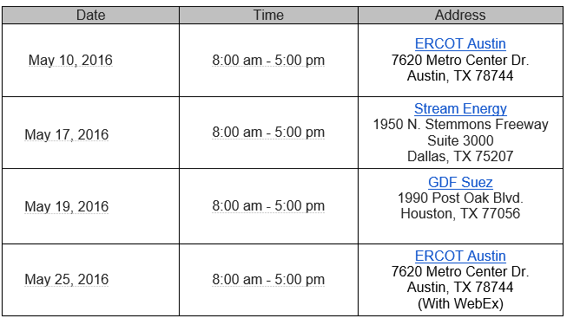
March 4th Market Notice
TSPs and QSEs are encouraged to send personnel that will either submit or maintain Outage information on the Outage Scheduler as well as those that may need to generate Outage-related reports.
Training course locations and dates are shown below:

Slide 7
Questions?

