Slide 1

Data Extract Variance (DEV) Issue Subtypes

Slide 2
Data Extract Variance (DEV) Overview
What is the purpose of DEVs? Data Extract Variances (DEVs) are used to synchronize the data among all Market Participants (MP)
What is a DEV? It's a discrepancy between the MP’s data and ERCOT’s extract data
There are two types of DEVs: LSE (Load Serving Entity) and Non-LSE (Reference: MarkeTrak SubTypes Quick Reference)
  LSE DEVs are used to correct the MP's StartTime and/or StopTime for Rep of Record (ROR) synchronization
  Non-LSE DEVs are used to synchronize ESI_ID Characteristics, Existence and/or usage data
  There are several subtypes for both LSE and Non-LSE DEVs that are used to synchronize specific data variances
One of the larger buckets of “Invalid” DEV submissions involves the +/- (2 calendar day) window for the StartTime and/or StopTime. If your discrepancy is within this 2 day window and you attempt to file a DEV issue, ERCOT will reject it. The correct action is to file a D2D Siebel MarkeTrak issue (Reference: MarkeTrak SubTypes Quick Reference)
“Valid” DEV submissions should only occur after transactions have been attempted to correct the discrepancy. Statistically there are no common DEV subtypes as DEVs are submitted on an as needed basis.

Slide 3
Data Extract Variance (DEV) Issues
There are many possible scenarios that may result in differences between ERCOT data and MP data. There are two Types of Data Extract Variances:
  Invalid submission - Differences that have been found invalid and do not require resolution. A Data Extract Variance cannot be filed for ‘Invalid submission’.
  Valid submission –Differences that are ‘Valid’ and do require analysis. A Data Extract Variance should be filed for ‘Valid submission’.
DEV issues should be filed for data discrepancies identified by comparing Extract data to the MP source system data.
  DEV issues require that transactions have been tried to correct the data discrepancy (i.e. back dated MVI, 814_20 Update for ESIID Characteristics, etc.), if applicable.
  DEV issues require the most recent SCR 727 Extract Addtime record to complete and update SCR 727 data extract.

Slide 4
Data Extract Variance (DEV) Issues
Invalid submission of Data Extract Variance Types:

Slide 5
Data Extract Variance (DEV) Issues
Valid submission of Data Extract Variance Types:

Slide 6
Data Extract Variance (DEV) Issues
Analysis Performed by Variance Type:
Variance Description | Analysis Details
LSE relationship record present in MP system but not in ERCOT system-Active and De-Engz. | Validation that there is not a Pending Service Order for the MP and time frame referenced on the MarkeTrak issue. Validation that there is not a Service Order with a sub-status of Cancelled By Customer Objection for the MP and time frame referenced on the MarkeTrak issue. Validation that the Requested New StartTime is not before the ESIID StartTime in ERCOT’s Registration System. Validation that the Service History Row to be added does not currently exist within a compressed period.
LSE relationship record present in ERCOT system but not in MP system | Validation that the Service History Row to be removed exists in ERCOT’s Registration System.
LSE relationship records present in both systems: Start Date Change | Validation that the Requested New StartTime is not before the ESIID StartTime in ERCOT’s Registration System. Validation that the StartTime and StopTime exist as submitted in ERCOT’s Registration System. Validation that the Requested New StartTime is not within a +/- two day variance of the StartTime. Validation that there is not a Pending Service Order for the MP and time frame referenced on the MarkeTrak issue. Validation that there is not a Service Order with a sub-status of Cancelled By Customer Objection for the MP and time frame referenced on the MarkeTrak issue.

Slide 7
Data Extract Variance (DEV) Issues
Analysis Performed by Variance Type:
Variance Description | Analysis Details
LSE relationship records present in both systems: Stop Date Change | Validation that the StartTime and StopTime exist as submitted in ERCOT's Registration System. Validation that the Requested New StopTime is not within a +/- two day variance of the StopTime. Validation that there is not a Pending Service Order for the MP and time frame referenced on the MarkeTrak issue. Validation that there is not a Service Order with a sub-status of Cancelled By Customer Objection for the MP and time frame referenced on the MarkeTrak issue.
LSE relationship records present in both systems: Start and Stop Date Change | Validation that the Requested New StartTime is not before the ESIID StartTime in ERCOT’s Registration System. Validation that the StartTime and StopTime exist as submitted in ERCOT's Registration System. Validation that the Requested New StartTime is not within a +/- two day variance of StartTime. Validation that the Requested New StopTime is not within a +/- two day variance of the StopTime. Validation that there is not a Pending Service Order for the MP and time frame referenced on the MarkeTrak issue. Validation that there is not a Service Order with a sub-status of Cancelled By Customer Objection for the MP and time frame referenced on the MarkeTrak issue.

Slide 8
Data Extract Variance (DEV) Issues
DEV LSE Timing
  Per the 10-16-2003 RMS directive, a 75 calendar day deadline for completion of each issue will be implemented. Each MP (including ERCOT) will complete the DEV process in accordance with the timelines and other requirements of the DEV manual. Variance must be submitted at least 75 calendar days prior to the scheduled True-Up settlement/resettlement to allow the full 75 calendar day resolution period for the various parties Variances submitted in less than 75 calendar days from the scheduled resettlement of the True-Up settlement/resettlement may not be fully resolved prior to the True-Up settlement/resettlement. The following details the expected turn-around deadlines for variances to ensure the 75 calendar day timeline is met:
    14 calendar days for initial validation and analysis by ERCOT
    21 calendar days for analysis and response by TDSP or CR
    40 calendar days for ERCOT & CR to take corrective action
    Issues requiring additional analysis or follow-up data from other MPs will be updated in MarkeTrak to indicate such a need. MPs are required to respond with the necessary information within seven (7) business days.

Slide 9
Data Extract Variance (DEV) Issues
DEV Issues – LSE Relationship record present in MP system but not in ERCOT system Active
  The DEV issue of LSE relationship present in MP system but not in ERCOT system- Active, the ESI ID relationship is in the MP’s system, but not in the data extract from ERCOT. This variance is used when a row being submitted shows MP as the current rep of record. A CR or a TDSP can submit this sub type.
  If the change request is approved and the new relationship conflicts with existing LSE relationships, the affected CR will be notified.
Submitting a DEV LSE Relationship record present in MP system not ERCOT system – Active:
  The following fields must be populated for successful submission of DEV-LSE sub type LSE in MP sys not ERCOT: active :
    ASSIGNEE
    New STARTTIME
    STARTTIME (The New STARTTIME must equal the STARTTIME or the Submitter will receive an error message and the submit process will fail. Submitter should correct the dates and select OK or select Cancel to exit.)
    ESIID
    ADDTIME

Slide 10
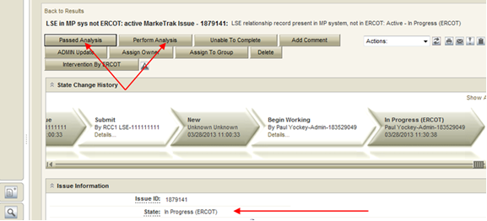
Data Extract Variance (DEV) Issues
Submitting a DEV LSE Relationship record present in MP system not ERCOT system – Active continued:
  The submitter selects OK.
  The issue enters ERCOT’s queue in the state of New and is visible only by the Submitter, Assignee and ERCOT.
  The Submitter can Withdraw only. ERCOT can acknowledge it only.
  ERCOT selects Begin Working.
  The Submitter can no longer Withdraw the issue. ERCOT selects Perform Analysis and, depending upon the analysis results, the issue will either transition Passed Analysis and move to a state of New (Pending Approval) with the next Responsible MP, or will transition Unable to Complete, at which point the issue will transition to a Failed Analysis (PC) state. ERCOT selects primary path: Passed Analysis.

Slide 11
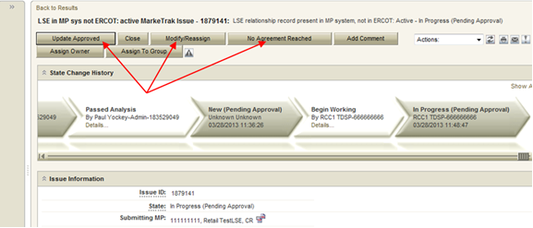
Data Extract Variance (DEV) Issues
Submitting a DEV LSE Relationship record present in MP system not ERCOT system – Active continued:
  The issue is transitioned to a state of New-Pending Approval. The visibility of the issue remains unchanged. Only the Responsible MP (TDSP) can transition and the only option is Begin Working.
  The Responsible party selects Begin Working.
  From the state of In Progress-Pending Approval the Responsible party has three options: Update Approved, No Agreement Reached or Modify/Reassign for approval transitioning to a New-Pending Approval State with the submitting CR as the only entity with transition capabilities.

Slide 12
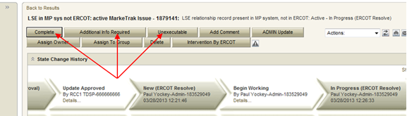
Data Extract Variance (DEV) Issues
Submitting a DEV LSE Relationship record present in MP system not ERCOT system – Active continued:
  Selection of Update Approved, the Responsible party is agreeing to the current requested resolution. The Responsible party selects OK and the issue is transitioned back to ERCOT as New (ERCOT). ERCOT selects Begin Working. ERCOT has the following options:
  Additional Info Required, if ERCOT needs additional information to make the change, this option is selected and the issue will be transitioned back to the TDSP. The TDSP selects Begin Working and provides the additional information in the comments field and selects Update Approved to transition the issue back to ERCOT or select Modify/Reassign to transition the issue to the Submitter to provide the additional information. When the CR is the submitting MP and the Modify/Reassign transition is executed, the ROR service history fields will be available to the TDSP to provide the service history.
  Complete, the change would be made in Siebel/Lodestar and any notifications would be sent to any MPs affected by the change. The issue is transitioned to a Pending Complete state . The submitter has the option to close the issue by selecting Complete or the issue will be auto closed in 14 calendar days.

Slide 13
Data Extract Variance (DEV) Issues
Submitting a DEV LSE Relationship record present in MP system not ERCOT system – Active continued:
  Selection of No Agreement Reached, the Responsible MP did not agree with the current requested resolution and the issue is transitioned back to the Submitter in an Unexecutable (Pending Complete) state. In this state the Submitter has the option to close the issue by selecting Accept or the issue will be auto closed in 14 calendar days.
  Selection of Modify/Reassign. The Assigned MP did not agree with the original requested New STARTTIME. The Responsible MP is required to give a modified New STARTTIME and select OK. The modified history log will be captured in the ‘Comments’ section in the MarkeTrak issue. The issue is transitioned back to the Submitter in a New Pending Approval state.

Slide 14
Data Extract Variance (DEV) Non LSE Issue Subtypes

Slide 15
Data Variance (DEV) Non LSE Issues
Invalid submission of Data Extract Variance Types:
Variance Description | Reason no resolution required
CR relationship records associated to the TDSP as LSE prior to 01-01-2002 | Per Market Decisions related to 2002-2003 Market Sync Project
CR relationship record date mismatches of +/- 2 calendar days on either the Start or Stop Time | Per Market Decisions related to 2002-2003 Market Sync Project
CR relationship records missing or date mismatches due to batch timing consideration | Siebel to Lodestar batch processing timing considerations
CR relationship records missing for consecutive Move In/Move Outs for same CR. For example, ERCOT has CR1 from 01/15/2002 to current. TDSP/CR has CR1 from 01/15/2002 – 05/01/2002 and 05/01/2002 – current | Prior to recent ERCOT system changes, CR relationships that did not contain any ESI ID characteristic changes were compressed to a minimum Start date and maximum End date for the ESIIDSERVICEHIST row. In addition, due to the Safety Net process, ERCOT often does not receive transactions for each MVI/MVO. As long as there are no de-energized periods or changes in CR, date issues for consecutive periods should be considered valid
Continuous Service Agreements (CSAs) are NOT reflected in the data extract | The ESI ID Service History extract only includes CR relationships as the energy provider. If there is an issue with a CSA relationship, a day to day MarkeTrak issue may be filed
Pending (In Review or Scheduled) energy relationship transactions are NOT reflected in the data extract | Only transactions completed by 867 transactions that have been updated to the Data Archive are provided in the data extract. If there is an issue with a pending service order, a day to day MarkeTrak issue may be filed
ERCOT system IDR data that matches for each interval but Start and Stop Time do not match | There are instances where ERCOT has manually cut IDR data at midnight to support TDSP submission of 814_20 maintain transactions

Slide 16
Data Variance (DEV) Non LSE Issues
Valid submission of Data Extract Variance Types:
Variance Description | Details
ESI ID present in TDSP system but not in ERCOT system | ESI ID does not exist in ERCOT systems
ESI ID present in ERCOT system but not in MP system | ESI ID needs to be retired
ESI ID present in ERCOT system but has start date issues | ESI ID Start Date needs to be adjusted to an earlier date
Inactive record has date issues | ESI ID is Inactive but has incorrect date
Status Assignment | Status needs to be Inactive
Un-Retire ESI ID | ESI ID retired in error, reinstate to De-energized
Region Code Assignment | Incorrect Region Code
Loss Code Assignment | Incorrect Loss Code
Profile Code Assignment | Incorrect Profile Code
Station Code Assignment | Incorrect Station Code
Zip Assignment | Incorrect Zip

Slide 17
Data Variance (DEV) Non LSE Issues
Valid submission of Data Extract Variance Types cont.:
Variance Description | Details
IDR Usage present in MP system but not in ERCOT system | IDR Data needs to be loaded at ERCOT
IDR Usage present in ERCOT system but not in MP system | Data needs to be cancelled from ERCOT system or TDSP to submit IDR Data to CR
IDR Usage present in both systems but has date issues | Delete and reload LSE file or TDSP to verify IDR Data values
IDR Usage present in both systems but has kWh issues | Load corrected LSE file or TDSP to verify IDR Data values
Non-IDR Usage present in MP system but not in ERCOT system | NIDR Data needs to be loaded at ERCOT
Non-IDR Usage present in ERCOT system but not in MP system | Data needs to be cancelled from ERCOT system or TDSP to submit NIDR Data to CR
Non-IDR Usage present in both systems but has date issues | Dates of NIDR reads are incorrect. Update to new STOPTIME
Non-IDR Usage present in both systems but has kWh or kW total issues | Need to update loaded data or TDSP to verify NIDR Data values

Slide 18
Data Extract Variance (DEV) Non LSE Issues
DEV Non LSE Timing
  Per the 10-16-2003 RMS directive, a 75 calendar day deadline for completion of each issue will be implemented. Each MP (including ERCOT) will complete the DEV process in accordance with the timelines and other requirements of the DEV manual. Variance must be submitted at least 75 calendar days prior to the scheduled True-Up settlement/resettlement to allow the full 75 calendar day resolution period for the various parties Variances submitted in less than 75 calendar days from the scheduled resettlement of the True-Up settlement/resettlement may not be fully resolved prior to the True-Up settlement/resettlement. The following details the expected turn-around deadlines for variances to ensure the 75 calendar day timeline is met:
  NIDR and IDR Usage DEV Issues:
    45 calendar days for TDSP validation and analysis to be completed
    30 calendar days for TDSP to send transactions (if necessary) or for CR to manually update their system (if needed)
  ESI ID Characteristics DEV Issues:
    45 calendar days for TDSP validation and analysis to be completed
    30 calendar days for TDSP to send transactions (if necessary) or for CR to manually update their system (if needed)
  ESI ID Existence DEV Issues:
    10 calendar days for initial validation and analysis by ERCOT
    65 calendar days for TDSP to send transactions (if necessary)
  Issues requiring additional analysis or follow-up data from other MPs will be updated in MarkeTrak to indicate such a need. MPs are required to respond with the necessary information within seven (7) business days.

Slide 19
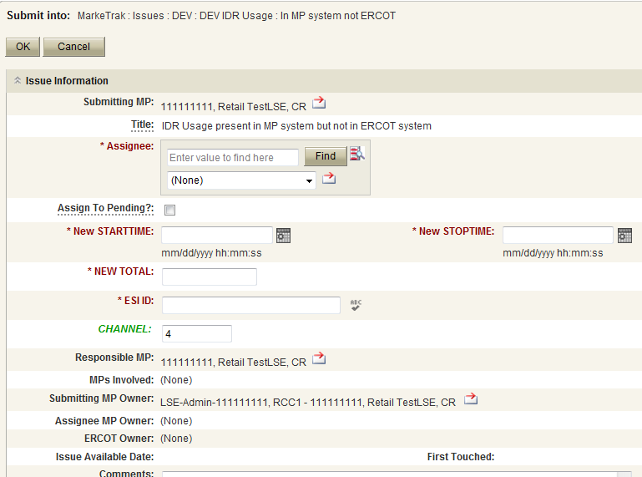
Data Extract Variance (DEV) Non LSE Issues
Submitting a DEV Non LSE Issue – Example of IDR: In MP System not ERCOT
  CR to TDSP
  The DEV issue of In MP system not ERCOT should be submitted when the ESI ID IDR meter data is in the MP’s system, but not in the data extract from ERCOT.
  The following fields must be populated for successful submission:
    Assignee
    New STARTTIME
    New STOPTIME
    NEW TOTAL
    ESIID
    ADDTIME
    CHANNEL is defaulted to 4
  Select OK

Slide 20
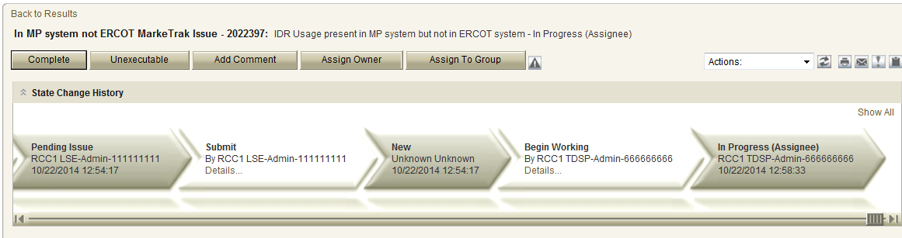
Data Extract Variance (DEV) Non LSE Issues
Submitting a DEV Non LSE Issue – Example of IDR: In MP System not ERCOT
  The issue enters TDSP’s queue in the state of New
  The CR only may Withdraw the issue prior to acknowledgement by TDSP
  TDSP selects Begin Working and the CR can no longer Withdraw the issue
  TDSP has the options of Complete and Unexecutable .
  If in agreement TDSP will take appropriate action then select Complete which transitions the issue to Pending Complete with the CR.

Slide 21
Data Extract Variance (DEV) Non LSE Issues
Submitting a DEV Non LSE Issue – Example of IDR: In MP System not ERCOT
  The CR selects Complete and the issue is closed
  If not in agreement the TDSP may:
    Select Unexecutable which will require a comment and return the issue back to the CR’s queue as Unexecutable (Pending Complete).
  CR will select Accept and issue will be closed.
  Once in the Pending Complete state, if the issue is not transitioned for 14 calendar days the issue will automatically go to Auto Complete. The issue will then be closed.

Slide 22
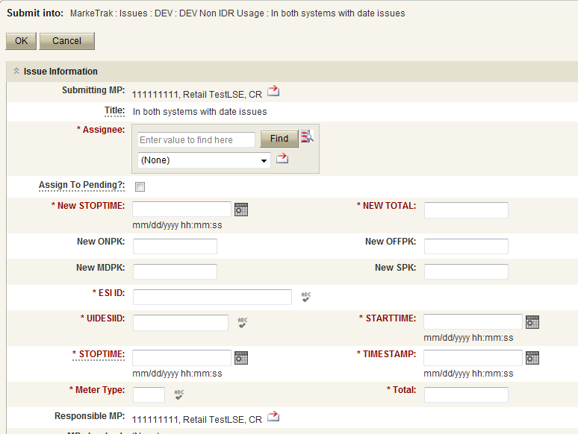
Data Extract Variance (DEV) Non LSE Issues
Submitting a DEV Non LSE Issue – Example of Non-IDR: In Both Systems with Date Issues
  TDSP to ERCOT or CR to TDSP
  The DEV Issue of In both system with date issues should be submitted when the ESI ID Non-IDR meter data is in the data extract from ERCOT and in the MP’s system, but has a STOPTIME issue.
  The following fields must be populated for successful submission:
    Assignee
    New STOPTIME
    New Total
    ESIID
    UIDESIID
    STARTTIME (STARTTIME - SCR727 Extract)
    STOPTIME (STOPTIME - SCR727 Extract)
    TIMESTAMP (TIMESTAMP - SCR727 Extract)
    METERTYPE
    TOTAL (TOTAL - SCR727 Extract)
  Select OK

Slide 23
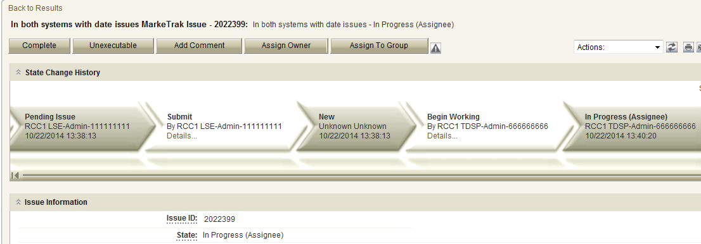
Data Extract Variance (DEV) Non LSE Issues
Submitting a DEV Non LSE Issue – Example of Non-IDR: In Both Systems with Date Issues
  The issue enters TDSP’s queue in the state of New.
  TDSP has the options of Complete and Unexecutable
  If in agreement TDSP will take appropriate action then select Complete which transitions the issue to Pending Complete with the CR. The CR selects Complete and the issue is closed
  If not in agreement TDSP may:
    Select Unexecutable which will require a comment and return the issue back to CR’s queue as Unexecutable-Pending Complete.
  CR will select Accept and issue will be closed
  Once in the Pending Complete state, if the issue is not transitioned for 14 calendar days the issue will automatically go to Auto Complete. The issue will then be closed.
  If in agreement TDSP will take appropriate action then select Complete which transitions the issue to Pending Complete with the CR.

Slide 24
Data Extract Variance (DEV) Quiz
In order to synchronize a Move-In StartTime from May 1, 2016 to May 3, 2016, a MarkeTrak DEV LSE should be submitted:
  True
  False
  Answer: False - Invalid submission via the +/- (2 calendar day) window

Slide 25
Data Extract Variance (DEV) Quiz
DEV Non-LSE MarkeTrak issues are submitted to synchronize the following:
  ESI_ID Characteristics
  Usage Data
  ESI_ID Existence
  A and C Only
  All of the Above
  Answer: E – All of the Above

