Slide 1
RUC Congestion Rent Discussion
QSE Managers Working Group
Jeff Gilbertson
ERCOT Market Analysis
3/23/2016

Slide 2
RUC Congestion Rent Discussion
During TAC discussion on RUC effects on prices, TAC requested that ERCOT quantify the impact of RUC deployments on congestion rent
NPRR626 added Reliability Deployment Price Adder to mitigate price suppression associated with RUC and other out of market deployments
Reliability Deployment Price Adder is system-wide, and therefore does not account for price effects of congestion

Slide 3
RUC Congestion Rent Methodology
Proposed methodology
  Re-run SCED for all intervals in 2015 for which one or more resources were RUCed and did not opt out
  In SCED re-run, set all RUCed resources to OFF
  Compare new congestion rent (constraint flow * shadow price) of all constraints against actual congestion rent

Slide 4
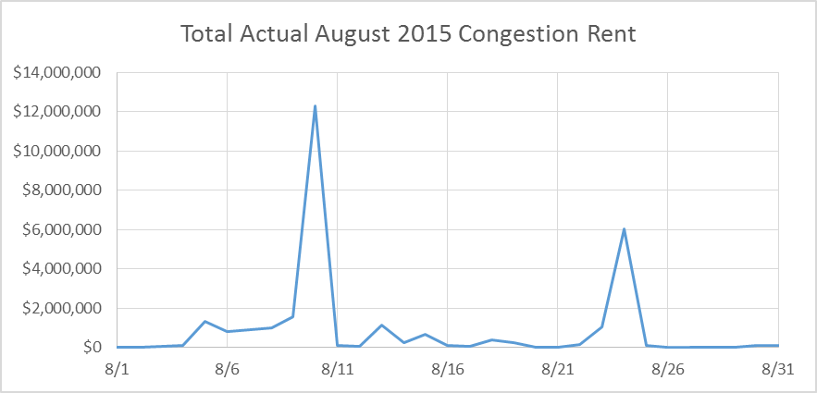
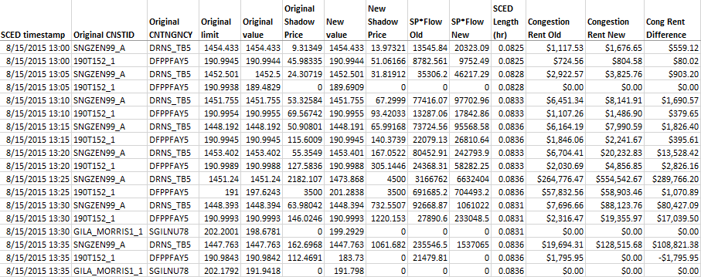
RUC Congestion Rent Example

