Slide 1
PLWG Review 6.9 and the Interconnection process

Slide 2
ROS Directive:
“Direct PLWG to review 6.9 and the Interconnection process and recommend PG changes or other appropriate action”
Source: Brittney Albracht notes from March 3, 2016 ROS Meeting

Slide 3
Planning Guide Section 6.9 Review

Slide 4
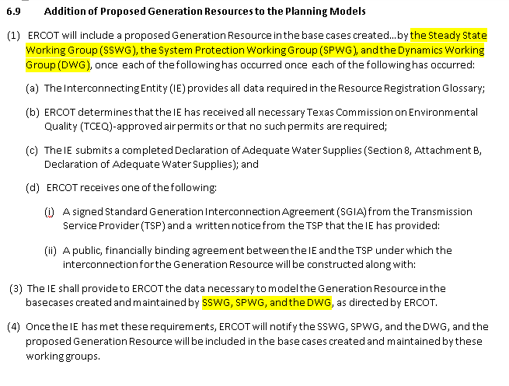
Current Requirements of Section 6.9(1)

Slide 5
Exploring Possible Solutions to address these concerns
Modify the RARF data requirement in PG Section 6.9 and use “preliminary” RARF data for modeling purposes for modeling in the SSWG cases
Review data requirements needed for modeling in the DWG and SPWG cases
Modify the outreach effort in order to help educate IE’s in importance of timely RARF submittals and clarify the data requirement is for ‘As Planned’ at this stage.

Slide 6
New Language Proposal for PG 6.9 (1)
6.9 Addition of Proposed Generation Resources to the Planning Models
(1) ERCOT will include a proposed Generation Resource in the base cases created and maintained by the Steady State Working Group (SSWG), the System Protection Working Group (SPWG), and the Dynamics Working Group (DWG), once each of the following has occurred:
The Interconnecting Entity (IE) provides all data required in the Resource Registration Glossary Screening Study (FIS if available);
(b) – (d) Unchanged
Add New Bullet (2)
(2) Upon meeting the requirements of 6.9 (1), the IE shall provide the required data with 60 days for modeling the proposed Generation Resource in the bases cases created and maintained by the System Protection Working Group (SPWG) and the Dynamics Working Group (DWG), as requested by ERCOT as well as the remaining data for SSWG.
Renumber current (2) to new (3)
Notwithstanding paragraph (1) of this Section, ERCOT will not require an IE proposing to interconnect a Generation Resource powered by wind or photovoltaic solar energy to provide notification of receiving an air permit or a Declaration of Adequate Water Supplies as a condition for including the Generation Resource in the base cases described in paragraph (1). However, ERCOT will not include such a Generation Resource in the base cases unless the IE has provided all data required by Paragraph (1)(a) and an agreement or letter as described in Paragraph (1)(d).
Delete redundant language in current (3)
(3) The IE shall provide to ERCOT the data necessary to model the Generation Resource in the base cases created and maintained by SSWG, SPWG, and the DWG, as directed by ERCOT.
(4) Once the IE has met these requirements, ERCOT will notify the SSWG, SPWG, and the DWG, and the proposed Generation Resource will be included in the base cases created and maintained by these working groups.
Consider adding PG 6.9 must be met before resource registration RARF will be accepted.

Slide 7
Additional Steps
Have DWG and SPWG determined the necessary modeling data in order to incorporate the proposed Generation Resource in the DWG and SPWG cases
Modify the outreach effort to notify the IE of meeting PG 6.9(1) and send a data request basis of the step above. Ensure the data request clearly communicates that the required data is ‘as planned’ data.

Slide 8

Questions

