Slide 1
Planning Guide Section 6.9 Issues
Impact of not including proposed generators lacking RARF data
in the planning models
March 23, 2016

Slide 2
Planning Guide Section 6.9
6.9 Addition of Proposed Generation Resources to the Planning Models
(1) ERCOT will include a proposed Generation Resource in the base cases created … once each of the following has occurred:
The Interconnecting Entity (IE) provides all data required in the Resource Registration Glossary;
ERCOT determines that the IE has received all necessary Texas Commission on Environmental Quality (TCEQ)-approved air permits or that no such permits are required;
(c) The IE submits a completed Declaration of Adequate Water Supplies (Section 8, Attachment B, Declaration of Adequate Water Supplies); and
(d) ERCOT receives one of the following:
(i) A signed Standard Generation Interconnection Agreement (SGIA) from the Transmission Service Provider (TSP) and a written notice from the TSP that the IE has provided:
(ii) A public, financially binding agreement between the IE and the TSP under which the interconnection for the Generation Resource will be constructed along with:
(3) The IE shall provide to ERCOT the data necessary to model the Generation Resource in the basecases created and maintained by SSWG, SPWG, and the DWG, as directed by ERCOT.
(4) Once the IE has met these requirements, ERCOT will notify the SSWG, SPWG, and the DWG, and the proposed Generation Resource will be included in the base cases created and maintained by these working groups.

Slide 3
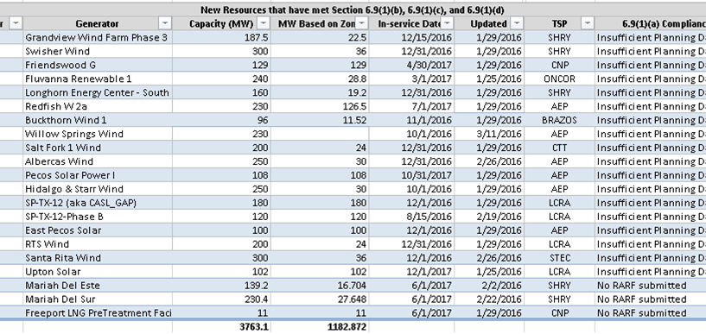
Existing Generators that meet PG Section 6.9 requirements except for RARF data requirement
* COASTAL wind units are assumed to have 55% average capacity percentage and NON-COASTAL wind units assumed to have 12% average capacity percentage during summer (as represented in December 2015 CDR)
* Solar units are assumed to have 100% capacity

Slide 4
Problem Statement for PLWG
Various Interconnecting Entities have met all requirements of Planning Guide Section 6.9 including an signing interconnection agreement, receiving necessary environmental air and water permits, providing a written notice to proceed and financial security, but are not being included in the Planning Models due to insufficient RARF data. The amount of generation capacity meeting PG Section 6.9 with the exception of providing complete RARF data is significant and can impact the generation dispatch assumptions in the planning cases due to extraordinary dispatch conditions.
PLWG should evaluate the different options to address this issue while maintain the fidelity of the new generation data in order to improve the accuracy of the generation models in the planning cases.

Slide 5
ROS Directive to PLWG
Review Planning Guide Section 6.9
Evaluate Generator data available at each stage of the interconnection process
Determine action to appropriately represent generators that have met requirement of PG Section 6.9 in the planning models developed by SSWG.

Slide 6
Potential solutions to address these concerns
Possible Solutions
Maintain status quo
Remove RARF data requirement from PG Section 6.9 and use “preliminary” RARF data for modeling purposes that was used during FIS process.
Add generators that have met all requirements of PG Section 6.9 except for RARF data as a high priority in Extraordinary Dispatch.
Require Generators to submit RARF sooner than the existing 90 day prior to COD requirement. (e.g. 12 months prior to COD)
Outreach effort in order to help educate IE’s in importance of timely RARF submittals (Not necessarily wait for As-built data before submitting RARF)

