Slide 1
ERCOT – LP&L Study Status Update
For Regional Planning Group
Ben Richardson
March 22, 2016

Slide 2
Outline
Introduction
Steps to Create Short-list of Options
Preliminary Results
Initial Transfer Capability Estimates
Next Steps

Slide 3
Introduction
Objective:
  Identify transmission facilities that will be required to integrate the LP&L load and transmission network into the ERCOT Grid and satisfy ERCOT and NERC Transmission Planning reliability standards in the most efficient way possible.
Scope and Assumptions:
  http://www.ercot.com/calendar/2015/12/15/31834-RPG
Next few slides describe 8 steps that we took to create short-list of options to focus on objective:
  Investigate potential for options not covered by LP&L and Sharyland reports
  Optimize list of proposed options
  Short-list options that offer potential to both integrate Lubbock as well as improve ERCOT reliability and economics

Slide 4
Create Short-list of Options – Steps 1 and 2
Step 1
Reviewed LP&L and Sharyland Studies for Possible Interconnection Points
  At this time ERCOT has not considered ERCOT interconnection points less than 345 kV based on voltage control and system strength conditions in Panhandle
  North, East and South of Lubbock tie points well covered in the studies
  From West ERCOT and Andrews to West Lubbock 345 kV tie was considered but not analyzed due to length (~100 miles), voltage control and system conditions in Far West Zone
  ERCOT did not identify any additional interconnection options beyond variations of options presented by LP&L and Sharyland
Step 2
Eliminate Options isolating Lubbock during ROW/Maintenance Outage plus N-1
  LPL Options 3B, 10
  SHY Options 1-1, 1-3, 2-1, 2-2, 2-3, 2-4

Slide 5

Create Short-list of Options – Step 2 Illustration

Slide 6
Create Short-list of Options – Step 3
Step 3
Initially parked options that had comparable alternatives with fewer upgrades
  LP&L Option 1 before 2,5,6,7,8A,8B,9 and 17
  LP&L Option 4 before 3A
  LP&L Option 11 before 14,15,16 and 18
  LP&L Option 12 before 13
  LP&L Option 19 before 20
  SHY Option 1-2 instead of 1-4
  Simulate alternatives if first options contained violations

Slide 7
Create Short-list of Options – Step 3 Illustration

Slide 8
Create Short-list of Options – Steps 4 and 5
Step 4
Update Sharyland Options based on latest information in LP&L Report. (Sharyland Option 1-2)
  North rather than Airport Park
  McDonald rather than Quincy
  South connection to Oliver rather than Southeast
Step 5
  Modify Sharyland Option 1-2 to Consider Interconnection Point Closer to Lubbock
  Created SHY Option 1-2a reflect Oliver to Vealmoor proposal
  Created SHY Option 1-2b to stop at Long Draw rather than go all the way to Vealmoor.

Slide 9
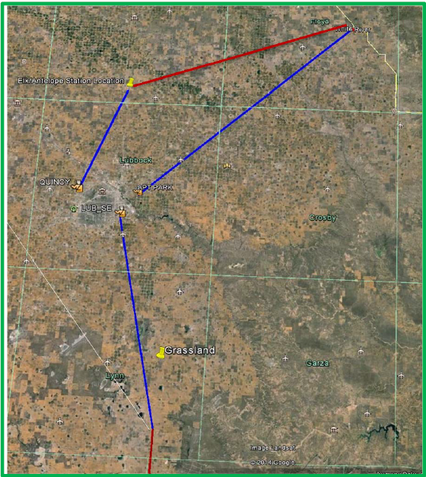
Create Short-list of Options – Steps 4 and 5 Illustration
White River
Abernathy
McDonald instead of Quincy
North instead of Airport Park
Oliver instead of Southeast
To Vealmoor (1-2a)
To Long Draw (1-2b)

Slide 10
Create Short-list of Options – Step 6
Step 6
Minimize Number of 345/115 kV Transformers in Each of the Options from 2 to 1 for following substations:
  LP&L Option 1b reduce Transformers at Oliver and Wads
  LP&L Option 4b reduce Transformers at Oliver and North
  LP&L Option 12b reduce Transformers at Oliver and Wads
  LP&L Option 12c reduce Transformers at Oliver
  SHY Option 1-2b1 reduce Transformers at Oliver and North
  SHY Option 1-2b2 reduce Transformers at Oliver
  May be optimized later

Slide 11
Create Short-list of Options – Step 6 Illustration
LP&L Option 12
LP&L Option 12b

Slide 12
Create Short-list of Options – Step 7
Step 7
Add Options based on potential to increase Panhandle Export
  LP&L Option 8A (Ogallala to Long Draw 345 kV Path)
  LP&L Option 8B (White River to Long Draw 345 kV Path)
  LP&L Option 4ow/~3A (Ogallala to Long Draw 345 kV Path)
  Create minimize number of 345/115 kV Transformers from these options from 2 to 1 for the following substations:
    LP&L Option 8A1 reduce Transformers at Oliver and Wads
    P&L Option 8A2 reduce Transformers at Oliver and North
    LP&L Option 8B1 reduce Transformers at Oliver and Wads
    LP&L Option 8B2 reduce Transformers at Oliver and North

Slide 13
Create Short-list of Options – Step 7 Illustration
LP&L Option 8A
LP&L Option 8A2

Slide 14
Create Short-list of Options – Step 8
Step 8
Test Maintenance Outages
  LP&L Option 12M White River to Abernathy Out plus N-1
  LP&L Option 19M White River to Abernathy Out plus N-1

Slide 15
Results – Options Initially Parked
Option | Simulated | Rational for Not Simulating
LPL 2 | No | Review results from Opt 1 first
LPL 3A | No | Review results from Opt 4 first
LPL 3B | No | Dbl Ckt Maintenance + P1 -> Isolate Lubbock (467MW+)
LPL 5 | No | Review results from Opt 1 first
LPL 6 | No | Review results from Opt 2 first
LPL 7 | No | Review results from Opt 2 first
LPL 9 | No | Review results from Opt 1 first
LPL 10 | No | Dbl Ckt Maintenance + P1 -> Isolate Lubbock (467MW+)
LPL 13 | No | Review results from Opt 12 first
LPL 14 | No | Review results from Opt 11 first
LPL 15 | No | Review results from Opt 14 first
LPL 16 | No | Review results from Opt 15 first
LPL 17 | No | Review results from Opt 5 first

Slide 16
Results – Options Initially Parked (Cont.)
Option | Simulated | Rational for Not Simulating
LPL 18 | No | Review results from Opt 17 first
LPL 20 | No | Review results from Opt 19 first
SHY 1-1 | No | Dbl Ckt Maintenance + P1 -> Isolate Lubbock (467MW+)
SHY 1-4 | No | Review 1-2 with 115 kV not 230kV or 345 kV loop
SHY 2-1 | No | Dbl Ckt Maintenance + P1 -> Isolate Lubbock (467MW+)
SHY 2-2 | No | Dbl Ckt Maintenance + P1 -> Isolate Lubbock (467MW+)
SHY 2-3 | No | Dbl Ckt Maintenance + P1 -> Isolate Lubbock (467MW+)
SHY 2-4 | No | Dbl Ckt Maintenance + P1 -> Isolate Lubbock (467MW+)

Slide 17
Results – Options Simulated
Option | Rational for Simulating | N-1 | G-1+N-1 | X-1+N-1
LPL 1 | LP&L Option 1 first before 2,5,6,7,8A,8B,9,17 | OK | OK | OK
LPL 1b | Reduce number of Transformers at Oliver and Wads from 2 to 1 | OK | OK | UR
LPL 4 | LP&L Option 4 first before 3A | OK | OK | OK
LPL 4b | Reduce number of Transformers at Oliver and North from 2 to 1 | OK | OK | UR
LPL 4ow | Improve PH Export Capbability 4 plus 345 kV Oliver to Wads | OK | OK | OK
LPL 8A | Improve PH Export Capbability (Ogallala to Long Draw 345 kV Path) | OK | OK | OK
LPL 8A1 | Reduce number of Transformers at Oliver and Wads from 2 to 1 | OK | OK | UR
LPL 8A2 | Reduce number of Transformers at Oliver and North from 2 to 1 | OK | OK | UR
LPL 8B | Improve PH Export Capbability (White River to Long Draw 345 kV Path) | OK | OK | OK
LPL 8B1 | Reduce number of Transformers at Oliver and Wads from 2 to 1 | OK | OK | UR
LPL 8B2 | Reduce number of Transformers at Oliver and North from 2 to 1 | OK | OK | UR
LPL 11 | LP&L Option 11 first before 14,15,16,18 | OK | OK | OK
UR – Upgrades Required

Slide 18
Results – Options Simulated (Cont.)
Option | Rational for Simulating | N-1 | G-1+N-1 | X-1+N-1
LPL 12 | LP&L Option 12 first before 13 | OK | OK | OK
LPL 12b | Reduce number of Transformers at Oliver and Wads from 2 to 1 | OK | OK | UR
LPL 12c | Reduce number of Transformers at Oliver from 2 to 1 | OK | OK | OK
LPL 19 | LP&L Option 19 first before 20 | OK | OK | UR
LPL 20 | Violations in LP&L Option 19 | OK | OK | OK
SHY 1-2a | Review 1-2 with 115 kV not 230kV or 345 kV loop | OK | OK | OK
SHY 1-2b | Long Draw Closer to Lubbock than Vealmoor | OK | OK | OK
SHY 1-2b1 | Reduce number of Transformers at Oliver and North from 2 to 1 | OK | OK | UR
SHY 1-2b2 | Reduce number of Transformers at Oliver from 2 to 1 | OK | OK | UR
UR – Upgrades Required

Slide 19
Initial Transfer Capability Estimates - Methodology
Thermal Steady-State
WSCR
Scaled
  Lubbock Load Up
  All External Generation Up
Linear then Non-linear Solution on 1st & 2nd Limiting Elements
N-1 Contingencies in Study Region
Monitored all facilities in Study Region, excluding:
  Branches flowing less than 3% of transfer
  Bus-tie contingent and/or monitored elements
Includes all CREZ project series capacitors in-service (except Rocky Mound)
Lubbock and Elk generators off-line
Conventional units in follow plants off-line: Permian Basin, Odessa-Ector, Oklaunion, Morgan Creek, Kinder Morgan, Falcon Seaboard, Quail Run, Wichita Falls Cogen
Panhandle WGRs offline
Buses used for calculation: AJ Swope, Alibates, Cotton Wood, Gray, Ogallala, Railhead, Tule Canyon, White River, Windmill
5,062 Panhandle Wind Capacity used for calculation

Slide 20
Notes for Transfer Capability Estimates
Transfer Capabilities Should be assumed to be non-simultaneous
Panhandle Export Limits are based on the assumption that WSCR=1.5 is the most limiting condition. Further voltage and transient stability analysis is required and may reduce these export limits. The export limits presented on the next slide do not include an operating margin.
For purposes of this initial Panhandle Export Limit analysis Lubbock was assumed outside of the Panhandle export interface definition. The actual interface definition will need to be considered later with input from system operators and more analysis.
All thermal Lubbock Load Deliverability limits were
  Based on Summer Peak Conditions only
  Determined to be restricted by internal Lubbock limiting elements although monitored elements included interconnecting facilities

Slide 21
Initial Transfer Capability Estimates - Values
Case | Lubbock Load Serving Capability Based on Thermal Limits (MW) | Panhandle Export Limit Based On WSCR=1.5 (MW)
Base | 0 | 3,766
LP&L Option 1 | 715 | 3,902
LP&L Option 4 | 726 | 4,074
LP&L Option 4ow | 822 | 4,236
LP&L Option 8A | 815 | 4,256
LP&L Option 8B | 819 | 4,029
LP&L Option 11 | 858 | 4,044
LP&L Option 12 | 820 | 3,928
LP&L Option 12c | 813 | 3,907
LP&L Option 20 | 802 | 4,084
SHY Option 1-2a | 754 | 3,912
SHY Option 1-2b | 789 | 3,928

Slide 22
Next Steps
Complete Steady-State Assessments
Complete Economic Assessments
  Complete Capital and Production Cost Estimates for each option
Complete Dynamic Assessments
Develop Preferred Option(s)
Publish Study Report

Slide 23
?

Slide 24
Appendix
WSCR DEFINITIONS AND RATINGS

Slide 25
Lubbock Load Integration Study
Interface & Transfer Limit

Slide 26
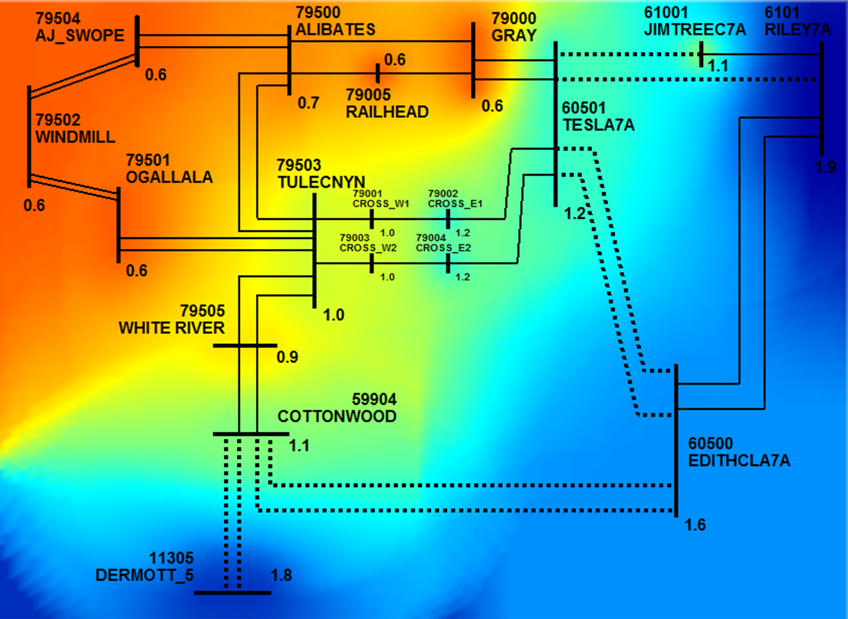
Base Case

Slide 27
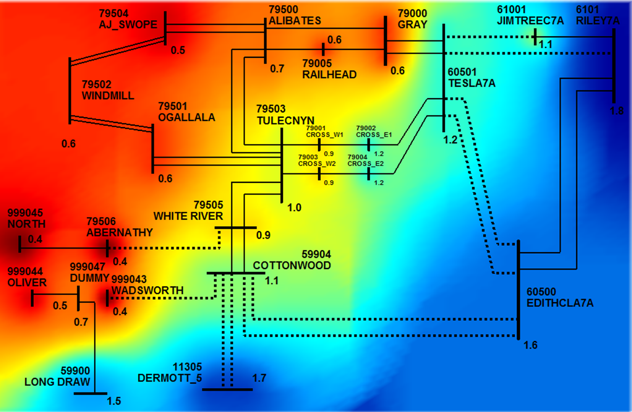
LPL Option 1

Slide 28
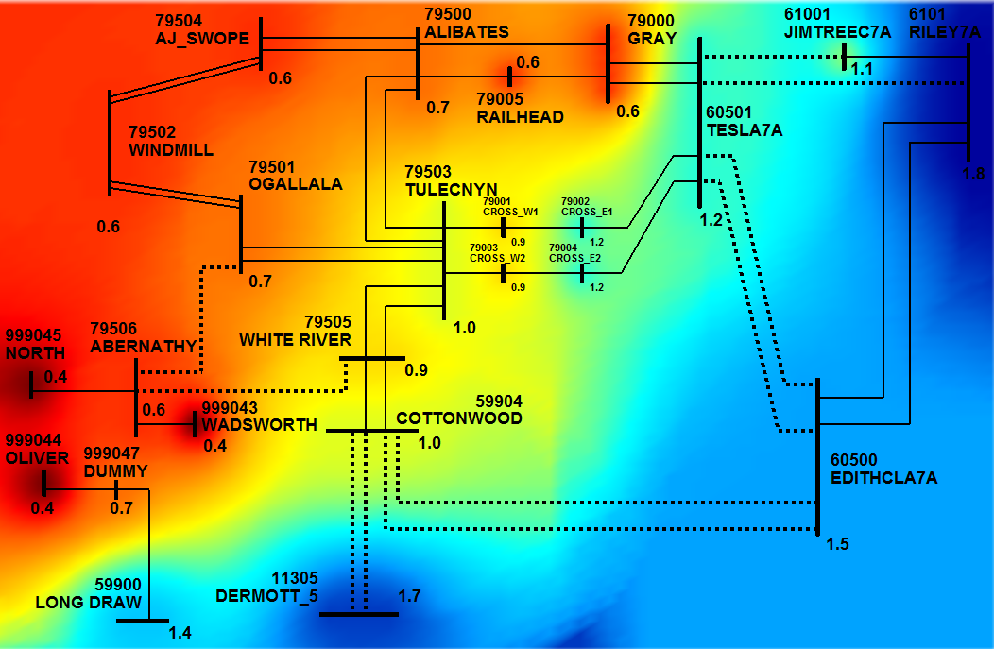
LPL Option 4

Slide 29
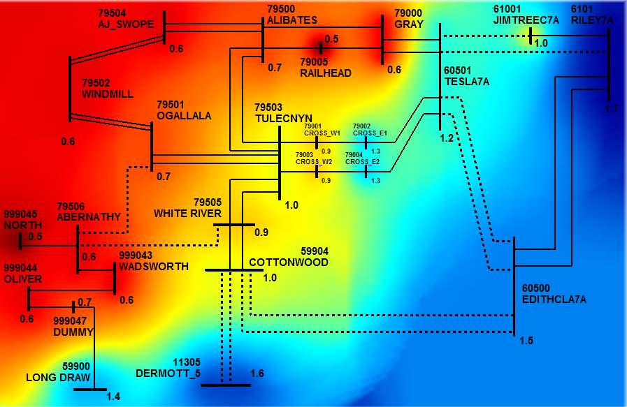
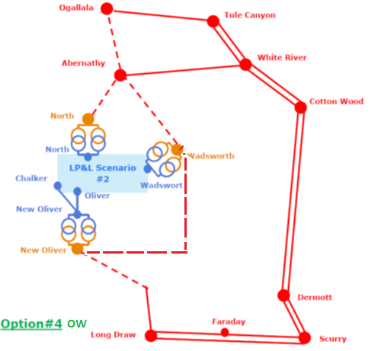
LPL Option 4ow
Add 345 kV Oliver to Wadsworth

Slide 30
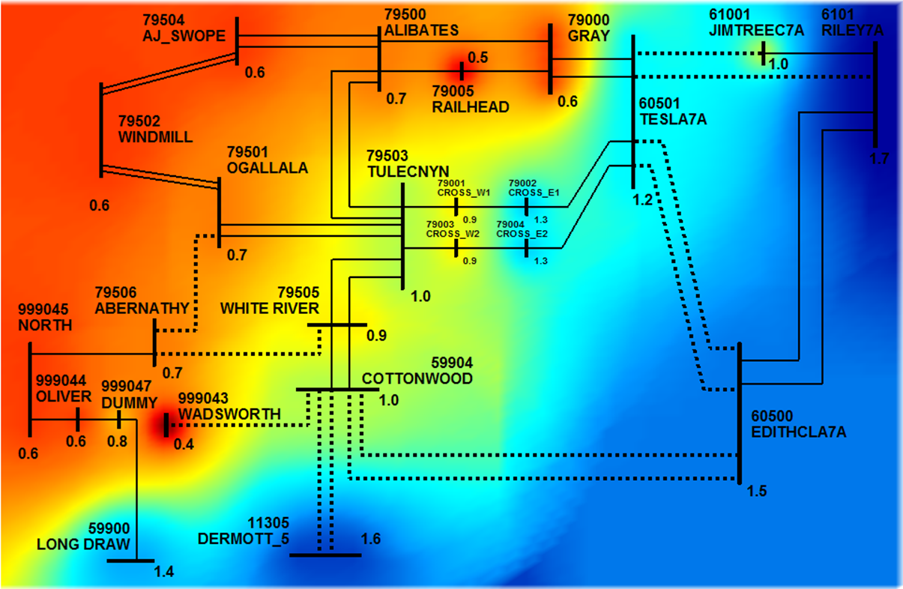
LPL Option 8A

Slide 31
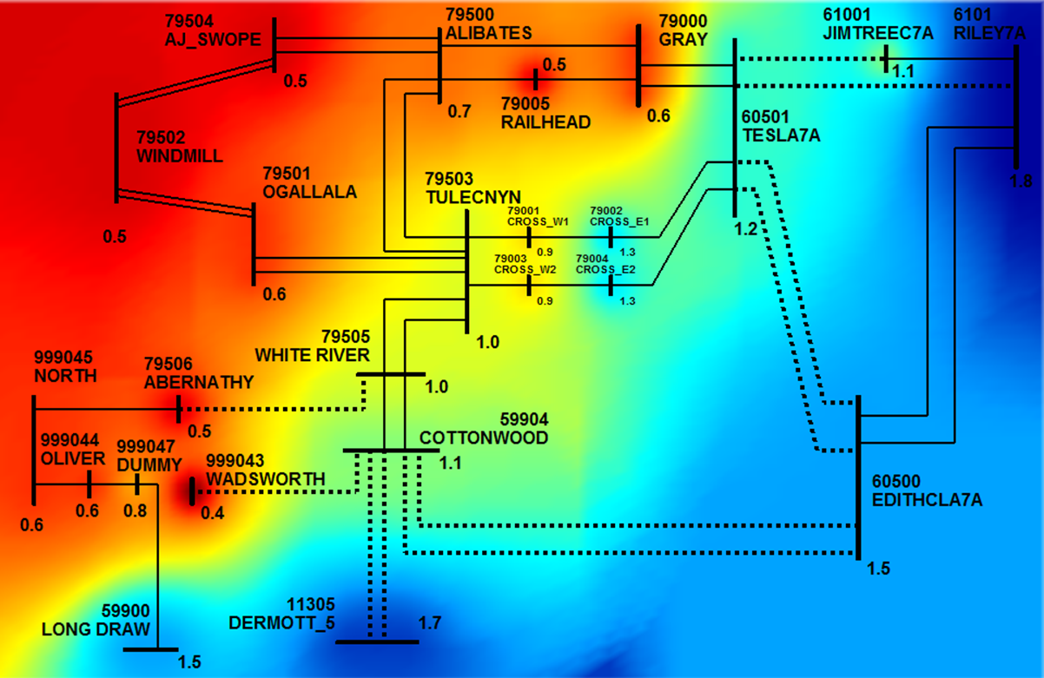
LPL Option 8B

Slide 32
LPL Option 11

Slide 33
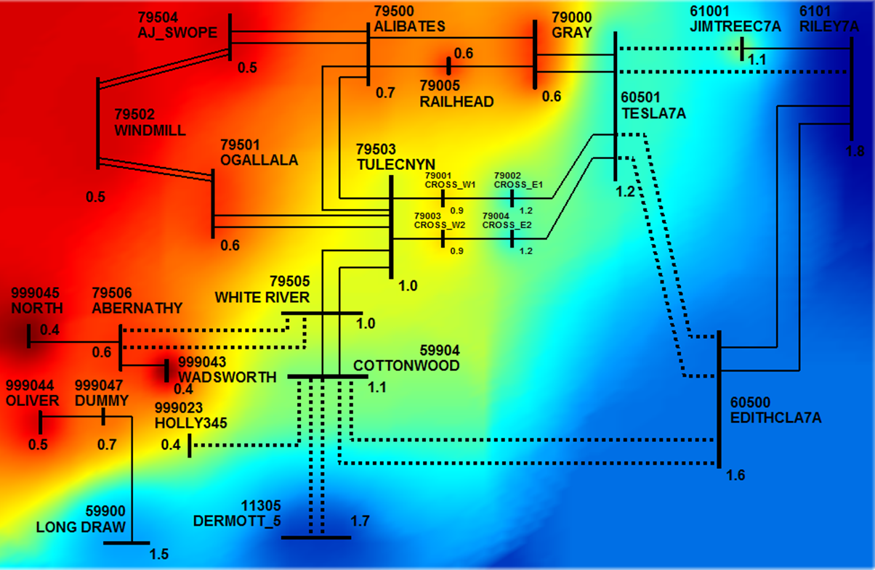
LPL Option 12

Slide 34
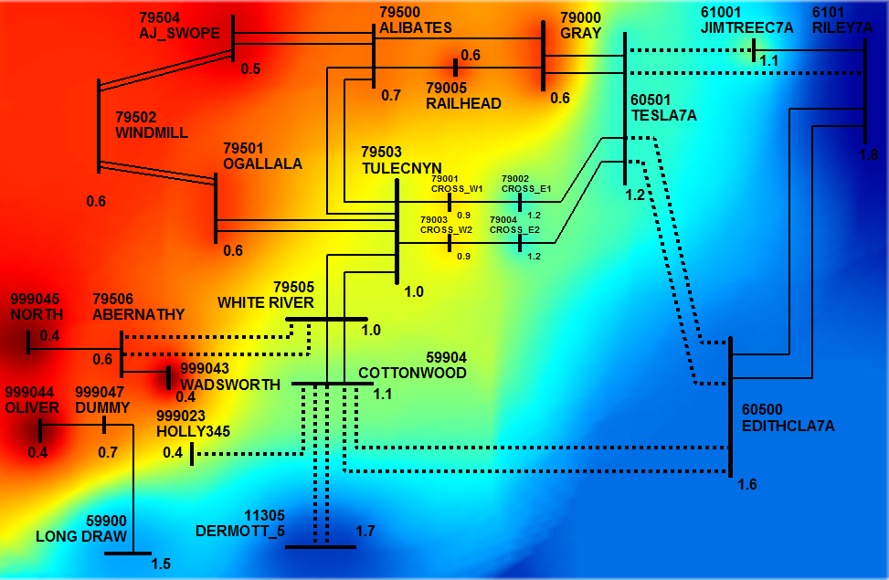
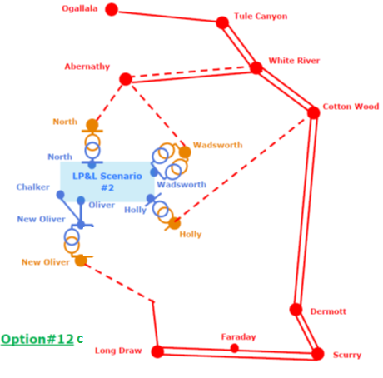
LPL Option 12c

Slide 35
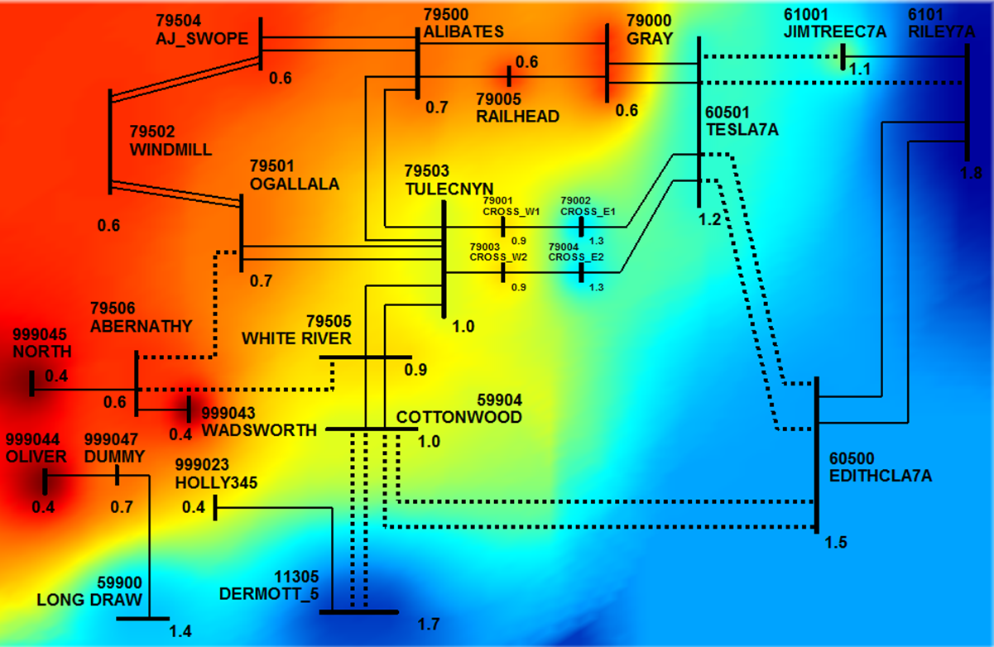
LPL Option 20

Slide 36
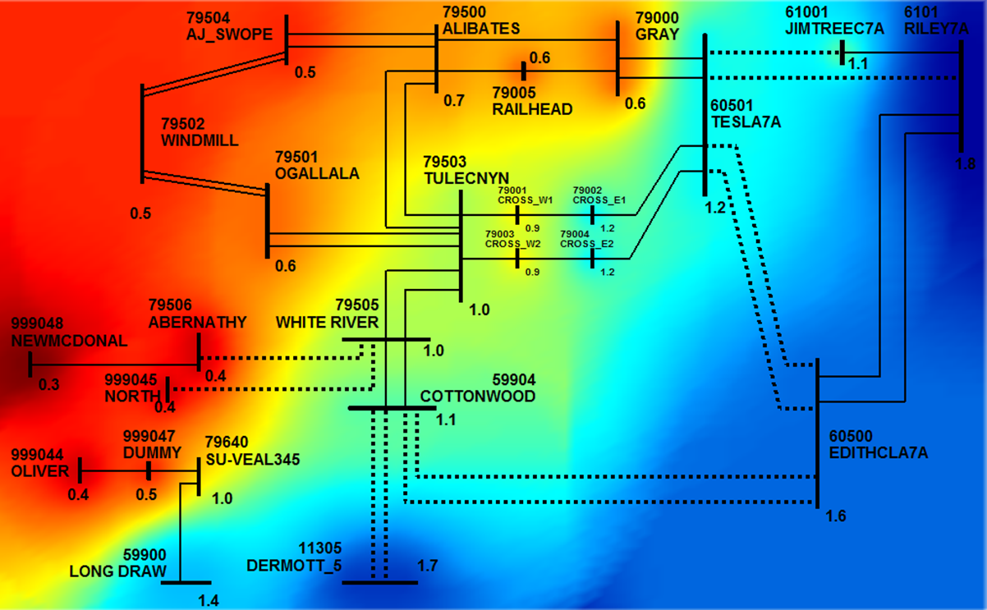
SHY Option 1-2a
White River
Abernathy
McDonald instead of Quincy
North instead of Airport Park
Oliver instead of Southeast
To Vealmoor
Notes:
According to Ben:
1. Connected to North rather than Airport Park
2. Connected to McDonald rather than Quincy
3. 1-2a is from Vealmoor just as Sharyland proposed but 1-2b is from Long Draw instead of Vealmoor since Long Draw is closer.

Slide 37
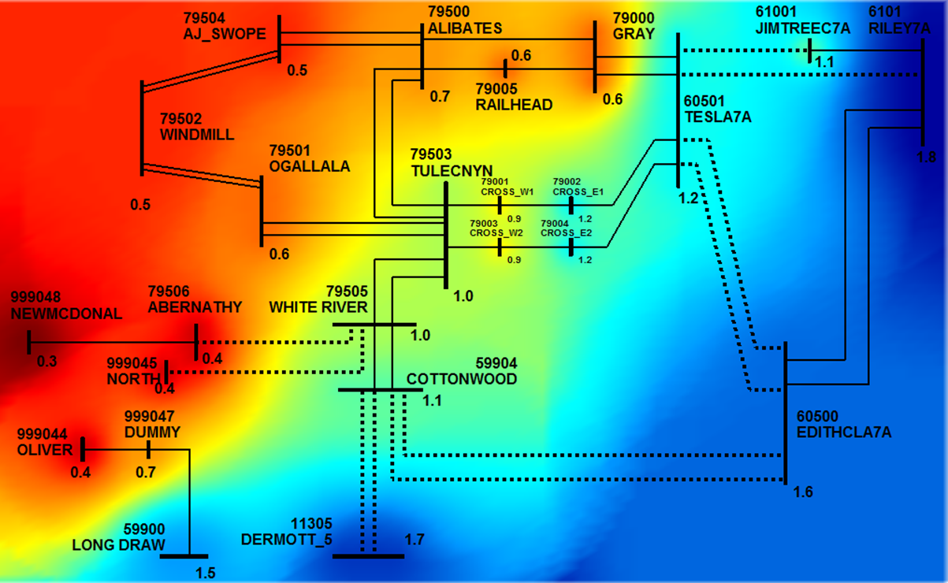
SHY Option 1-2b
White River
Abernathy
McDonald instead of Quincy
North instead of Airport Park
Oliver instead of Southeast
To Long Draw
Notes:
According to Ben:
1. Connected to North rather than Airport Park
2. Connected to McDonald rather than Quincy
3. 1-2a is from Vealmoor just as Sharyland proposed but 1-2b is from Long Draw instead of Vealmoor since Long Draw is closer.

Slide 38
Panhandle Transfer Limit with WSCR=1.5
Summary
LP&L Interconnection Impacts on WSCR

