Slide 1
CSWG
March 21, 2016

Slide 2
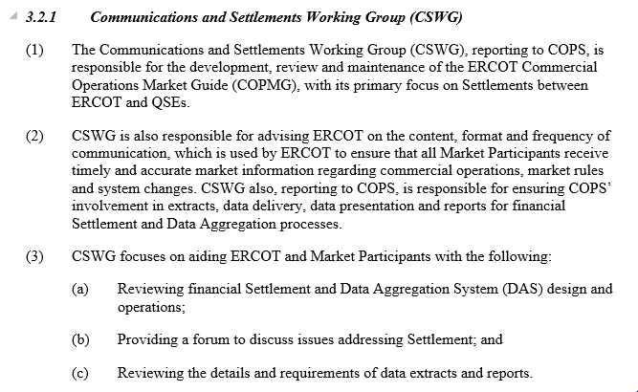
Review of CSWG function

Slide 3
Scope of MDWG
MDWG is involved in and provides consistent direction for market data issues including data output, data access, data accuracy, data classification, and in some cases, format and content of data posted for Market Participants. Responsibilities include:
  Data output, including but not limited to report formats, Service Level Agreements, documentation and training;
  Data Access, including but not limited to the ERCOT Public website, Alerts and Notifications, the Market Information System (MIS), and External Web Services (EWS);
  Data Accuracy, including but not limited to report corrections and report enhancements; and
  Data Classification, including but not limited to Public, Secure, and Certified classifications, and Digital Certificates.

Slide 4
Scope of CSWG
          Redundancy of effort?
MDWG focus will be more technical, so CSWG will work with them to make sure market data is timely, complete, accurate and transparent.
CSWG advises on content, format and frequency to be included in the extracts and sponsor any changes to extract data and posting timelines.
SLA approved
  http://www.ercot.com/services/sla
Review reports
  http://www.ercot.com/services/mdt

Slide 5
Goals – 2016
Support COPS Goals
  Maintain settlements stability in alignment with Protocol Section 8.2, ERCOT Performance Monitoring (2) Paragraphs (c), Settlement Stability and (g) Load Uplift Amounts
  Improve Commercial Operations processes to accommodate changes in the ERCOT Market design
  Work with Market Participants and ERCOT staff to develop Market improvements and Protocols that support increased Commercial Operations data transparency and data availability
  Maintain and update the Commercial Operations Market Guide and the Nodal Settlements Handbook
  Work with Market Participants and ERCOT staff to review Market Communications/Notifications and identify process improvements
  Work with Market Participants and ERCOT staff, and coordinate with MDWG, to implement improvements to the Market Information System (MIS) and External Web Services (EWS) and market data access for market participants, information security classifications, data extracts and Commercial Operations reports
Review any revision request language with impacts to Settlement
Nodal Settlements Handbook
  Review Assignments
Ongoing Distributed Generation topics
Upcoming Market Continuity

Slide 6
Most recent
NPRR689 – R1 – 02/10/16 – for AS Insufficiency when assigned via VDI will require filing a Settlement Dispute to receive payment. ERCOT will send the needed data set on request, as it will not be available in our routine extracts.
NPRR744 – Buy-Back notification – (approved, awaiting implementation date) ERCOT agrees to CSWGs requested Settlement eligibility process revamp to include MMS-driven Buy-Back flag and RUC value = 5. Matrix updates forthcoming.
NPRR746 – Negative load impacts – (approved, awaiting implementation date) “max(0,” logic added to prevent negative QSE Load Ratio Shares from unintended payments to negative loads.

Slide 7
Next CSWG Meetings
2016 Proposed schedule:
April 18
May 16
June 20
July 25
August 22
September 19
October 24
November 14
December 19

