Slide 1

PGDTF MEETING – Mar 2016
GIC Model Development
Qiuli Yu, Jay Teixeira, and Ed Geer
ERCOT
March 21, 2016

Slide 2
TOPICS
Draft GIC Model Development
  Introduction
  Input Data
  Output Data
Issues With Draft GIC Model
  PSSE V34 vs. V33
  Default Data vs. Real Data

Slide 3
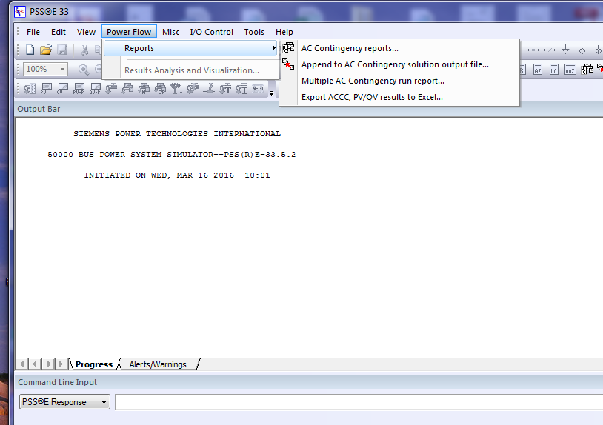
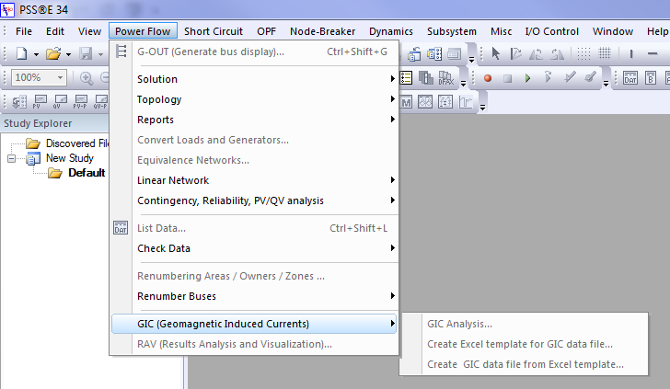
Draft GIC Model Development
Introduction
GIC model is an dependent on ERCOT network model base case
  Use SSWG 15DSA_2015_SUM1_TPIT_Final_02242015 as base case
  This base case is for summer peak load
  The GIC input file has to be run above the SSWG base case
GIC input/output are based on PSSE v33 GIC module
  GIC input file has been run using PSSE v33, which has the minimum data requirement
  Use the same PSSE version as for SSWG base case development

Slide 4
Draft GIC Model Development
Input Data for V33
Substation Data
  Geographic coordinates, not geomagnetic coordinates
  Don’t have real substation grounding resistance data, assuming all 0.1 Ω
Bus – Substation Mapping Data
  Bus numbers are assigned in SSWG base case development
  Over 100 buses are missing assigned substations in SSWG
  Substation numbers are created arbitrarily but can be fixed to a NMMS ID
  Will keep the substation number the same for future GIC models
BUSNUMBER | SUBNUMBER
1 | 3292
2 | 1986
4 | 1883
5 | 3380
6 | 1843

Slide 5
Draft GIC Model Development
Input Data for V33
Transformer Data
  Default data extracted from PSSE GIC Module
  Most VECGRPs are missing in SSWG base case
  CORE and KFACTOR data don’t exist in SSWG base case
I | J | K | CIRCUIT | WRI | WRJ | WRK | GICBDI | GICBDJ | GICBDK | VECGRP | CORE | KFACTOR
36 | 35 | 0 | '1 ' | 0.1321 | 0.5285 | 0 | 0 | 0 | 0 | 'YNyn0 ' | 0 | 0
48 | 47 | 0 | '1 ' | 0.1816 | 0.7264 | 0 | 0 | 0 | 0 | 'YNyn0 ' | 0 | 0
92 | 91 | 0 | '1 ' | 0.0614 | 0.2457 | 0 | 0 | 0 | 0 | 'YNyn0 ' | 0 | 0
131 | 130 | 0 | '1 ' | 0.0614 | 0.2457 | 0 | 0 | 0 | 0 | 'YNyn0 ' | 0 | 0
133 | 132 | 0 | '1 ' | 0.123 | 0.4542 | 0 | 0 | 0 | 0 | 'YNyn0 ' | 0 | 0
202 | 203 | 0 | '1 ' | 0.4431 | 1.6368 | 0 | 0 | 0 | 0 | 'YNyn0 ' | 0 | 0

Slide 6
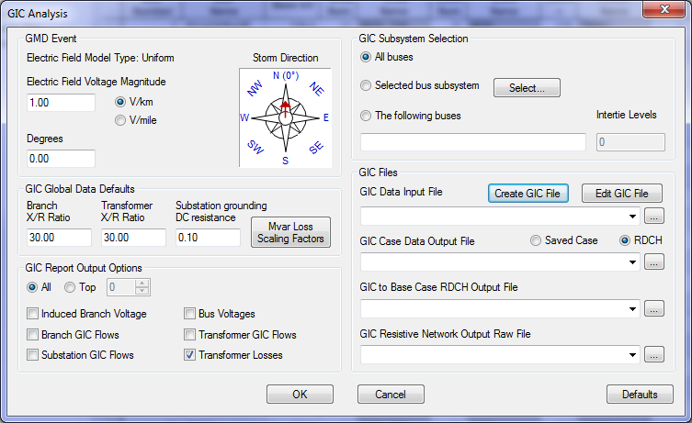
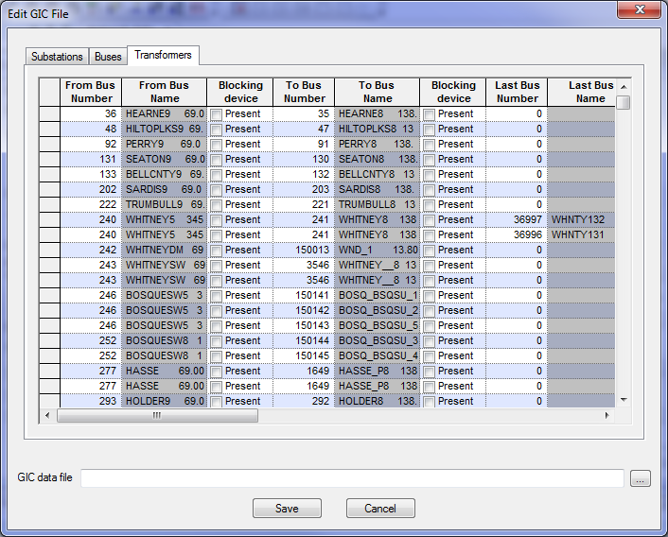
Draft GIC Model Development
Input Data for V33
Transformer Data

Slide 7
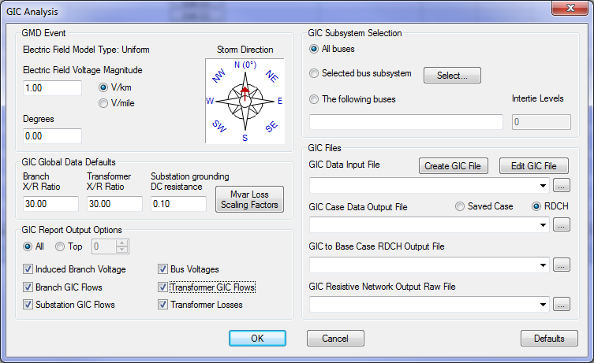
Draft GIC Model Development
Output Data
The output was calculated based on
  Uniform electric field = 8.00 V/km
  Orientation: 45 ̊Northeast
Select all six outputs:

Slide 8
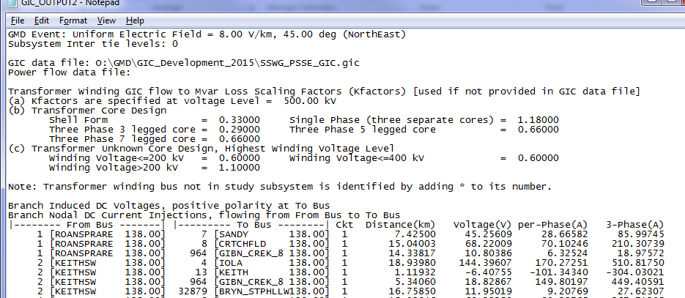
Draft GIC Model Development
Output Data
Output summary and Branch induced DC voltages

Slide 9
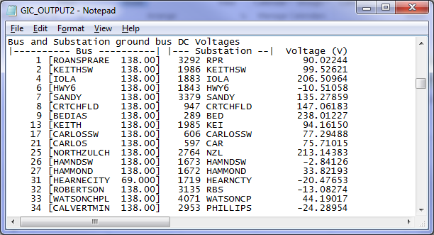
Draft GIC Model Development
Output Data
Bus and Substation ground bus DC Voltages

Slide 10
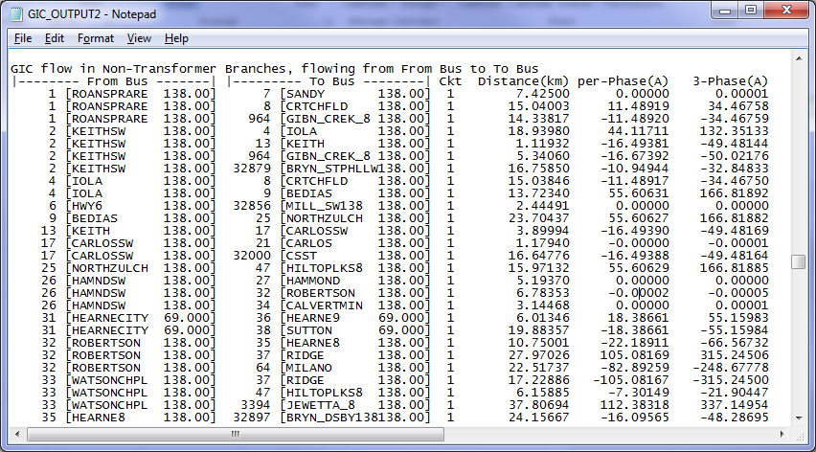
Draft GIC Model Development
Output Data
GIC flow in Non-Transformer Branches, flowing from From Bus to To Bus

Slide 11
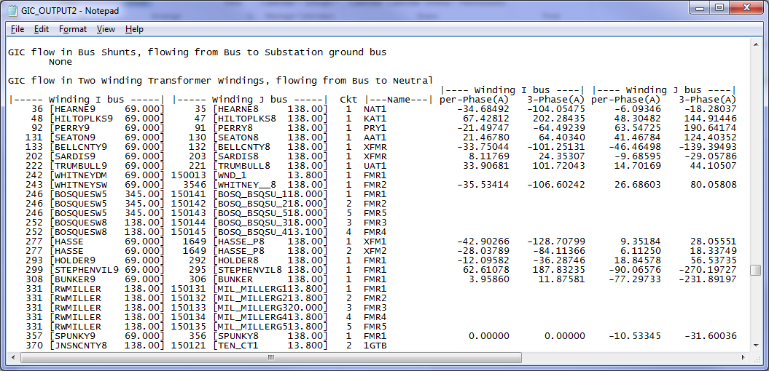
Draft GIC Model Development
Output Data
GIC flow in Shunts and 2-W Transformer, flowing from Bus to Neutral

Slide 12
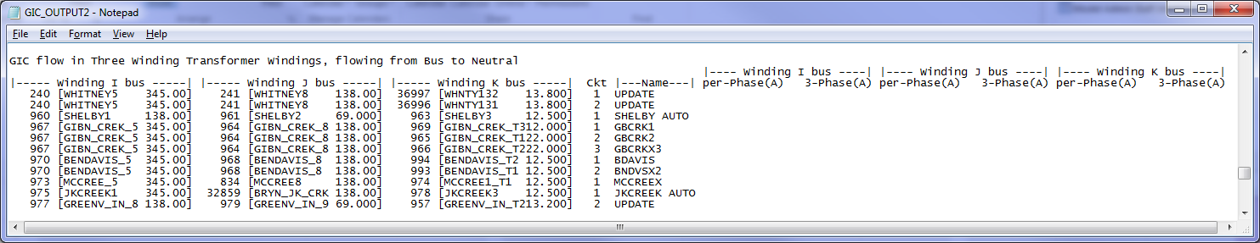
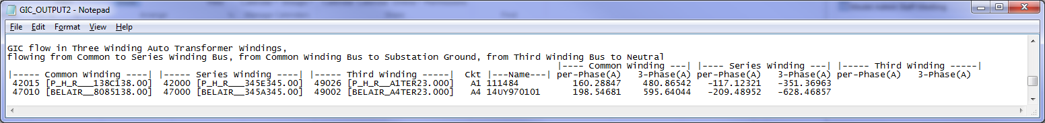
Draft GIC Model Development
Output Data
GIC flow in 3-W Transformer and 3-W Auto Transformers

Slide 13
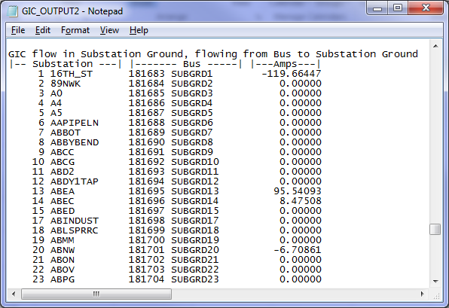
Draft GIC Model Development
Output Data
GIC flow in Substation Ground

Slide 14
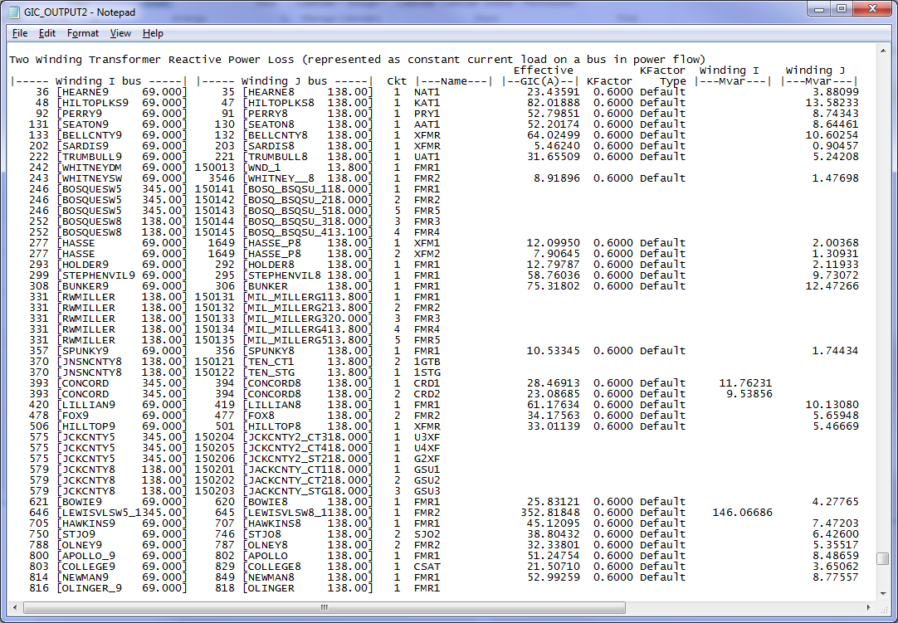
Draft GIC Model Development
Output Data
2-W Transformer Reactive Power Loss

Slide 15
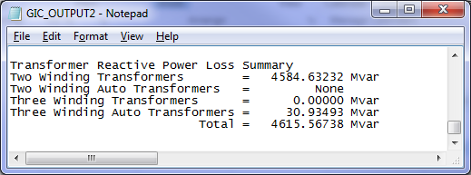
Draft GIC Model Development
Output Data
Transformer Reactive Power Loss Summary

Slide 16
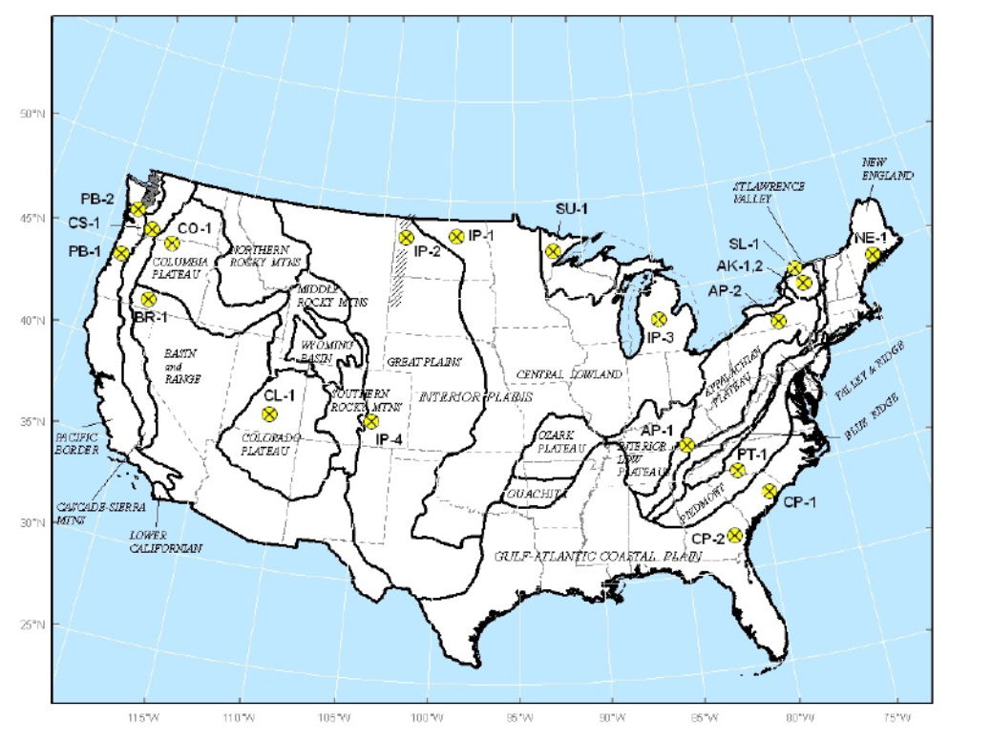
Issues With Draft GIC Model
PSSE V34 vs. V33:
Earth Model (EARTHMDL) in Substation Data Section

Slide 17
Issues With Draft GIC Model
PSSE V34 vs. V33:
Winding Grounding DC Impedances (GRDWRI, GRDWRJ, and GRDWRK) and Transformer Model (TMODEL) in Transformer Data Section

Slide 18
Issues With Draft GIC Model
PSSE V34 vs. V33:
Bus Fixed Shunt Data Section

Slide 19
Issues With Draft GIC Model
PSSE V34 vs. V33:
Branch Data Section

Slide 20
Issues With Draft GIC Model
Default Data vs. Real Data:
Substation Grounding DC Resistance
Transformer Winding Grounding DC Resistances
Bus Fixed Shunt Grounding DC Resistances
Bus Fixed Shunt DC Resistances
Transformer Core Number
Transformer Kfactor
Most real data need to be manually entered into the GIC input file!

Slide 21

Questions or Comments?

